Slide 1
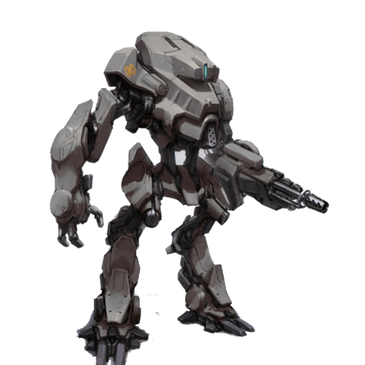
Weaponizing AI
Brian Craft

Slide 2
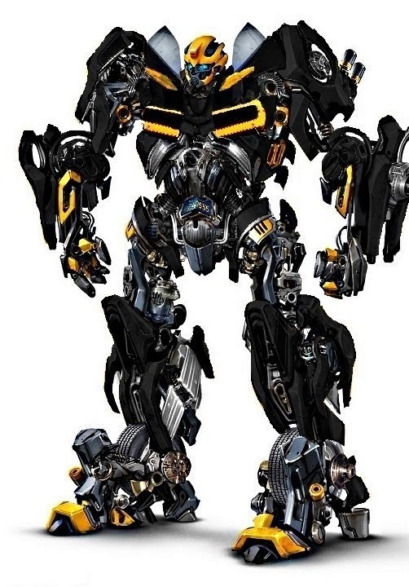


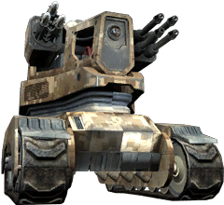
First Thought Examples
Video Games
Movies

Slide 3
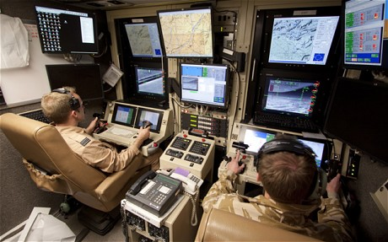
Traits of These vs. Drones
Autonomous weapons would require no human intervention, but drones will have human pilots.

Slide 4


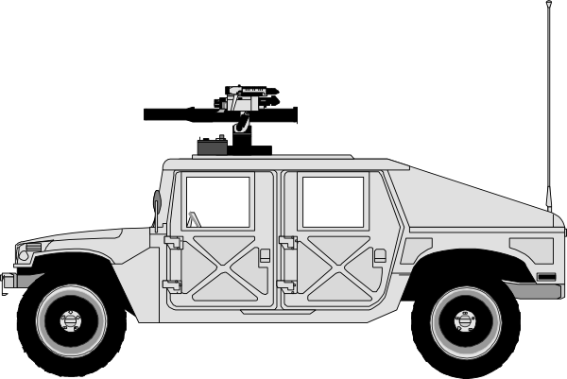

Brimstone Missle

Slide 5
Brimstone

Slide 6


Brimstone
Jam Radar
Surveillance
Attack Enemy

Slide 7
Downside
Cost is material, not human, so less deterrent to declare war.
Who wins?
Would the new norm be a bunch of robots fighting daily?
As sad as it is…economic. Many people’s careers are military based.
No emotions…basically a bunch of sociopathic killers?

Slide 8

Are We Doomed?

