Slide 1
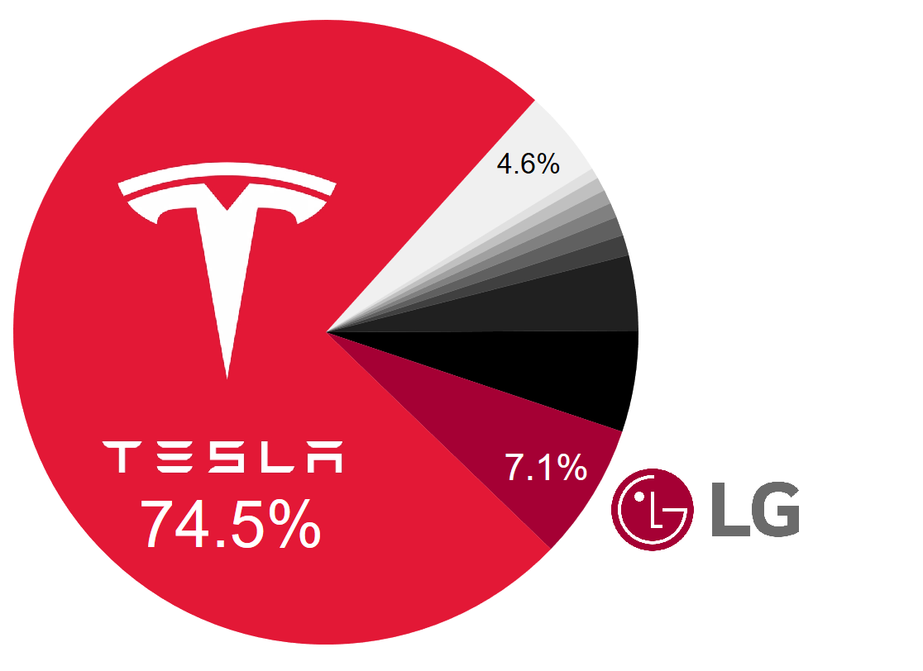
55 other firms
next 8 largest firms
13.9 %

