Slide 1
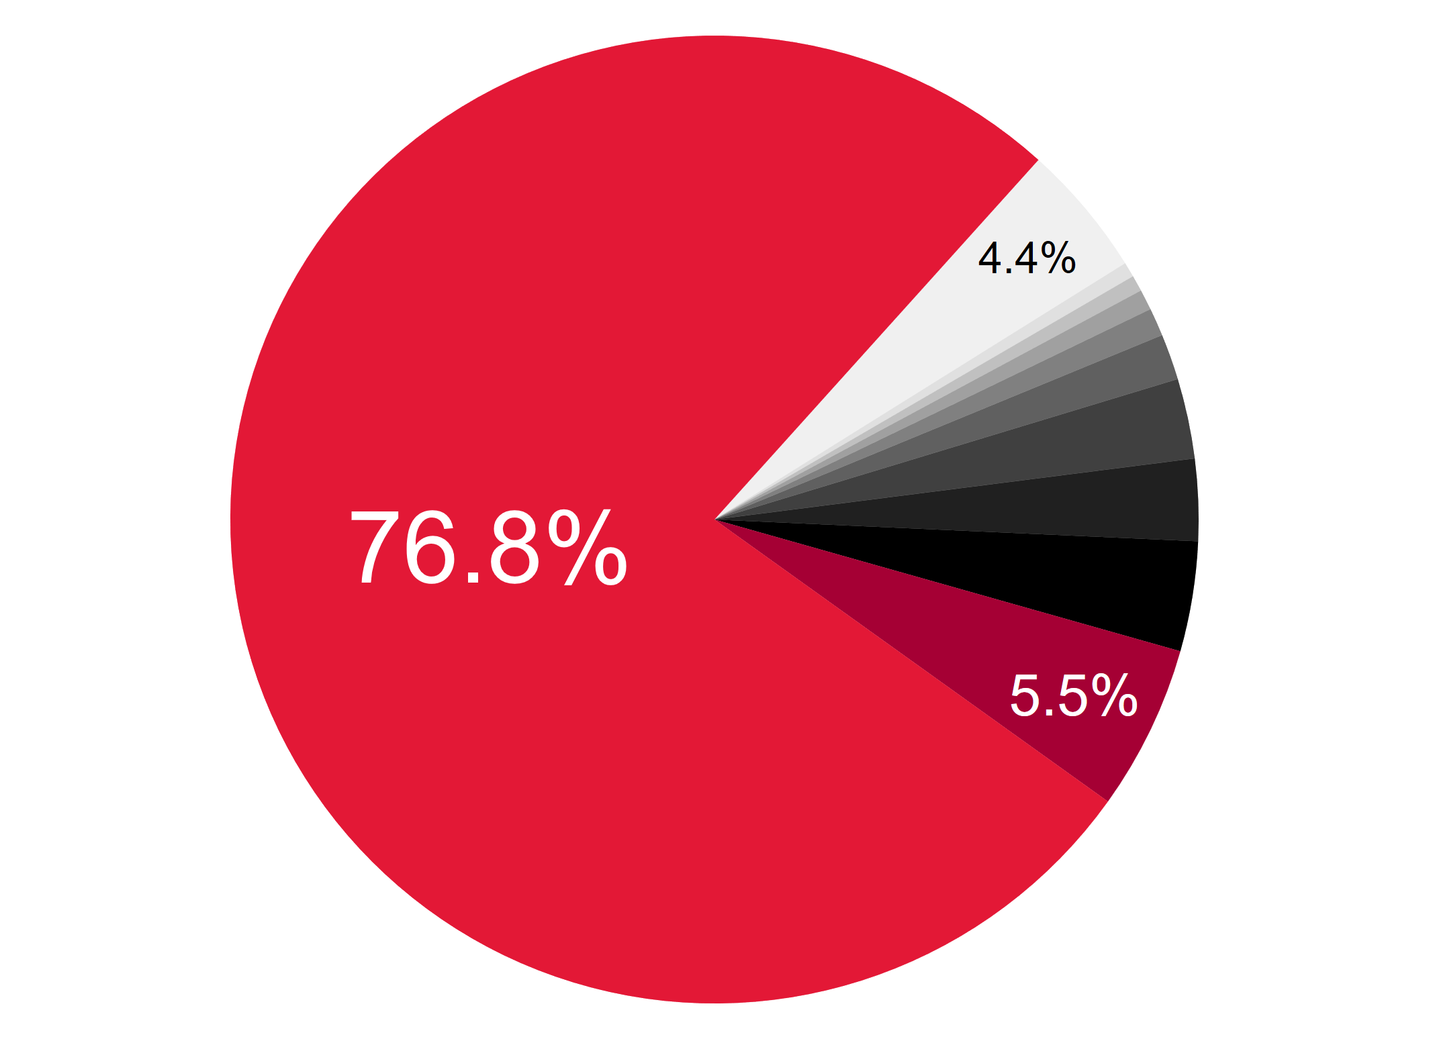
70 other firms
Tesla
next 8 largest firms
13.9 %
LG

