Slide 1
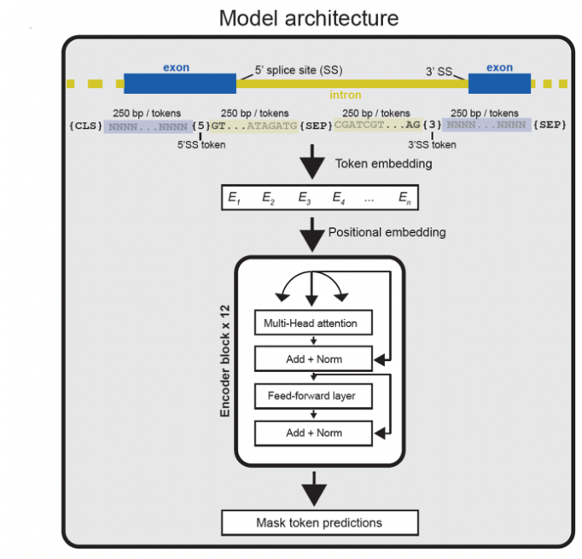

Slide 2
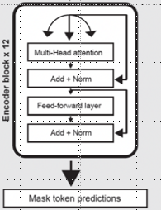
high-level-tokenizer
low-level-tokenizer
ids add and torch.cat
Token Embedding
Positional Embedding

Slide 3
LineByLineTextDataset
high-level-tokenizer
low-level-tokenizer
DataCollatorForMLM
Token and Positional Embedding
Token and Positional Embedding
Trainer

Slide 4
E1
E2
E3
E4
...
En
E1E2E3E4...En

