Slide 1
Basic Engineering Design for Electronics Engineering 2nd Week
Prof. Jewon Kang
Information Coding and Processing Lab.

Slide 2


General Problem Solving Procedure
Problem identification
Sentence for problem definition
Brainstorming for ideas
Idea generations
Proposal
Idea assessment
Idea screening
Idea judgment
Final idea selection
Idea execution
Problem Solved!

Slide 3
Brainstorming
Brain + Storming
A way of creating ideas in groups
Group (or team) members
generate as many ideas as possible
post them so that everyone can see them
use the ideas as building blocks
Do not evaluate the ideas. This rule should be kept during brainstorming
Discussed in detail next

Slide 4
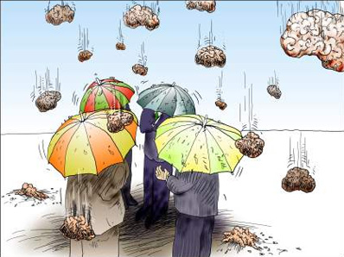
Rules of Brainstorming
The more ideas, the better
All ideas are acceptable
Other members’ ideas should be used to come up with more ideas
Criticism or evaluation of ideas is generally NOT allowed
Interesting website for brainstorming:
http://www.ideachampions.com/weblogs/archives/brainstorming/

Slide 5
Tips for Brainstorming
Members from various fields related to the topic
Not just in the same conference room
New, beautiful, comfortable places
Recording device
Voice recorder, white board, notebook, post-it, etc.
Keep remembering the following rules
Focus on quantity
Welcome unusual ideas
Combine and improve ideas
Withhold criticism
No more than 3 hours
Morning meeting is more productive
Arrange enough time for the meeting
Provide refreshing environments

Slide 6
 | Meaning | Description | Example
S | Substitute (대체) | Substitute with different material, element, process | Paper cup, wooden chopstick
C | Combine (결합) | Mix, assemble, or combine the functions, methods, ideas | Pencil with eraser, cigarette with filter, Rice cooker with warmer
A | Adapt (적용) | Adopt ideas to different places | Rose thorn vine → barbed wire entanglement
M | Modify, Magnify (변형 및 확대) | Modify or add new concepts Magnify a specific function | Air injection into the soap → floating soap Failure to develop a new adhesive → Post-it (3M)
P | Put to other Use (다른 용도) | Use to suit different purposes | Egg package → sound absorbing wall Garbage → building block Used tires → energy source for the generator
E | Eliminate, Minify (제거,최소화) | Make it smaller, lighter or into small pieces. | Transistor, laptop (tablet) PC
R | Reverse, Rearrange (역방향) | Reverse the function or the direction | Electric motor and generator

Slide 7
Example of SCAMPER: Pencil
S (Substitute) What can we use instead of the pencil? |  |  |  | C (Combine) What can we combine with the pencil?
A (Adapt) What or where can we adapt the pencil to? |  | Pencil |  | M (Modify) How can we modify the pencil? Color, shape, structure?
M (Magnify) What if we make the pencil bigger? |  |  |  | P (Put to other use) What can we do with the pencil except for writing?
E (Eliminate) What if we eliminate the wood from the pencil? |  |  |  | R (Reverse) What can we do to reverse the pencil’s function?

Slide 8
What to do when brainstorming is stuck
Imagine the success or the worst (think of “extreme”!)
Combine two irreverent ideas
Apply Osborn’s SCAMPER method

Slide 9
Next Weekly Report
Think of more than 5 problems that you found.
Write more than 10 brainstorming results discussed in your group.

Slide 10
Next Schedule
Arduino and some materials are provided today
Lecture about Arduino in the next week
Estimated schedules as below (but not subject to)
Brain storming: 3/9~3/16
Idea Assessment: 3/16~3/23
Write-up proposal: 3/24~3/29

