Slide 1
Introduction to Basic Engineering Design for Electronics Engineering
Prof. Jewon Kang
Information Coding and Processing Lab.

Slide 2
Instructors Info.
Professor: Je-Won Kang
Office: Eng-B 254
Email: jewonk@ewha.ac.kr
Office Hour: TBA (appointment with email)
TA: Min-Joo Kang
Email: basic.36564@gmail.com

Slide 3
Course Introduction - Objectives
Develop skills for creative engineering design
Perform project from idea generation to final product
Team activities and presentations
→ “Creative Thinking” is the most important part!
Textbooks:
‘창의공학’, 박강 외, 교보문고
Ralph M. Ford and Chris S. Coulston, “Design for electrical and computer engineers,” McGrawHill

Slide 4
Course Introduction - Outline
Project implementation
Research/study/survey
Etc.
Sharing results
Discussion
Planning
Weekly report
At home
In-Class (team meeting)

Slide 5
Course Introduction - Requirement
Schedule & To do lists
Requirement
Project proposal, mid-presentation, and final demo
Weekly progress report (starting from the 2nd week)
Proposal submission at 3/30 (36564-1) & 3/29(36564-2)
-Template provided; 2-3 page report (motivation, problem statement, prior arts, the improvements as compared with the prior arts.)
Mid presentation (report, ppt, prototype of final product) in the late Apr or early May.
Final demo (report, ppt, demo of the final product)

Slide 6
Course Introduction - Evaluation
Evaluation and Grades
Project proposal: 10%
Midterm report and presentation: 30% (15%, 15%)
Final report and presentation: 30% (15%, 15%)
Team meeting report & class attendance: 10%
Final product evaluation (demo): 20%

Slide 7
Course Introduction – Important Notes
Team
Basically 5 members randomly determined
Homework/reports due
Announced in cyber-campus
Late submission will give 10% penalty per day.
Attendance
According to school regulations, 5 absences without notice will result in F.
Material distribution, submission, all important announcements
Via cyber-campus
Do not use cyber-campus for questions. (email is preferred)

Slide 8
Course Introduction – Lecture, Resources
Lecture or important announcement in the first 30 minutes.
Team activity later (Asan 424 or 410, computer lab.)
410 is reserved for this course from 3:30 – 6:15, Tue. and 12:30-3:15, Wed.
Facility/Lab.
Asan 424 / 410 (computer Lab.) / 422 (circuit implementation/experiments)
Cyber Campus
Team board per team
Budget ( 50,000 ~ 70,000)

Slide 9
Weekly report (before the next class)
Show team activity in this week
Report submitted via cyber campus (1page limit)
Used for the communication with the advisor in the class.

Slide 10
Team building

Slide 11
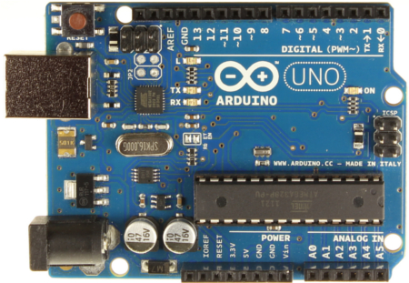
Topics
See summary of the previous projects, uploaded in cyber campus.
Any topics related to electrical engineering
Analog circuits
Using Arduino
Educational microcontrol board platform for inexperienced embedded system developer.

Slide 12
Next Weekly Report
Introduction to your team and members.
Decide a (internal) team name, a leader, etc.

