Slide 1
Firewalls and VPN
Chapter 6

Slide 2
Introduction
Technical controls – essential
Enforcing policy for many IT functions
Not involve direct human control
Improve organization’s ability to balance
Availability vs. increasing information’s levels of confidentiality and integrity
Notes:
Introduction
As one of the methods of control that go into a well-planned information security program, technical controls are essential in enforcing policy for many IT functions that do not involve direct human control.
Technical control solutions, properly implemented, can improve an organization’s ability to balance the often conflicting objectives of making information more readily and widely available against increasing the information’s levels of confidentiality and integrity.

Slide 3
Access Control
Method
Whether and how to admit a user
Into a trusted area of the organization
Achieved by policies, programs, & technologies
Must be mandatory, nondiscretionary, or discretionary

Slide 4
Access Control
Mandatory access control (MAC)
Use data classification schemes
Give users and data owners limited control over access
Data classification schemes
Each collection of information is rated
Each user is rated
May use matrix or authorization
Access control list

Slide 5
Access Control
Nondiscretionary controls
Managed by central authority
Role-based
Tied to the role a user performs
Task-based
Tied to a set of tasks user performs

Slide 6
Access Control
Discretionary access controls
Implemented at the option of the data user
Used by peer to peer networks
All controls rely on
Identification
Authentication
Authorization
Accountability

Slide 7
Access Control
Identification
Unverified entity – supplicant
Seek access to a resource by label
Label is called an identifier
Mapped to one & only one entity
Authentication
Something a supplicant knows
Something a supplicant has
Something a supplicant is

Slide 8
Access Control
Authorization
Matches supplicant to resource
Often uses access control matrix
Handled by 1 of 3 ways
Authorization for each authenticated users
Authorization for members of a group
Authorization across multiple systems

Slide 9
Access Control
Accountability
Known as auditability
All actions on a system can be attributed to an authenticated identity
System logs and database journals

Slide 10
Firewalls
Purpose
Prevent information from moving between the outside world and inside world
Outside world – untrusted network
Inside world – trusted network

Slide 11
Processing Mode
Five major categories
Packet filtering
Application gateway
Circuit gateway
MAC layer
Hybrids
Most common use
Several of above

Slide 12
Packet Filtering
Filtering firewall
Examine header information & data packets
Installed on TCP/IP based network
Functions at the IP level
Drop a packet (deny)
Forward a packet (allow)
Action based on programmed rules
Examines each incoming packet

Slide 13
Filtering Packets
Inspect networks at the network layer
Packet matching restriction = deny movement
Restrictions most commonly implemented in Filtering Packets
IP source and destination addresses
Direction (incoming or outgoing)
Protocol
Transmission Control Protocol (TCP) or User Datagram Protocol (UD) source or destination

Slide 14
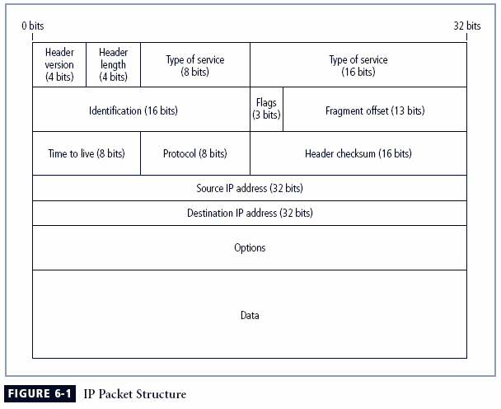
IP Packet

Slide 15
TCP/IP Packet
Source Port |  |  |  |  |  |  |  | Destination Port
Sequence Number
Acknowledgement Number
Offset | Reserved | U | A | P | R | S | F | Window
Checksum |  |  |  |  |  |  |  | Urgent Pinter
Options |  |  |  |  |  |  |  |  | Padding
Data
Data

Slide 16
UDP Datagram Structure
Source Port | Destination Port
Length | Checksum
Data
Data
Data

Slide 17
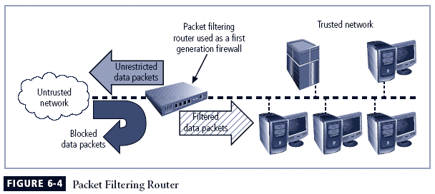

Slide 18
Sample Firewall Rule Format
Source Address | Destination Address | Service | Action (Allow/Deny)
172.16.xx | 10.10.x.x | Any | Deny
192.168.xx | 10.10.10.25 | HTTP | Allow
192.168.0.1 | 10.10.10.10 | FTP | Allow

Slide 19
Packet Filtering Subsets
Static filtering
Requires rules to be developed and installed with firewall
Dynamic filtering
Allows only a particular packet with a particular source, destination, and port address to enter

Slide 20
Packet Filtering Subsets
Stateful
Uses a state table
Tracks the state and context of each packet
Records which station sent what packet and when
Perform packet filtering but takes extra step
Can expedite responses to internal requests
Vulnerable to DOS attacks because of processing time required

Slide 21
Application Gateway
Installed on dedicated computer
Used in conjunction with filtering router
Proxy server
Goes between external request and webpage
Resides in DMZ
Between trusted and untrusted network
Exposed to risk
Can place additional filtering routers behind
Restricted to a single application

Slide 22
Circuit Gateways
Operates at transport level
Authorization based on addresses
Don’t look at traffic between networks
Do prevent direct connections
Create tunnels between networks
Only allowed traffic can use tunnels

Slide 23
MAC Layer Firewalls
Designed to operate at media access sublayer
Able to consider specific host computer identity in filtering
Allows specific types of packets that are acceptable to each host

Slide 24
OSI Model
7 Application
6 Presentation
5 Session
4 Transport
3 Network
2 Data
1 Physical
Application Gateway
Circuit Gateway
Packet Filtering
Mac Layer

Slide 25
Hybrid Firewalls
Combine elements of other types of firewalls; i.e., elements of packet filtering and proxy services, or of packet filtering and circuit gateways
Alternately, may consist of two separate firewall devices; each a separate firewall system, but are connected to work in tandem
Notes:
Hybrid Firewalls
Hybrid firewalls combine the elements of other types of firewalls—that is, the elements of packet filtering and proxy services, or of packet filtering and circuit gateways.
Alternately, a hybrid firewall system may actually consist of two separate firewall devices; each is a separate firewall system, but they are connected so that they work in tandem.

Slide 26
Categorization by Development Generation
First Generation
Static packet filtering
Simple networking devices
Filter packets according to their headers
Second Generation
Application level or proxy servers
Dedicated systems
Provides intermediate services for the requestors
Third Generation
Stateful
Uses state tables

Slide 27
Categorization by Development Generation
Fourth Generation
Dynamic filtering
Particular packet with a particular source, destination, and port address to enter
Fifth Generation
Kernel proxy
Works un the Windows NT Executive
Evaluates at multiple layers
Checks security as packet passes from one level to another

Slide 28
Categorized by Structure
Commercial-Grade
State-alone
Combination of hardware and software
Many of features of stand alone computer
Firmware based instructions
Increase reliability and performance
Minimize likelihood of their being compromised
Customized software operating system
Can be periodically upgraded
Requires direct physical connection for changes
Extensive authentication and authorization
Rules stored in non-volatile memory

Slide 29
Categorized by Structure
Commercial-Grade Firewall Systems
Configured application software
Runs on general-purpose computer
Existing computer
Dedicated computer

Slide 30
Categorized by Structure
Small Office/Home Office (SOHO)
Broadband gateways or DSL/cable modem routers
First – stateful
Many newer one – packet filtering
Can be configured by use
Router devices with WAP and stackable LAN switches
Some include intrusion detection

Slide 31
Categorized by Structure
Residential
Installed directly on user’s system
Many free version not fully functional
Limited protection

Slide 32
Software vs. Hardware: the SOHO Firewall Debate
Which firewall type should the residential user implement?
Where would you rather defend against a hacker?
With the software option, hacker is inside your computer
With the hardware device, even if hacker manages to crash firewall system, computer and information are still safely behind the now disabled connection
Notes:
Software vs. Hardware: The SOHO Firewall Debate
So which type of firewall should the residential user implement?
Where would you rather defend against a hacker?
With the software option, the hacker is inside your computer, battling with a piece of software that may not have been correctly installed, configured, patched, upgraded, or designed. If the software happens to have a known vulnerability, the hacker could bypass it and then have unrestricted access to your system. With the hardware device, even if the hacker manages to crash the firewall system, your computer and information are still safely behind the now disabled connection, which is assigned a non-routable IP address making it virtually impossible to reach from the outside.

Slide 33
Firewall Architectures
Sometimes the architecture is exclusive
Configuration decision
Objectives of the network
The org’s ability to develop and implement architecture
Budget

Slide 34
Firewall Architectures
Packet filtering routers
Lacks auditing and strong authentication
Can degrade network performance

Slide 35
Firewall Architectures
Screened Host firewall
Combines packet filtering router with dedicated firewall – such as proxy server
Allows router to prescreen packets
Application proxy examines at application layer
Separate host – bastion or sacrificial host
Requires external attack to compromise 2 separate systems.

Slide 36
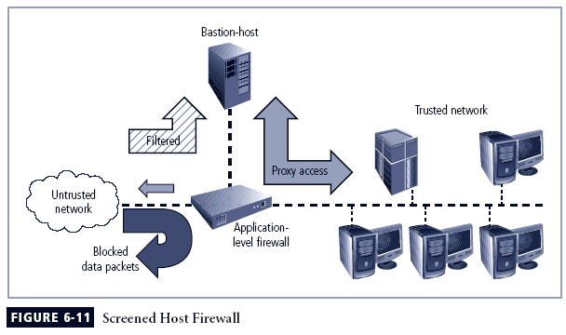

Slide 37
Firewall Architectures
Dual Homed Host
Two network interface cards
One connected to external network
One connected to internal network
Additional protection
All traffic must go through firewall to get to networks
Can translate between different protocols at different layers

Slide 38
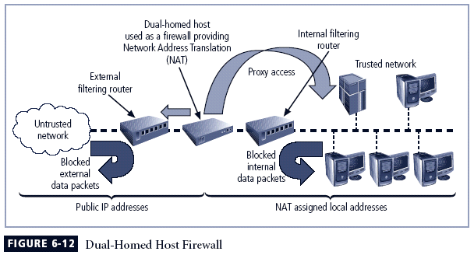

Slide 39
Firewall Architectures
Screened Subnet Firewalls (with DMZ)
Dominant architecture used today
Provides DMZ
Common arrangement
2 or most hosts behind a packet filtering router
Each host protecting the trusted net
Untrusted network routed through filtering router
Come into a separate network segment
Connection into the trusted network only allowed through DMZ
Expensive to implement
Complex to configure and manage

Slide 40
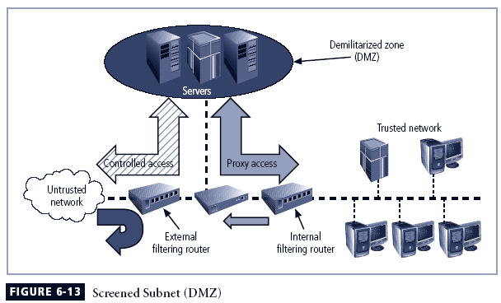

Slide 41
Firewall Architectures
SOCS Servers
Protocol for handling TCP traffic through a proxy server
Proprietary circuit-level proxy server
Places special SOCS client-side agents on each workstation
General approach – place filtering requirements on individual workstation

Slide 42
Selecting the Right Firewall
What firewall offers right balance between protection and cost for needs of organization?
What features are included in base price and which are not?
Ease of setup and configuration? How accessible are staff technicians who can configure the firewall?
Can firewall adapt to organization’s growing network?

Slide 43
Selecting the Right Firewall
Most important factor
Extent to which the firewall design provides the required protection
Second most important factor
Cost

Slide 44
Configuring and Managing Firewalls
Each firewall device must have own set of configuration rules regulating its actions
Firewall policy configuration is usually complex and difficult
Configuring firewall policies both an art and a science
When security rules conflict with the performance of business, security often loses

Slide 45
Best Practices for Firewalls
All traffic from trusted network is allowed out
Firewall device never directly accessed from public network
Simple Mail Transport Protocol (SMTP) data allowed to pass through firewall
Internet Control Message Protocol (ICMP) data denied
Telnet access to internal servers should be blocked
When Web services offered outside firewall, HTTP traffic should be denied from reaching internal networks

Slide 46
Firewall Rules
Operate by examining data packets and performing comparison with predetermined logical rules
Logic based on set of guidelines most commonly referred to as firewall rules, rule base, or firewall logic
Most firewalls use packet header information to determine whether specific packet should be allowed or denied
Notes:
Firewall Rules
Firewalls operate by examining a data packet and performing a comparison with some predetermined logical rules.
This logical set is most commonly referred to as firewall rules, rule base, or firewall logic.
Most firewalls use packet header information to determine whether a specific packet should be allowed to pass through or should be dropped.

Slide 47
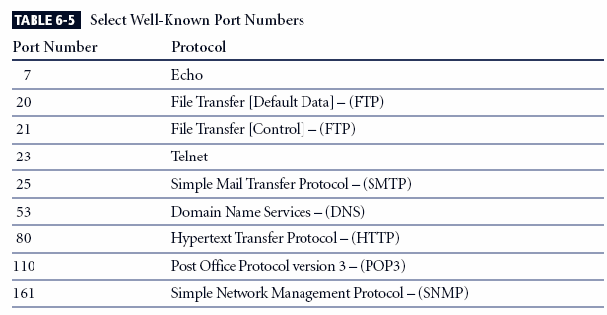

Slide 48
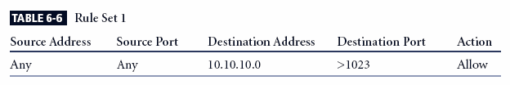
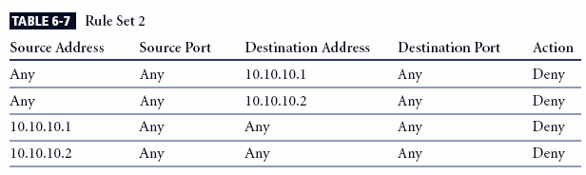
Notes:
Responses to internal requests are allowed. In most firewall implementations, it is desirable to allow a response to an internal request for information. In dynamic or stateful firewalls, this is most easily accomplished by matching the incoming traffic to an outgoing request in a state table. In simple packet filtering, this can be accomplished with the following rule for the External Filtering Router. (Note that the network address for the destination ends with .0. Some firewalls use a notation of .X instead.)
(NOTES)
From Table 6-6, you can see that this rule states that any incoming packet (with any source address and from any source port) that is destined for the internal network (whose destination address is 10.10.10.0) and for a destination port greater than 1023 (that is, any port out of the number range for the well-known ports) is allowed to enter. Why allow all such packets? While outgoing communications request information from a specific port (i.e., a port 80 request for a Web page), the response is assigned a number outside the well-known port range. If multiple browser windows are open at the same time, each window can request a packet from a Web site, and the response is directed to a specific destination port, allowing the browser and Web server to keep each conversation separate. While this rule is sufficient for the external router (firewall), it is dangerous simply to allow any traffic in just because it is destined to a high port range. A better solution is to have the internal firewall router use state tables that track connections and prevent dangerous packets from entering this upper port range.
The firewall device is never accessible directly from the public network. If hackers can directly access the firewall, they may be able to modify or delete rules and allow unwanted traffic through. For the same reason, the firewall itself should never be allowed to access other network devices directly. If hackers compromise the firewall and then use its permissions to access other servers or clients, they may cause additional damage or mischief. The rules shown in Table 6-7 prohibit anyone from directly accessing the firewall and the firewall from directly accessing any other devices. Note that this example is for the external filtering router/firewall only. Similar rules should be crafted for the internal router. Why are there separate rules for each IP address? The 10.10.10.1 address regulates external access to and by the firewall, while the 10.10.10.2 address regulates internal access. Not all hackers are outside the firewall!

Slide 49
Content Filters
Software filter—not a firewall—that allows administrators to restrict content access from within network
Essentially a set of scripts or programs restricting user access to certain networking protocols/Internet locations
Primary focus to restrict internal access to external material
Most common content filters restrict users from accessing non-business Web sites or deny incoming span
Notes:
Content Filters
A content filter is a software filter—technically not a firewall—that allows administrators to restrict access to content from within a network.
It is essentially a set of scripts or programs that restricts user access to certain networking protocols and Internet locations, or restricts users from receiving general types or specific examples of Internet content. Some refer to content filters as reverse firewalls, as their primary focus is to restrict internal access to external material.
In most common implementation models, the content filter has two components: rating and filtering.
The rating is like a set of firewall rules for Web sites, and is common in residential content filters.
The filtering is a method used to restrict specific access requests to the identified resources, which may be Web sites, servers, or whatever resources the content filter administrator configures.
The most common content filters restrict users from accessing Web sites with obvious non-business related material, such as pornography, or deny incoming spam e-mail.

Slide 50
Protecting Remote Connections
Installing internetwork connections requires leased lines or other data channels; these connections usually secured under requirements of formal service agreement
When individuals seek to connect to organization’s network, more flexible option must be provided
Options such as Virtual Private Networks (VPNs) have become more popular due to spread of Internet
Notes:
Protecting Remote Connections
Installing internetwork connections requires using leased lines or other data channels provided by common carriers, and therefore these connections are usually permanent and secured under the requirements of a formal service agreement.
In the past, organizations provided remote connections exclusively through dial-up services like Remote Authentication Service (RAS).
Since the Internet has become more widespread in recent years, other options such as Virtual Private Networks (VPNs) have become more popular.

Slide 51
Dial-Up
Unsecured, dial-up connection points represent a substantial exposure to attack
Attacker can use device called a war dialer to locate connection points
War dialer: automatic phone-dialing program that dials every number in a configured range and records number if modem picks up
Some technologies (RADIUS systems; TACACS; CHAP password systems) have improved authentication process
Notes:
Dial-Up
It is a widely held view that these unsecured, dial-up connection points represent a substantial exposure to attack.
An attacker who suspects that an organization has dial-up lines can use a device called a war dialer to locate the connection points.
A war dialer is an automatic phone-dialing program that dials every number in a configured range, and checks to see if a person, answering machine, or modem picks up.
Some technologies, such as RADIUS systems, TACACS, and CHAP password systems, have improved the authentication process.

Slide 52
Protecting Remote Connections
VPN (Virtual Private Networks)
Authentication systems
RADIUS AND TACACS
Access control for dial-up
Kerberos
Symmetric key encryption to validate
Keeps a database containing the private keys
Both networks and clients have to register
Does the authentication based on database

Slide 53
Kerberos
Three interacting services
Authentication server
Key distribution center
Kerberos ticket granting service
Principles
KDC knows the secret keys of all clients and servers
KDC initially exchanges information with the client and server by using the keys
Authenticates a client to a requested service by issuing a temporary session key

Slide 54
Sesame
Secure European System for applications in Multiple vendor Environment
Similar to Kerberos
User first authenticated to an authentication server and receives a token
Token presented to a privilege attribute server
Get a privilege attribute certificate
Build on Kerberos model – addition and more sophisticated access control features

Slide 55
VPN
Implementation of cryptographic technology
Private and secure network connection
Trusted VPN
Secure VPN
Hybrid VPN

Slide 56
Transport Mode
Data within IP packet is encrypted, but header information is not
Allows user to establish secure link directly with remote host, encrypting only data contents of packet
Two popular uses:
End-to-end transport of encrypted data
Remote access worker connects to office network over Internet by connecting to a VPN server on the perimeter

Slide 57
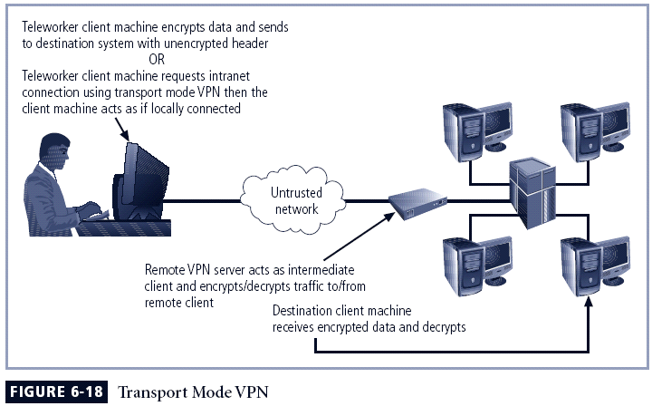

Slide 58
Tunnel Mode
Organization establishes two perimeter tunnel servers
These servers act as encryption points, encrypting all traffic that will traverse unsecured network
Primary benefit to this model is that an intercepted packet reveals nothing about true destination system
Example of tunnel mode VPN: Microsoft’s Internet Security and Acceleration (ISA) Server

Slide 59
