Slide 1

Global
Divides:
The North and South

Slide 2


Learning Objectives
Identify the historical, economic, and political factors contributing to the development of the global North-South divide.
Identify the historical, economic, and political factors contributing to the development of the global North-South divide.
Evaluate key global initiatives, such as trade agreements and UN programs, that aim to reduce disparities between the global North and South.

Slide 3
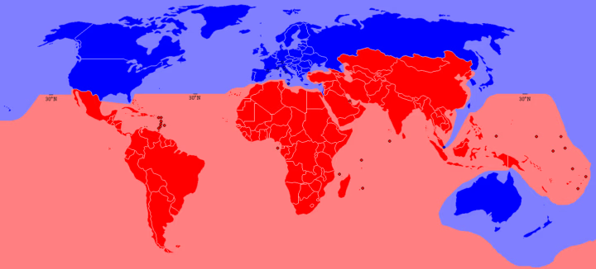
UNDERSTANDING THE NORTH-SOUTH DIVIDE
GLOBAL DIVIDES
The North-South divide is a socio-economic and political distinction between the Global North (which includes North America, Europe, parts of Asia like Japan and South Korea, and Australia) and the Global South (primarily Latin America, Africa, Asia, and the Middle East).
: North
: South

Slide 4
GLOBAL NORTH
GLOBAL DIVIDES
America
Canada
Japan
Europe
South Korea
Singapore
Australia (exception)
New Zealand (exception)
GLOBAL SOUTH
Most countries are in Asia and Africa
: North
: South
Philippines
Malaysia
Haiti
Lebanon
Chad
Brazil

Slide 5
UNDERSTANDING THE NORTH-SOUTH DIVIDE
GLOBAL DIVIDES
This divide is not just about geography but is rooted in historical, economic, and political factors. The concept emerged after World War II, as differences in wealth, industrialization, and access to resources became more pronounced.
: North
: South

Slide 6
GLOBAL NORTH
GLOBAL DIVIDES
The Global North (one quarter of the world population) refers to the developed societies of Europe and North America, which are characterized by established democracy, wealth, technological advancement, political stability, aging and zero population growth and dominance of world trade and politics.
: North
: South

Slide 7
GLOBAL NORTH
GLOBAL DIVIDES
Problems:
Overconsumption and Food Waste
Immigration and Integration
Expensive Healthcare
Increasing Rate of Mental Health Problems
Economic Transition and Automation
: North
: South

Slide 8
GLOBAL SOUTH
GLOBAL DIVIDES
The Global South (the developing countries; three quarters of the world population) represents mainly agrarian economies in Africa, India, China, Latin America and others that are not as economically sound and politically stable as their global North counterparts and tend to be characterized by turmoil, war, conflict, poverty, anarchy and tyranny (Odeh, 2010).
: North
: South

Slide 9
GLOBAL SOUTH
GLOBAL DIVIDES
Problems:
Contemporary Global Capitalism
Neocolonialism
Labor Conditions
Poverty and Income Inequality
Access to Education and Health Services
Climate Vulnerability
Unemployment and Underemployment
: North
: South

