Slide 1
TOYO TOYS.
Assalam u alaikum hope you all are fine.
Here we’re representing you our project
We’re four people in a group
Abdullah Javed .
Khadija Akmal Dar.
Muhammad Umar.
Aleeza Khan.

Slide 2
GROUP MEMBER | ENROLMENT NO.
Khadija Akmal Dar | Student1332434
Abdullah Javed | STUDENT1332438
Muhammad Umar | Student1331525
Aleeza Khan | STUDENT1332436

Slide 3
OBJECTIVES
Introduction.
About eProject.
Describe eProject.
Student work division.
Overall eProject Experience.

Slide 4
PROBLEM STATEMENT
TOYO TOYS is selling various types of Toys. Company has a huge collection of Toys for different segments of kids. The company advertises by distributing the pamphlets, advertising on television and so on. Due to rapid development in internet field, the company decides to launch a website where people will get all the information about the various products available with them easily.

Slide 5
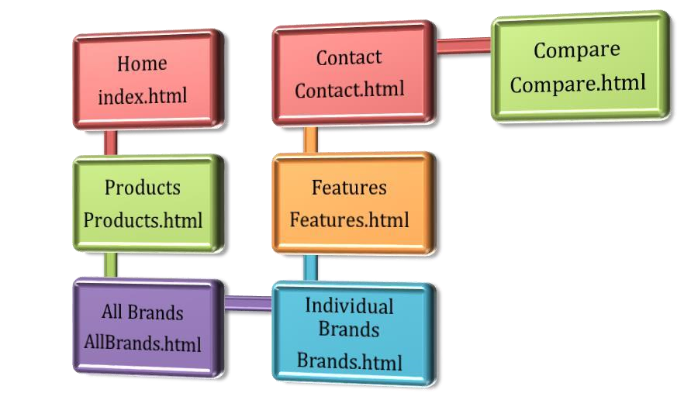
FLOW CHART

Slide 6
PROJECT DURATION
Analysis- 1 days
Design – 10 days
Development –15 days
Testing – 2 days
Documentation -2 days

Slide 7
Student work division.
Project Ref. No.: eP/Advertisement Portal Management System/01 |  | PROJECT TITLE | Date of Preparation of Activity Plan
S .No | Task | TOYO TOYS | Actual | Actual | Team-mate | Status
 |  |  | Start Date | Days | Names
1 | Build Home |  | 06/03/22 | 1 | ABDULLAH | Complete
2 | Products pages and find the items |  | 12/03/22 | 10 | Khadija | Complete
3 | All brand, contact us and coding help for product pages. |  | 20/03/22 | 10 | Khadija, Abdullah | Complete
4 | About us page |  | 25/03/22 | 7 | Umar | Complete
5 | Visited different websites and chose the theme. |  | 10/03/22 | 2 | Aleeza | Complete
6 | Begin Code JavaScript for home page and All brands pages. |  | 19/03/22 | 10 | Abdullah | Complete

Slide 8
OVERALL EXPERIENCE
It is very nice initiative that has made us work harder on our project and it has polished our skills now I am capable of making a Website by own self. I am very thankful to you.

Slide 9
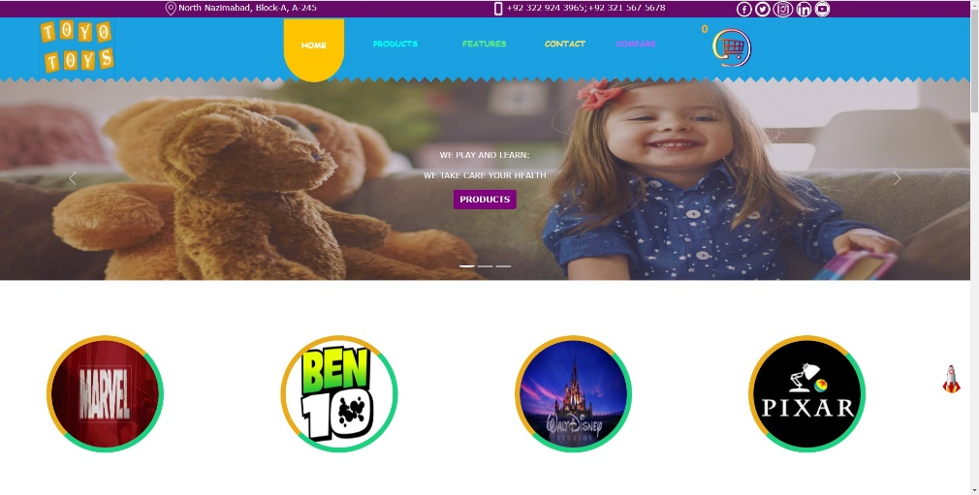
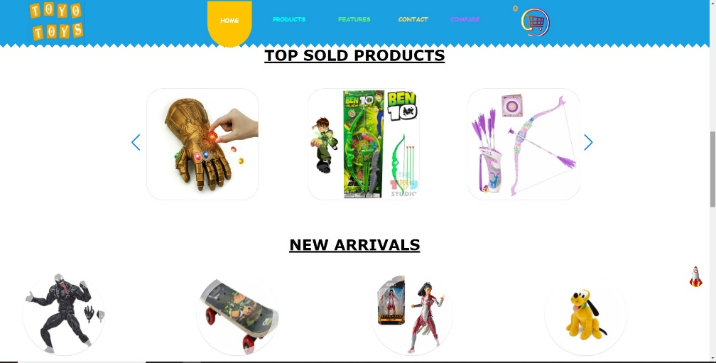
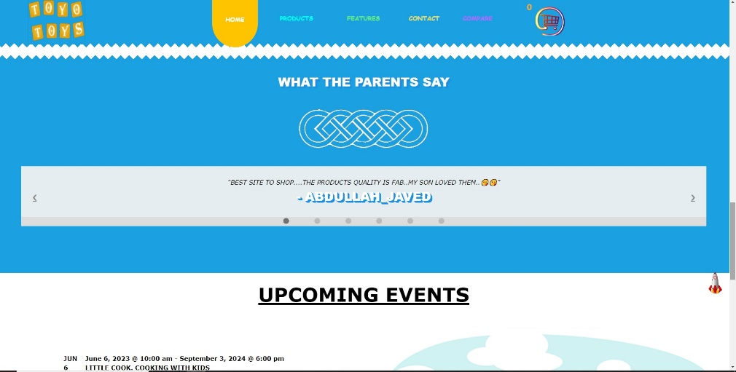
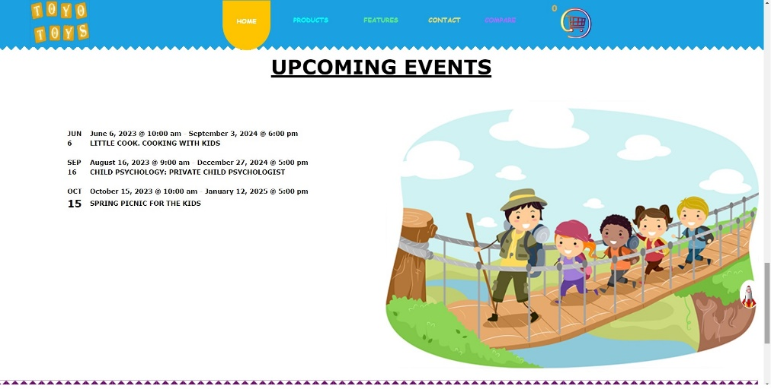
MAIN HOME PAGE
Nav Bar

Slide 10
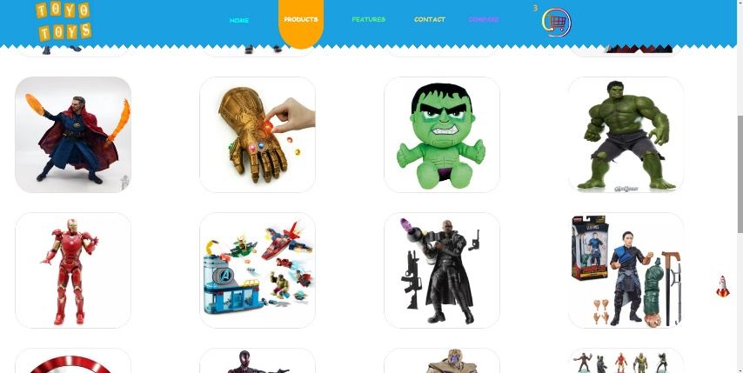
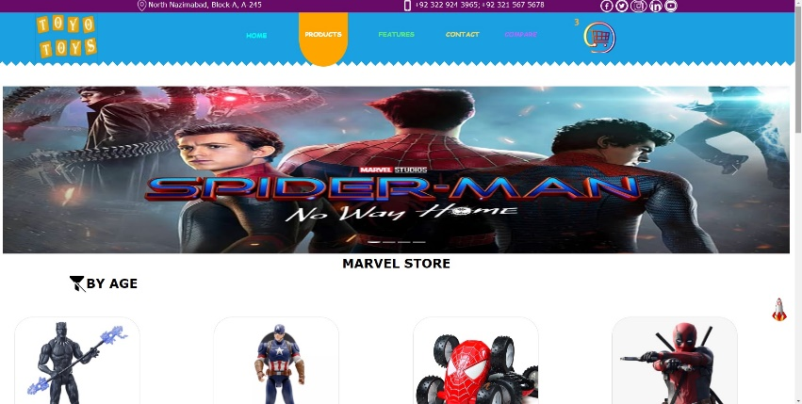
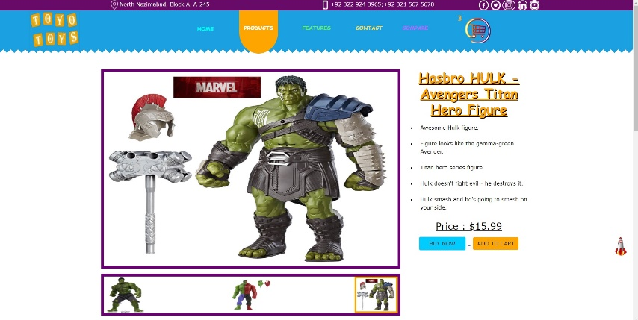
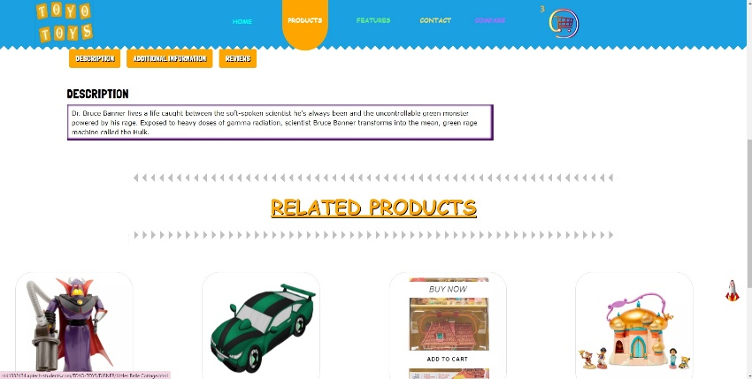
MARVEL’S BRAND STORE.
MAIN PAGE
PRODUCTS
INDIVIDUAL ITEM PAGE
INDIVIDUAL ITEM’S DETAILS AND RELATED PRODUCTS

Slide 11
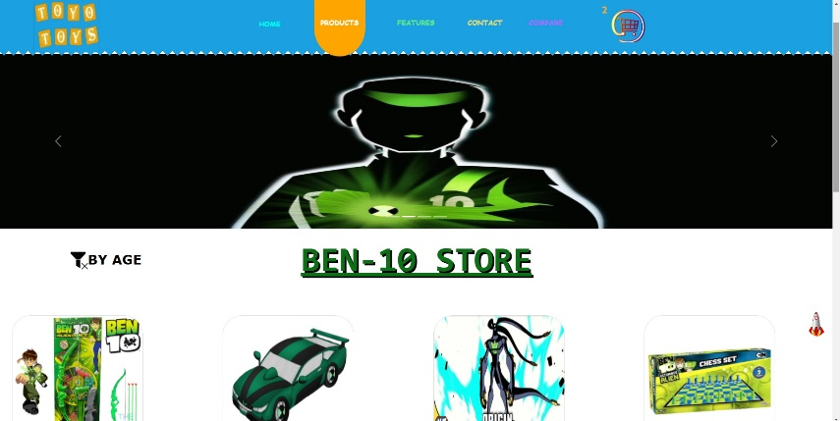
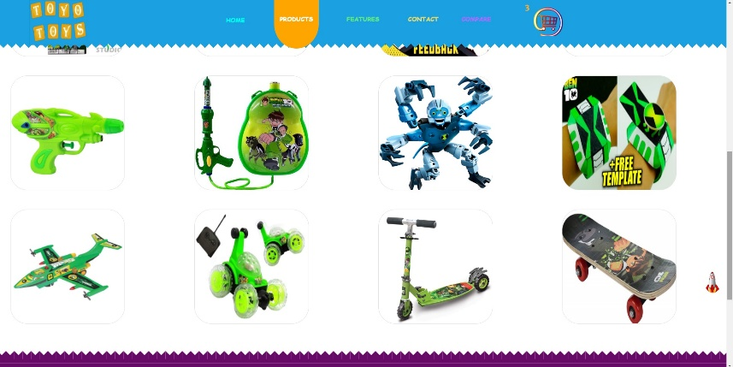
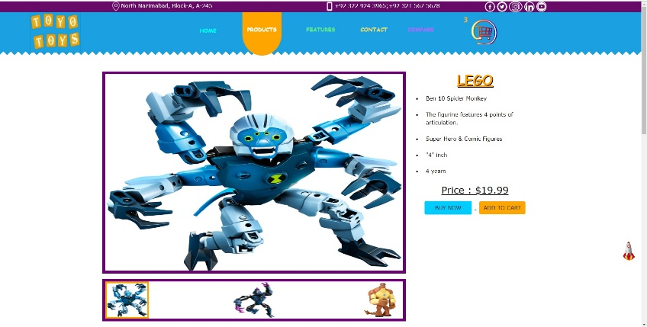
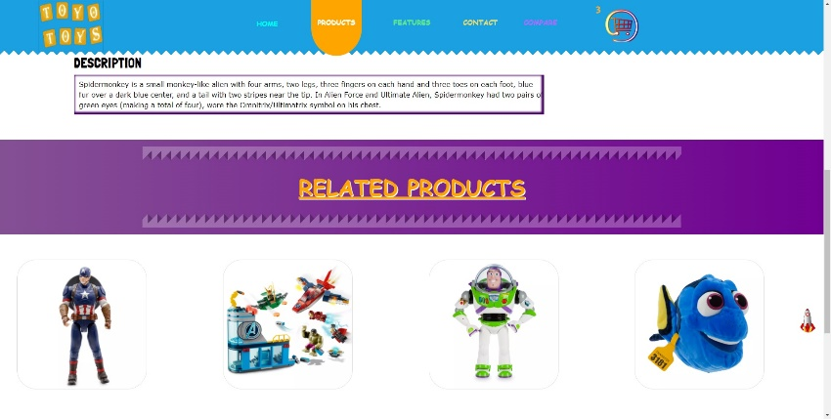
BEN 10’S BRAND STORE.
MAIN PAGE
PRODUCTS
INDIVIDUAL ITEM PAGE
INDIVIDUAL ITEM’S DETAILS AND RELATED PRODUCTS

Slide 12
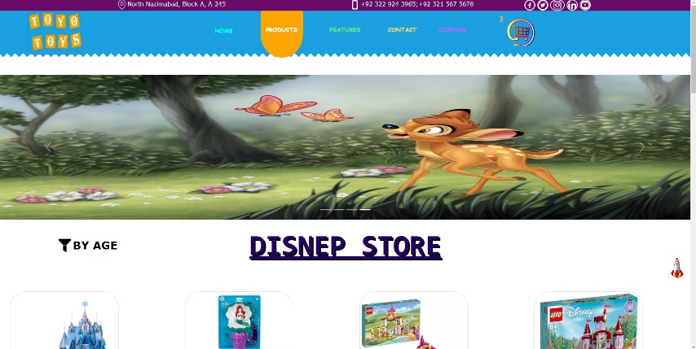
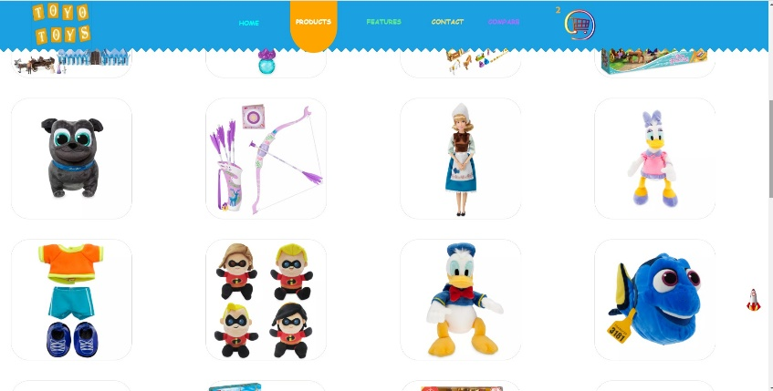
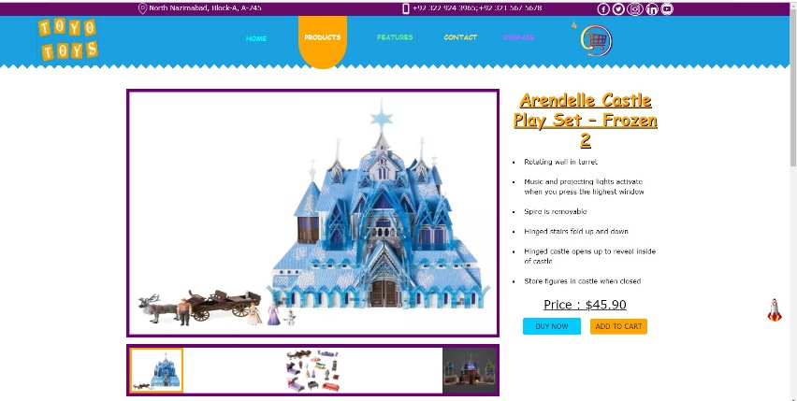
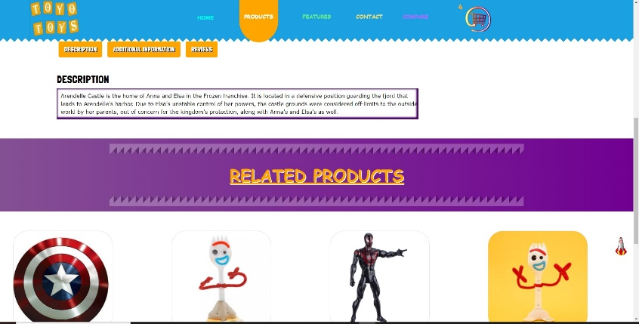
DISNEP’S BRAND STORE.
MAIN PAGE
PRODUCTS
INDIVIDUAL ITEM PAGE
INDIVIDUAL ITEM’S DETAILS AND RELATED PRODUCTS

Slide 13
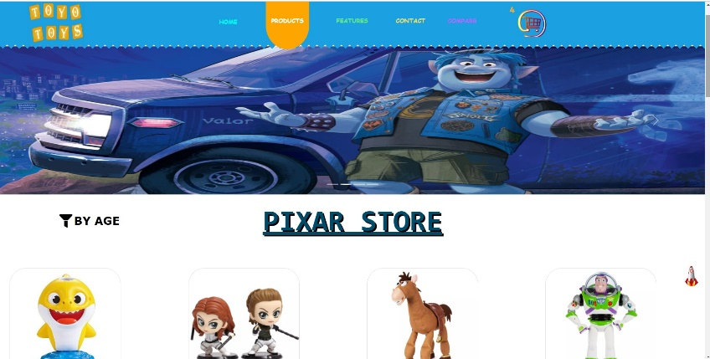
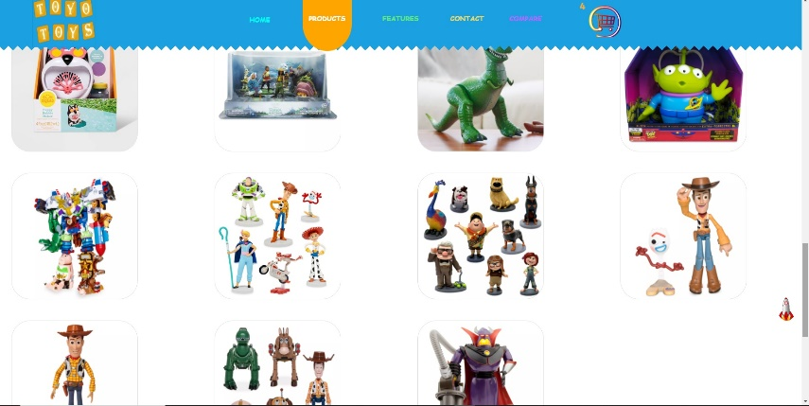
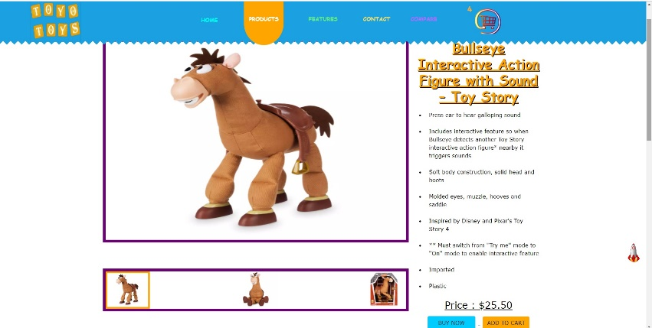
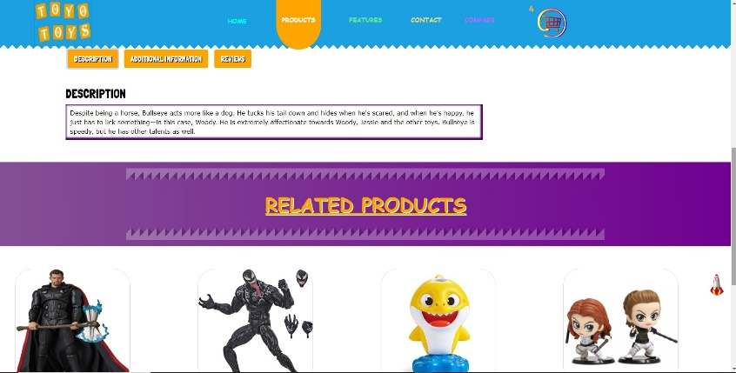
PIXAR’S BRAND STORE.
MAIN PAGE
RODUCTS
INDIVIDUAL ITEM PAGE
INDIVIDUAL ITEM’S DETAILS AND RELATED PRODUCTS

Slide 14
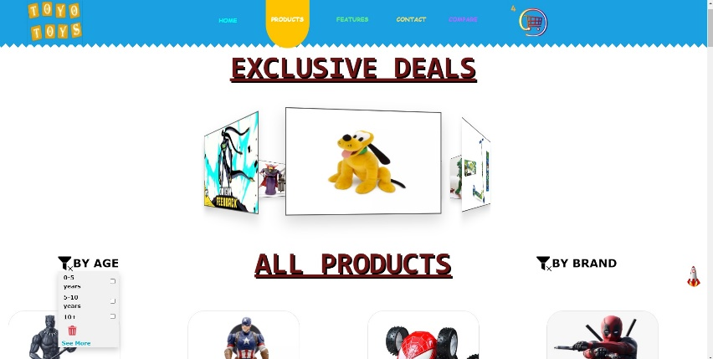
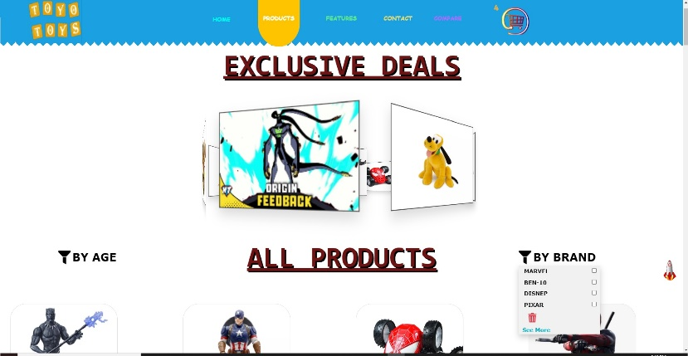
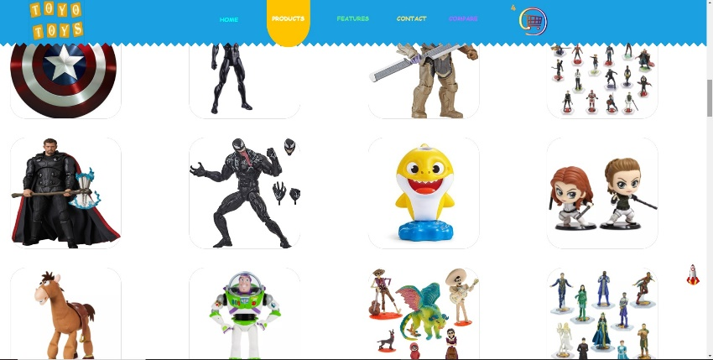
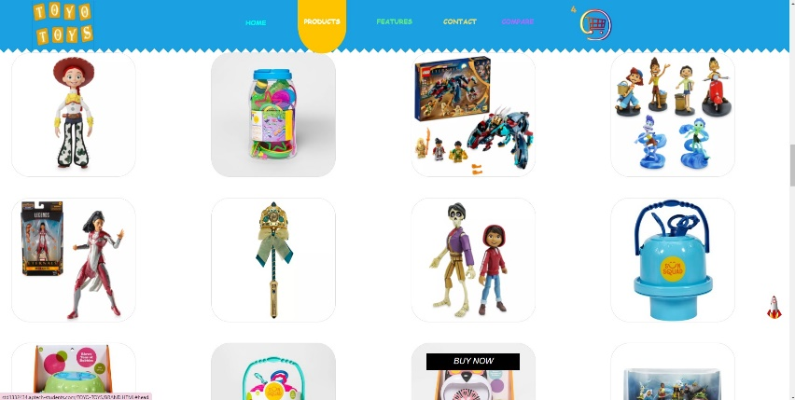
ALL BRANDS PAGE.
ALL BRNDS PRODUCTS BY AGE FILTER
ALL BRNDS PRODUCTS BRANDS FILTER
ALL BRNDS MIXED PRODUCT
ALL BRNDS MIXED PRODUCT

Slide 15
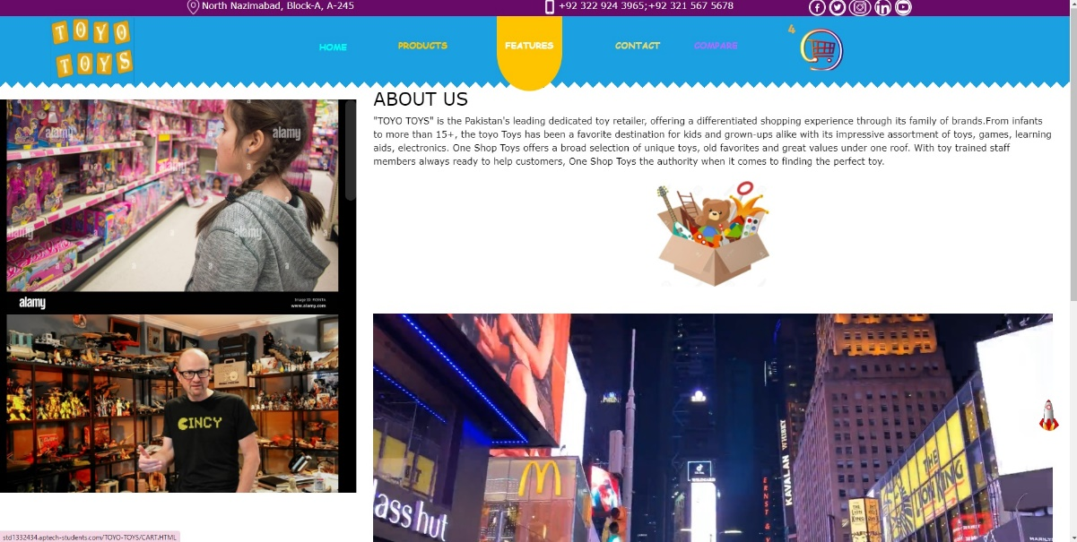
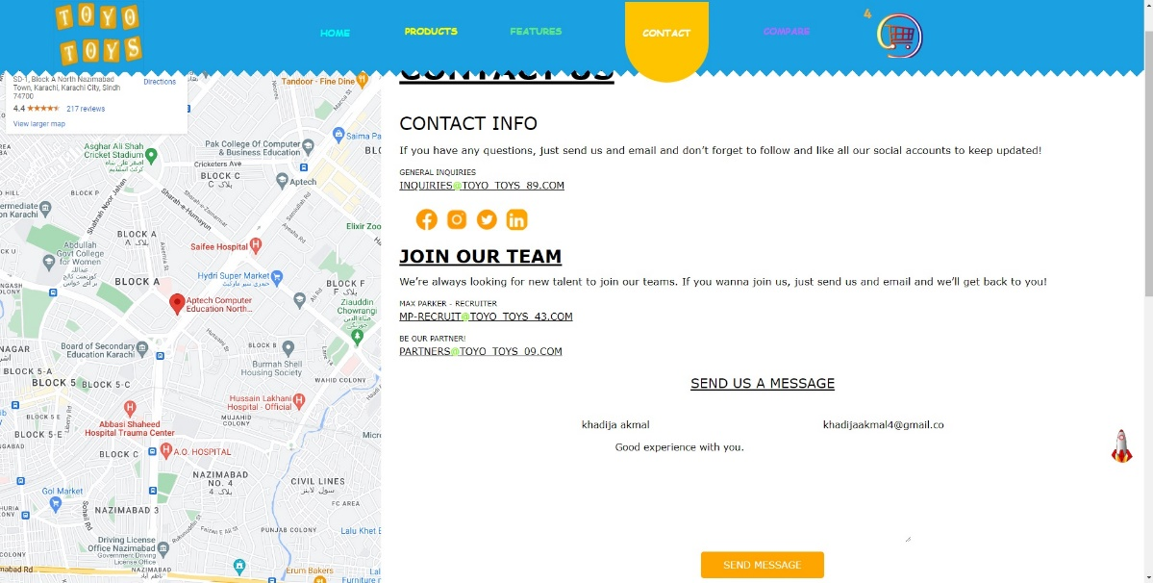
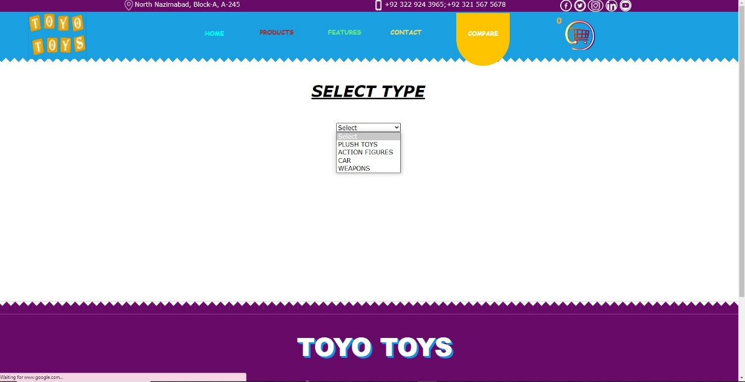
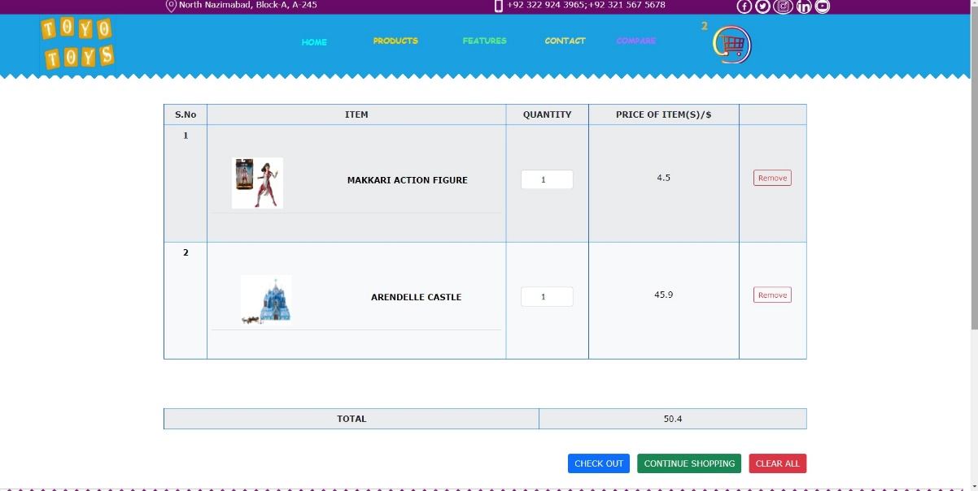
ABOUT US
CONTACT’S PAGE
COMPARE’S PAGE
ADD TO CART’S PAGE

Slide 16
THANK YOU

