Slide 1


Build a Personalized Online Course Recommender System with Machine Learning
Antonio Jimenez
March, 2023

Slide 2

Outline
Introduction and Background
Exploratory Data Analysis
Content-based Recommender System using Unsupervised Learning
Collaborative-filtering based Recommender System using Supervised learning
Conclusion
Appendix

Slide 3
Introduction
AI Training Room is Massive Open Online Course start up that is growing rapidly and has reached the million user milestone in a short period of time. As a part of a effort to improve user experience, the company wants to implement a recommendation system.
The project is at the Proof of Concept (PoC) phase and the focus is on exploring and comparing various algorithms and find the best performing one in off-line evaluations.
The data is provided from the company datasets. This data have been preprocessed and cleaned and is ready for specialized analysis.
The exploratory data analysis process is going to unveil the characteristics of users and courses, and the quantity and quality of data will be assessed.
Several algorithms are going to be implemented using this dataset, and the performance metrics will determine which ones are going to be tested in a real-world scenario.

Slide 4
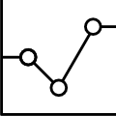
Exploratory Data Analysis

Slide 5
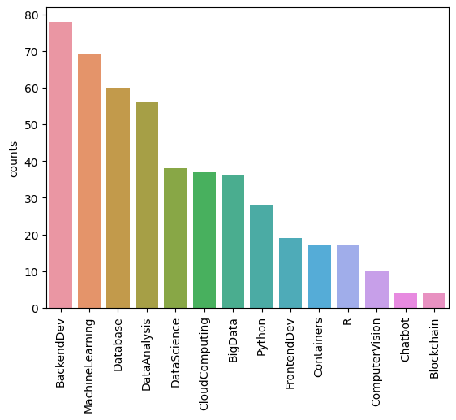
Course counts per genre
From the plot, BackendDev is the most commond coure genre, followed closely by MachineLearning, Database and DataAnalysis

Slide 6
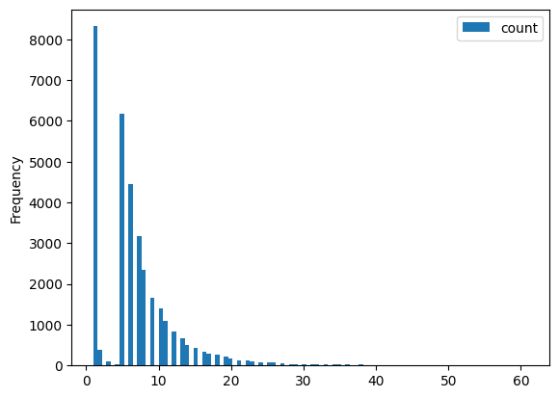
Course enrollment distribution
It could be seen that enrolling in just one course is the most common behavior among users. In addition, enrolling in just two or three courses is very rare. If a user enrolls in more than one course, the number of enrollments is likely to be 5 or greater.

Slide 7
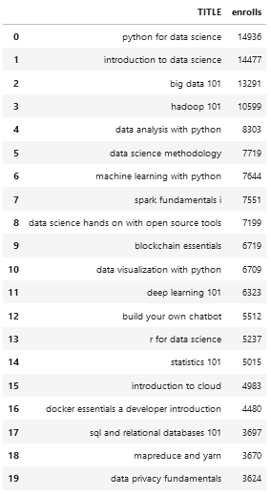
20 most popular courses
Python for Data Science is the most popular course followed closely by introduction to data science. Intro to big data, Hadoop and data analysis are also in top positions. Data related courses are the most popular.

Slide 8
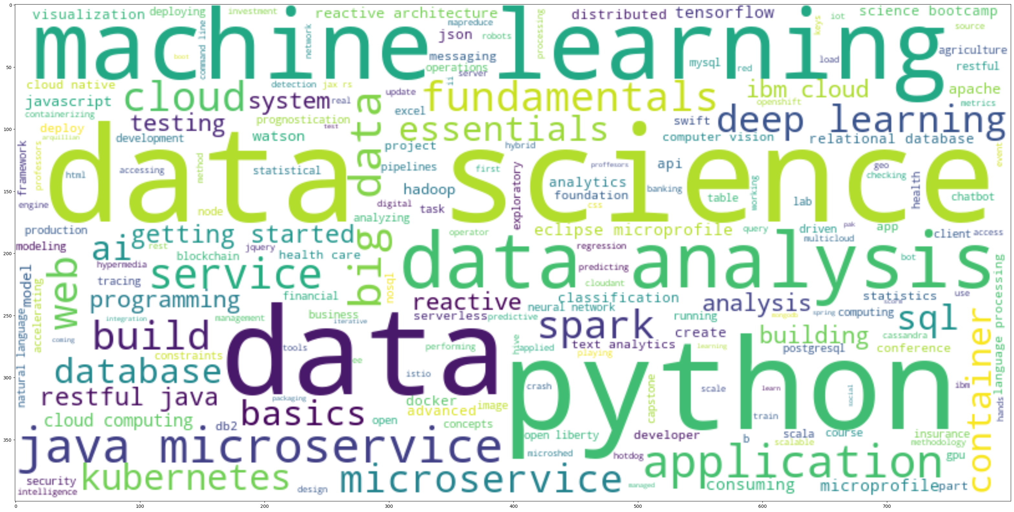
Word cloud of course titles
Data science, machine learning, data analysis and python are the most popular words in course titles. This gives an intuition about the nature of the courses in the dataset.

Slide 9
Content-based Recommender System using Unsupervised Learning
Cluster2
Cluster1

Slide 10
Flowchart of content-based recommender system using user profile and course genres
User Profile Extraction
Raw data
Exploratory Data Analysis
Data processing
Course vector
Given the threshold:
Recommendation
List of recommended courses
Dot product
The input is raw data. After an EDA stage, the data has been processed and features were extracted, such as user profile and course vector. Then, dot product operation was made on new the course vectors using that user profile vector to get a recommendation score. Then, courses above the threshold were recommended.

Slide 11
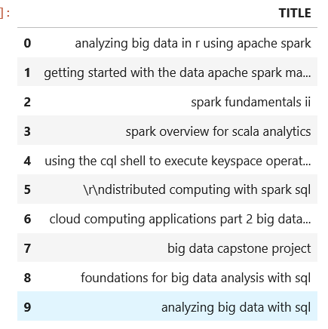
Evaluation results of user profile-based recommender system
Top 10
On average, 19 new courses have been recommended to each user in the Data set
Recommendation Threshold: 30

Slide 12
Flowchart of content-based recommender system using course similarity
Raw data
Exploratory Data Analysis
Data processing
Similarity matrix
List of recommended courses
Given the threshold:
Recommendation
Similarity for new course with user courses
The input is raw data. After an EDA stage, the data has been processed and The similarity matrix for every course is obtained. Then, each new course for the user is compared with each courser of the user and a similarity score is extracted. If this score is greater than a threshold, it is recommended. This process is repeated for each user. At the end a list of recommended course is obtained.

Slide 13
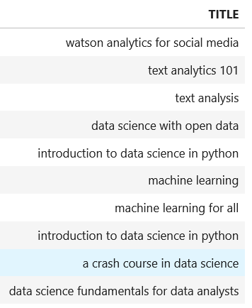
Evaluation results of course similarity based recommender system
Top 10
On average, 2 new courses have been recommended to each user in the Data set
Similarity Threshold: 0.6

Slide 14
Flowchart of clustering-based recommender system
Exploratory Data Analysis
Data processing:
Stardad Scaling
Principal Component Analysis
Raw data
Recommendation list based on user cluster and unseen popular courses
List of popular courses within each cluster
K-means with optimized number of clusters
The input is raw data. After an EDA stage, the data has been standardized and normalized. Then, Principal Component analysis was performed for dimensionality reduction. With this new features, k-means algorithm was used for clustering. As a note, grid search was used to get the best hyperparameters for PCA and K-means. Finally, for each cluster a list of popular courses was made, and recommended courses were obtained from this list for each user. Unseen popular courses within the user cluster were the recommended ones.

Slide 15
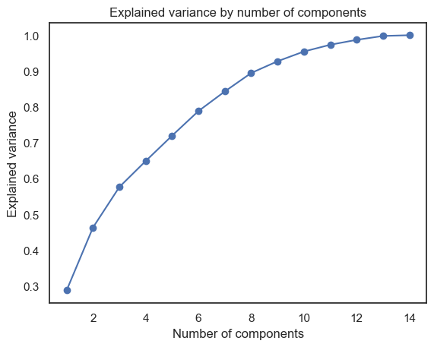
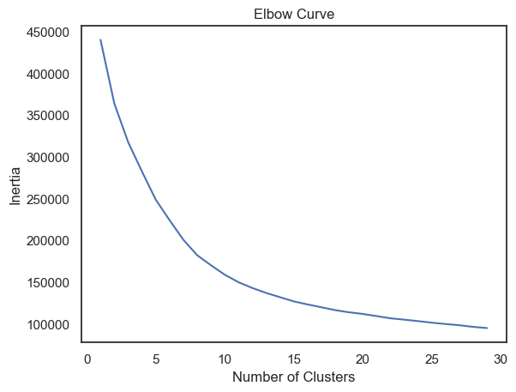
Explained Variance Curve and Elbow Curve
It can be seen that the first eight components explain 90% of the variance. Also, using these components, the optimal number of clusters is eleven.

Slide 16
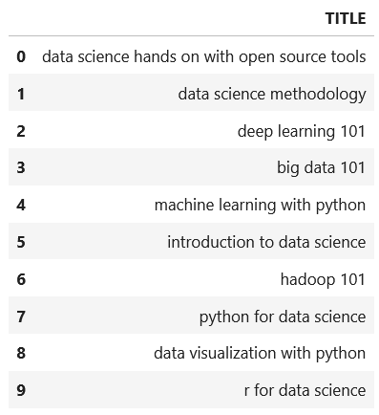
Evaluation results of clustering-based recommender system
Top 10
On average, 3 new courses have been recommended to each user in the Data set
PCA features: 8
Number of clusters (PCA features): 11

Slide 17
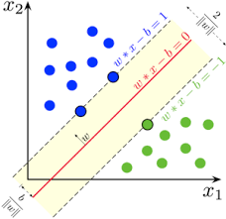
Collaborative-filtering Recommender System using Supervised Learning

Slide 18
Flowchart of KNN based recommender system
Exploratory Data Analysis
Rating sparse matrix
Training-test splitting
Raw data
Performance evaluation: RMSE
KNN algorithm on data
Data scaling and normalization
The input is raw data. After an EDA stage, the rating matrix in sparse form was built. This matrix was then used as the input data for KNN algorithm. Before the training process, the data was split in train test sets and standardized. The algorithm was fitted using the training set and then, performance was evaluated using the test set.

Slide 19
Flowchart of NMF based recommender system
Exploratory Data Analysis
Rating Sparce matrix
Training-test splitting
Raw data
Performance evaluation: RMSE
NMF algorithm on data
Data scaling and normalization
The input is raw data. After an EDA stage, the Rating matrix was built, this in sparse format. This matrix was then used as the input data for NMF algorithm from SciKit Learn. Before the training process, the data was split in train test sets and standardized. The algorithm was fitted using the training set and then, performance was evaluated using the test set.

Slide 20
Flowchart of Neural Network Embedding based recommender system
Exploratory Data Analysis
Rating matrix
Encoding data
Raw data
Embedding vector extraction
Performance evaluation: RMSE
Define-train RecommenderNet network
Train-Validation-Test data splitting
The input is raw data. After an EDA stage, the Rating matrix was built. Then, the data was encoded an split in train, validation, and test sets. This data was then used to train the previously defined RecommenderNet network. Once the model was built, performance was evaluated using the RMSE metric. Finally, the embedding vectors were extracted.

Slide 21
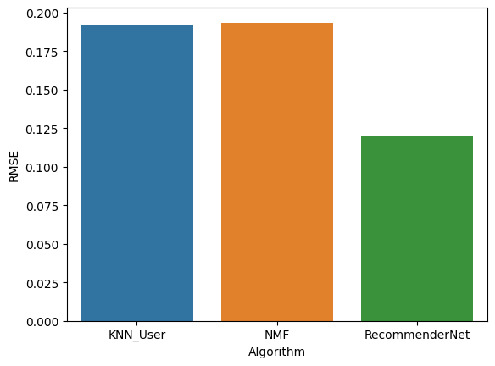
Compare the performance of collaborative-filtering models
It is clear the RecommenderNet algorithm, which is a neural network, has the lowest rmse error. Therefore this is the best performing algorithm.

Slide 22
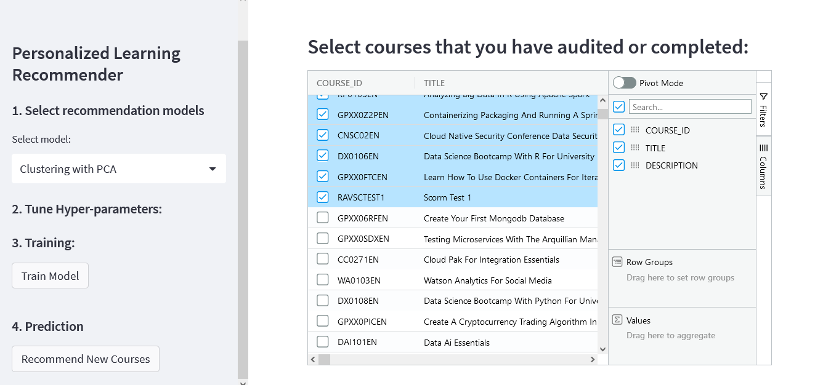
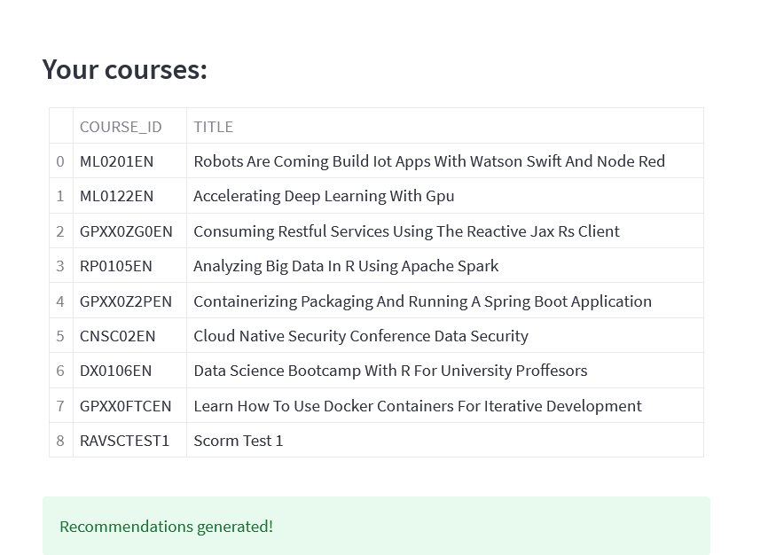
Optional: Build a course recommender system app with Streamlit
Streamlit app screenshot1
Streamlit app screenshot2

Slide 23
Conclusions
Most courses are data related ones. This explains why they are the popular ones.
For content-based unsupervised algorithms, The top ten most recommended courses vary considerably from algorithm to algorithm. User-profile recommender system recommends more big data realated courses. Similarity recommender system suggests more text analytics courses, and the clustering algorithm recommends more data science courses.
Evaluation of Unsupervised Algorithms, content-based, is difficult due to the lack of a performance metric. Selection of the right algorithm cold be made evaluating the recommendation outputs . Also, the number of recommended courses can be fine tuned by changing the hyperparameters for each algorithm.
The best model for collaborative Filtering Recommender System is a neural network: RecommenderNet. The evaluation of supervised algorithms is simpler thanks to performance metrics being readily available.
RecommenderNet is the algorithm that is going to be selected for the next stage of the project.
Further work in fine tuning hyper-parameters is advised for future work.

Slide 24
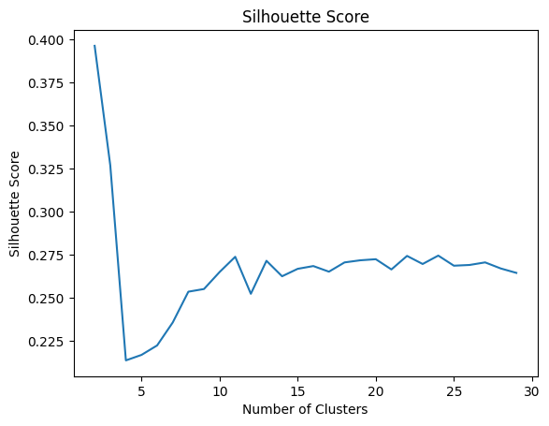
Appendix
To have a second metric to choose the right number of clusters using K-Means algorithm, the silhouette score was also evaluated:
Ignoring low and high values for number of clusters, where the score have a high value regardless of performance, the optimal value is around 11. This is for the case of using all features, without dimensionality reduction

Slide 25
Appendix
The link to the github repo for this project is:
https://github.com/jimenezc-bo/Machine_Learning_Capstone

