Slide 1
Hashing - 2
Designing Hash Tables
Sections 5.3, 5.4, 5.4, 5.6

Slide 2
Designing a hash table
Hash function: establishing a key with an indexed location in a hash table.
  Index = hash(key) % table_size;
Resolve conflicts:
  Need to handle multiple keys that may be mapped to the same index.
  Two representative solutions
    Linear probe open addressing (will discuss more later)
    Chaining with separate lists.

Slide 3

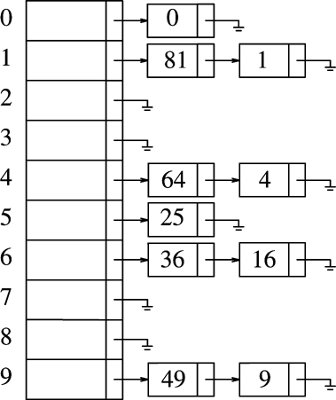
Separate Chaining
Each table entry stores a list of items
So we don’t need to worry about multiple keys mapped to the same entry.

Slide 4
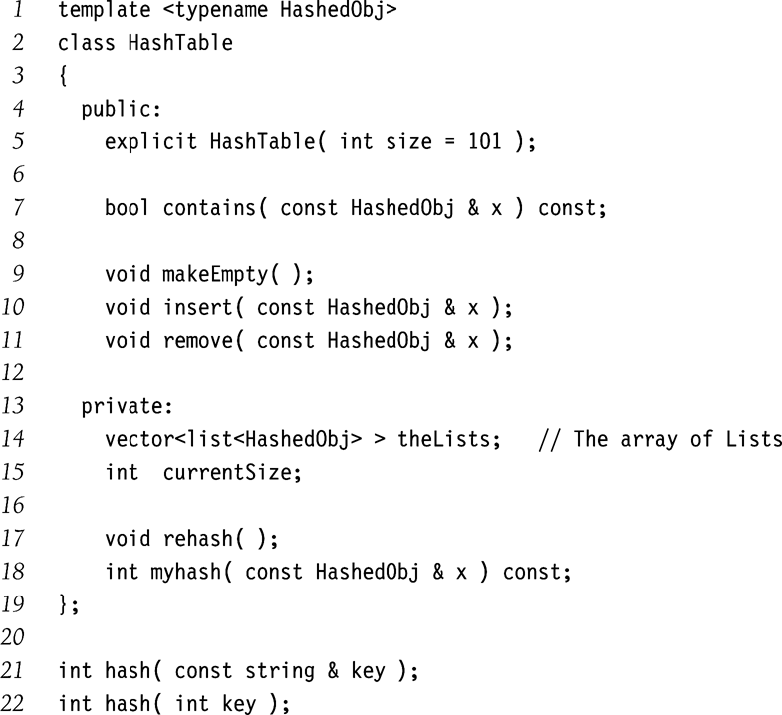
Separate Chaining (contd.)
Type Declaration for
Separate Chaining
Hash Table

Slide 5
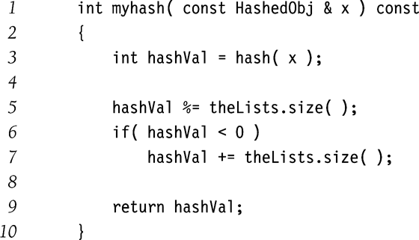
Separate Chaining (contd.)

Slide 6
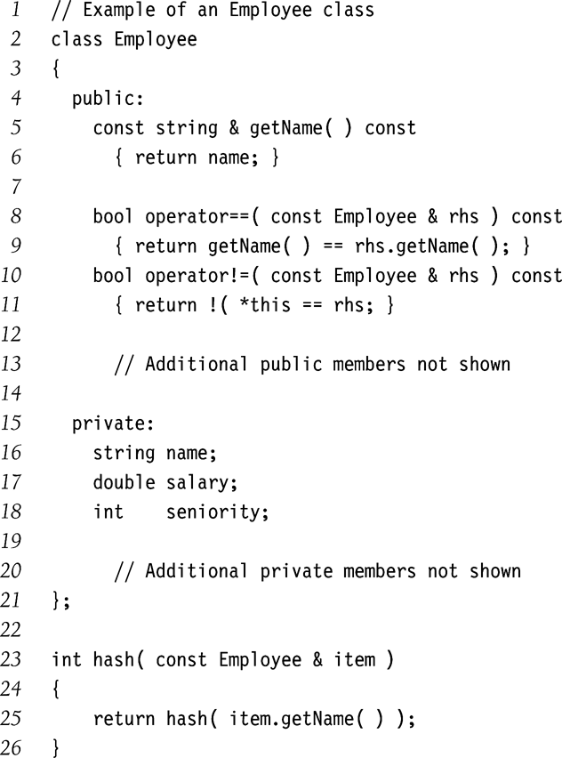
Separate Chaining (contd.)

Slide 7
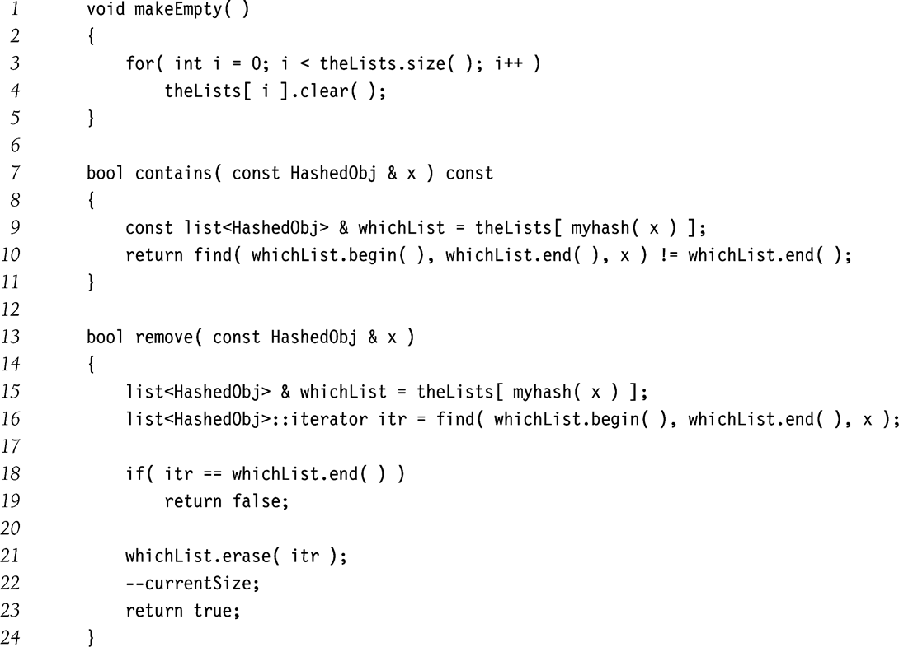
Separate Chaining (contd.)

Slide 8
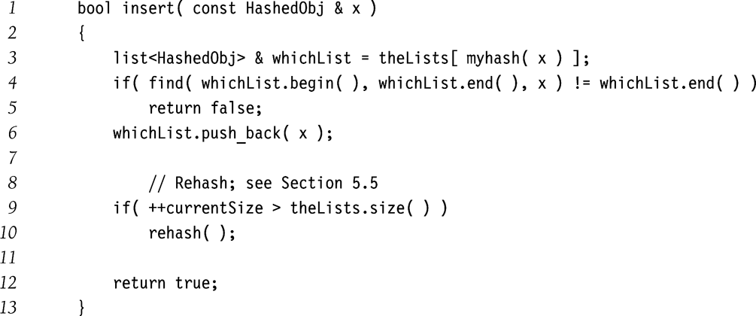
Separate Chaining (contd.)

Slide 9
Hash Tables Without Chaining
Try to avoid buckets with separate lists
How ➔ use Probing Hash Tables
  If collision occurs, try another cell in the hash table.
  More formally, try cells h₀(x), h₁(x), h₂(x), h₃(x)… in succession until a free cell is found.
    h_{i}(x) = (hash(x) + f(i))
    And f(0) = 0

Slide 10
Linear Probing: f(i) = i
Insert(k,x) // assume unique keys
  index = hash(key) % table_size;
  if (table[index]== NULL)
    table[index]=
    new key_value_pair(key, x);
  Else {
    index++;
    index = index % table_size;
    goto 2;
    }

Slide 11
Linear Probing: Search
Search (key)
  Index = hash(key) % table_size;
  If (table[index]==NULL)
  return –1; // Item not found
  Else if (table[index].key == key) return index;
  Else {
    Index ++;
    index = index % table_size;
    goto 2;
  }

Slide 12
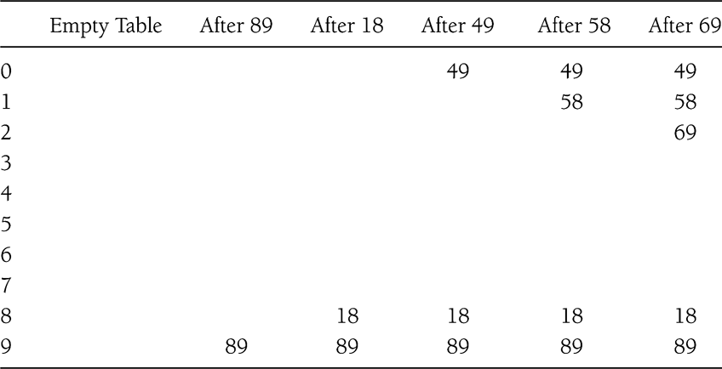
Linear Probing Example
Insert 89, 18, 49, 58, 69

Slide 13
Linear Probing: Delete
Can be tricky ...
How to maintain the consistency of the hash table
What is the simplest deletion strategy you can think of?

Slide 14
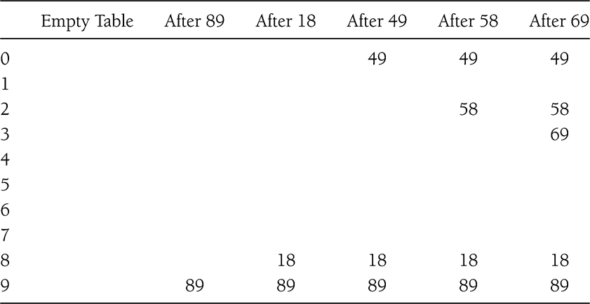
Quadratic Probing
f(i) = i²

Slide 15
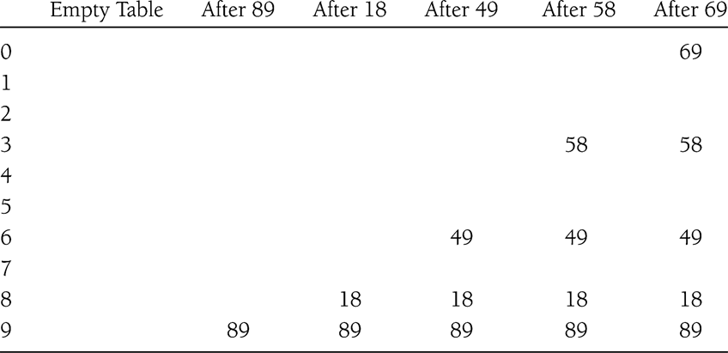
Double Hashing
f(i) = i*hash₂(x)
E.g.: hash₂(x) = 7 – (x % 7)
What if hash₂(x) == 0 for some x?

Slide 16
Rehashing
Hash Table may get full
  No more insertions possible
Hash table may get too full
  Insertions, deletions, search take longer time
Solution: Rehash
  Build another table that is twice as big and has a new hash function
  Move all elements from smaller table to bigger table
Cost of Rehashing = O(N)
  But happens only when table is close to full
  Close to full = table is X percent full, where X is a tunable parameter

Slide 17
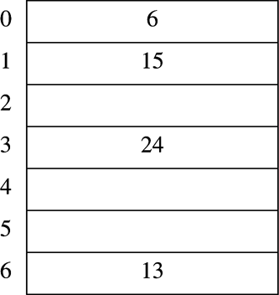
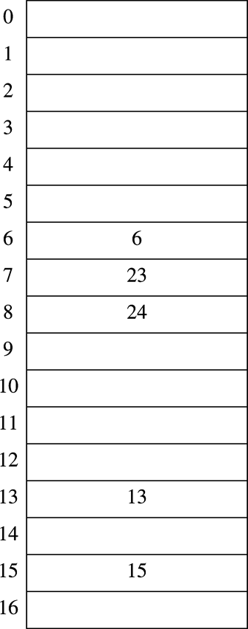
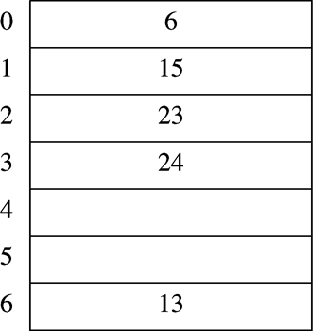
Rehashing Example
Original Hash Table
After Rehashing
After Inserting 23

Slide 18
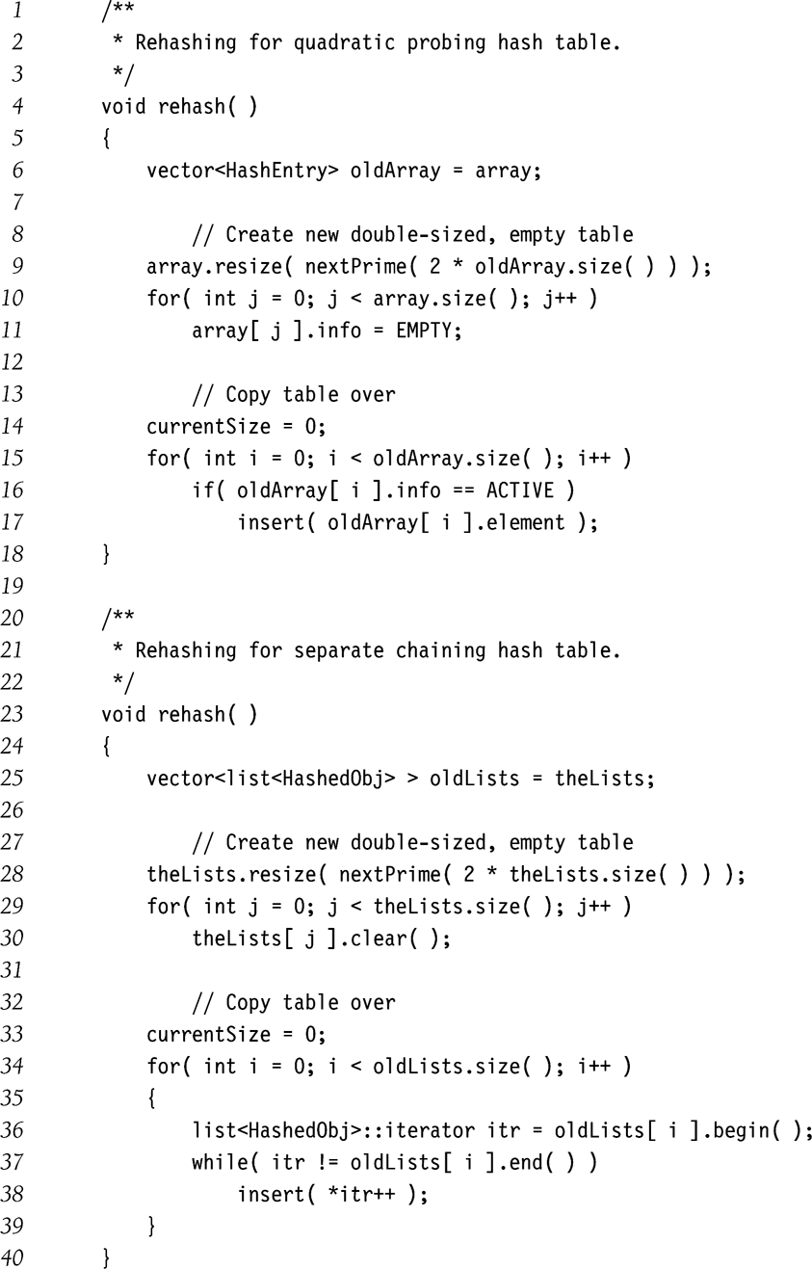
Rehashing Implementation

