Slide 1
Hash Tables
Many of the slides are from Prof. Plaisted’s resources at University of North Carolina at Chapel Hill

Slide 2
Dictionary
Dictionary:
  Dynamic-set data structure for storing items indexed using keys.
  Supports operations Insert, Search, and Delete.
  Applications:
    Symbol table of a compiler.
    Memory-management tables in operating systems.
    Large-scale distributed systems.
Hash Tables:
  Effective way of implementing dictionaries.
  Generalization of ordinary arrays.

Slide 3
Direct-address Tables
Direct-address Tables are ordinary arrays.
Facilitate direct addressing.
  Element whose key is k is obtained by indexing into the k^{th} position of the array.
Applicable when we can afford to allocate an array with one position for every possible key.
  i.e. when the universe of keys U is small.
Dictionary operations can be implemented to take O(1) time.
  Details in Sec. 11.1.

Slide 4
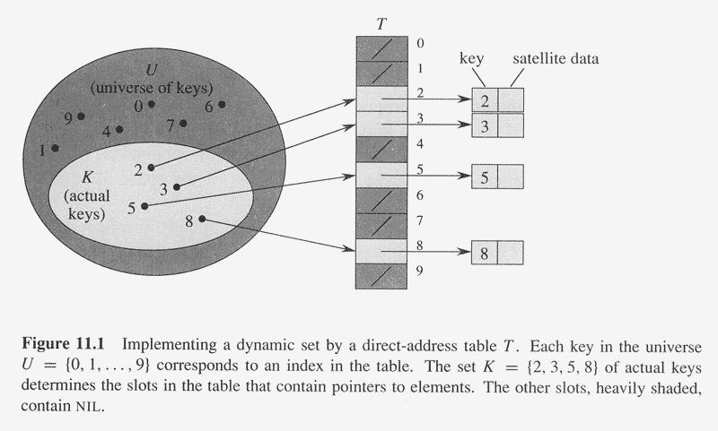
Copyright © The McGraw-Hill Companies, Inc. Permission required for reproduction or display.

Slide 5
Hash Tables
Notation:
  U – Universe of all possible keys.
  K – Set of keys actually stored in the dictionary.
  |K| = n.
When U is very large,
  Arrays are not practical.
  |K| << |U|.
Use a table of size proportional to |K| – The hash tables.
  However, we lose the direct-addressing ability.
  Define functions that map keys to slots of the hash table.

Slide 6
Hashing
Hash function h: Mapping from U to the slots of a hash table T[0..m–1].
  h : U → {0,1,…, m–1}
With arrays, key k maps to slot A[k].
With hash tables, key k maps or “hashes” to slot T[h[k]].
h[k] is the hash value of key k.

Slide 7
Hashing
0
U
(universe of keys)
h(k₁)
h(k₄)
K
(actual
keys)
k₁
k₄
k₂
collision
h(k₂)=h(k₅)
k₅
k₃
h(k₃)
m–1

Slide 8
Issues with Hashing
Multiple keys can hash to the same slot – collisions are possible.
  Design hash functions such that collisions are minimized.
  But avoiding collisions is impossible.
    Design collision-resolution techniques.
Search will cost Ө(n) time in the worst case.
  However, all operations can be made to have an expected complexity of Ө(1).

Slide 9
Methods of Resolution
Chaining:
  Store all elements that hash to the same slot in a linked list.
  Store a pointer to the head of the linked list in the hash table slot.
Open Addressing:
  All elements stored in hash table itself.
  When collisions occur, use a systematic (consistent) procedure to store elements in free slots of the table.
0
k₁
k₄
k₅
k₂
k₆
k₇
k₃
k₈
m–1

Slide 10
Collision Resolution by Chaining
0
U
(universe of keys)
h(k₁)=h(k₄)
X
k₁
k₄
K
(actual
keys)
k₂
k₆
X
h(k₂)=h(k₅)=h(k₆)
k₅
k₈
k₇
k₃
X
h(k₃)=h(k₇)
h(k₈)
m–1

Slide 11
Collision Resolution by Chaining
0
U
(universe of keys)
k₁
k₄
k₁
k₄
K
(actual
keys)
k₂
k₆
k₅
k₂
k₆
k₅
k₈
k₇
k₃
k₇
k₃
k₈
m–1

Slide 12
Hashing with Chaining
Dictionary Operations:
Chained-Hash-Insert (T, x)
  Insert x at the head of list T[h(key[x])].
  Worst-case complexity – O(1).
Chained-Hash-Delete (T, x)
  Delete x from the list T[h(key[x])].
  Worst-case complexity – proportional to length of list with singly-linked lists. O(1) with doubly-linked lists.
Chained-Hash-Search (T, k)
  Search an element with key k in list T[h(k)].
  Worst-case complexity – proportional to length of list.

Slide 13
Analysis on Chained-Hash-Search
Load factor α=n/m = average keys per slot.
  m – number of slots.
  n – number of elements stored in the hash table.
Worst-case complexity: Θ(n) + time to compute h(k).
Average depends on how h distributes keys among m slots.
Assume
  Simple uniform hashing.
    Any key is equally likely to hash into any of the m slots, independent of where any other key hashes to.
  O(1) time to compute h(k).
Time to search for an element with key k is Θ(|T[h(k)]|).
Expected length of a linked list = load factor = α = n/m.

Slide 14
Expected Cost of an Unsuccessful Search
Theorem:
An unsuccessful search takes expected time Θ(1+α).
Proof:
Any key not already in the table is equally likely to hash to any of the m slots.
To search unsuccessfully for any key k, need to search to the end of the list T[h(k)], whose expected length is α.
Adding the time to compute the hash function, the total time required is Θ(1+α).

Slide 15
Expected Cost of a Successful Search
Theorem:
A successful search takes expected time Θ(1+α).
Proof:
The probability that a list is searched is proportional to the number of elements it contains.
Assume that the element being searched for is equally likely to be any of the n elements in the table.
The number of elements examined during a successful search for an element x is 1 more than the number of elements that appear before x in x’s list.
  These are the elements inserted after x was inserted.
Goal:
  Find the average, over the n elements x in the table, of how many elements were inserted into x’s list after x was inserted.

Slide 16
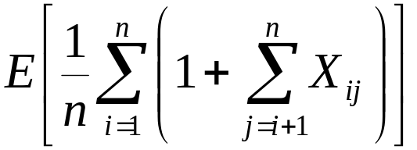
Expected Cost of a Successful Search
Theorem:
A successful search takes expected time Θ(1+α).
Proof (contd):
Let x_{i} be the i^{th} element inserted into the table, and let k_{i} = key[x_{i}].
Define indicator random variables X_{ij} = I{h(k_{i}) = h(k_{j})}, for all i, j.
Simple uniform hashing ⇒ Pr{h(k_{i}) = h(k_{j})} = 1/m
⇒ E[X_{ij}] = 1/m.
Expected number of elements examined in a successful search is:
No. of elements inserted after x_{i} into the same slot as x_{i}.

Slide 17
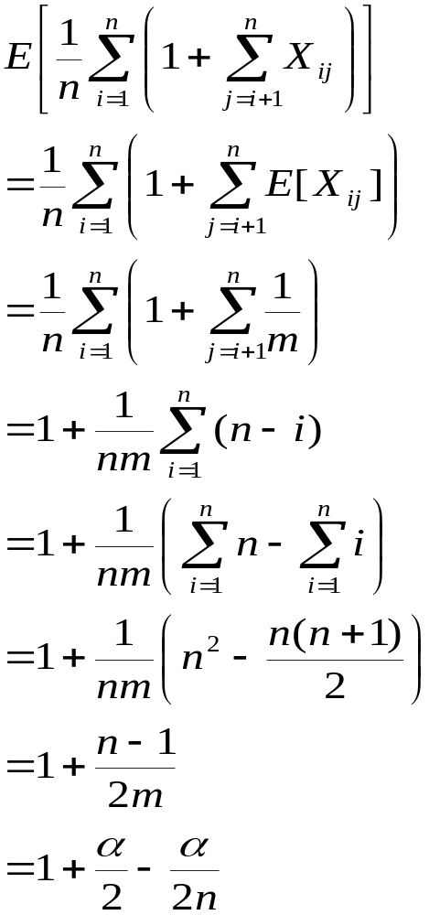
Proof – Contd.
(linearity of expectation)
Expected total time for a successful search = Time to compute hash function + Time to search
= O(2+α/2 – α/2n) = O(1+ α).

Slide 18
Expected Cost – Interpretation
If n = O(m), then α=n/m = O(m)/m = O(1).
⇒ Searching takes constant time on average.
Insertion is O(1) in the worst case.
Deletion takes O(1) worst-case time when lists are doubly linked.
Hence, all dictionary operations take O(1) time on average with hash tables with chaining.

Slide 19
Good Hash Functions
Satisfy the assumption of simple uniform hashing.
  Not possible to satisfy the assumption in practice.
Often use heuristics, based on the domain of the keys, to create a hash function that performs well.
Regularity in key distribution should not affect uniformity. Hash value should be independent of any patterns that might exist in the data.
  E.g. Each key is drawn independently from U according to a probability distribution P:
∑_{k:h(k) = j} P(k) = 1/m for j = 0, 1, … , m–1.
  An example is the division method.

Slide 20
Keys as Natural Numbers
Hash functions assume that the keys are natural numbers.
When they are not, have to interpret them as natural numbers.
Example: Interpret a character string as an integer expressed in some radix notation. Suppose the string is CLRS:
  ASCII values: C=67, L=76, R=82, S=83.
  There are 128 basic ASCII values.
  So, CLRS = 67·128³+76 ·128²+ 82·128¹+ 83·128⁰ = 141,764,947.

Slide 21
Division Method
Map a key k into one of the m slots by taking the remainder of k divided by m. That is,
h(k) = k mod m
Example: m = 31 and k = 78 ⇒ h(k) = 16.
Advantage: Fast, since requires just one division operation.
Disadvantage: Have to avoid certain values of m.
  Don’t pick certain values, such as m=2^{p}
  Or hash won’t depend on all bits of k.
Good choice for m:
  Primes, not too close to power of 2 (or 10) are good.

Slide 22
Multiplication Method
If 0 < A < 1, h(k) = ⎣m (kA mod 1)⎦ = ⎣m (kA – ⎣kA⎦) ⎦
where kA mod 1 means the fractional part of kA, i.e., kA – ⎣kA⎦.
Disadvantage: Slower than the division method.
Advantage: Value of m is not critical.
  Typically chosen as a power of 2, i.e., m = 2^{p}, which makes implementation easy.
Example: m = 1000, k = 123, A ≈ 0.6180339887…
h(k) = ⎣1000(123 · 0.6180339887 mod 1)⎦
= ⎣1000 · 0.018169... ⎦ = 18.

Slide 23
Multiplication Mthd. – Implementation
Choose m = 2^{p}, for some integer p.
Let the word size of the machine be w bits.
Assume that k fits into a single word. (k takes w bits.)
Let 0 < s < 2^{w}. (s takes w bits.)
Restrict A to be of the form s/2^{w}.
Let k × s = r₁ ·2^{w}+ r₀ .
r₁ holds the integer part of kA (⎣kA⎦) and r₀ holds the fractional part of kA (kA mod 1 = kA – ⎣kA⎦).
We don’t care about the integer part of kA.
  So, just use r₀, and forget about r₁.

Slide 24
Multiplication Mthd – Implementation
w bits
k
binary point
×
s = A·2^{w}
r₁
·
r₀
extract p bits
h(k)
We want ⎣m (kA mod 1)⎦. We could get that by shifting r₀ to the left by p = lg m bits and then taking the p bits that were shifted to the left of the binary point.
But, we don’t need to shift. Just take the p most significant bits of r₀.

Slide 25
How to choose A?
How to choose A?
  The multiplication method works with any legal value of A.
  But it works better with some values than with others, depending on the keys being hashed.
  Knuth suggests using A ≈ (√5 – 1)/2.

Slide 26
Universal Hashing
A malicious adversary who has learned the hash function chooses keys that all map to the same slot, giving worst-case behavior.
Defeat the adversary using Universal Hashing
  Use a different random hash function each time.
  Ensure that the random hash function is independent of the keys that are actually going to be stored.
  Ensure that the random hash function is “good” by carefully designing a class of functions to choose from.
    Design a universal class of functions.

Slide 27
Universal Set of Hash Functions
A finite collection of hash functions H that map
a universe U of keys into the range {0, 1,…, m–1}
is “universal” if, for each pair of distinct keys, k, l∈U,
the number of hash functions h∈H
for which h(k)=h(l) is no more than |H|/m.
The chance of a collision between two keys is the 1/m chance of choosing two slots randomly & independently.
Universal hash functions give good hashing behavior.

Slide 28
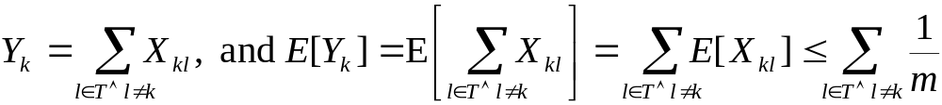
Cost of Universal Hashing
Theorem:
Using chaining and universal hashing on key k:
If k is not in the table T, the expected length of the list that k hashes to is ≤ α.
If k is in the table T, the expected length of the list that k hashes to is ≤ 1+α.
Proof:
X_{kl} = I{h(k)=h(l)}. E[X_{kl}] = Pr{h(k)=h(l)} ≤ 1/m.
RV Y_{k} = no. of keys other than k that hash to the same slot as k. Then,

Slide 29
Example of Universal Hashing
When the table size m is a prime,
key x is decomposed into bytes s.t. x = <x₀ ,…, x_{r}>,
and a = <a₀ ,…, a_{r}> denotes a sequence of r+1
elements randomly chosen from {0, 1, … , m – 1},
The class H defined by
H = _{a} {h_{a}} with h_{a}(x) = ∑_{i=0 to r} a_{i}x_{i} mod m
is a universal function,
(but if some a_{i} is zero, h does not depend on all bytes of x and if all a_{i} are zero the behavior is terrible. See text for better method of universal hashing.)

Slide 30
Open Addressing
An alternative to chaining for handling collisions.
Idea:
  Store all keys in the hash table itself. What can you say about α?
  Each slot contains either a key or NIL.
  To search for key k:
    Examine slot h(k). Examining a slot is known as a probe.
    If slot h(k) contains key k, the search is successful. If the slot contains NIL, the search is unsuccessful.
    There’s a third possibility: slot h(k) contains a key that is not k.
      Compute the index of some other slot, based on k and which probe we are on.
      Keep probing until we either find key k or we find a slot holding NIL.
Advantages: Avoids pointers; so can use a larger table.

Slide 31
Probe Sequence
Sequence of slots examined during a key search constitutes a probe sequence.
Probe sequence must be a permutation of the slot numbers.
  We examine every slot in the table, if we have to.
  We don’t examine any slot more than once.
The hash function is extended to:
  h : U × {0, 1, …, m – 1} → {0, 1, …, m – 1}
  probe number slot number
⟨h(k,0), h(k,1),…,h(k,m–1)⟩ should be a permutation of ⟨0, 1,…, m–1⟩.

Slide 32
Ex: Linear Probing
Example:
  h(x) = x mod 13
  h(x,i)=(h(x) + i) mod 13
  Insert keys 18, 41, 22, 44, 59, 32, 31, 73, in this order
0
1
2
3
4
5
6
7
8
9
10
11
12
41
18
44
59
32
22
31
73
0
1
2
3
4
5
6
7
8
9
10
11
12

Slide 33
Operation Insert
Act as though we were searching, and insert at the first NIL slot found.
Pseudo-code for Insert:
Hash-Insert(T, k)
1. i ← 0
2. repeat j ← h(k, i)
3. if T[j] = NIL
4. then T[j] ← k
5. return j
6. else i ← i + 1
7. until i = m
8. error “hash table overflow”

Slide 34
Pseudo-code for Search
Hash-Search (T, k)
1. i ← 0
2. repeat j ← h(k, i)
3. if T[j] = k
4. then return j
5. i ← i + 1
6. until T[j] = NIL or i = m
7. return NIL

Slide 35
Deletion
Cannot just turn the slot containing the key we want to delete to contain NIL. Why?
Use a special value DELETED instead of NIL when marking a slot as empty during deletion.
  Search should treat DELETED as though the slot holds a key that does not match the one being searched for.
  Insert should treat DELETED as though the slot were empty, so that it can be reused.
Disadvantage: Search time is no longer dependent on α.
  Hence, chaining is more common when keys have to be deleted.

Slide 36
Computing Probe Sequences
The ideal situation is uniform hashing:
  Generalization of simple uniform hashing.
  Each key is equally likely to have any of the m! permutations of ⟨0, 1,…, m–1⟩ as its probe sequence.
It is hard to implement true uniform hashing.
  Approximate with techniques that at least guarantee that the probe sequence is a permutation of ⟨0, 1,…, m–1⟩.
Some techniques:
  Use auxiliary hash functions.
    Linear Probing.
    Quadratic Probing.
    Double Hashing.
  Can’t produce all m! probe sequences.

Slide 37
Linear Probing
h(k, i) = (h′(k)+i) mod m.
The initial probe determines the entire probe sequence.
  T[h′(k)], T[h′(k)+1], …, T[m–1], T[0], T[1], …, T[h′(k)–1]
  Hence, only m distinct probe sequences are possible.
Suffers from primary clustering:
  Long runs of occupied sequences build up.
  Long runs tend to get longer, since an empty slot preceded by i full slots gets filled next with probability (i+1)/m.
  Hence, average search and insertion times increase.
key
Probe number
Auxiliary hash function

Slide 38
Ex: Linear Probing
Example:
  h’(x) = x mod 13
  h(x)=(h’(x)+i) mod 13
  Insert keys 18, 41, 22, 44, 59, 32, 31, 73, in this order
0
1
2
3
4
5
6
7
8
9
10
11
12
41
18
44
59
32
22
31
73
0
1
2
3
4
5
6
7
8
9
10
11
12

Slide 39
Quadratic Probing
h(k,i) = (h′(k) + c₁i + c₂i²) mod m c₁≠ c₂
The initial probe position is T[h′(k)], later probe positions are offset by amounts that depend on a quadratic function of the probe number i.
Must constrain c₁, c₂, and m to ensure that we get a full permutation of ⟨0, 1,…, m–1⟩.
Can suffer from secondary clustering:
  If two keys have the same initial probe position, then their probe sequences are the same.
key
Probe number
Auxiliary hash function

Slide 40
Double Hashing
h(k,i) = (h₁(k) + i h₂(k)) mod m
Two auxiliary hash functions.
  h₁ gives the initial probe. h₂ gives the remaining probes.
Must have h₂(k) relatively prime to m, so that the probe sequence is a full permutation of ⟨0, 1,…, m–1⟩.
  Choose m to be a power of 2 and have h₂(k) always return an odd number. Or,
  Let m be prime, and have 1 < h₂(k) < m.
Θ(m²) different probe sequences.
  One for each possible combination of h₁(k) and h₂(k).
  Close to the ideal uniform hashing.
key
Probe number
Auxiliary hash functions

Slide 41
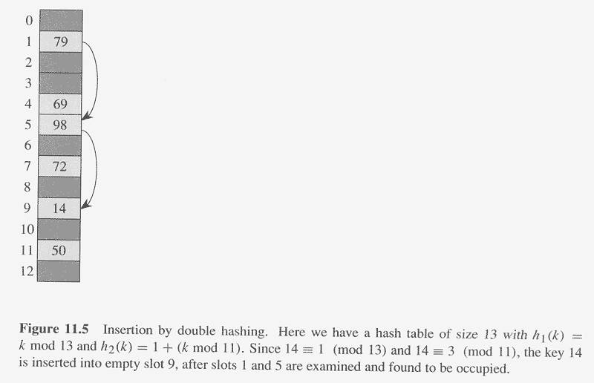
Copyright © The McGraw-Hill Companies, Inc. Permission required for reproduction or display.

Slide 42
Analysis of Open-address Hashing
Analysis is in terms of load factor α.
Assumptions:
  Assume that the table never completely fills, so n <m and α < 1.
  Assume uniform hashing.
  No deletion.
  In a successful search, each key is equally likely to be searched for.

Slide 43
Expected cost of an unsuccessful search
Theorem:
The expected number of probes in an unsuccessful search in an open-
address hash table is at most 1/(1–α).
Proof:
Every probe except the last is to an occupied slot.
Let RV X = # of probes in an unsuccessful search.
X ≥ i iff probes 1, 2, …, i – 1 are made to occupied slots
Let A_{i} = event that there is an ith probe, to an occupied slot.
Pr{X ≥ i}
= Pr{A₁∩A₂∩…∩A_{i-1}}.
= Pr{A₁}Pr{A₂| A₁} Pr{A₃| A₂∩A₁} …Pr{A_{i-1} | A₁∩… ∩ A_{i-2}}

Slide 44
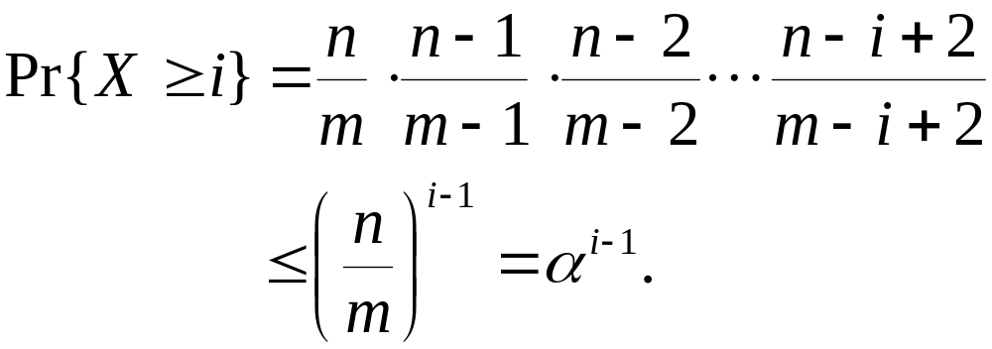
Proof – Contd.
X ≥ i iff probes 1, 2, …, i – 1 are made to occupied slots
Let A_{i} = event that there is an ith probe, to an occupied slot.
Pr{X ≥ i}
= Pr{A₁∩A₂∩…∩A_{i-1}}.
= Pr{A₁}Pr{A₂| A₁} Pr{A₃| A₂∩A₁} …Pr{A_{i-1} | A₁∩… ∩ A_{i-2}}
Pr{A_{j} | A₁ ∩A₂ ∩… ∩ A_{j-1}} = (n–j+1)/(m–j+1).

Slide 45
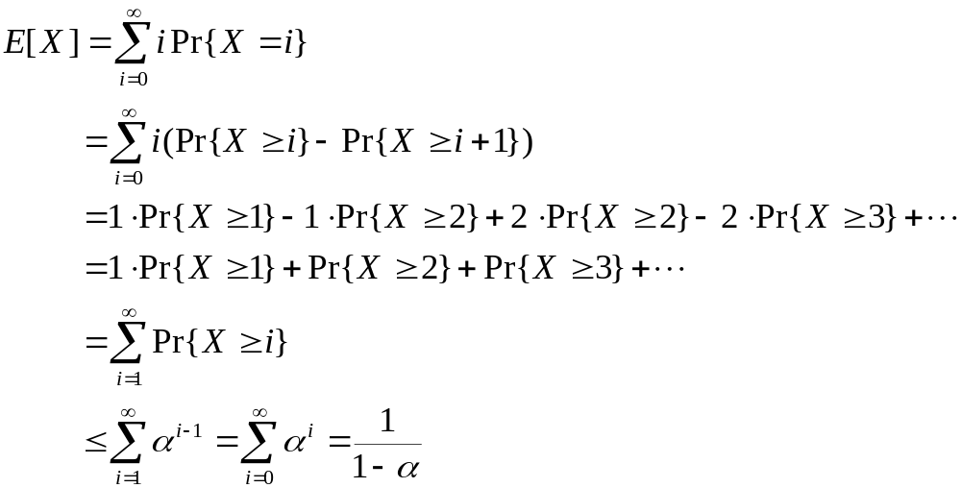
Proof – Contd.
If α is a constant, search takes O(1) time.
Corollary: Inserting an element into an open-address table takes ≤ 1/(1–α) probes on average.
(C.25)
(A.6)

Slide 46
Expected cost of a successful search
Theorem:
The expected number of probes in a successful search in an open-
address hash table is at most (1/α) ln (1/(1–α)).
Proof:
A successful search for a key k follows the same probe sequence as when k was inserted.
If k was the (i+1)st key inserted, then α equaled i/m at that time.
By the previous corollary, the expected number of probes made in a search for k is at most 1/(1–i/m) = m/(m–i).
This is assuming that k is the (i+1)st key. We need to average over all n keys.

Slide 47
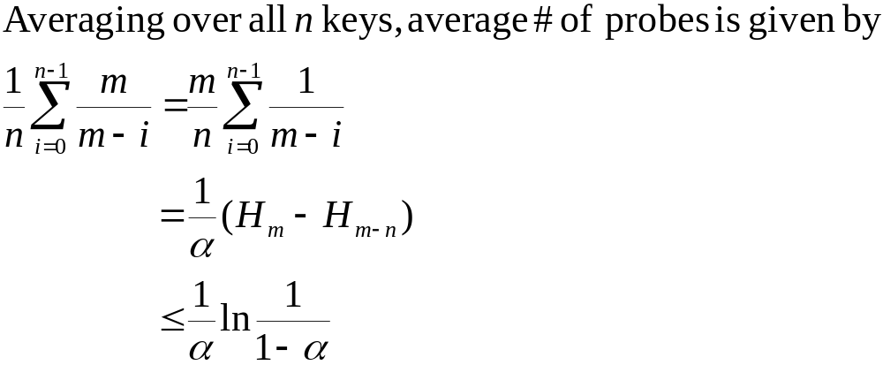
Proof – Contd.

Slide 48
Perfect Hashing
If you know the n keys in advance,
make a hash table with O(n) size,
and worst-case O(1) lookup time!
Start with O(n²) size… no collisions
Thm 11.9: For a table of size m = n²,
if we choose h from a universal class of hash functions, we have no collisions with probability >½.
Pf: Expected number of collisions among pairs:
E[X] = (n choose 2) / n² < ½,
& Markov inequality says Pr{X≥t} ≤ E[X]/t. (t=1)

Slide 49
Perfect Hashing
If you know the n keys in advance,
make a hash table with O(n) size,
and worst-case O(1) lookup time!
With table size n, few (collisions)²…
Thm 11.10: For a table of size m = n,
if we choose h from a universal class of hash functions,
E[Σ_{j}n_{j}²]< 2n, where n_{j} is number of keys hashing to j.
Pf: essentially the total number of collisions.

Slide 50
Perfect Hashing
If you know the n keys in advance,
make a hash table with O(n) size,
and worst-case O(1) lookup time!
Just use two levels of hashing:
A table of size n, then tables of size n_{j}².
k₁
k₄
k₂
k₅
k₇
k₆
k₈
k₃

Slide 51
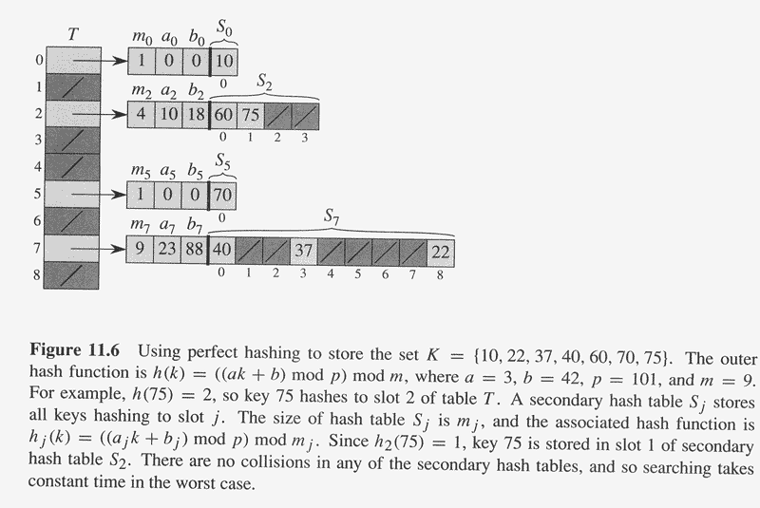
Copyright © The McGraw-Hill Companies, Inc. Permission required for reproduction or display.

