Slide 1
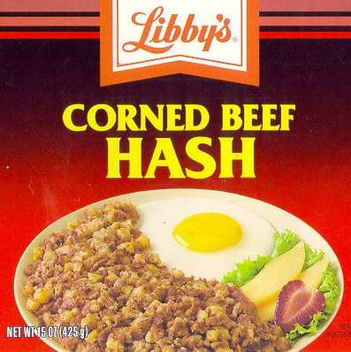
CSE 326: Data Structures
Part 5
Hashing
Henry Kautz
Autumn 2002

Slide 2
Midterm
Monday November 4th
Will cover everything through hash tables
No homework due that day, but a study sheet and practice problems on trees and hashing will be distributed
50 minutes, in class
You may bring one page of notes to refer to

Slide 3
Dictionary & Search ADTs
Operations
  create
  destroy
  insert
  find
  delete
Dictionary: Stores values associated with user-specified keys
  keys may be any (homogenous) comparable type
  values may be any (homogenous) type
  implementation: data field is a struct with two parts
Search ADT: keys = values
kim chi
  spicy cabbage
kreplach
  tasty stuffed dough
kiwi
  Australian fruit
insert
kohlrabi
- upscale tuber
find(kreplach)
kreplach
- tasty stuffed dough
Notes:
Dictionaries associate some key with a value, just like a real dictionary (where the key is a word and the value is its definition).
In this example, I’ve stored user-IDs associated with descriptions of their coolness level.
This is probably the most valuable and widely used ADT we’ll hit.
I’ll give you an example in a minute that should firmly entrench this concept.

Slide 4
Implementations So Far
 | unsorted list | sorted array | Trees BST – average AVL – worst case splay – amortized | Array of size n where keys are 0,…,n-1
insert | find+θ(1) | θ(n) | θ(log n)
find | θ(n) | θ(log n) | θ(log n)
delete | find+θ(1) | θ(n) | θ(log n)

Slide 5
Hash Tables: Basic Idea
Use a key (arbitrary string or number) to index directly into an array – O(1) time to access records
  A[“kreplach”] = “tasty stuffed dough”
  Need a hash function to convert the key to an integer
 | Key | Data
0 | kim chi | spicy cabbage
1 | kreplach | tasty stuffed dough
2 | kiwi | Australian fruit

Slide 6
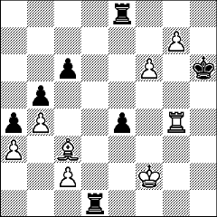
Applications
When log(n) is just too big…
  Symbol tables in interpreters
  Real-time databases (in core or on disk)
    air traffic control
    packet routing
When associative memory is needed…
  Dynamic programming
    cache results of previous computation
    f(x) →if ( Find(x) ) then Find(x) else f(x)
    Chess endgames
  Many text processing applications – e.g. Web
    $Status{$LastURL} = “visited”;
Notes:
Before talking about how hashing is done, let’s mention some applications.
When is it important to do lookups in constant time?

Slide 7
How could you use hash tables to…
Implement a linked list of unique elements?
Create an index for a book?
Convert a document to a Sparse Boolean Vector (where each index represents a different word)?

Slide 8
Properties of Good Hash Functions
Must return number 0, …, tablesize
Should be efficiently computable – O(1) time
Should not waste space unnecessarily
  For every index, there is at least one key that hashes to it
  Load factor lambda λ = (number of keys / TableSize)
Should minimize collisions
  = different keys hashing to same index

Slide 9
Integer Keys
Hash(x) = x % TableSize
Good idea to make TableSize prime. Why?

Slide 10
Integer Keys
Hash(x) = x % TableSize
Good idea to make TableSize prime. Why?
  Because keys are typically not randomly distributed, but usually have some pattern
    mostly even
    mostly multiples of 10
    in general: mostly multiples of some k
  If k is a factor of TableSize, then only (TableSize/k) slots will ever be used!
  Since the only factor of a prime number is itself, this phenomena only hurts in the (rare) case where k=TableSize

Slide 11
Strings as Keys
If keys are strings, can get an integer by adding up ASCII values of characters in key
  for (i=0;i<key.length();i++)
  hashVal += key.charAt(i);
Problem 1: What if TableSize is 10,000 and all keys are 8 or less characters long?
Problem 2: What if keys often contain the same characters (“abc”, “bca”, etc.)?
Notes:
Keys will hash only to positions 0 through 8*127 = 1016

Slide 12
Hashing Strings
Basic idea: consider string to be a integer (base 128):
  Hash(“abc”) = (‘a’*128² + ‘b’*128¹ + ‘c’) % TableSize
Range of hash large, anagrams get different values
Problem: although a char can hold 128 values (8 bits), only a subset of these values are commonly used (26 letters plus some special characters)
  So just use a smaller “base”
  Hash(“abc”) = (‘a’*32² + ‘b’*32¹ + ‘c’) % TableSize

Slide 13
Making the String Hash
Easy to Compute
Horner’s Rule
Advantages:
int hash(String s) {
h = 0;
for (i = s.length() - 1; i >= 0; i--) {
h = (s.keyAt(i) + h<<5) % tableSize;
}
return h;
}
What is happening here???
Notes:
minimum number of multiplications (handled by shifts!)
avoids overflow, because is doing mods during computation

Slide 14
How Can You Hash…
A set of values – (name, birthdate) ?
An arbitrary pointer in C?
An arbitrary reference to an object in Java?

Slide 15
How Can You Hash…
A set of values – (name, birthdate) ?
(Hash(name) ^ Hash(birthdate))% tablesize
An arbitrary pointer in C?
((int)p) % tablesize
An arbitrary reference to an object in Java?
Hash(obj.toString())
or just obj.hashCode() % tablesize
What’s this?

Slide 16
Optimal Hash Function
The best hash function would distribute keys as evenly as possible in the hash table
“Simple uniform hashing”
  Maps each key to a (fixed) random number
  Idealized gold standard
  Simple to analyze
  Can be closely approximated by best hash functions

Slide 17
Collisions and their Resolution
A collision occurs when two different keys hash to the same value
  E.g. For TableSize = 17, the keys 18 and 35 hash to the same value
  18 mod 17 = 1 and 35 mod 17 = 1
Cannot store both data records in the same slot in array!
Two different methods for collision resolution:
  Separate Chaining: Use a dictionary data structure (such as a linked list) to store multiple items that hash to the same slot
  Closed Hashing (or probing): search for empty slots using a second function and store item in first empty slot that is found

Slide 18
A Rose by Any Other Name…
Separate chaining = Open hashing
Closed hashing = Open addressing

Slide 19
Hashing with Separate Chaining
h(a) = h(d)
h(e) = h(b)
Put a little dictionary at each entry
  choose type as appropriate
  common case is unordered linked list (chain)
Properties
  performance degrades with length of chains
  λ can be greater than 1
0
1
a
d
2
3
e
b
4
5
c
What was
λ??
6
Notes:
What decides what is appropriate?
Memory requirements
Speed requirements
Expected size of dictionaries
How easy is comparison (< vs. ==)
Why unordered ll then?
Small mem. requirement; near zero if empty dictionary!
Fast enough if small
Only need == comparison
Where should I put a new entry?
(Think splay trees)
What _might_ I do on a successful search?

Slide 20
Load Factor with Separate Chaining
Search cost
  unsuccessful search:
  successful search:
Optimal load factor:
Notes:
Let’s analyze it.
How long does an unsuccessful search take?
Well, we have to traverse the whole list wherever we hash to.
How long is the whole list?
On average, λ.
How about successful search?
On average we traverse only half of the list before we find the one we’re looking for (but we still have to check that one): λ/2 + 1
So, what load factor might we want?
Obviously, ZERO!
But we can shoot for between 1/2 and 1.

Slide 21
Load Factor with Separate Chaining
Search cost (assuming simple uniform hashing)
  unsuccessful search:
    Whole list – average length λ
  successful search:
    Half the list – average length λ/2+1
Optimal load factor:
  Zero! But between ½ and 1 is fast and makes good use of memory.
Notes:
Let’s analyze it.
How long does an unsuccessful search take?
Well, we have to traverse the whole list wherever we hash to.
How long is the whole list?
On average, λ.
How about successful search?
On average we traverse only half of the list before we find the one we’re looking for (but we still have to check that one): λ/2 + 1
So, what load factor might we want?
Obviously, ZERO!
But we can shoot for between 1/2 and 1.

Slide 22
Alternative Strategy: Closed Hashing
Problem with separate chaining:
Memory consumed by pointers –
32 (or 64) bits per key!
What if we only allow one Key at each entry?
  two objects that hash to the same spot can’t both go there
  first one there gets the spot
  next one must go in another spot
Properties
  λ ≤ 1
  performance degrades with difficulty of finding right spot
h(a) = h(d)
h(e) = h(b)
0
1
a
2
d
3
e
4
b
5
c
6
Notes:
Alright, what if we stay inside the table?
Then, we have to try somewhere else when two things collide.
That means we need a strategy for finding the next spot.
Moreover, that strategy needs to be deterministic why?
It also means that we cannot have a load factor larger than 1.

Slide 23
Collision Resolution by Closed Hashing
Given an item X, try
cells h₀(X), h₁(X), h₂(X), …, h_{i}(X)
h_{i}(X) = (Hash(X) + F(i)) mod TableSize
  Define F(0) = 0
F is the collision resolution function. Some possibilities:
  Linear: F(i) = i
  Quadratic: F(i) = i²
  Double Hashing: F(i) = iHash₂(X)

Slide 24
Closed Hashing I: Linear Probing
Main Idea: When collision occurs, scan down the array one cell at a time looking for an empty cell
  h_{i}(X) = (Hash(X) + i) mod TableSize (i = 0, 1, 2, …)
  Compute hash value and increment it until a free cell is found

Slide 25
Linear Probing Example
insert(14)
14%7 = 0
insert(8)
8%7 = 1
insert(21)
21%7 =0
insert(2)
2%7 = 2
0
14
0
14
0
14
0
14
1
1
8
1
8
1
8
2
2
2
21
2
12
3
3
3
3
2
4
4
4
4
5
5
5
5
6
6
6
6
1
1
3
2
probes:
Notes:
You can see that this works pretty well for an empty table and gets worse as the table fills up.
There’s another problem here. If a bunch of elements hash to the same spot, they mess each other up.
But, worse, if a bunch of elements hash to the same area of the table, they mess each other up! (Even though the hash function isn’t producing lots of collisions!)
This phenomenon is called primary clustering.

Slide 26
Drawbacks of Linear Probing
Works until array is full, but as number of items N approaches TableSize (λ ≈ 1), access time approaches O(N)
Very prone to cluster formation (as in our example)
  If a key hashes anywhere into a cluster, finding a free cell involves going through the entire cluster – and making it grow!
  Primary clustering – clusters grow when keys hash to values close to each other
Can have cases where table is empty except for a few clusters
  Does not satisfy good hash function criterion of distributing keys uniformly

Slide 27
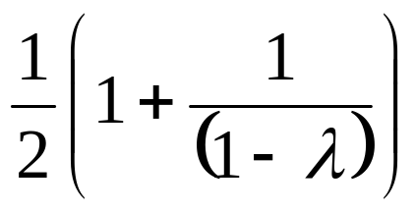
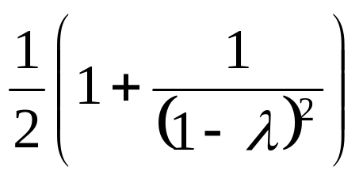
Load Factor in Linear Probing
For any λ < 1, linear probing will find an empty slot
Search cost (assuming simple uniform hashing)
  successful search:
  unsuccessful search:
Performance quickly degrades for λ > 1/2
Notes:
There’s some really nasty math that shows that (because of things like primary clustering), each successful search w/linear probing costs…
That’s 2.5 probes per unsuccessful search for lambda = 0.5.
50.5 comparisons for lambda = 0.9
We don’t want to let lambda get above 1/2 for linear probing.

Slide 28
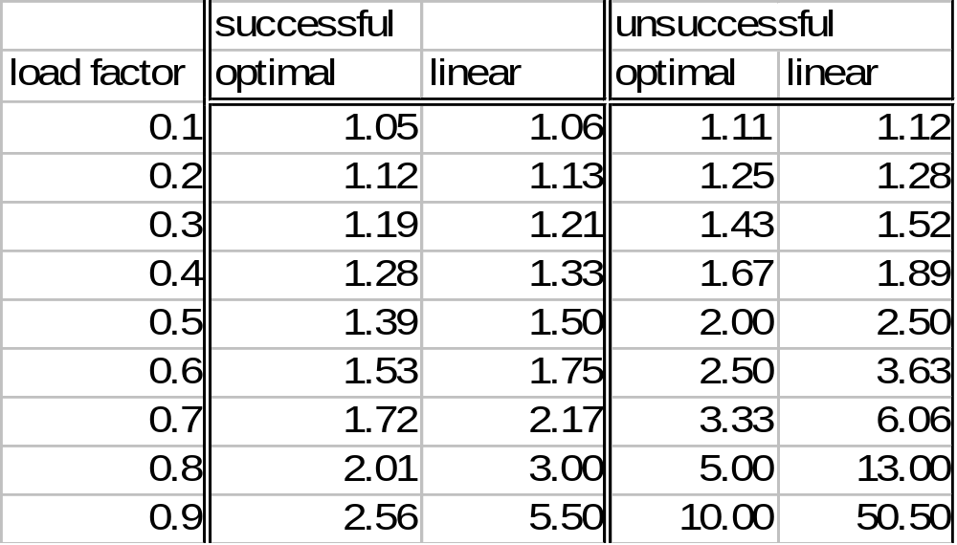
Optimal vs Linear

Slide 29
Closed Hashing II: Quadratic Probing
Main Idea: Spread out the search for an empty slot –
Increment by i² instead of i
h_{i}(X) = (Hash(X) + i²) % TableSize
  h0(X) = Hash(X) % TableSize
  h1(X) = Hash(X) + 1 % TableSize
  h2(X) = Hash(X) + 4 % TableSize
  h3(X) = Hash(X) + 9 % TableSize

Slide 30
Quadratic Probing Example
insert(14)
14%7 = 0
insert(8)
8%7 = 1
insert(21)
21%7 =0
insert(2)
2%7 = 2
0
14
0
14
0
14
0
14
1
1
8
1
8
1
8
2
2
2
2
2
3
3
3
3
4
4
4
21
4
21
5
5
5
5
6
6
6
6
1
1
3
1
probes:
Notes:
You can see that this works pretty well for an empty table and gets worse as the table fills up.
There’s another problem here. If a bunch of elements hash to the same spot, they mess each other up.
But, worse, if a bunch of elements hash to the same area of the table, they mess each other up! (Even though the hash function isn’t producing lots of collisions!)
This phenomenon is called primary clustering.

Slide 31
Problem With Quadratic Probing
insert(14)
14%7 = 0
insert(8)
8%7 = 1
insert(21)
21%7 =0
insert(2)
2%7 = 2
insert(7)
7%7 = 0
0
14
0
14
0
14
0
14
0
14
1
1
8
1
8
1
8
1
8
2
2
2
2
2
2
2
3
3
3
3
3
4
4
4
21
4
21
4
21
5
5
5
5
5
6
6
6
6
6
probes:
1
1
3
1
??
Notes:
You can see that this works pretty well for an empty table and gets worse as the table fills up.
There’s another problem here. If a bunch of elements hash to the same spot, they mess each other up.
But, worse, if a bunch of elements hash to the same area of the table, they mess each other up! (Even though the hash function isn’t producing lots of collisions!)
This phenomenon is called primary clustering.

Slide 32
Load Factor in Quadratic Probing
Theorem: If TableSize is prime and λ ≤ ½, quadratic probing will find an empty slot; for greater λ, might not
With load factors near ½ the expected number of probes is empirically near optimal – no exact analysis known
Don’t get clustering from similar keys (primary clustering), still get clustering from identical keys (secondary clustering)
Notes:
That’s actually pretty close to perfect… but there are two problems.
First, we might fail if the load factor is above 1/2.
Second, quadratic probing still suffers from secondary clustering. That’s where multiple keys hashed to the same spot all follow the same probe sequence.
How can we solve that?

Slide 33
Closed Hashing III: Double Hashing
Idea: Spread out the search for an empty slot by using a second hash function
  No primary or secondary clustering
h_{i}(X) = (Hash₁(X) + iHash₂(X)) mod TableSize
  for i = 0, 1, 2, …
Good choice of Hash₂(X) can guarantee does not get “stuck” as long as λ < 1
  Integer keys:
  Hash₂(X) = R – (X mod R)
  where R is a prime smaller than TableSize

Slide 34
Double Hashing Example
insert(14)
14%7 = 0
insert(8)
8%7 = 1
insert(21)
21%7 =0
5-(21%5)=4
insert(2)
2%7 = 2
insert(7)
7%7 = 0
5-(21%5)=4
0
14
0
14
0
14
0
14
0
14
1
1
8
1
8
1
8
1
8
2
2
2
2
2
2
2
3
3
3
3
3
4
4
4
21
4
21
4
21
5
5
5
5
5
6
6
6
6
6
probes:
1
1
2
1
??
Notes:
You can see that this works pretty well for an empty table and gets worse as the table fills up.
There’s another problem here. If a bunch of elements hash to the same spot, they mess each other up.
But, worse, if a bunch of elements hash to the same area of the table, they mess each other up! (Even though the hash function isn’t producing lots of collisions!)
This phenomenon is called primary clustering.

Slide 35
Double Hashing Example
insert(14)
14%7 = 0
insert(8)
8%7 = 1
insert(21)
21%7 =0
5-(21%5)=4
insert(2)
2%7 = 2
insert(7)
7%7 = 0
5-(21%5)=4
0
14
0
14
0
14
0
14
0
14
1
1
8
1
8
1
8
1
8
2
2
2
2
2
2
2
3
3
3
3
3
4
4
4
21
4
21
4
21
5
5
5
5
5
7
6
6
6
6
6
probes:
1
1
2
1
4
Notes:
You can see that this works pretty well for an empty table and gets worse as the table fills up.
There’s another problem here. If a bunch of elements hash to the same spot, they mess each other up.
But, worse, if a bunch of elements hash to the same area of the table, they mess each other up! (Even though the hash function isn’t producing lots of collisions!)
This phenomenon is called primary clustering.

Slide 36
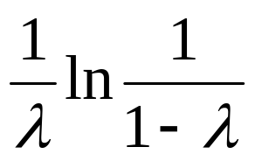
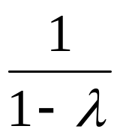
Load Factor in Double Hashing
For any λ < 1, double hashing will find an empty slot (given appropriate table size and hash₂)
Search cost approaches optimal (random re-hash):
  successful search:
  unsuccessful search:
No primary clustering and no secondary clustering
Still becomes costly as λ nears 1.
Note natural logarithm!
Notes:
We can actually calculate things more precisely than this, but let’s not.
Basically, this gets us optimal performance (actually, we _can_ do better).
Quadratic may be a better choice just to avoid the extra hash, however.

Slide 37
Deletion with Separate Chaining
Why is this slide blank?

Slide 38
Deletion in Closed Hashing
delete(2)
find(7)
0
0
0
0
1
1
1
1
Where is it?!
2
2
2
3
7
3
7
4
4
5
5
6
6
What should we do instead?
Notes:
You know, I never mentioned deletion for closed hashing.
What happens if we use normal physical deletion?
If we delete 2 then try to find 7, we can’t!
Fortunately, we can use lazy deletion.
But, we pay the usual penalties. Plus, we can actually run out of space in a hash table!

Slide 39
Lazy Deletion
delete(2)
find(7)
0
0
0
0
Indicates deleted value:
if you find it, probe again
1
1
1
1
2
2
2
#
3
7
3
7
4
4
5
5
6
6
But now what is the problem?
Notes:
You know, I never mentioned deletion for closed hashing.
What happens if we use normal physical deletion?
If we delete 2 then try to find 7, we can’t!
Fortunately, we can use lazy deletion.
But, we pay the usual penalties. Plus, we can actually run out of space in a hash table!

Slide 40

The Squished Pigeon Principle
An insert using Closed Hashing cannot work with a load factor of 1 or more.
  Quadratic probing can fail if λ > ½
  Linear probing and double hashing slow if λ > ½
  Lazy deletion never frees space
Separate chaining becomes slow once λ > 1
  Eventually becomes a linear search of long chains
How can we relieve the pressure on the pigeons?
REHASH!
Notes:
This brings us to what happens when space does get tight.
In other words, how do we handle the squished pigeon principle: it’s hard to fit lots of pigeons into not enough extra holes.
What ever will we do?
Remember what we did for circular arrays and d-Heaps?
Just resize the array, right? But we can’t just copy elements over since their hash values change with the table size.

Slide 41
Rehashing Example
Separate chaining
  h₁(x) = x mod 5 rehashes to h₂(x) = x mod 11
0
1
2
3
4
λ=1
25
37
52
83
98
0
1
2
3
4
5
6
7
8
9
10
λ=5/11
25
37
83
52
98

Slide 42

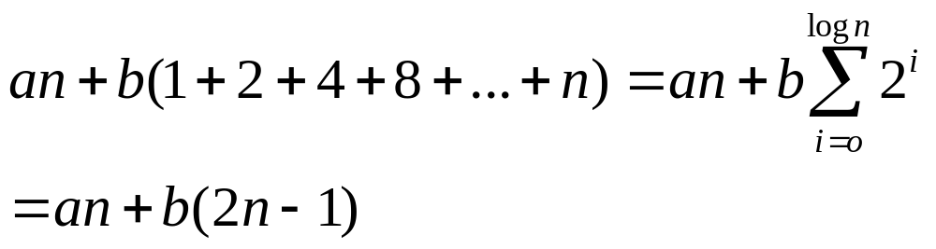
Rehashing Amortized
Analysis
Consider sequence of n operations
  insert(3); insert(19); insert(2); …
What is the max number of rehashes?
What is the total time?
  let’s say a regular hash takes time a, and rehashing an array contain k elements takes time bk.
Amortized time = (an+b(2n-1))/n = O( 1 )
log n

Slide 43
Rehashing without Stretching
Suppose input is a mix of inserts and deletes
  Never more than TableSize/2 active keys
  Rehash when λ=1 (half the table must be deletions)
Worst-case sequence:
  T/2 inserts, T/2 deletes, T/2 inserts, Rehash,
  T/2 deletes, T/2 inserts, Rehash, …
Rehashing at most doubles the amount of work – still O(1)

Slide 44
Case Study
Spelling dictionary
  50,000 words
  static
  arbitrary(ish) preprocessing time
Goals
  fast spell checking
  minimal storage
Practical notes
  almost all searches are successful
  words average about 8 characters in length
  50,000 words at 8 bytes/word is 400K
  pointers are 4 bytes
  there are many regularities in the structure of English words
Why?
Notes:
Alright, let’s move on to the case study.
Here’s the situation.
Why are most searches successful?
Because most words will be spelled correctly.

Slide 45
Solutions
Solutions
  sorted array + binary search
  separate chaining
  open addressing + linear probing

Slide 46
Storage
Assume words are strings and entries are pointers to strings
Array +
binary search
Closed hashing
Separate chaining
…
n pointers
table size + 2n pointers =
n/λ + 2n
n/λ pointers
Notes:
Notice that all of these use the same amount of memory for the strings.
How many pointers does each one use?
N for array. Just store a pointer to each string.
n (pointer to each string) + n/lambda (null pointer ending each list). Note, I’m playing a little game here; without an optimization, this would actually be 2n + n/lambda.
N/lambda.

Slide 47
Analysis
50K words, 4 bytes @ pointer
Binary search
  storage: n pointers + words = 200K+400K = 600K
  time: log₂n ≤ 16 probes per access, worst case
Separate chaining - with λ = 1
  storage: n/λ + 2n pointers + words = 200K+400K+400K = 1GB
  time: 1 + λ/2 probes per access on average = 1.5
Closed hashing - with λ = 0.5
  storage: n/λ pointers + words = 400K + 400K = 800K
  time: probes per access on average = 1.5
Notes:
The answer, of course, is it depends!
However, given that we want fast checking, either hash table is better than the BST.
And, given that we want low memory usage, we should use the closed hash table.
Can anyone argue for the binary search?

Slide 48
Approximate Hashing
Suppose we want to reduce the space requirements for a spelling checker, by accepting the risk of once in a while overlooking a misspelled word
Ideas?

Slide 49
Approximate Hashing
Strategy:
  Do not store keys, just a bit indicating cell is in use
  Keep λ low so that it is unlikely that a misspelled word hashes to a cell that is in use

Slide 50
Example
50,000 English words
Table of 500,000 cells, each 1 bit
  8 bits per byte
Total memory: 500K/8 = 62.5 K
  versus 800 K separate chaining, 600 K open addressing
Correctly spelled words will always hash to a used cell
What is probability a misspelled word hashes to a used cell?

Slide 51
Rough Error Calculation
Suppose hash function is optimal - hash is a random number
Load factor λ ≤ 0.1
  Lower if several correctly spelled words hash to the same cell
So probability that a misspelled word hashes to a used cell is ≤ 10%

Slide 52
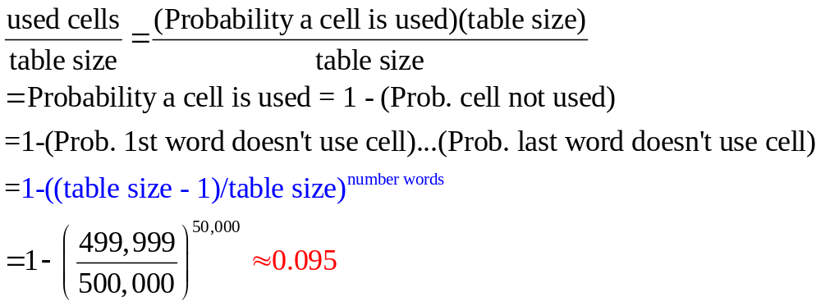
Exact Error Calculation
What is expected load factor?

Slide 53
A Random Hash…
Extensible hashing
  Hash tables for disk-based databases – minimizes number disk accesses
Minimal perfect hash function
  Hash a given set of n keys into a table of size n with no collisions
  Might have to search large space of parameterized hash functions to find
  Application: compilers
One way hash functions
  Used in cryptography
  Hard (intractable) to invert: given just the hash value, recover the key

Slide 54
Puzzler
Suppose you have a HUGE hash table, that you often need to re-initialize to “empty”. How can you do this in small constant time, regardless of the size of the table?

Slide 55
Databases
A database is a set of records, each a tuple of values
  E.g.: [ name, ss#, dept., salary ]
How can we speed up queries that ask for all employees in a given department?
How can we speed up queries that ask for all employees whose salary falls in a given range?

