Slide 1
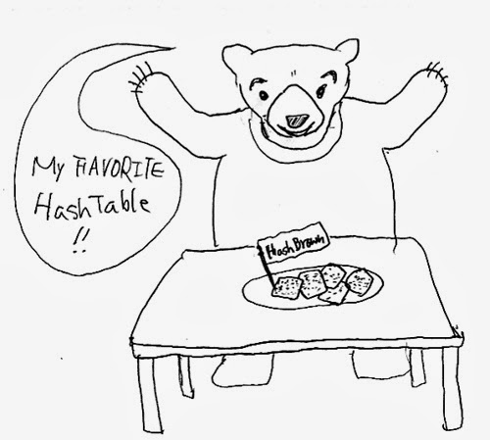
[HashTables]
In this data structure we are going to describe several ways of storing information in an array, and later searching for the information.
Hash Tables are a common approach to the storing/searching problem.
This presentation introduces hash tables.
Data Structures
Teacher : Dr. E Khanjari
Notes:
This lecture illustrates hash tables, using open addressing.
Before this lecture, students should have seen other forms of a Dictionary, where a collection of data is stored, and each data item has a key associated with it.

Slide 2
What is a Hash Table ?
The simplest kind of hash table is an array of records.
This example has 701 records.
[ 0 ]
[ 1 ]
[ 2 ]
[ 3 ]
[ 4 ]
[ 5 ]
[ 700]
. . .
An array of records
Data Structures | hash tables
Notes:
This lecture introduces hash tables, which are an array-based method for implementing a Dictionary. You should recall that we have seen dictionaries implemented in other ways, for example with a binary search tree. The abstract properties of a dictionary remain the same: We can insert items in the dictionary, and each item has a key associated with it. When we want to retrieve an item, we specify only the key, and the retrieval process finds the associated data.
What we do now is use an array to implement the dictionary. The array is an array of records. In this example, we could store up to 701 records in the array.

Slide 3
What is a Hash Table ?
[ 4 ]
Number 506643548
Each record has a special field, called its key.
In this example, the key is a long integer field called Number.
[ 0 ]
[ 1 ]
[ 2 ]
[ 3 ]
[ 4 ]
[ 5 ]
[ 700]
. . .
Data Structures | hash tables
Notes:
Each record in the array contains two parts. The first part is a number that we'll use for the key of the item. We could use something else for the keys, such as a string. But for a hash table, numbers make the most convenient keys.

Slide 4

What is a Hash Table ?
[ 4 ]
Number 506643548
The number might be a person's identification number, and the rest of the record has information about the person.
[ 0 ]
[ 1 ]
[ 2 ]
[ 3 ]
[ 4 ]
[ 5 ]
[ 700]
. . .
Data Structures | hash tables
Notes:
The numbers might be identification numbers of some sort, and the rest of the record contains information about a person. So the pattern that you see here is the same pattern that you've seen in other dictionaries: Each entry in the dictionary has a key (in this case an identifying number) and some associated data.

Slide 5



What is a Hash Table ?
When a hash table is in use, some spots contain valid records, and other spots are "empty".
[ 0 ]
[ 1 ]
[ 2 ]
[ 3 ]
[ 4 ]
[ 5 ]
[ 700]
Number 281942902
Number 233667136
Number 506643548
. . .
Number 155778322
Data Structures | hash tables
Notes:
When a hash table is being used as a dictionary, some of the array locations are in use, and other spots are "empty", waiting for a new entry to come along.
Oftentimes, the empty spots are identified by a special key. For example, if all our identification numbers are positive, then we could use 0 as the Number that indicates an empty spot.
With this drawing, locations [0], [4], [6], and maybe some others would all have Number=0.

Slide 6
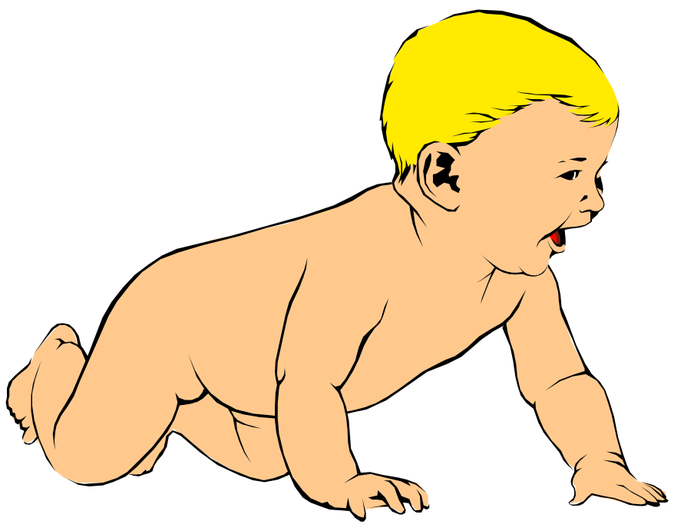
Inserting a New Record
Number 580625685
In order to insert a new record, the key must somehow be converted to an array index.
The index is called the hash value of the key.
[ 0 ]
[ 1 ]
[ 2 ]
[ 3 ]
[ 4 ]
[ 5 ]
[ 700]
Number 281942902
Number 233667136
Number 506643548
. . .
Number 155778322
Data Structures | hash tables
Notes:
In order to insert a new entry, the key of the entry must somehow be converted to an index in the array. For our example, we must convert the key number into an index between 0 and 700. The conversion process is called hashing and the index is called the hash value of the key.

Slide 7
Inserting a New Record
Number 580625685
Typical way create a hash value:
(Number mod 701)
What is (580625685 mod 701) ?
[ 0 ]
[ 1 ]
[ 2 ]
[ 3 ]
[ 4 ]
[ 5 ]
[ 700]
Number 281942902
Number 233667136
Number 506643548
. . .
Number 155778322
Data Structures | hash tables
Notes:
There are many ways to create hash values. Here is a typical approach.
a. Take the key mod 701 (which could be anywhere from 0 to 700).
So, quick, what is (580,625,685 mod 701) ?

Slide 8
Inserting a New Record
Number 580625685
Typical way to create a hash value:
(Number mod 701)
3
What is (580625685 mod 701) ?
[ 0 ]
[ 1 ]
[ 2 ]
[ 3 ]
[ 4 ]
[ 5 ]
[ 700]
Number 281942902
Number 233667136
Number 506643548
. . .
Number 155778322
Data Structures | hash tables
Notes:
Three.

Slide 9
Inserting a New Record
Number 580625685
The hash value is used for the location of the new record.
[3]
[ 0 ]
[ 1 ]
[ 2 ]
[ 3 ]
[ 4 ]
[ 5 ]
[ 700]
Number 281942902
Number 233667136
Number 506643548
. . .
Number 155778322
Data Structures | hash tables
Notes:
So, this new item will be placed at location [3] of the array.

Slide 10
Inserting a New Record
The hash value is used for the location of the new record.
[ 0 ]
[ 1 ]
[ 2 ]
[ 3 ]
[ 4 ]
[ 5 ]
[ 700]
Number 281942902
Number 233667136
Number 580625685
Number 506643548
. . .
Number 155778322
Data Structures | hash tables
Notes:
The hash value is always used to find the location for the record.

Slide 11

Collisions
Number 701466868
Here is another new record to insert, with a hash value of 2.
My hash
value is [2].
[ 0 ]
[ 1 ]
[ 2 ]
[ 3 ]
[ 4 ]
[ 5 ]
[ 700]
Number 281942902
Number 233667136
Number 580625685
Number 506643548
. . .
Number 155778322
Data Structures | hash tables
Notes:
Sometimes, two different records might end up with the same hash value.

Slide 12

Collisions
Number 701466868
This is called a collision, because there is already another valid record at [2].
When a collision occurs,
move forward until you
find an empty spot.
[ 0 ]
[ 1 ]
[ 2 ]
[ 3 ]
[ 4 ]
[ 5 ]
[ 700]
Number 281942902
Number 233667136
Number 580625685
Number 506643548
. . .
Number 155778322
Data Structures | hash tables
Notes:
This is called a collision.
When a collision occurs, the insertion process will move forward through the array until an empty spot is found. Sometimes you will have a second collision...

Slide 13
Collisions
Number 701466868
This is called a collision, because there is already another valid record at [2].
When a collision occurs,
move forward until you
find an empty spot.
[ 0 ]
[ 1 ]
[ 2 ]
[ 3 ]
[ 4 ]
[ 5 ]
[ 700]
Number 281942902
Number 233667136
Number 580625685
Number 506643548
. . .
Number 155778322
Data Structures | hash tables
Notes:
...and a third collision...

Slide 14
Collisions
Number 701466868
This is called a collision, because there is already another valid record at [2].
When a collision occurs,
move forward until you
find an empty spot.
[ 0 ]
[ 1 ]
[ 2 ]
[ 3 ]
[ 4 ]
[ 5 ]
[ 700]
Number 281942902
Number 233667136
Number 580625685
Number 506643548
. . .
Number 155778322
Data Structures | hash tables
Notes:
But if there are any empty spots, eventually you will reach an empty spot, and the new item is inserted here.

Slide 15
Collisions
This is called a collision, because there is already another valid record at [2].
The new record goes
in the empty spot.
[ 0 ]
[ 1 ]
[ 2 ]
[ 3 ]
[ 4 ]
[ 5 ]
[ 700]
Number 281942902
Number 233667136
Number 580625685
Number 506643548
Number 701466868
. . .
Number 155778322
Data Structures | hash tables
Notes:
The new record is always placed in the first available empty spot, after the hash value.

Slide 16

A Quiz
Where would you be placed in this table, if there is no collision? Use your social security number or some other favorite number.
[ 0 ]
[ 1 ]
[ 2 ]
[ 3 ]
[ 4 ]
[ 5 ]
[ 700]
Number 281942902
Number 233667136
Number 580625685
Number 506643548
Number 701466868
. . .
Number 155778322
Data Structures | hash tables
Notes:
Time for another quiz . . . Did anyone end up with a hash value of 700?
Well, I did. My ID number is 155779023, which has a hash value of 700. (No, not really, but I needed to illustrate another kind of collision.
There is a collision with the last location of the array. In this case, you would circle back to the start of the array, and try location number 0, then 1, .... until you find an empty spot. In this example, I would be inserted at location 0, since that location is empty.

Slide 17
Searching for a Key
Number 701466868
The data that's attached to a key can be found fairly quickly.
[ 0 ]
[ 1 ]
[ 2 ]
[ 3 ]
[ 4 ]
[ 5 ]
[ 700]
Number 281942902
Number 233667136
Number 580625685
Number 506643548
Number 701466868
. . .
Number 155778322
Data Structures | hash tables
Notes:
It is fairly easy to search for a particular item based on its key.

Slide 18
Searching for a Key
Number 701466868
Calculate the hash value.
Check that location of the array for the key.
My hash
value is [2].
Not me.
[ 0 ]
[ 1 ]
[ 2 ]
[ 3 ]
[ 4 ]
[ 5 ]
[ 700]
Number 281942902
Number 233667136
Number 580625685
Number 506643548
Number 701466868
. . .
Number 155778322
Data Structures | hash tables
Notes:
Start by computing the hash value, which is 2 in this case. Then check location 2. If location 2 has a different key than the one you are looking for, then move forward...

Slide 19
Searching for a Key
Number 701466868
Keep moving forward until you find the key, or you reach an empty spot.
My hash
value is [2].
Not me.
[ 0 ]
[ 1 ]
[ 2 ]
[ 3 ]
[ 4 ]
[ 5 ]
[ 700]
Number 281942902
Number 233667136
Number 580625685
Number 506643548
Number 701466868
. . .
Number 155778322
Data Structures | hash tables
Notes:
...if the next location is not the one we are looking for, then keep moving forward...

Slide 20
Searching for a Key
Number 701466868
Keep moving forward until you find the key, or you reach an empty spot.
My hash
value is [2].
Not me.
[ 0 ]
[ 1 ]
[ 2 ]
[ 3 ]
[ 4 ]
[ 5 ]
[ 700]
Number 281942902
Number 233667136
Number 580625685
Number 506643548
Number 701466868
. . .
Number 155778322
Data Structures | hash tables
Notes:
Keep moving forward until you find the sought-after key...

Slide 21
Searching for a Key
Number 701466868
Keep moving forward until you find the key, or you reach an empty spot.
My hash
value is [2].
Yes!
[ 0 ]
[ 1 ]
[ 2 ]
[ 3 ]
[ 4 ]
[ 5 ]
[ 700]
Number 281942902
Number 233667136
Number 580625685
Number 506643548
Number 701466868
. . .
Number 155778322
Data Structures | hash tables
Notes:
In this case we find the key at location [5].

Slide 22
Searching for a Key
Number 701466868
When the item is found, the information can be copied to the necessary location.
My hash
value is [2].
Yes!
[ 0 ]
[ 1 ]
[ 2 ]
[ 3 ]
[ 4 ]
[ 5 ]
[ 700]
Number 281942902
Number 233667136
Number 580625685
Number 506643548
Number 701466868
. . .
Number 155778322
Data Structures | hash tables
Notes:
The data from location [5] can then be copied to to provide the result of the search function.
What happens if a search reaches an empty spot? In that case, it can
halt and indicate that the key was not in the hash table.

Slide 23
Deleting a Record
Records may also be deleted from a hash table.
Please
delete me.
[ 0 ]
[ 1 ]
[ 2 ]
[ 3 ]
[ 4 ]
[ 5 ]
[ 700]
Number 281942902
Number 233667136
Number 580625685
Number 506643548
Number 701466868
. . .
Number 155778322
Data Structures | hash tables
Notes:
Records can be deleted from a hash table...

Slide 24
Deleting a Record
Records may also be deleted from a hash table.
But the location must not be left as an ordinary "empty spot" since that could interfere with searches.
[ 0 ]
[ 1 ]
[ 2 ]
[ 3 ]
[ 4 ]
[ 5 ]
[ 700]
Number 281942902
Number 233667136
Number 580625685
Number 701466868
. . .
Number 155778322
Data Structures | hash tables
Notes:
But the spot of the deleted record cannot be left as an ordinary empty spot, since that would interfere with searches. (Remember that a search can stop when it reaches an empty spot.)

Slide 25
Deleting a Record
Records may also be deleted from a hash table.
But the location must not be left as an ordinary "empty spot" since that could interfere with searches.
The location must be marked in some special way so that a search can tell that the spot used to have something in it.
[ 0 ]
[ 1 ]
[ 2 ]
[ 3 ]
[ 4 ]
[ 5 ]
[ 700]
Number 281942902
Number 233667136
Number 580625685
Number 701466868
. . .
Number 155778322
Data Structures | hash tables
Notes:
Instead we must somehow mark the location as "a location that used to have something here, but no longer does."
We might do this by using some other special value for the Number field of the record.
In any case, a search can not stop when it reaches "a location that used to have something here". A search can only stop when it reaches a true empty spot.

Slide 26
Drink Some Psudo Code
table = array of some size
h = some hash function
function add(key, val):
index = h(key)
table[index].append(key, val)
function get(key):
index = h(key)
for (k, v) in table[index]:
if k = key:
return v
error(“key not found”)
O(1)
depends on the size of the bucket!
Data Structures | hash tables

Slide 27
Hash Table Illustrated
array of “buckets” with (key, val) pairs:
hash function:
h(key) = key % 7
B00472885
David Laidlaw
B00231924
Luke Fiorante
0
1
2
3
4
5
6
keys:
Banner ID #
B00239625
Leah Steinberg
B00943855
B00238494
B00943855
Patrick Maiden
B00238494
Sarah Parker
B00472885
B00745911
Marley Rafson
B00543163
Surbhi Madan
Data Structures | hash tables

Slide 28
Summary
Hash tables store a collection of records with keys.
The location of a record depends on the hash value of the record's key.
When a collision occurs, the next available location is used.
Searching for a particular key is generally quick.
When an item is deleted, the location must be marked in a special way, so that the searches know that the spot used to be used.
Data Structures | hash tables
Notes:
A quick summary . . .

Slide 29

THE END
This presentation is created to illustrate how hash tables coordinate data and concentrates
On the time and space complexity of this data structure .
Thanks for your attention and remember that
you CAN present complex data clearly!
Arash Khajelou | January 2016
Data structures class
IUST
Data Structures | hash tables
Notes:
Feel free to send your ideas to:
Michael Main
main@colorado.edu

