Slide 1
Serialization
Programming II
Narendra Pershad

Slide 2
What is Serialization?
Is the process of converting an object into a stream of bytes to store or transmit
The data members of the object and the name of the class, including the assembly containing the class, is converted to a stream of bytes, which is then written to a data stream.
It is the only way to persistent an object.
When the object is subsequently de-serialized, an exact clone of the original object is created.
Can be used for deep copy of an object (Shallow copy is provided by .NET)
Serialization is not part of C# language but part of the .NET Framework

Slide 3
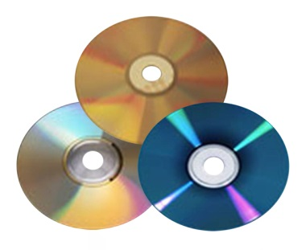

Why serialize?
To save an object to memory/disk
To send an object to another application

Slide 4
Methods of serialization
Manual
Lots of work
You have to handle each member yourself in the writing and reading process
Not portable
You decide what will be stored
Binary
Very efficient in speed and memory
Not humanly-readable (good/bad?)
Useful socket-based network streams

Slide 5
Methods of serialization
Soap
Open standard
Does extra work so that the result encoding follows the required standard
Xml
Readable, but verbose, open standard
Must have a public parameter-less constructor
Json
Readable and compact, open standard
Most used of all the methods

Slide 6
What is serialized?
To serialize a type it must be decorated with the SerializableAttribute
The fields, the object's type, such as its version, culture, and assembly name are all serialized
If you don’t want a field to be serialize, apply the NotSerializedAttribute attribute to that member

Slide 7
Json
{
"Name":"Leopard gecko",
"Number":3,
"Healthy":true
}
Plain Text
Leopard gecko
3
true
Xml
<Lizard>
<Name>Leopard gecko</Name>
<Number>3</Number>
<Healthy>true</Healthy>
</Lizard>

Slide 8
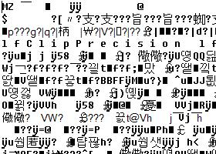
Binary
Serializer provided by .Net
Fast and efficient
Truest replication

Slide 9

Xml
Industry specification
Readable
Requires a parameter-less constructor
Data members have to public
You can choose which members to persist

Slide 10

json
Industry specification
Readable
Also requires a parameter-less constructor
The fields/properties must have public writable access
Less verbose than xml
Easier to code than xml

Slide 11
Xml Serialization
Add the necessary namespace
using System.Xml.Serialization;
Create and initialise a serializer object
XmlSerializer serializer = new XmlSerializer(typeof(Student));
(You will also need a writable stream such as a TextWriter)
TextWriter writer = new StreamWriter(filename);
Use the Serialize method to serialize the object
serializer.Serialize(writer, student);

Slide 12
Xml De-Serialization
Add the necessary namespace
using System.Xml.Serialization;
Create and initialise a serializer object
XmlSerializer serializer = new XmlSerializer(typeof(Student));
(You will also need a readable stream such as a TextReader)
TextReader reader = new StreamReader(filename);
Use the Deserialize method to de-serialize the object
Student student = (Student)serializer.Deserialize(reader);
Console.WriteLine(student);

Slide 13
Json Serialization
Add the necessary reference
System.Web.Extensions
Add the necessary namespace
using System.Web.Script.Serialization;
Create and initialise a serializer object
JavaScriptSerializer serializer = new JavaScriptSerializer();
(You will also need a writable stream such as a TextWriter)
TextWriter writer = new StreamWriter(filename);
Use the Serialize method to serialize the object. The method returns a string that is normally written to a file
writer.Write(serializer.Serialize(«object»));

Slide 14
Json Deserialization
Add the necessary reference
System.Web.Extensions
Add the necessary namespace
using System.Web.Script.Serialization;
Create and initialise a serializer object
JavaScriptSerializer serializer = new JavaScriptSerializer());
(You will also need the source of the serialized data normally contents from a file)
TextReader reader = new StreamReader(filename);
Use the Deserialize method to serialize the object. The method returns an object
Lizard lizard = serializer.Deserialize<Lizard>(reader.ReadToEnd()));

Slide 15
Summary
Serialization allows you to convert an object into a byte stream
The results can be stored to persist the object
Of transmitted
The most popular method is to use the JavaScriptSerializer

