Slide 1
Timeseries + NLP
What can we learn about a person from years of writing?

Slide 2
Questions
What can we learn about a person from their writing?
What psychological characterics stand out?
What linguistic characterics stand out?
What psychological patterns are interesting?
What linguistic patterns are interesting?

Slide 3
Datasets
Problem: No datasets available for longitudinal text analysis
Solution: Collect our own.
1 blog
~39k posts spanning 17 years
~212mb of content in posts/*txt files
~10mb of metadata in scrape_index.json
~40 hours learning + writing + debugging a custom crawler/scraper
~12 hrs crawling time
Notes:
Hard time finding datasets for longitudinal text analysis.
So we collected our own - about 39 thousand single-author blog posts spanning 17 years. Some of the stats here.

Slide 4
Data Prep Pipeline
Clean Transform Extract Derive Integrate Normalize
… in varying orders
LIWC (NLP + Psych Model)
Linguistic Feature Extract + Derive Psych Features
liwc_features.csv
posts/*txt
Integrate
psych_features.csv
Integrate Derive Normalize … continued
Blog
Transform + Clean
posts_meta.csv
...
scrape_index.json
Integrate
posts.csv
Extract+ Transform+ Clean
posts/*txt
Linguistic Feature Extract + Derive
linguistic_features.json
spaCy (NLP model)
Notes:
Getting those posts into a usable format involved many steps, files, and iterations. The result was two CSVs containing linguistic and psych features.

Slide 5
Tools
Coord: Github, Trello, Slack, Zoom Writing: Google Docs, Slides, VPN Scraping: Puppeteer (Chromium), CSS, Chrome Dev Tools, Node.js, custom JS
Cleaning / Integration: Funcy, Pandas, Custom Python
Normalizing: Pandas + sklearn Feature Extraction: spaCy (NLP model) and LIWC2015 (Psych + NLP Model) Classification: LIWC (Linguistic Inquiry and Word Count) Dimension reduction: LIWC, pandas, sklearn Vis: Pandas, Seaborn, Matplotlib
Notes:
Tools for those transformations, and everything else in the project, included these. I’m sure you used many of the same.

Slide 6
Techniques: Adam
All those in the data pipeline. Plus:
Dimensionality Reduction: Manual removal
Dimensionality Reduction: Subsets by LIWC class, year, month
Visualization
Clustering: Automated - Sklearn OPTICS
Correlation Analysis
Correlation Change Analysis
Notes:
We did analysis separately due to scheduling constraints. Techniques I appliedincluded:

Slide 7
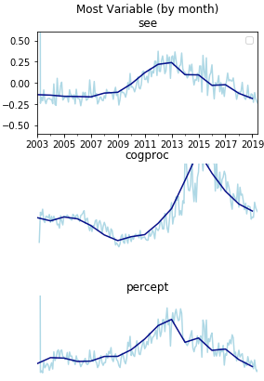
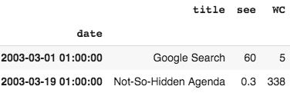
Results: Adam
Correlation Analysis (Meh. Plotting dimensions is more useful.) Correlation Change Analysis (Ditto) More cleaning needed. Especially contextual outlier handling for scenarios like few-word-posts in few-post-months.
More Variable
(Sensory Category)
(Word Count)
All March Posts
More outlier!
Notes:
Correlation tables’ low info density make them unhelpful.
One thing that stood out in all results was a need for further contextual cleaning.
Here March 1’s post has 5 words. LIWC categorizes 3 as visual/sensory. 60% spike!
It was easier to find spikes like that with visualization.

Slide 8
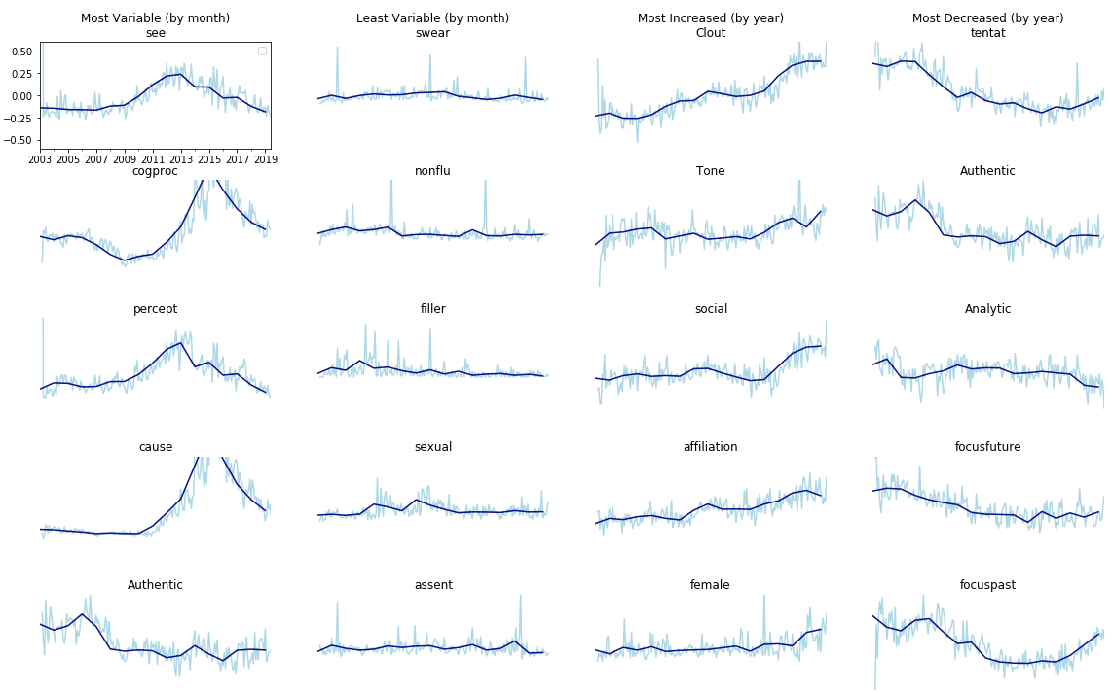
Results: Adam
Infinite ways to slice and visualize. Simple FTW. Manual clustering + vis by year + month. Measurement ranges matter. Month increase/decrease == Year variability.
Notes:
Here each each row is the top 5 of ~70 dimensions. Each column sorts them differently. Interesting spike in causality references (correlated with cogproc)
Clout increased. Authenticity (down right) decreased. Time focus (two bottom) decreased. Tentativeness (top) decreased, which makes sense after 17 years of blogging. These are individual dimensions. Clustering and visualizing them is also useful.

Slide 9
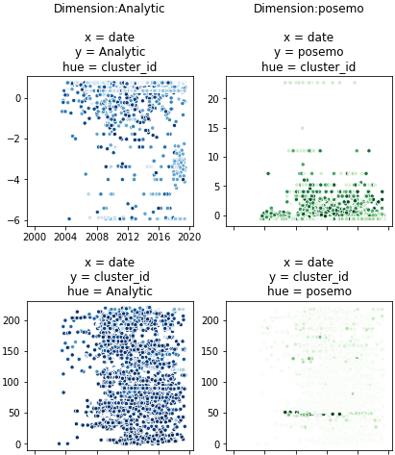
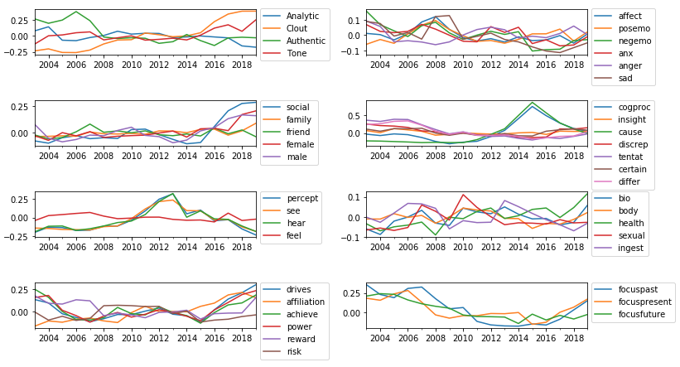
Results: Adam
Clustering: Automated - Sklearn OPTICS - 210 clusters - 90% of data points non-clustered - Unclear clustering results - Unclear vis from many clusters + dims
Manual dimensionality reduction (by LIWC group, grouped by year)
Notes:
Plotting manual clusters yielded the best results. On the left are correlations within LIWC category clusters.
Automated clustering with OPTICS yields ambiguously useful results. Trying different params, algorithms, and visualizations may help. On the right are two dimensions visualized in two ways, swapping color and y axis - neither are intuitive. Next I’d try clustering on fewer dimensions, or a biclustering algorithm, until I find clusters that make sense. Or re-read the book chaper.

Slide 10
Techniques: Henry
Read the data through python pandas, archive the article data of the author for about 40 years, and calculate the emotional value for each article, using the library VADER( VADER (Valence Aware Dictionary and sEntiment Reasoner) is a lexicon and rule-based sentiment analysis tool that is specifically attuned to sentiments expressed in social media, and works well on texts from other domains.), after getting the emotion of each article. By re-sampling the entire data in the monthly dimension, it was found that the author's article was positive for most of the time and the author's frequency of publication was very high, so he was inferred to be a positive and diligent person.

Slide 11
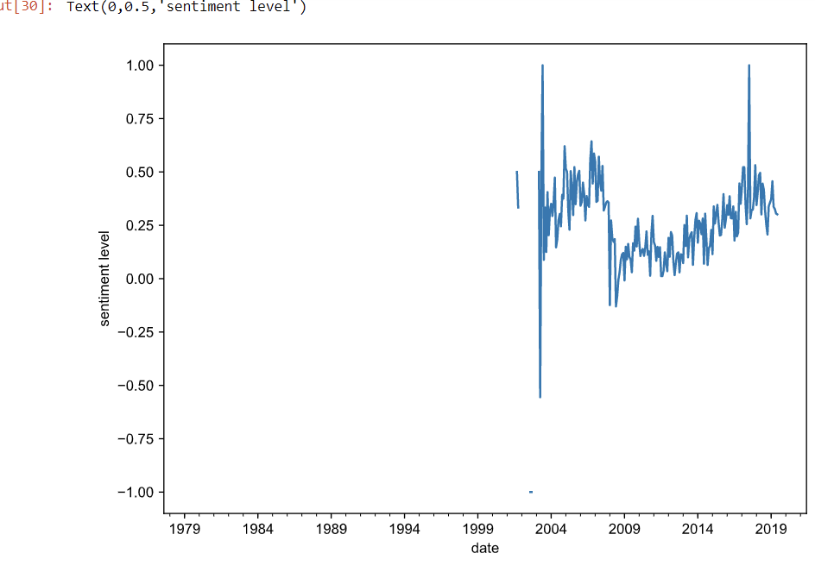
Results: Henry
The data shows the author's article was positive for most of the time. So we can think of him as an positive person. At the same time, statistics are made on the author's writing style. Almost all of the author's articles use a lot of scientific data to support their views. Using data to prove the correctness of one's point of view has almost become the author's main rhetorical and writing characteristics. In addition, the author has added pictures or videos to almost all of his articles to help readers understand the views they want to make. Combining articles and pictures to express one's point of view is also a great writing feature of the author.

Slide 12
Techniques: Kyle
For my analysis I decided to look at if the author of these blog posts is overall a positive or negative person based on what he writes about. LIWC provides us with two statistics pertaining to this: negative and positive emotion words. So, I read in the data using a pandas dataframe and took the average of many different categories that LIWC provided. However, the easiest to clearly see was the positive and negative emotion words.

Slide 13
Results: Kyle
After taking the averages of many columns in the dataframe, I ended up analyzing the positive and negative emotion words. His negative emotion average was 1.48 and his positive emotion average was 2.67, almost double the negative emotion average. This leads me to believe the author is a more positive person overall.

Slide 14
Applications
We can use our results to make assumptions about the author of these blog posts. Using VADAR and analyzing the positive and negative words we can conclude that he is mostly a positive person. There are countless other applications using Timeseries and NLP, such as analyzing the author’s psychological and linguistic characteristics.

Slide 15
Thanks for Watching!
https://github.com/a-laughlin/data-mining-group
Adam Laughlin Computer Science University of Colorado Boulder adam.laughlin@colorado.edu
Jiaheng Zhao Computer Science University of Colorado Boulder jizh3194@colorado.com
Kyle Bremont Computer Science University of Colorado Boulder kyle.bremont@colorado.edu

