Slide 1
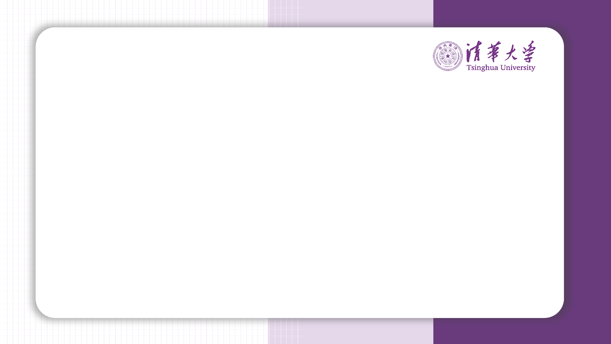
Can we teach the model twice?
严绍波 王翼飞

Slide 2
Experiment Setting
As a project manager for a company, you have finetuned GPT-2 to meet Demand #1. Now, your boss has assigned you Demand #2, and you need to decide which approach will be more effective:
Finetune the original GPT-2 model again for Demand #2.
Finetune the previously finetuned model (from Demand #1) on Demand #2.

Slide 3
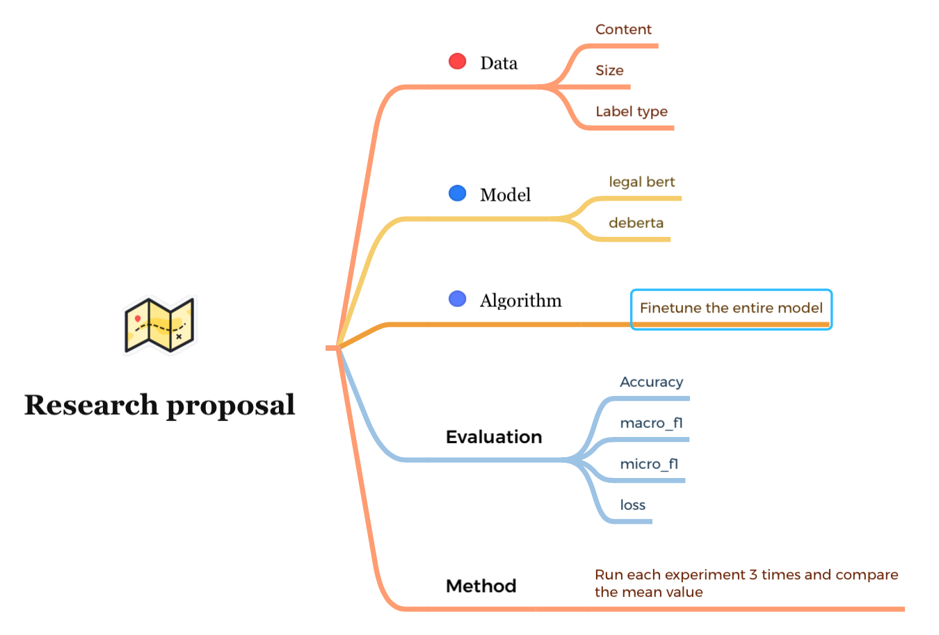
Notes:
这是针对这个问题的一些brain storm。我们考虑的是怎么样在不同应用下使用语言模型更经济这个问题。不同应用场景对应的就是data和model的不同。这里每项列举了几个可能因素。然后结合实际应用。我们在finetune整个模型时更倾向于考虑不同操作的经济性。所以我这里主要就是考虑finetune全模型。

Slide 4
Questions
Finetune A after finetuning B v.s. finetune A directly (or the other way around)
Small dataset v.s. huge dataset
Model with expert knowledge v.s. general large language model
Same label v.s. different label
Relevant dataset v.s. irrelevant dataset
Notes:
所以我们有了这些问题，下面的实验就是针对这些问题一一回答

Slide 5
Conclusion
We did a thorough research on how to finetune LLMs under different circumstances. We found that:
When having datasets of similar sizes, it is more efficient for us to use a tuned model rather than the original model.
When we want to tune the model on an rather large dataset, we’d better start from the original model
The final performance depends on whether the two tasks are relevant or not.
Label type and model type doesn’t affect the result.
We should select the model that fits our tasks best.
Theoretically speaking, a finetuned model provides a better initialization for us, thus helping us adapt to new tasks faster and better. (This needs to be further explored)

Slide 6
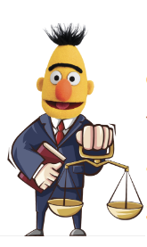
Model
LEGAL-BERT is a family of BERT models for the legal domain, intended to assist legal NLP research, computational law, and legal technology applications.
To pre-train the different variations of LEGAL-BERT, we collected 12 GB of diverse English legal text from several fields (e.g., legislation, court cases, contracts) scraped from publicly available resources.
DeBERTa improves the BERT and RoBERTa models using disentangled attention and enhanced mask decoder. With those two improvements, DeBERTa out perform RoBERTa on a majority of NLU tasks with 80GB training data.

Slide 7
Datasets
Ledgar
LEDGAR dataset aims contract provision (paragraph) classification. The contract provisions come from contracts obtained from the US Securities and Exchange Commission (SEC) filings, which are publicly available from EDGAR. Each label represents the single main topic (theme) of the corresponding contract provision.
Scotus
The US Supreme Court (SCOTUS) is the highest federal court in the United States of America and generally hears only the most controversial or otherwise complex cases which have not been sufficiently well solved by lower courts. This is a single-label multi-class classification task, where given a document (court opinion), the task is to predict the relevant issue areas. The 14 issue areas cluster 278 issues whose focus is on the subject matter of the controversy (dispute).
Notes:
dataset都是classification 民商法刑法国际法宪法行政法都有

Slide 8
Datasets
ledgar
{
"text": "All Taxes shall be the financial responsibility of the party obligated to pay such Taxes as determined by applicable law and neither party is or shall be liable at any time for any of the other party ...","label": 32
}
Scotus
{
"text": "Per Curiam\nSUPREME COURT OF THE UNITED STATES\nRANDY WHITE, WARDEN v. ROGER L. WHEELER\n Decided December 14, 2015\nPER CURIAM.\nA death sentence imposed by a Kentucky trial court and\naffirmed by the ...",
"label": 8
}

Slide 9
Code Availability
Our code can be found at this github repository.
We adapted our code from the example code of the Transformers library.
We also used the helper functions provides by huggingface Datasets and PEFT library.
Our visualized results can be found in our Wandb account.

Slide 10
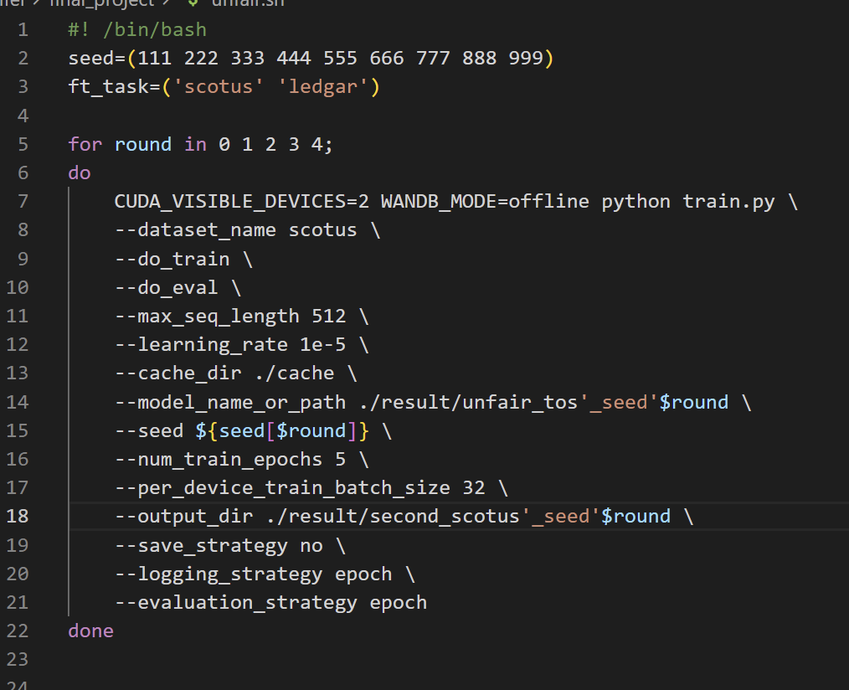
Training Details

Slide 11
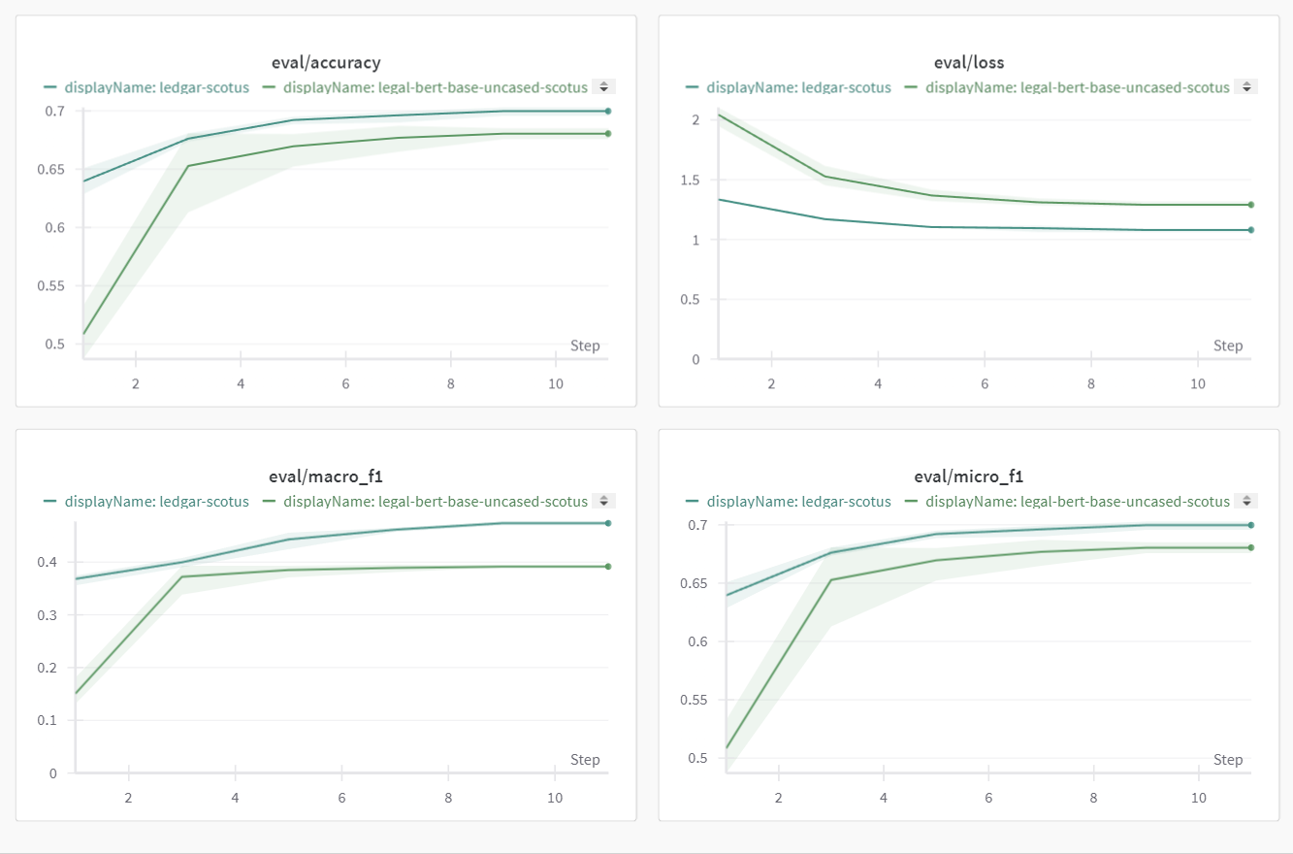
Finetune A after finetuning B v.s. Finetune A directly

Slide 12
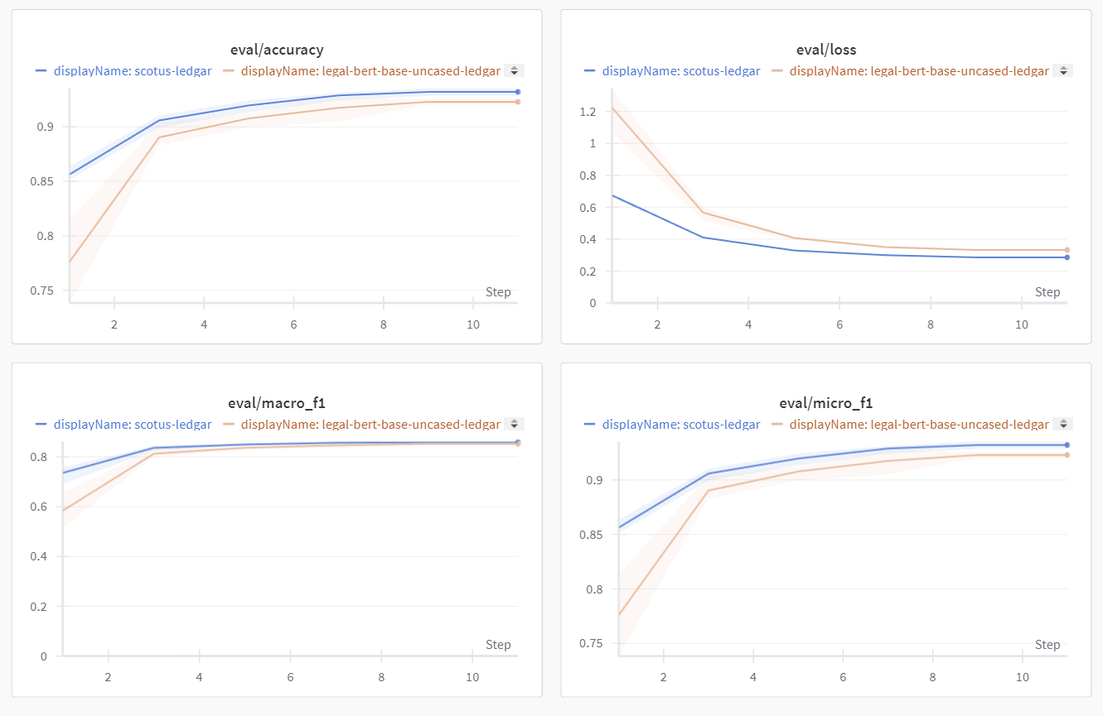
Finetune A after finetuning B v.s. Finetune A directly
Notes:
两点发现：初始accuracy更高，loss更低。最终performance也会有少量变优

Slide 13
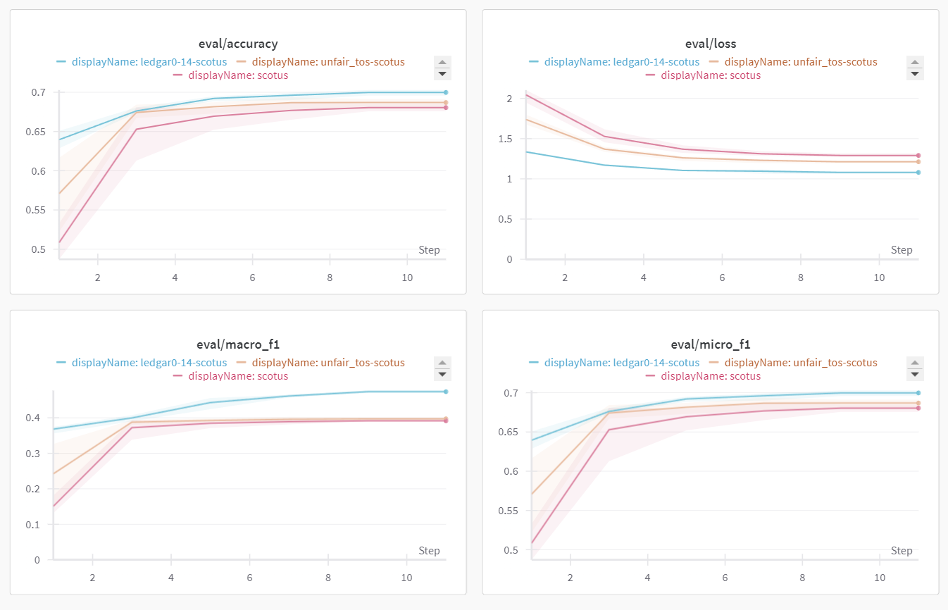
Relevant v.s. Irrelevant
unfair_tos:The UNFAIR-ToS dataset contains 50 Terms of Service (ToS) from on-line platforms (e.g., YouTube, Ebay, Facebook, etc.). The dataset has been annotated on the sentence-level with 8 types of unfair contractual terms (sentences), meaning terms that potentially violate user rights according to the European consumer law.
Notes:
但是我们之前的结论对于两个相差悬殊的数据集而言便不成立了。

Slide 14
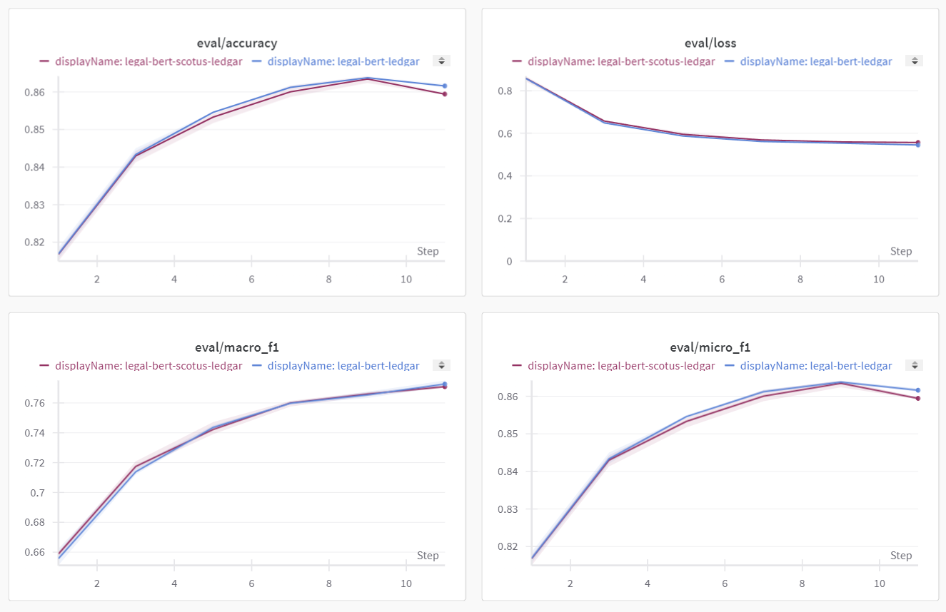
Small dataset v.s. Huge dataset
Notes:
这种现象当数据集体量相差过大时消失了，性能甚至会有略微下降

Slide 15
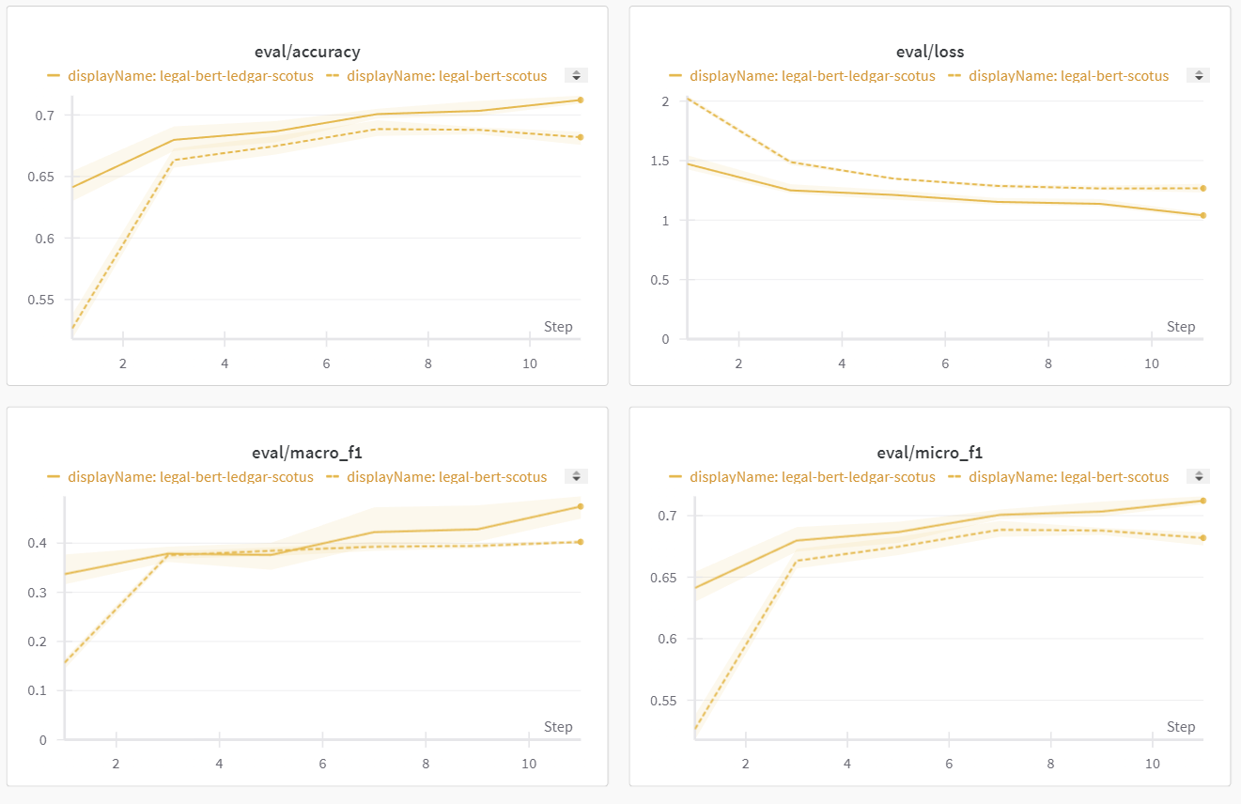
The other way around
Notes:
反过来，如果在large dataset上训练，再在小数据集上finetune，仍会有提升效果

Slide 16
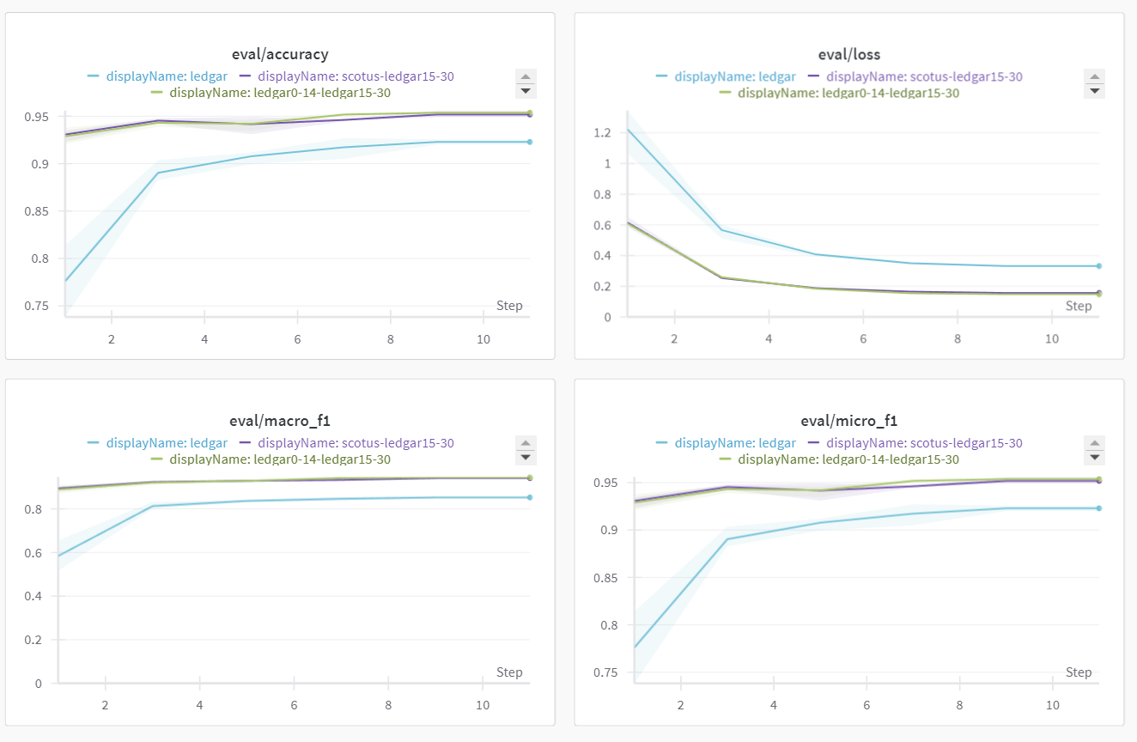
Same label v.s. Different label

Slide 17
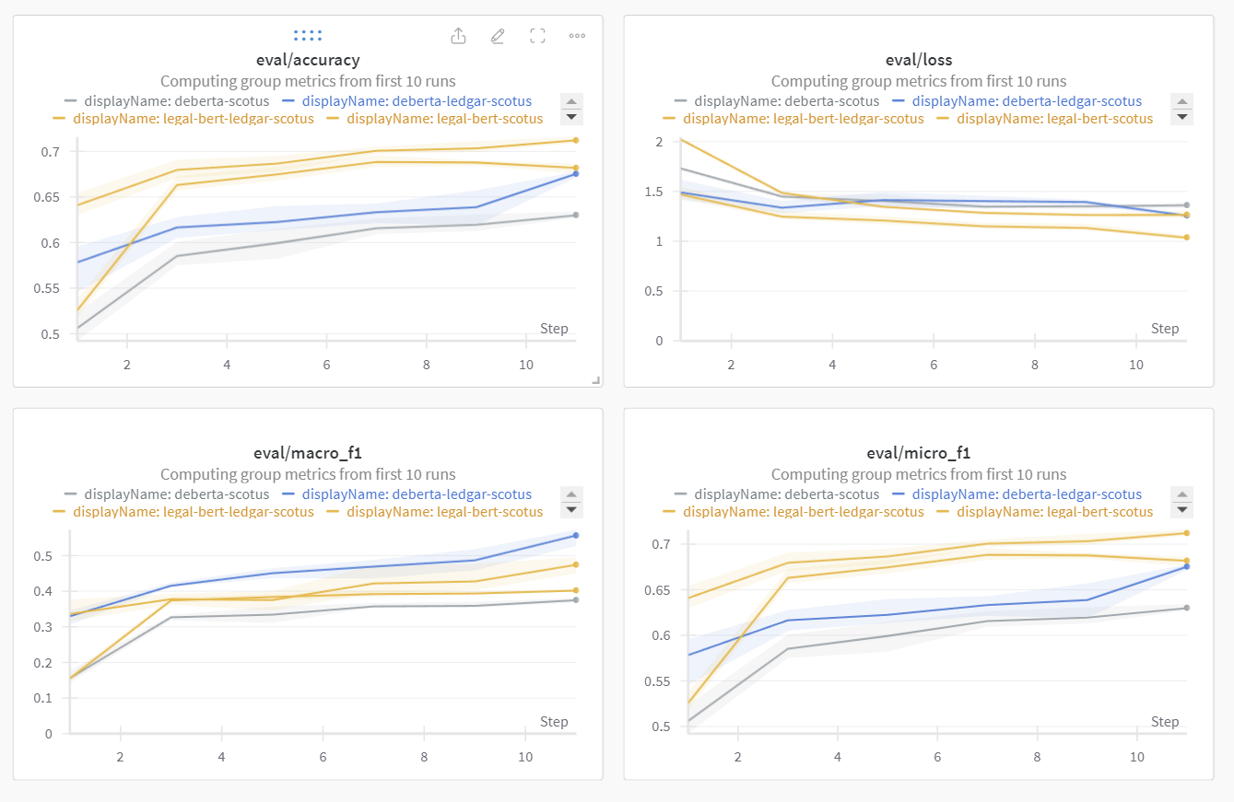
Model with expert knowledge v.s. General large language model
Notes:
对比legal bert和deberta

Slide 18
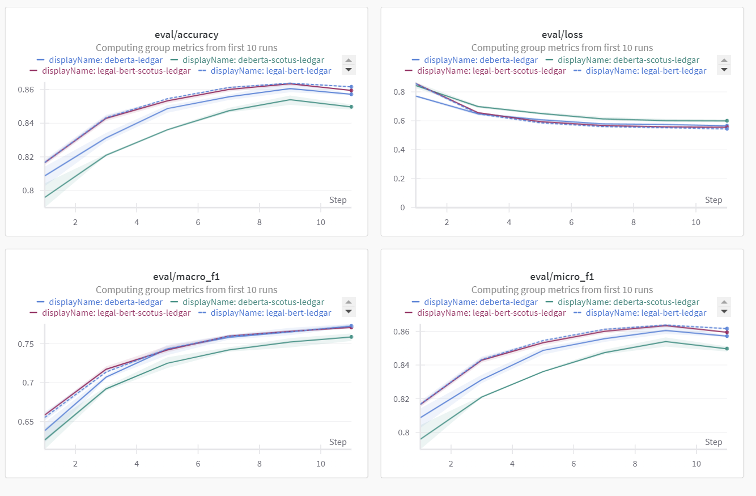
Model with expert knowledge v.s. General large language model

Slide 19
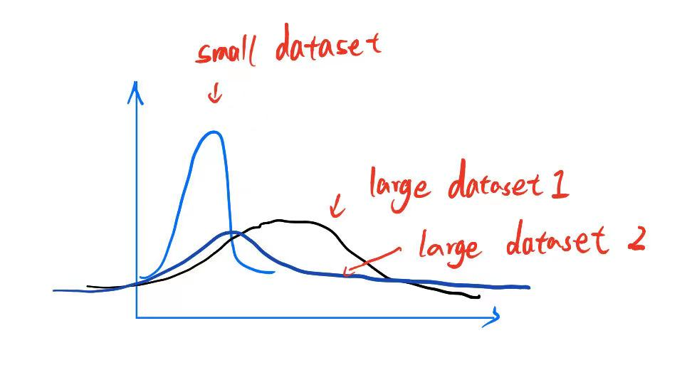
Some Guesses
Using a tuned model give us a good initializaion
Model that tuned on a small dataset makes the initial distribution peak

Slide 20
Thanks！

