Slide 1

Model-View高级
QT6 QML 开发教程
第6章

Slide 2
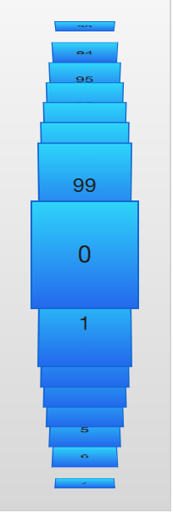
PathView
使用PathView时，必须定义代理和路径。除此之外，还可以通过一系列属性自定义PathView本身。最常见的是pathItemCount，它控制一次可见项目的数量。
path属性需要一个Path元素来定义代理在滚动PathView时所遵循的路径。
PathView {
anchors.fill: parent
model: 100
delegate: flipCardDelegate
path: Path {
startX: root.width / 2 ; startY: 0
PathAttribute { name: "itemZ"; value: 0 }
PathAttribute { name: "itemAngle"; value: -90.0; }
PathAttribute { name: "itemScale"; value: 0.5; }
PathLine { x: root.width / 2; y: root.height * 0.4; }
PathPercent { value: 0.48; }
PathLine { x: root.width / 2; y: root.height * 0.5; }
PathAttribute { name: "itemAngle"; value: 0.0; }
PathAttribute { name: "itemScale"; value: 1.0; }
PathAttribute { name: "itemZ"; value: 100 }
PathLine { x: root.width / 2; y: root.height * 0.6; }
PathPercent { value: 0.52; }
PathLine { x: root.width / 2; y: root.height; }
PathAttribute { name: "itemAngle"; value: 90.0; }
PathAttribute { name: "itemScale"; value: 0.5; }
PathAttribute { name: "itemZ"; value: 0 }
}
pathItemCount: 16
preferredHighlightBegin: 0.5
preferredHighlightEnd: 0.5
}
这些属性设置视图中高亮显示（当前项）的首选范围。首选值必须在0到1的范围内。

Slide 3
Component {
id: flipCardDelegate
BlueBox {
id: wrapper
required property int index
property real rotX: PathView.itemAngle
visible: PathView.onPath
width: 64; height: 64
scale: PathView.itemScale
z: PathView.itemZ
antialiasing: true
gradient: Gradient {
GradientStop { position: 0.0; color: "#2ed5fa" }
GradientStop { position: 1.0; color: "#2467ec" }
}
transform: Rotation {
axis { x: 1; y: 0; z: 0 }
angle: wrapper.rotX
origin { x: 32; y: 32; }
}
text: wrapper.index
}
}

Slide 4
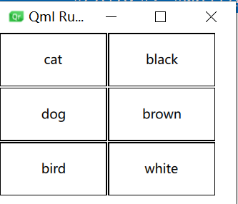
TableModel
TableModel类型将JavaScript/JSON对象存储为可与TableView一起使用的表模型的数据。支持非常简单的模型，而不需要在C++中创建自定义QAbstractTableModel子类。
import QtQuick
import Qt.labs.qmlmodels
TableView {
width: 220
anchors.fill: parent
columnSpacing: 1
rowSpacing: 1
clip: true model: TableModel {
TableModelColumn { display: "name" }
TableModelColumn { display: "color" } rows: [
{
"name": "cat",
"color": "black"
},
{
"name": "dog",
"color": "brown"
},
{
"name": "bird",
"color": "white"
}
]
}
delegate: Rectangle {
implicitWidth: 100
implicitHeight: 50
border.width: 1 Text {
text: display
anchors.centerIn: parent
}
}
}
模型中的每个列都是通过声明TableModelColumn实例来指定的，其中每个实例的顺序决定了其列索引。
如果是布局的子项，布局将使用其隐式大小确定项的大小。在这种情况下，将忽略显式大小。

Slide 5
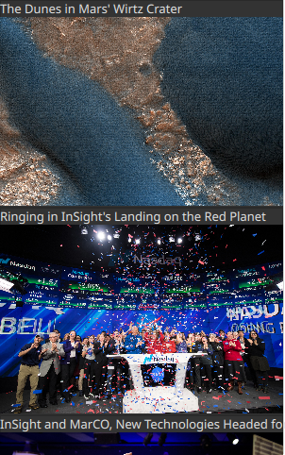
XmlListModel
QML提供了XmlListModel元素，可以在本地或远程获取XML数据。
下面的示例演示了从RSS流获取图像。source属性引用HTTP上的远程位置，数据将自动下载。
XmlListModel {
id: imageModel
source: "https://www.nasa.gov/rss/dyn/image_of_the_day.rss"
query: "/rss/channel/item"
XmlListModelRole { name: "title"; elementName: "title" }
XmlListModelRole { name: "imageSource"; elementName: "enclosure"; attributeName: "url"; }
}
ListView {
id: listView
anchors.fill: parent
model: imageModel
delegate: imageDelegate
}
Component {
id: imageDelegate
Box {
id: wrapper
required property string title
required property string imageSource
width: listView.width ； height: 220
color: '#333’
Column {
Text {
text: wrapper.title
color: '#e0e0e0’
}
Image {
width: listView.width; height: 200
fillMode: Image.PreserveAspectCrop
source: wrapper.imageSource
}
}
}
}

Slide 6
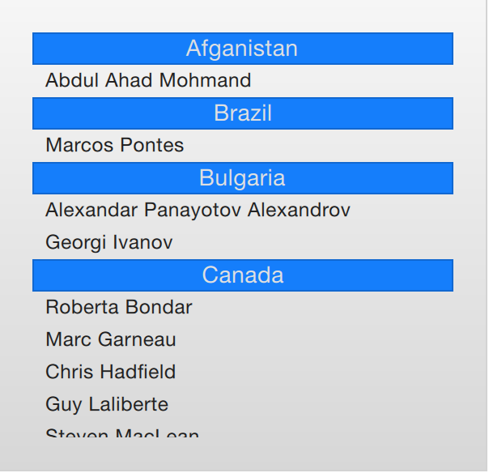
分段显示列表
使用ListView可以将平面列表划分为多个类别，从而为体验提供更多深度。
ListView {
anchors.fill: parent
anchors.margins: 20
clip: true
model: spaceMen
delegate: spaceManDelegate
section.property: "nation"
section.delegate: sectionDelegate
}
Component {
id: spaceManDelegate
Item {
id: spaceManWrapper
required property string name
width: ListView.view.width; height: 20
Text {
anchors.left: parent.left
anchors.verticalCenter: parent.verticalCenter
anchors.leftMargin: 8
font.pixelSize: 12
text: spaceManWrapper.name
color: '#1f1f1f’
}
}
}
Component {
id: sectionDelegate
BlueBox {
id: sectionWrapper
required property string section
width: ListView.view ? ListView.view.width : 0
height: 20
text: sectionWrapper.section
fontColor: '#e0e0e0’
}
}
section.property定义用于将内容划分的属性。必须对模型进行排序，以便每个部分都由连续的元素组成，否则，相同的属性名称可能会出现在多个位置。

Slide 7
ListModel {
id: spaceMen
ListElement { name: "Abdul Ahad Mohmand"; nation: "Afganistan"; }
ListElement { name: "Marcos Pontes"; nation: "Brazil"; }
ListElement { name: "Alexandar Panayotov Alexandrov"; nation: "Bulgaria"; }
ListElement { name: "Georgi Ivanov"; nation: "Bulgaria"; }
ListElement { name: "Roberta Bondar"; nation: "Canada"; }
ListElement { name: "Marc Garneau"; nation: "Canada"; }
ListElement { name: "Chris Hadfield"; nation: "Canada"; }
ListElement { name: "Guy Laliberte"; nation: "Canada"; }
ListElement { name: "Steven MacLean"; nation: "Canada"; }
ListElement { name: "Julie Payette"; nation: "Canada"; }
ListElement { name: "Robert Thirsk"; nation: "Canada"; }
ListElement { name: "Bjarni Tryggvason"; nation: "Canada"; }
ListElement { name: "Dafydd Williams"; nation: "Canada"; }
}

Slide 8
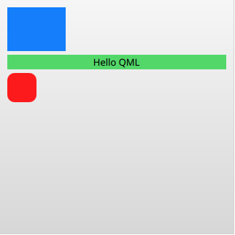
ObjectModel
ObjectModel与其他模型不同，因为它允许你将实际的视觉元素放入模型中。这样，视图就不需要任何代理。
import QtQuick
import QtQml.Models
Rectangle {
width: 320 ; height: 320
gradient: Gradient {
GradientStop { position: 0.0; color: "#f6f6f6" }
GradientStop { position: 1.0; color: "#d7d7d7" }
}
ObjectModel {
id: itemModel
Rectangle { height: 60; width: 80; color: "#157efb" }
Rectangle {
height: 20; width: 300; color: "#53d769"
Text { anchors.centerIn: parent; color: "black"; text: "Hello QML" }
}
Rectangle { height: 40; width: 40; radius: 10; color: "#fc1a1c" }
}
ListView {
anchors.fill: parent
anchors.margins: 10
spacing: 5
model: itemModel
}
}

Slide 9
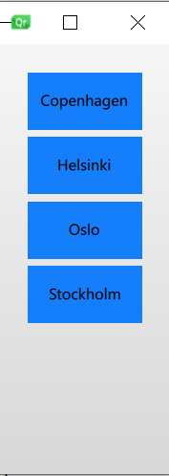
Model中添加Action
ListElement类型支持Javascript函数与属性的绑定。这意味着可以将函数放入模型中。
ListModel {
id: actionModel
ListElement {
name: "Copenhagen"
hello: function(value) { console.log(value + ": You clicked Copenhagen!"); }
}
ListElement {
name: "Helsinki"
hello: function(value) { console.log(value + ": Helsinki here!"); }
}
ListElement {
name: "Oslo"
hello: function(value) { console.log(value + ": Hei Hei fra Oslo!"); }
}
ListElement {
name: "Stockholm"
hello: function(value) { console.log(value + ": Stockholm calling!"); }
}
}
qml: 1: Helsinki here!
qml: 0: You clicked Copenhagen!
qml: 2: Hei Hei fra Oslo!
qml: 2: Hei Hei fra Oslo!
qml: 0: You clicked Copenhagen!
qml: 1: Helsinki here!
qml: 2: Hei Hei fra Oslo!
qml: 3: Stockholm calling!
ListView {
… …
delegate: Rectangle {
id: delegate
required property int index
required property string name
required property var hello
… …
MouseArea {
anchors.fill: parent
onClicked: delegate.hello(delegate.index)
}
}
}

