Slide 1

粒子特效
QT6 QML 开发教程
第9章

Slide 2

一个简单的粒子特效
Qt Quick使得粒子渲染入门变得非常简单。为此，我们需要：
将所有元素绑定到ParticleSystem
粒子发射（Emitter）
ParticlePainter派生元素，用于可视化粒子
import QtQuick
import QtQuick.Particles
Rectangle {
id: root
width: 480; height: 160
color: "#1f1f1f"
ParticleSystem { id: particleSystem }
Emitter {
id: emitter
anchors.centerIn: parent
width: 160; height: 80
system: particleSystem
emitRate: 10
lifeSpan: 1000
lifeSpanVariation: 500
size: 16
endSize: 32
Tracer { color: 'green’ }
}
ImageParticle {
source: "assets/particle.png"
system: particleSystem
}
}

Slide 3
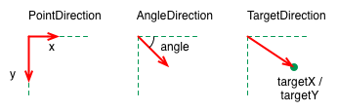
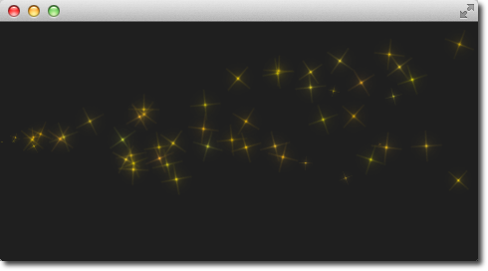
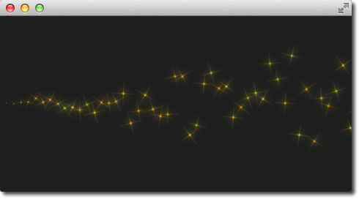
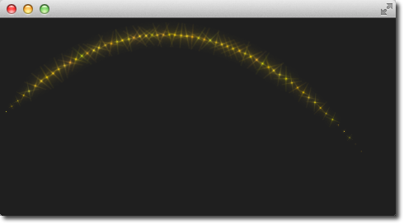
粒子方向
粒子也可以有轨迹。轨迹取决于粒子的速度(velocity)、加速度、向量空间
有三种不同的向量空间：
PointDirection
AngleDirection
TargetDirection
Emitter {
id: emitter
anchors.left: parent.left
anchors.verticalCenter: parent.verticalCenter
width: 1; height: 1
system: particleSystem
lifeSpan: 6400
lifeSpanVariation: 400
size: 32
velocity: AngleDirection {
angle: 0
angleVariation: 15
magnitude: 100
magnitudeVariation: 50
}
}
velocity: PointDirection {
x: 100
y: 0
xVariation: 0
yVariation: 100/6
}
velocity: TargetDirection {
targetX: 100
targetY: 0
targetVariation: 100/6
magnitude: 100
}
Emitter {
……
velocity: AngleDirection {
angle: -45
angleVariation: 0
magnitude: 100
}
acceleration: AngleDirection {
angle: 90
magnitude: 25
}
}

Slide 4
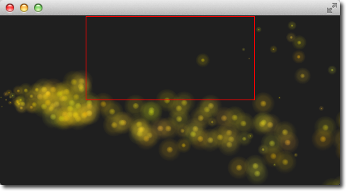
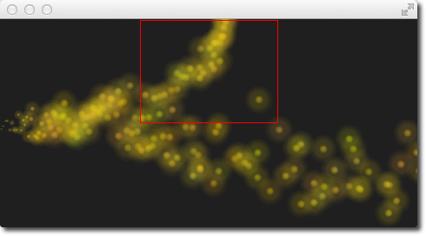
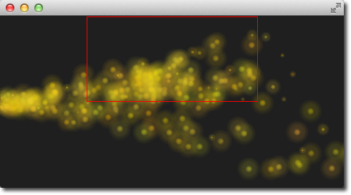
粒子影响器
粒子发射后，发射器无法再对其进行更改。
粒子发射后需要通过影响器进行控制，影响器有以下类型：
Age：改变粒子在其生命周期中的位置
Attractor：将粒子吸引到特定点
Friction：减慢与粒子当前速度成比例的运动
Gravity：是一个角度的加速度
Turbulence：基于噪波图像的类似流体的力
Wander：随机改变轨迹
GroupGoal：更改粒子组的状态
SpriteGoal：更改精灵粒子的状态
Age {
anchors.horizontalCenter: parent.horizontalCenter
width: 240; height: 120
system: particleSystem
advancePosition: true
lifeLeft: 1200
once: true
Tracer {}
}
Attractor {
anchors.horizontalCenter: parent.horizontalCenter
width: 160; height: 120
system: particleSystem
pointX: 0
pointY: 0
strength: 1.0
Tracer {}
}
Friction {
anchors.horizontalCenter: parent.horizontalCenter
width: 240; height: 120
system: particleSystem
factor : 0.8
threshold: 25
Tracer {}
}

Slide 5
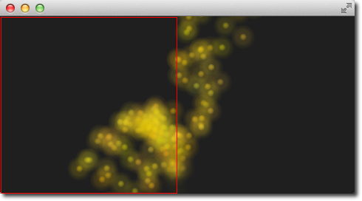
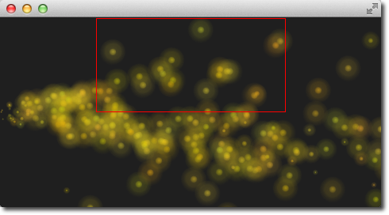
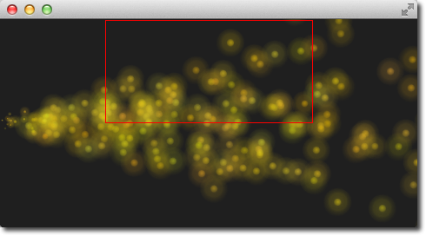
Gravity {
width: 240; height: 240
system: particleSystem
magnitude: 50
angle: 90
Tracer {}
}
Turbulence {
anchors.horizontalCenter: parent.horizontalCenter
width: 240; height: 120
system: particleSystem
strength: 100
Tracer {}
}
Wander {
anchors.horizontalCenter: parent.horizontalCenter
width: 240; height: 120
system: particleSystem
affectedParameter: Wander.Position
pace: 200
yVariance: 240
Tracer {}
}

Slide 6
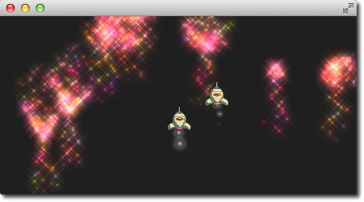
粒子分组
粒子默认情况下是分在空组（“”）。使用GroupGoal影响器可以让粒子更改组。
使用groups属性来声明粒子所属的组。
Emitter {
id: rocketEmitter
anchors.bottom: parent.bottom
width: parent.width; height: 40
system: particleSystem
group: 'rocket’
emitRate: 2
maximumEmitted: 4
lifeSpan: 4800
lifeSpanVariation: 400
size: 32
velocity: AngleDirection { angle: 270; magnitude: 150; magnitudeVariation: 10 }
acceleration: AngleDirection { angle: 90; magnitude: 50 }
Tracer { color: 'red'; visible: root.tracer }
}
ImageParticle {
id: smokePainter
system: particleSystem
groups: ['smoke’]
source: "assets/particle.png"
alpha: 0.3
entryEffect: ImageParticle.None
}
ImageParticle {
id: rocketPainter
system: particleSystem
groups: ['rocket’]
source: "assets/rocket.png"
entryEffect: ImageParticle.None
}

Slide 7
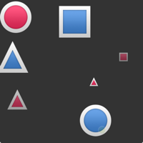
ItemParticle
ItemParticle是基于delegate的。可用于将QML Item作为粒子。为此，需要为粒子指定自己的代理。
ItemParticle {
id: particle
system: particleSystem
delegate: itemDelegate
}
在本例中，delegate是一个随机图像，并使用随机大小。
Component {
id: itemDelegate
Item {
id: container
width: 32 * Math.ceil(Math.random() * 3)
height: width
Image {
anchors.fill: parent
anchors.margins: 4
source: 'assets/' + root.images[Math.floor(Math.random() * 9)]
}
}
}

