Slide 1
Business Analytics Project
Magno Alessandro 4478234

Slide 2
Introduction
Focus: Process and Data Mining activity
Data: Aulaweb logs 2019-2020-2021
Aim: interpret student learning behavior through raw data

Slide 3
Preprocessing
  Cleaning data
  After got the following variables:
    Time
    User
    Action
    Information
  Filter the actions performed by students that can affect their performace (Quiz, Forum, Assignment)

Slide 4
Time Analysis
Aggregated results related to time spent to working:
  Time theory
  Time quiz
  Time forum
  Time assignment
These results must be considered as approximations

Slide 5
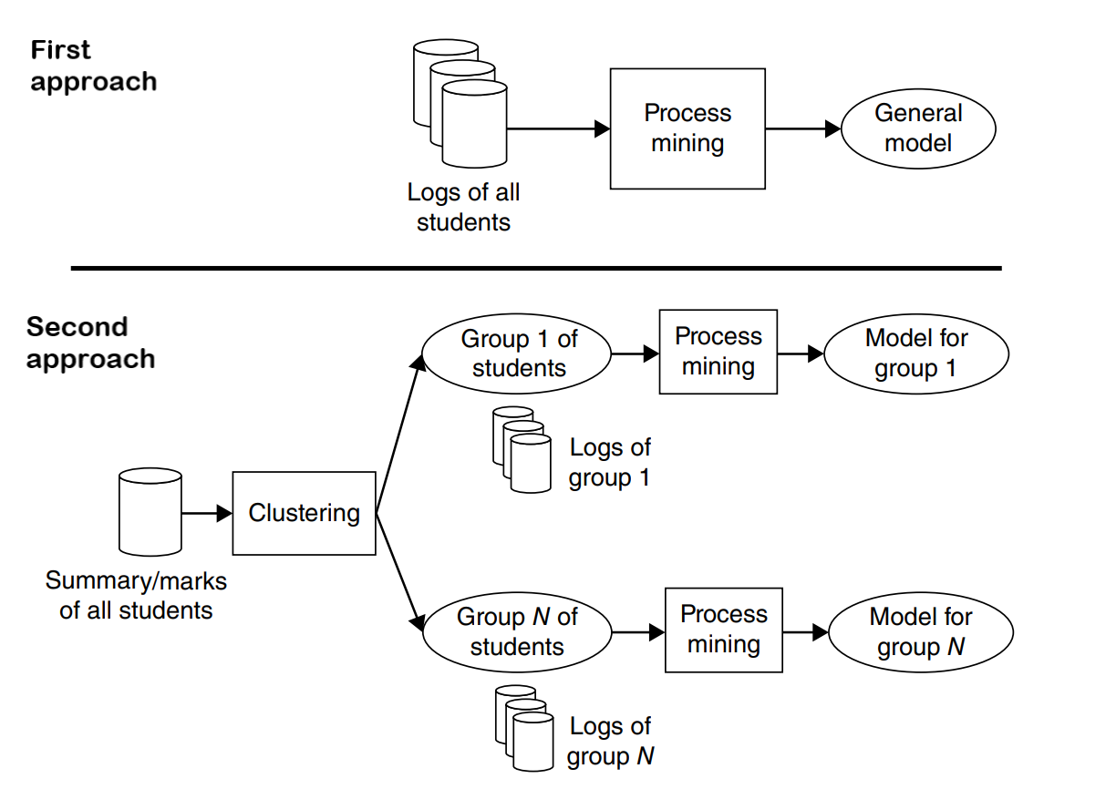
Approaches to generate the models

Slide 6
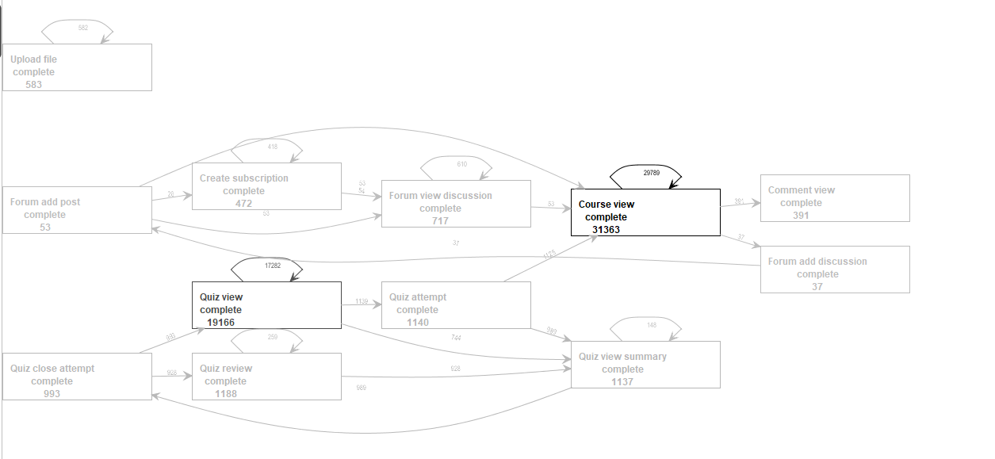
Results
Heuristic Network log 2020 (all students)

Slide 7
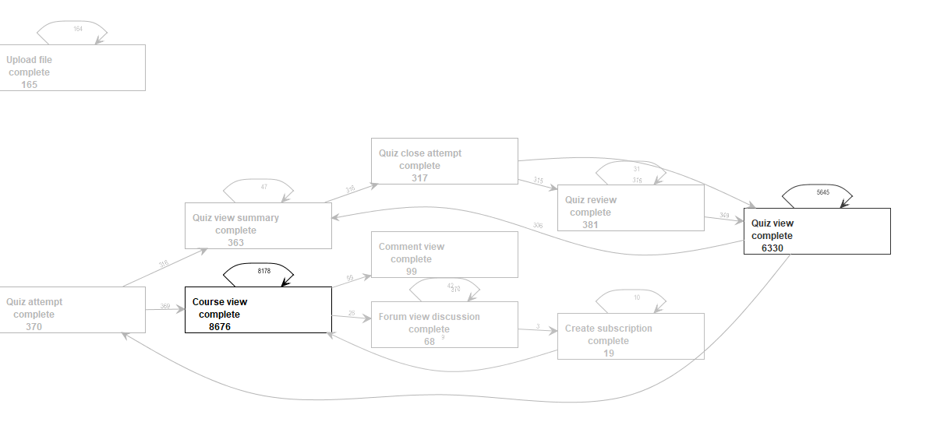
Results
Cluster of students who probably passed the exam

Slide 8
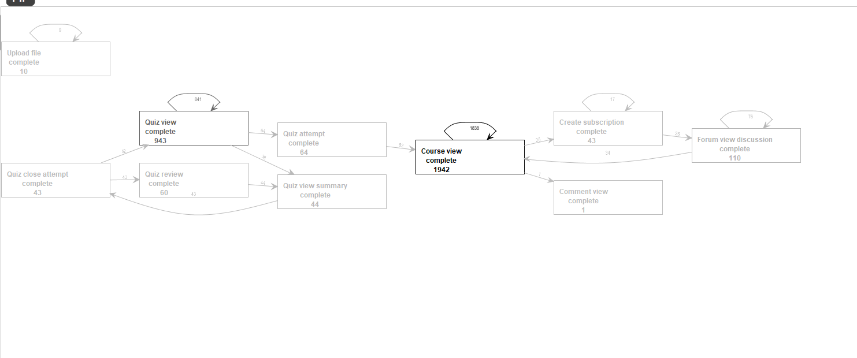
Results
Cluster of students who probably did not pass or passed it with low grades

