Slide 1
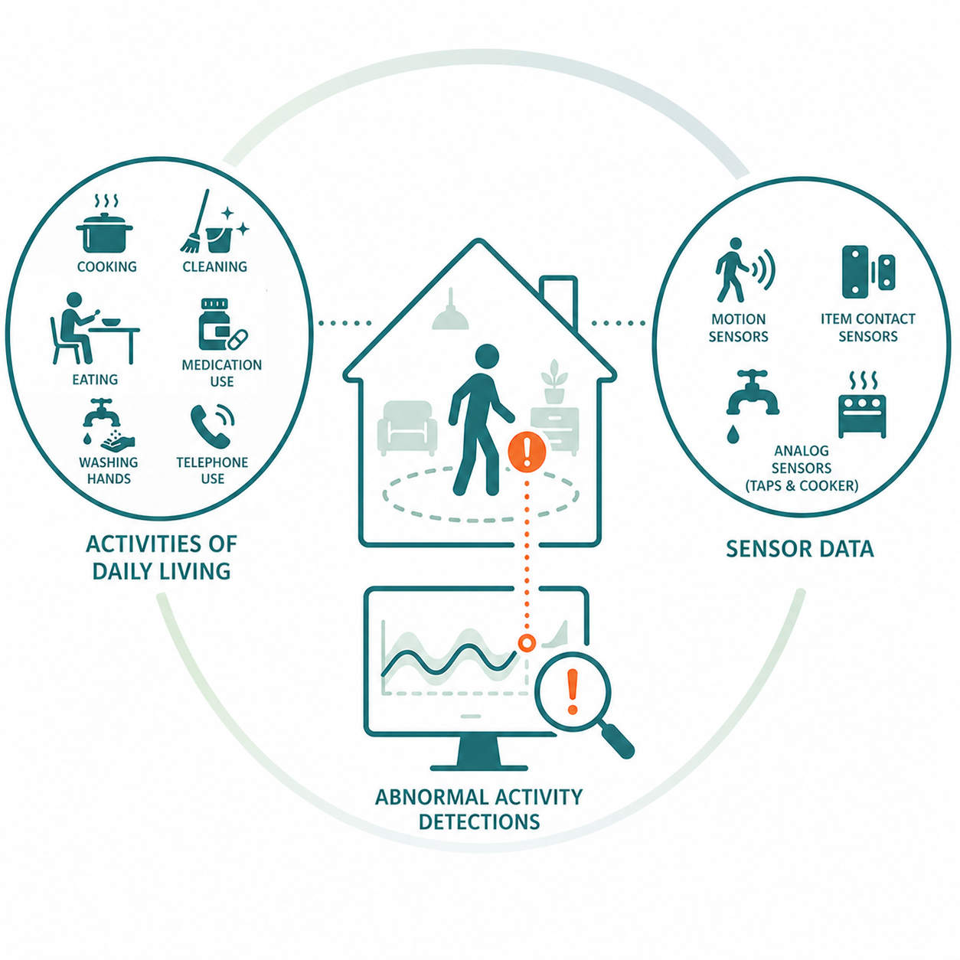





Abnormal Activity Detections in Smart Homes Using Normal Behaviour Modelling
Notes:
Good morning my name is Alison McDowell, and today I’ll be presenting my work on abnormal activity detection in smart homes using normal behaviour modelling.

Slide 2
Motivation & Problem
Problem
An aging population places a heavy burden on existing healthcare systems [1].
Need to support independent living for longer to ease that burden [2].
Activities of Daily Living (ADLs) are key indicators of health and wellbeing [3].
Solution
Smart environments use sensors to monitor behaviour unobtrusively [4].
Can monitor ADLs such as cooking, cleaning, and hygiene.
AI can be used to detect if the ADLs are performed normally/abnormally.
Challenges
Abnormal behaviour is challenging to define due to the variable nature of human behaviour [5].
Limited labelled abnormal data restricts the ability to capture the variability of abnormal behaviours [6].
Sensor noise can introduce spurious readings that do not reflect true user interactions [7].
Notes:
We’re seeing a rapidly ageing population, which is placing increasing pressure on healthcare systems. One way to reduce this burden is by supporting independent living for longer.
A key approach is monitoring activities of daily living, such as cooking, cleaning, and hygiene, as changes in how these activities are performed can signal potential health issues.
However, they can be performed in many different ways, and this variation doesn’t necessarily indicate abnormal behaviour.
True abnormal behaviour may involve missing steps, incorrect ordering, or longer durations, which makes both activity recognition and anomaly detection challenging, especially with noisy sensor data.
In addition, there is very limited labelled abnormal data, which further complicates model development and evaluation.

Slide 3
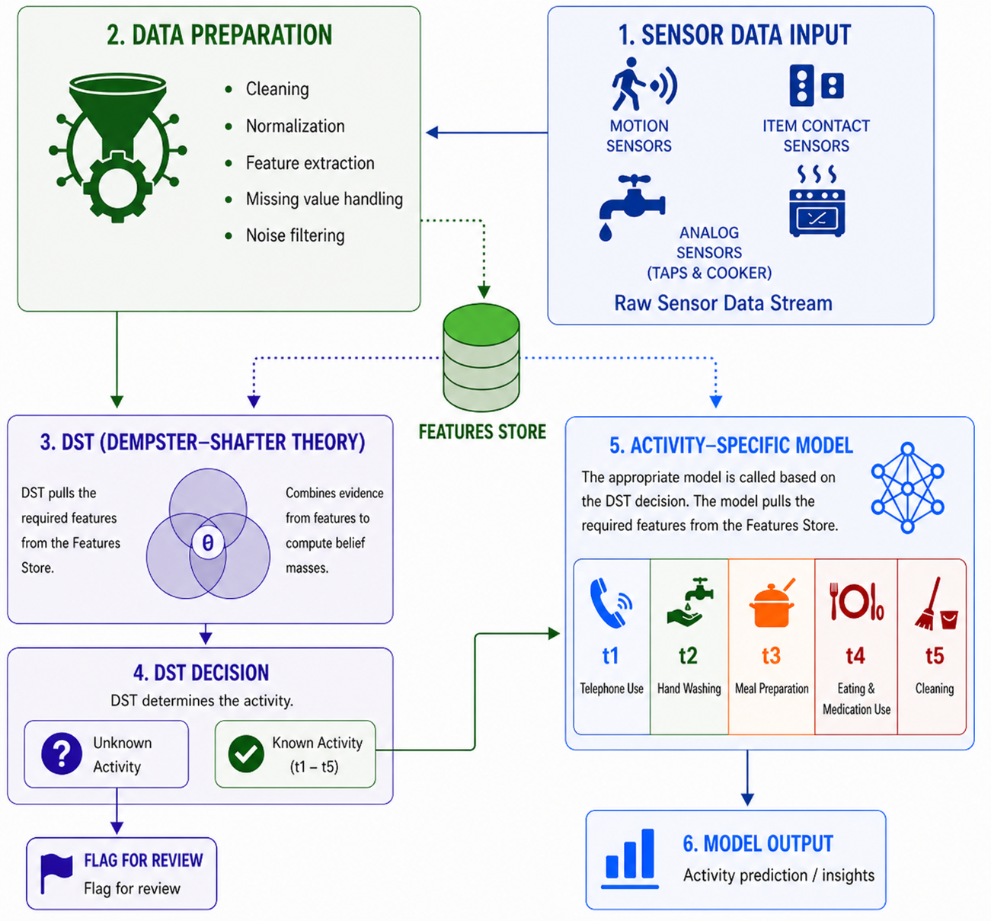
Research Aim & Contribution
Aim
Detect abnormal activity in smart homes using only normal behaviour.
Recognise ADLs from smart home sensor data using models trained on normal behaviour only.
Contribution
Proposed a two-stage approach: activity recognition + anomaly detection.
Applied Dempster-Shafer Theory (DST) for robust activity classification.
Developed per-activity anomaly detection models.
Compared per-activity models vs global models.
Demonstrated effectiveness using CASAS Kyoto dataset.
Notes:
The aim of this project is to detect abnormal behaviour using only normal data.
To achieve this, I am proposing a two-stage approach.
The first stage, is identifying the activity using Dempster-Shafer Theory, which allows uncertainty to be explicitly modelled and handles noisy sensor data effectively.
The second stage uses an activity-specific model to determine if the activity is being performed abnormally.
The diagram shows the flow from raw sensor data through to the final model output.
Sensor data will be collected, and prepped which includes cleaning, noise filtering, windowing and creating features which are saved to a features store for use in later stages.
The DST stage then pulls the relevant features from the feature store and combines the evidence to compute belief masses and from this determines the activity.
The model built for the activity along with the required features from the feature store are used together to determine if the activity is normal or abnormal.

Slide 4
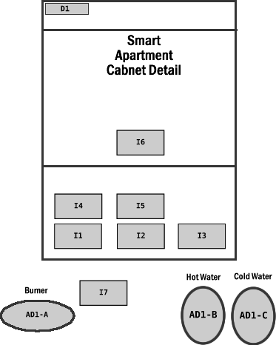
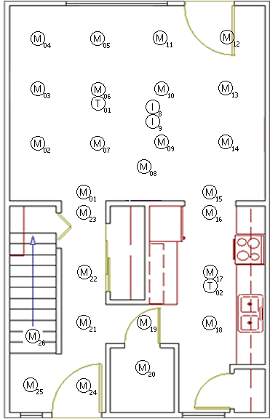
CASAS Kyoto One Dataset
Overview
Activities
220 episodes
  120 normal: correctly performed
  100 error: simulated abnormal behaviour
44 participants
  24 normal
  20 error
T1: Telephone use
T3: Meal preparation
T5: Cleaning
T2: Hand washing
T4: Eating & medication use
Sensors
56 sensors (29 used)
Motion (15)
Item (9)
Door (1)
Phone (1)
AD1-A (burner) (1)
AD1-B (hot tap) (1)
AD1-C (cold tap) (1)
Notes:
I used the CASAS Kyoto One dataset, which is widely used in smart home research.
The data was collected in a smart home environment equipped with a range of sensors, as shown in the diagrams.
The right diagram is the ground floor of a home which includes the placement of key objects such as the cooker and sink.
The left diagram is a first person view of the cupboard within the kitchen and shows the item sensors within the cupboard.
Each episode corresponds to a single participant performing one of five activities, labelled t1 to t5, from start to finish.
The activities include telephone use …
In total, the dataset contains 220 episodes, split between normal behaviour and episodes with simulated errors which represent abnormal behaviour.
Each participant performs all five activities, with their episodes being either entirely normal or entirely abnormal.

Slide 5
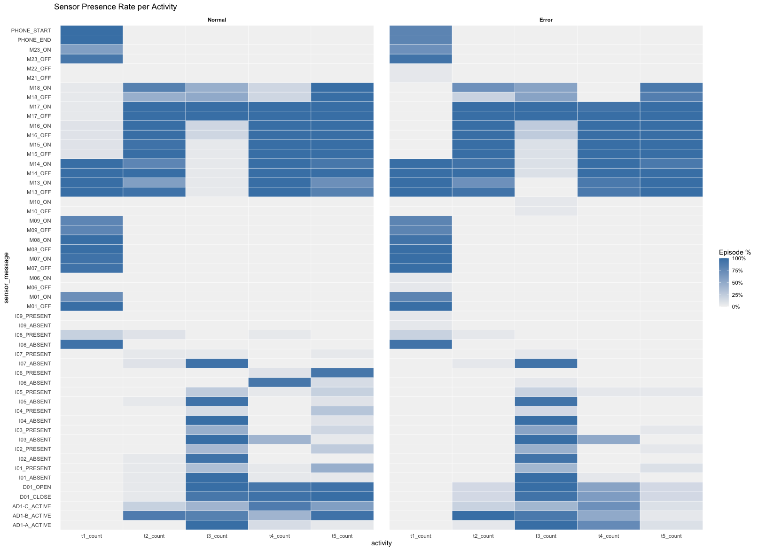
CASAS Kyoto One Dataset
Sensor Presence Rate Per Activity
Data Cleaning
Invalid sensor-message pairs removed.
Smooth noisy tap analogue sensors (AD1-B/C jitter removal).
Training Strategy
Trained exclusively on normal data.
5-fold GroupKFold cross-validation (by participant).
Evaluated on error dataset (inference only).
Notes:
The diagram shows the sensor presence rate per activity across the normal and error episodes.
Down the left we can see the types of sensors, phone, motion, item, door and analogue sensors.
We can see activities 2, 4, and 5 are quite similar when it comes to the motion and tap sensors whereas 1 and 3 have more distinct sensor activations. So there are some challenges in distinguishing activities.
In the error data we can see in some patterns becoming less consistent in particular the I06 sensor in t4 however there isn’t a clear way just from sensor presence to determine if an action is normal or abnormal.
Prior to modelling the tap sensor data was smoothed to remove jitter and better reflect meaningful human interactions.
All models were trained using only normal data. They were validated using 5-fold GroupKFold cross-validation by participant, ensuring no participant appeared in both training and validation sets, preventing data leakage.
Finally, the error dataset was used only for evaluation, testing how well the models detect abnormal behaviour.

Slide 6
Activity Recognition Approach
Models & Modelling Approaches
DST Implementation
Logistic Regression (LR)
Random Forest (RF)
XGBoost (XGB)
Long Short-Term Memory (LSTM)
Dempster-Shafer Theory (DST)
Step One: Create two per-activity frequency tables with a row for each sensor–message pair: one for occurrences and one for non-occurrences.
Step Two: Calculate belief, disbelief and uncertainty adding the total activity count to reduce over confidence.
Step Three: Calculate distinctiveness score of each sensor-message.
Step Four: Set reliability weighting based on sensor-type.
Step Five: Calculate the discounted belief, disbelief and uncertainty using the distinctiveness score and reliability weighting.
Step Six: Combine evidence using Dempster’s Rule of Combination.
Step Seven: Select activity with highest belief score.
Data Preprocessing
Remove AD1-A (burner) activations <70s
Event-based features:
  Sensor/message counts (LR, RF, XGB)
  Binary event presence (DST)
Activity-specific features:
  Tap duration bins
  Burner ACTIVE flag (LR, RF, XGB, DST)
  Burner binned analogue values (LSTM)
Sequence features (LSTM)
Notes:
Both traditional machine learning models and Dempster-Shafer Theory were used to perform activity recognition and allow comparison of the approaches.
One key data processing step was removing short burner activations with a duration under 70 seconds, as these are unlikely to represent meaningful cooking activity and were not beneficial for activity classification.
However, these events were retained for anomaly detection, where they can be indicative of abnormal behaviour.
These are the high level DST implementation steps that were undertaken.
Steps 1-2 capture the evidence strength. How frequently does this sensor-message appear for this activity vs others?
In step 3 the distinctiveness score captures does this sensor-message uniquely identify this activity, or does it appear across many activities?
Step 4 accounts for the reliability of each sensor type, where motion sensors are given lower reliability as they can be noisy and frequently triggered by general movement, while item and tap sensors provide more activity-specific indication and reliable evidence.
The final steps combine all the evidence using Dempsters Rule of Combination and select the activity with the highest belief as the most likely activity.

Slide 7
Activity Recognition
DST Results Normal
DST Results Error
Accuracy = 0.96
Activity | Recall | FPR | Precision | F1
T1 | 1.00 | 0.00 | 1.00 | 1.00
T2 | 0.83 | 0.00 | 1.00 | 0.91
T3 | 1.00 | 0.01 | 0.96 | 0.98
T4 | 0.96 | 0.02 | 0.92 | 0.94
T5 | 1.00 | 0.02 | 0.92 | 0.96
Accuracy = 0.95
Activity | Recall | FPR | Precision | F1
T1 | 1.00 | 0.00 | 1.00 | 1.00
T2 | 0.90 | 0.00 | 1.00 | 0.95
T3 | 1.00 | 0.01 | 0.95 | 0.98
T4 | 0.95 | 0.05 | 0.83 | 0.88
T5 | 0.90 | 0.00 | 1.00 | 0.95
LSTM Results Normal
LSTM Results Error
Accuracy = 0.96
Activity | Recall | FPR | Precision | F1
T1 | 1.00 | 0.01 | 0.96 | 0.98
T2 | 0.92 | 0.00 | 1.00 | 0.96
T3 | 0.96 | 0.01 | 0.96 | 0.96
T4 | 0.96 | 0.01 | 0.96 | 0.96
T5 | 0.96 | 0.02 | 0.92 | 0.94
Accuracy = 0.91
Activity | Recall | FPR | Precision | F1
T1 | 1.00 | 0.00 | 1.00 | 1.00
T2 | 1.00 | 0.11 | 0.69 | 0.82
T3 | 1.00 | 0.00 | 1.00 | 1.00
T4 | 0.95 | 0.00 | 1.00 | 0.97
T5 | 0.60 | 0.00 | 1.00 | 0.75
Notes:
I have only included the best performing ML model results to compare against DST.
The most important metrics are f1 and overall accuracy
Accuracy is the proportion of all predictions that the model gets correct.
F1 score balances precision and recall into a single metric.
They are important as together they show how many activities are classified correctly overall and ensure performance is consistent across all activities, not just overall.
DST performed very strongly, with 96% accuracy on normal data and f1 score of 0.88 and above and was more stable on error conditions than LSTM.
In the LSTM error results many t5 activities got classified as t2 which has many overlapping sensors.
In addition, DST is inherently explainable, as it provides interpretable belief, disbelief, and uncertainty measures.

Slide 8
Anomaly Detection Implementation
Models
Activity Features
Isolation Forest (IF)
One-Class SVM (OCSVM)
Autoencoder (AE)
t1 - Telephone Use:
  mean_dt, mean_transition_log_lik, p90_minus_p50, event_rate, switch_rate.
t2 - Hand Washing:
  unexpected_sensor_during_tap_usage, tap_active_last_8s, last_tap_value_lt_2_5.
t3 - Meal Preparation:
  burner_last_value, extra_event_ratio.
t4 - Eating & Medication Use:
  sensor::I06(medication), episode_duration, burner_last_value, unique_sensor_message_count.
t5 - Cleaning:
  episode_duration, num_events, p90, hot_tap_active, missing_event_ratio unique_sensor_message_count.
Data Preprocessing Stages
Feature processing stages (handling noisy analogue sensors):
Stage 1: Statistical features based on analogue sensors are created.
Stage 2: Collapse repeated tap readings.
Stage 3: Merge rapid tap interactions.
Stage 4: Convert analogue tap values into directional events.
Stage 5: Remove all analogue signals.
Notes:
Now that we have decided what activity is being carried out we want to detect if it is abnormal or not.
All models are designed to learn normal behaviour patterns and identify abnormalities as deviations from this learned baseline.
The features engineered for anomaly detection were more complex than simple event counts, which made them more sensitive to noise from analogue sensors.
Feature engineering was carried out in stages. Analogue-based statistical features were created early in the process, while features such as P90 were computed later, once the data had been cleaned and stabilised.
Each activity used a different feature set, although some features were shared. This is because each activity involves distinct behaviour patterns and sensor interactions, requiring activity-specific features for effective modelling e.g. activities with involved tap usage contain tap-based features.
Notes
Temporal / statistical features
mean_dt - Average time between consecutive sensor events.
mean_transition_log_lik - Average likelihood of observed sensor transitions based on normal patterns.
p90_minus_p50 - Spread of event timing (difference between 90th percentile and median).
p90 - 90th percentile of time between events (captures longer delays).
event_rate - Number of events per unit time (activity speed).
episode_duration - Total duration of the activity.
Tap / activity-specific features (T2)
unexpected_sensor_during_tap_usage - Indicates if unusual sensors activate while the tap is in use.
tap_active_last_8s -Whether the tap was active in the final 8 seconds of the activity.
last_tap_value_lt_2_5 - Whether the final tap reading is below a threshold (low flow).
Cooking-related
burner_last_value - Final value of the burner sensor at the end of the activity.
sensor::I06 (medication) - Whether the medication item sensor was activated.
extra_event_ratio - Proportion of unexpected or additional events beyond normal patterns.
unique_sensor_message_count -Number of unique sensor-message combinations used.
num_events - Total number of sensor events.
missing_event_ratio - Proportion of expected events that are absent.
Switch rate - Measures how often the sensor sequence changes from one sensor (or sensor–message pair) to another.

Slide 9
Per-Activity Anomaly Detection Results
Isolation Forest
OCSVM
Activity | Accuracy | Recall | FPR | Precision | F1
T1 | 0.73 | 0.70 | 0.25 | 0.70 | 0.70
T2 | 0.75 | 0.75 | 0.25 | 0.71 | 0.73
T3 | 0.95 | 0.95 | 0.04 | 0.95 | 0.95
T4 | 0.95 | 0.95 | 0.04 | 0.95 | 0.95
T5 | 0.98 | 0.95 | 0.00 | 1.00 | 0.97
All | 0.87 | 0.86 | 0.12 | 0.86 | 0.86
Activity | Accuracy | Recall | FPR | Precision | F1
T1 | 0.61 | 0.55 | 0.33 | 0.58 | 0.56
T2 | 0.86 | 0.80 | 0.08 | 0.89 | 0.84
T3 | 0.98 | 0.95 | 0.00 | 1.00 | 0.97
T4 | 0.93 | 0.95 | 0.08 | 0.90 | 0.93
T5 | 0.89 | 0.90 | 0.13 | 0.86 | 0.88
All | 0.85 | 0.83 | 0.13 | 0.85 | 0.84
Autoencoder
Activity | Accuracy | Recall | FPR | Precision | F1
T1 | 0.66 | 0.40 | 0.13 | 0.73 | 0.52
T2 | 0.86 | 0.80 | 0.08 | 0.89 | 0.84
T3 | 0.95 | 0.95 | 0.04 | 0.95 | 0.95
T4 | 0.89 | 0.90 | 0.13 | 0.86 | 0.88
T5 | 0.98 | 1.00 | 0.04 | 0.95 | 0.98
All | 0.87 | 0.81 | 0.08 | 0.89 | 0.85
Notes:
Overall, Isolation Forest achieved the best performance, although each model showed strengths for different activities.
A potential extension would be to implement a AIOps pipeline that trains and tunes all models per activity and automatically selects the best-performing model based on evaluation metrics.
Recall measures how many actual abnormal behaviours are correctly detected. It is the priority metric here as missing abnormal behaviour can have real consequences such as
a person forgetting to turn off the cooker
or a medication routine not being completed properly

Slide 10
Global Anomaly Detection Results
Isolation Forest
OCSVM
Activity | Accuracy | Recall | FPR | Precision | F1
T1 | 0.57 | 0.30 | 0.21 | 0.55 | 0.39
T2 | 0.80 | 0.90 | 0.29 | 0.72 | 0.80
T3 | 0.55 | 0.10 | 0.08 | 0.50 | 0.17
T4 | 0.80 | 0.75 | 0.17 | 0.79 | 0.77
T5 | 0.59 | 0.30 | 0.17 | 0.60 | 0.40
All | 0.66 | 0.47 | 0.18 | 0.68 | 0.56
Activity | Accuracy | Recall | FPR | Precision | F1
T1 | 0.50 | 0.15 | 0.21 | 0.38 | 0.21
T2 | 0.61 | 0.50 | 0.29 | 0.59 | 0.54
T3 | 0.61 | 0.40 | 0.21 | 0.62 | 0.48
T4 | 0.77 | 0.65 | 0.13 | 0.81 | 0.72
T5 | 0.91 | 0.85 | 0.04 | 0.94 | 0.89
All | 0.68 | 0.51 | 0.18 | 0.71 | 0.59
Autoencoder
Activity | Accuracy | Recall | FPR | Precision | F1
T1 | 0.52 | 0.35 | 0.33 | 0.47 | 0.40
T2 | 0.57 | 0.50 | 0.38 | 0.53 | 0.51
T3 | 0.50 | 0.20 | 0.25 | 0.40 | 0.27
T4 | 0.55 | 0.30 | 0.25 | 0.50 | 0.38
T5 | 0.73 | 0.70 | 0.25 | 0.70 | 0.70
All | 0.57 | 0.41 | 0.29 | 0.54 | 0.47
Notes:
When using a single global model, performance drops significantly across all models because each activity has different behaviour patterns and a global model can’t capture these differences effectively. You are also having to balance how successful the predictions are for one activity are against another's.

Slide 11
Conclusion & Future Work
Conclusion
Future Work
DST provides robust activity classification
  Accuracy 0.96 (normal) / 0.95 (error).
  Handles noise and uncertainty inherent in sensor data.
  Outperforms traditional ML models under error conditions (+0.04 accuracy).
Abnormal detection using only normal data is effective, with per-activity Isolation Forest achieving 0.87 accuracy and 0.86 recall.
A two-stage approach (DST + anomaly detection model) was effective.
Per-activity models outperform global models
  Recall: 0.86 vs 0.51
  Accuracy: 0.89 vs 0.68
Evaluate the system on a larger dataset to further evaluate generalisation.
Some error episodes were scripted. Additional evaluation should be carried out on real-world non-scripted anomalies.
Introduce realistic noise conditions:
  Sensor faults
  Missing data
  Spurious activations
Notes:
To conclude
DST provides robust activity classification.
Per-activity models are effective at identifying abnormal behaviour. Global models were not.
In terms of future work, this could be extended by evaluating on real-world, non-scripted anomalies, as well as introducing more complex and realistic noise conditions, such as sensor faults and missing data. This would help assess how well the system generalises to real-world environments.
Overall, the two-stage approach provides a strong and practical framework for smart home monitoring.

Slide 12
References
[1] | J. Y. Xi et al., “Effects of population aging on quality of life and disease burden: a population-based study,” Glob. Health Res. Policy, vol. 10, no. 2, Dec. 2025, doi: 10.1186/s41256-024-00393-8.
[2] | H. T. A. Khan, K. M. Addo, and H. Findlay, “Public Health Challenges and Responses to the Growing Ageing Populations,” Public Health Challenges, vol. 3, no. 3, Sep. 2024, doi: 10.1002/puh2.213.
[3] | M. Lussier et al., “Using ambient assisted living to monitor older adults with alzheimer disease: Single-case study to validate the monitoring report,” JMIR Med. Inform., vol. 8, no. 11, Nov. 2020, doi: 10.2196/20215.
[4] | A. Motwani, P. K. Shukla, and M. Pawar, “Ubiquitous and smart healthcare monitoring frameworks based on machine learning: A comprehensive review,” Artif. Intell. Med., vol. 134, Dec. 2022, doi: 10.1016/j.artmed.2022.102431.
[5] | N. C. Tay, T. Connie, T. S. Ong, A. B. J. Teoh, and P. S. Teh, “A Review of Abnormal Behavior Detection in Activities of Daily Living,” IEEE Access, vol. 11, pp. 5069–5088, 2023, doi: 10.1109/ACCESS.2023.3234974.
[6] | S. W. Yahaya, A. Lotfi, and M. Mahmud, “Detecting Anomaly and Its Sources in Activities of Daily Living,” SN Comput. Sci., vol. 2, no. 1, Feb. 2021, doi: 10.1007/s42979-020-00418-2.
[7] | B. Lee, P. Mohan, T. Chaspari, and C. Ryan Ahn, “Assessing Daily Activity Routines Using an Unsupervised Approach in a Smart Home Environment,” Journal of Computing in Civil Engineering, vol. 37, no. 1, Jan. 2023, doi: 10.1061/jccee5.cpeng-4895.
Notes:
These are the references using through out this presentation.

Slide 13
Thank you for listening.
Any questions?

