Slide 1

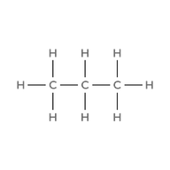

01
PROPANE
  Molecular Formula
  Lewis Structure
C₃H₈
  Condensed Structural Formula
  Bond-Line Formula
CH₃CH₂CH₃
atom count verified valence checked bond order checked same connectivity confirmed

Slide 2
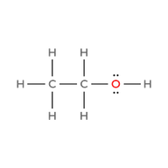

02
Ethanol
  Molecular Formula
  Lewis Structure
C₂H₆O
  Condensed Structural Formula
  Bond-Line Formula
CH₃CH₂OH
atom count verified valence checked bond order checked same connectivity confirmed

Slide 3
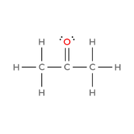

03
Acetone
(propan-2-one)
  Molecular Formula
  Lewis Structure
C₃H₆O
  Condensed Structural Formula
  Bond-Line Formula
CH₃C(=O)CH₃
atom count verified valence checked bond order checked same connectivity confirmed

Slide 4
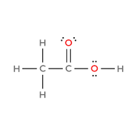

04
Acetic acid
(ethanoic acid)
  Molecular Formula
  Lewis Structure
C₂H₄O₂
  Condensed Structural Formula
  Bond-Line Formula
CH₃C(=O)OH
atom count verified valence checked bond order checked same connectivity confirmed

Slide 5
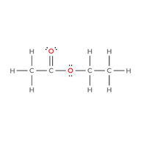

05
Ethyl acetate
(ethyl ethanoate)
  Molecular Formula
  Lewis Structure
C₄H₈O₂
  Condensed Structural Formula
  Bond-Line Formula
CH₃C(=O)OCH₂CH₃
atom count verified valence checked bond order checked same connectivity confirmed

Slide 6
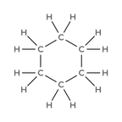

06
Cyclohexane
  Molecular Formula
  Lewis Structure
C₆H₁₂
  Condensed Structural Formula
  Bond-Line Formula
cyclo-(CH₂)₆
atom count verified valence checked bond order checked same connectivity confirmed

Slide 7
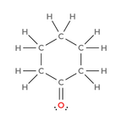

07
Cyclohexanone
  Molecular Formula
  Lewis Structure
C₆H₁₀O
  Condensed Structural Formula
  Bond-Line Formula
cyclo-(CH₂)₅C=O
atom count verified valence checked bond order checked same connectivity confirmed

Slide 8
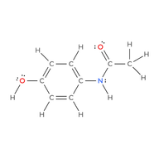

Acetaminophen
08
(paracetamol)
  Molecular Formula
  Lewis Structure
C₈H₉NO₂
  Condensed Structural Formula
  Bond-Line Formula
CH₃C(=O)NH-C₆H₄-OH
(para, 1,4)
atom count verified valence checked bond order checked same connectivity confirmed

Slide 9
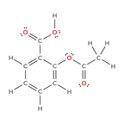

09
Aspirin
(acetylsalicyclic acid)
  Molecular Formula
  Lewis Structure
C₉H₈O₄
  Condensed Structural Formula
  Bond-Line Formula
CH₃C(=O)O-C₆H₄-COOH
(ortho, 1,2)
atom count verified valence checked bond order checked same connectivity confirmed

Slide 10
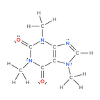

10
Caffeine
  Molecular Formula
  Lewis Structure
C₈H₁₀N₄O₂
  Condensed Structural Formula
  Bond-Line Formula
C₅H(CH₃)₃N₄O₂
atom count verified valence checked bond order checked same connectivity confirmed

