Slide 1
Reporting based on data from geonames.org
http://download.geonames.org/export/dump/readme.txt

Slide 2
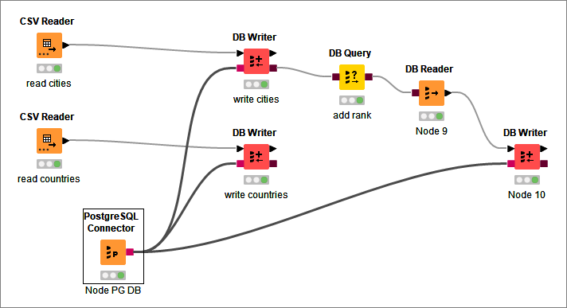
KNIME wf
KNIME 4.6.1

Slide 3
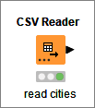
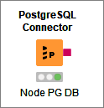

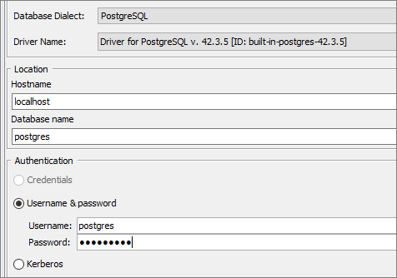






KNIME cfg 1

Slide 4



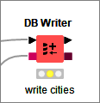
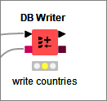
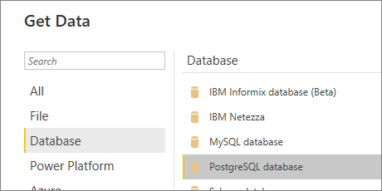
KNIME cfg 2

Slide 5

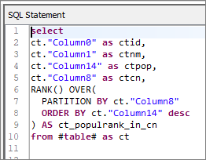
KNIME cfg 3
select
ct."Column0" as ctid,
ct."Column1" as ctnm,
ct."Column14" as ctpop,
ct."Column8" as ctcn,
RANK() OVER(
PARTITION BY ct."Column8"
ORDER BY ct."Column14" desc
) AS ct_populrank_in_cn
from public.cities as ct

Slide 6
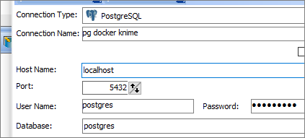

DB client

Slide 7
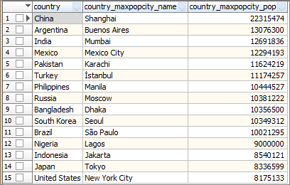
SQL v1
select
cn."Column4" country,
ct."Column1" country_maxpopcity_name,
ct."Column14" country_maxpopcity_pop
from public.cities ct, public.countries cn
where cn."Column0" = ct."Column8"
and not exists (
select * from public.cities ultract
where
ultract."Column14" > ct."Column14"
and ultract."Column8" = ct."Column8"
)
order by ct."Column14" desc limit 15

Slide 8
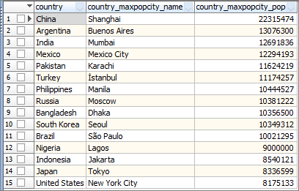
SQL v2 = v1
select
cn."Column4" as country,
ctr.ctnm as country_maxpopcity_name,
ctr.ctpop as country_maxpopcity_pop
from (
select
ct."Column1" as ctnm,
ct."Column14" as ctpop,
ct."Column8" as ctcn,
RANK() OVER(
PARTITION BY ct."Column8"
ORDER BY ct."Column14" desc
) AS ct_rank_in_cn
from public.cities ct) ctr,
public.countries cn
where cn."Column0" = ctr.ctcn
and ctr.ct_rank_in_cn=1
order by ctpop desc limit 15

Slide 9
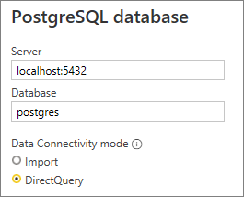
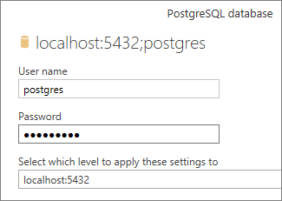
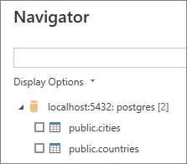
PowerBI cfg

Slide 10
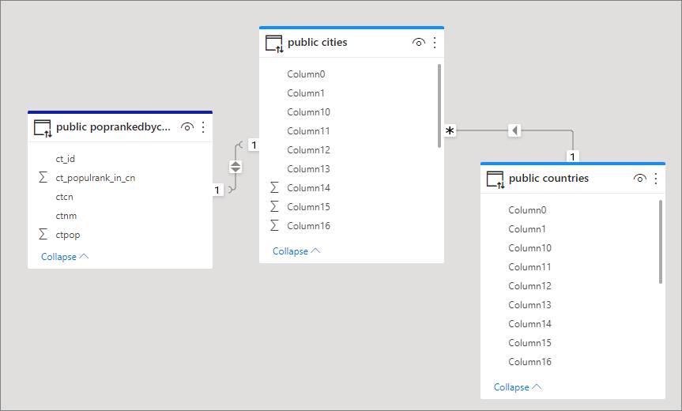
PowerBI rels

Slide 11
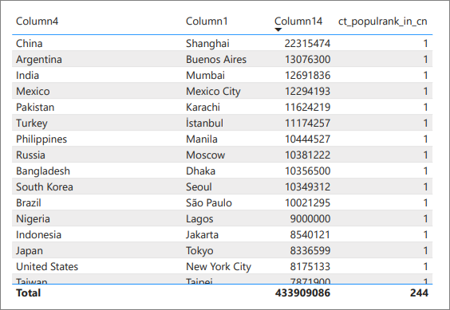
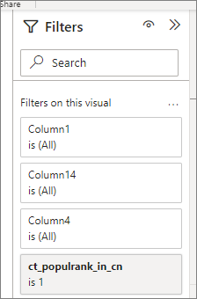
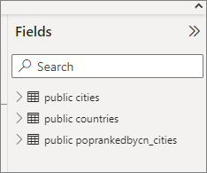
powerBI report

Slide 12
END

