Slide 1






FaceGate
Team Double Stuffed Oreo

Slide 2
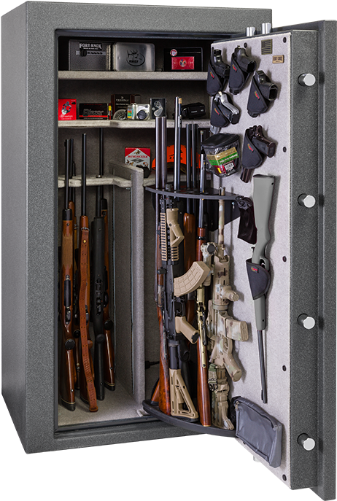


What is the Problem?
Theft is no joke with an ~267,988 robberies in the US in 2019
A lot of security methods are one-off and lack convenience.
How do we generalize personal safekeeping in a convenient method.

Slide 3



FaceGate…?
A mobile app that allows users to interact with NFC-enabled devices/locks which uses advanced face recognition to authenticate
Built on Flutter → iOS and Android compatible
Users’ data saved on Firebase backend
Deep Learning face authentication built-in using AWS Rekognition’s face comparison API

Slide 4

DEMO

Slide 5
Issues & the Future
Flutter’s deprecated libraries (due to null safety update in 2021)
aws_ai would not work with any other firebase or https dependencies
Possible future goals include:
Adding a web-element for an admin permissions
Implementing 2FA for accounts and alternative sign-ins in case of possible camera issues.
More external hardware connections like Raspberry Pi & servos

