Slide 1
K-Means Clustering on Social Media Data
By: Abdul Muizz & Muhammad Abdullah
FA23-BCS-117 & FA23-BCS-108
Course: AI354-Machine Learning Fundamentals
Dataset: Facebook Post Engagement Data

Slide 2
Abstract
This project uses the K-Means clustering algorithm to identify patterns in social media engagement data
The dataset contains Facebook post statistics, including likes, comments, shares, and reaction types.
The primary goal is to group similar posts based on their engagement metrics and find the optimal number of clusters.
Different values of k (2, 3, 4) were tested, with k=2 achieving the highest accuracy of 61%

Slide 3
Problem Statement
Goal: Group social media posts based on engagement metrics.
Use the Elbow method to determine the optimal number of clusters (k)
Evaluate the performance of the clustering using accuracy metrics
Identify and analyze distinct patterns in user engagement behavior.

Slide 4
Dataset Description
Source: Facebook post statistics
Samples: 7,050
Classes: Malignant, Benign
Features: 16 columns

Slide 5
Key Features Used
The analysis focused on user interaction and post type features:
status_type (photo, video, link, etc.)
num_reactions , num_comments, num_shares
Specific reaction counts (num_likes, num_loves, num_wows, etc.)

Slide 6
Methodology
1. Data Preprocessing:
Cleaning: Removed empty columns and non-numeric identifiers (status_id).
Encoding: Applied Label Encoding to the categorical status_type feature.
Scaling: Used Min-Max scaling to normalize all features into a common range.
2. Optimal Cluster Selection:
The Elbow Method was used to find the best k by plotting the within-cluster sum of squares (WCSS) for different k values.

Slide 7
Results & Analysis
Clustering Performance: The models were tested for k=2, 3, and 4. The highest accuracy was achieved with k=2
Accuracy Results:
Number of Clusters (k) | Correct Predictions | Total Samples | Accuracy
k = 2 | 4,288 | 7,050 | 61%
k = 3 | 4,066 | 7,050 | 58%
k = 4 | 4,112 | 7,050 | 58%

Slide 8
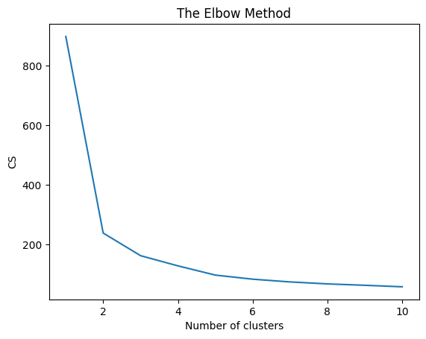
Elbow method Analysis
Elbow Curve to determine best accuracy rate by cluster change.
Key Findings:
Optimal Performance: k=2 achieved the highest accuracy of 61%
Elbow Method: The elbow plot suggested an optimal cluster range between 2-4 clusters

Slide 9
Conclusion
Best Performance: Two clusters (k=2) provided the most accurate grouping with 61% accuracy.
Distinct Patterns: The analysis successfully revealed clear and distinct patterns in how users engage with different social media posts.
Business Application: These findings can directly inform content strategy, helping marketers and content creators to better target their audience.
Scalability: The K-Means approach is efficient and can be scaled to analyze much larger, real-time social media datasets.

