Slide 1
K-Nearest Neighbor (KNN) Classification for Diabetes Prediction
By: Abdul Muizz & Muhammad Abdullah
FA23-BCS-117 & FA23-BCS-108
Course: AI354-Machine Learning Fundamentals
Dataset: Pima Indians Diabetes Dataset

Slide 2
Abstract
This project implements the
K-Nearest Neighbor (KNN) algorithm to predict the onset of diabetes based on medical attributes.
The analysis was performed on the well-known Pima Indians Diabetes Dataset.
The model was configured with k=11 neighbors and used the Euclidean distance metric.
Upon evaluation, the classifier achieved a predictive accuracy of 74.7%, establishing an effective baseline.

Slide 3
Problem Statement
Goal: Classify Patients as either diabetic or non-diabetic.
Preprocess the dataset using feature scaling to ensure model performance isn't biased by different data ranges.
Train the classifier on an 80% training set and evaluate it on a 20% test set.
Assess the model's performance using accuracy and a confusion matrix

Slide 4
Dataset Description
Source: Pima Indians Diabetes Dataset
Samples: 768
Class Labels: Diabetic (1) or Non-Diabetic (0)
Features: 9 columns (8 predictive features and 1 target variable)
Target Variable: Outcome (0 for non-diabetic, 1 for diabetic)

Slide 5
Feature Categories
The model was trained on 8 key physiological measurements:
Pregnancies
Glucose
BloodPressure
SkinThickness
Insulin
BMI
DiabetesPedigreeFunction
Age

Slide 6
Methodology
Data Preprocessing: 80/20 split for training and testing , scaling to normalize features to avoid biasness.
KNN Algorithm Configuration: k value of 11 was used, Euclidean distance was used to measure closeness.
Evaluation Metrics: using confusion matrix and accuracy score.

Slide 7
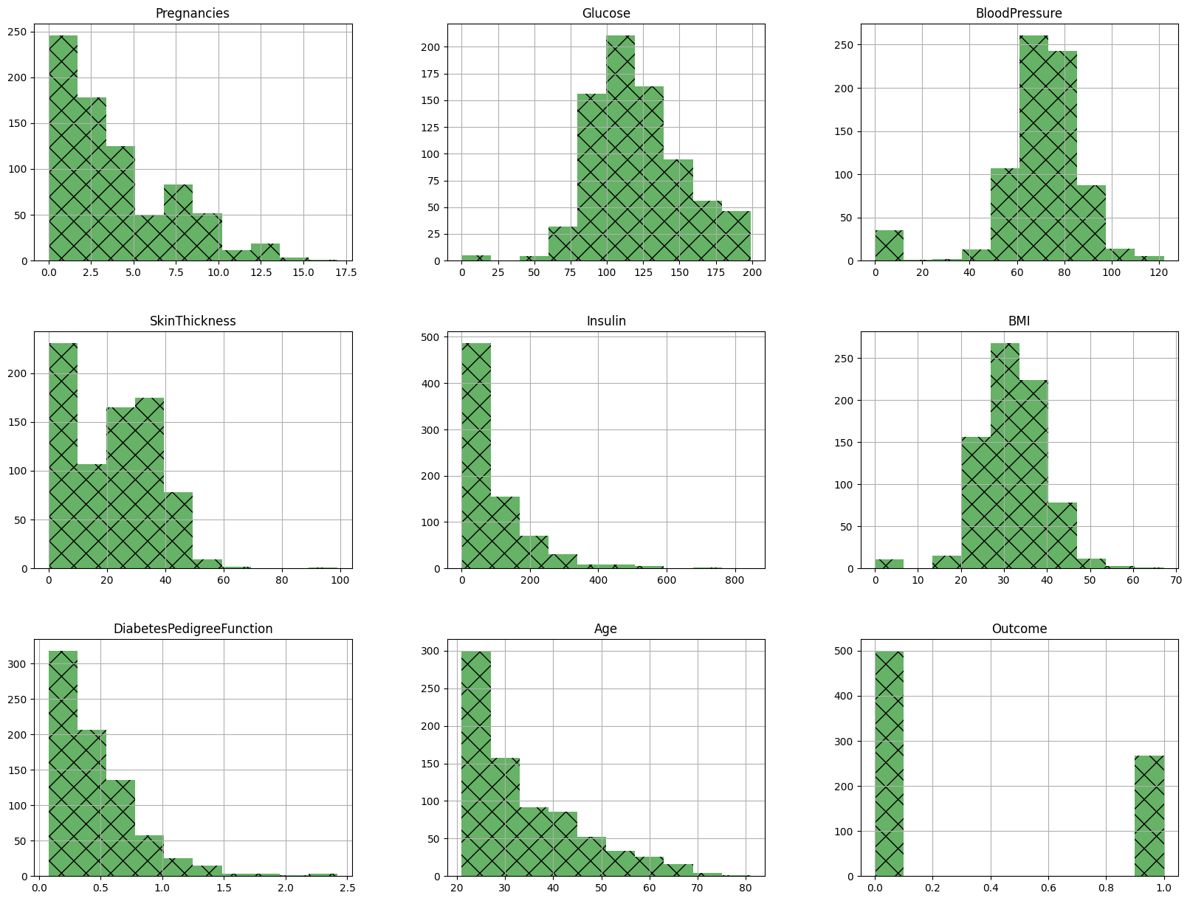
Data analysis and visualization
Figure : Distribution of Features in the Dataset

Slide 8
Results & Analysis
Overall Performance: The model achieved an accuracy of 74.7% on the test set of 154 samples.
Classification Results:
Accuracy Score | 74.7% |
Confusion Matrix:
88 (True Negatives) | 14 (False Positives)
25 (False Negatives) | 27 (True Positives)

Slide 9
Conclusion
The KNN algorithm provided a solid baseline for diabetes prediction, achieving 74.7% accuracy after proper feature scaling.
The results show that KNN can effectively identify patterns but struggles with correctly classifying the minority class (diabetic patients), as seen by the high number of False Negatives
The model serves as a strong starting point for further analysis and improvement.

