Slide 1
Linear regression for predictive modeling
By: Abdul Muizz & Muhammad Abdullah
FA23-BCS-117 & FA23-BCS-108
Course: AI354-Machine Learning Fundamentals
Dataset: Canada Per Capita Income & Hiring Dataset

Slide 2
Abstract
This project implements two linear regression models for predictive analysis on two different datasets
A simple linear regression model is built to predict Canada's per capita income based on the year, achieving an R-squared (R²) score of 0.77.
A multiple linear regression model is developed to predict candidate salaries from a hiring dataset. After significant data preprocessing, this model achieves a strong R² score of 0.95.
The project demonstrates key steps including data cleaning, model training, performance evaluation using R², and making predictions on new data.

Slide 3
Problem Statement
Goal: To build and evaluate linear regression models for two distinct predictive tasks.
Task 1: Predict Canada's per capita income for the year 2020 based on historical data from 1970-2016.
Task 2: Predict a candidate's salary based on their experience, test score, and interview score, which involves handling missing and non-numeric data.
Evaluation: Assess each model's performance using the R-squared (R²) metric to determine the goodness of fit.

Slide 4
Part 1 - Simple Linear Regression (Canada Income)

Slide 5
Dataset
Dataset: canada_per_capita_income.csv
Features: year (independent), per capita income (US$) (dependent).
Samples: 47

Slide 6
Methodology
Data was split into a 67% training set and a 33% test set.
A simple linear regression model was trained to find the relationship between the year and income.

Slide 7
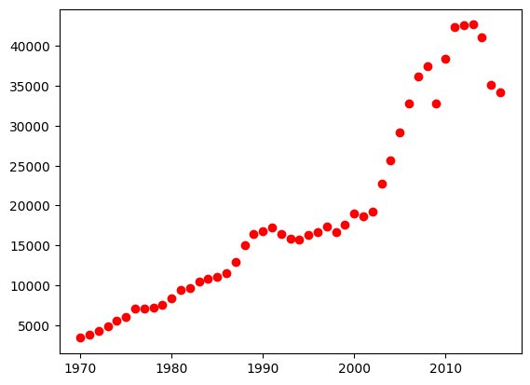
Part 1 - Data Analysis and Visualization
Figure: Scatter plot of per capita income and year

Slide 8
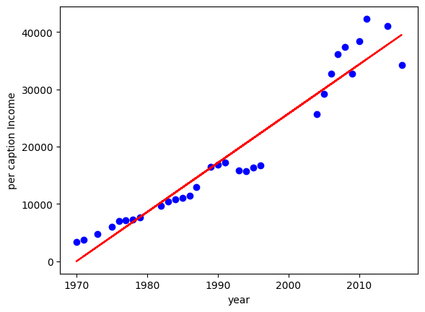
Results & Analysis
R² Score: 0.7738 (Indicates a good fit, with ~77% of income variance
explained by the year).
Prediction for 2020: $42,960.58
Figure: Linear Regression fit for per capita income

Slide 9
Part 2 - Multiple Linear Regression (Hiring Data)

Slide 10
Dataset
Dataset: hiring.csv
Features: experience, test_score, interview_score.
Target: salary($)
Data Preprocessing:
Filled missing experience values with 0.
Filled missing test_score values with the median (8.0).
Converted word-based experience (e.g., 'five') to integer values (5).

Slide 11
Methodology
The cleaned dataset was split into training and testing sets.
A multiple linear regression model was trained on the three input features.

Slide 12
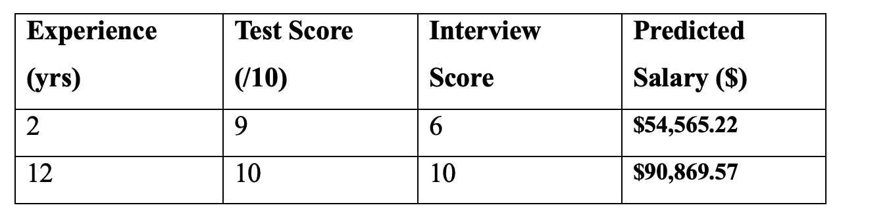
Results & Analysis
Overall Performance: The model achieved an excellent R² score of 0.9497 on the test set.
This means the model can explain ~95% of the variance in salary, indicating a very strong predictive capability.
Predictions:

Slide 13
Conclusion
Both simple and multiple linear regression models were successfully implemented to solve two different prediction problems.
The multiple regression model for salary prediction (R² = 0.95) performed significantly better than the simple regression model for income prediction (R² = 0.77), showing the value of using multiple relevant features.
Data preprocessing, including handling missing values and converting text to numbers, was a critical step for the success of the hiring model.
Linear regression is demonstrated to be a simple, interpretable, and powerful algorithm for regression tasks.

