Slide 1
Decision Tree for Breast Cancer Analysis
By: Abdul Muizz & Muhammad Abdullah
FA23-BCS-117 & FA23-BCS-108
Course: AI354-Machine Learning Fundamentals
Dataset: Wisconsin Breast Cancer

Slide 2
Abstract
Implemented Decision Tree classifiers for breast cancer diagnosis.
Compared 3 feature selection approaches:
All 30 features
Reduced correlated features
PCA transformation
Random Forest used for comparison.

Slide 3
Problem Statement
Goal: Predict breast cancer (Malignant vs Benign).
Build interpretable Decision Tree models.
Compare feature selection techniques.
Evaluate performance vs Random Forest.

Slide 4
Dataset Description
Source: sklearn Breast Cancer Dataset
Samples: 569 cases
Classes: Malignant, Benign
Features: 30 numerical features
Each feature: mean, std error, worst value.

Slide 5
Feature Categories
Features include:
Radius, Texture, Perimeter, Area
Smoothness, Compactness, Concavity
Concave Points, Symmetry, Fractal Dimension

Slide 6
Methodology
1. Data Preprocessing (80/20 split)
2. Exploratory Data Analysis
3. Feature Selection (3 approaches)
4. Model Configuration (Decision Tree)
5. Visualization & Analysis

Slide 7
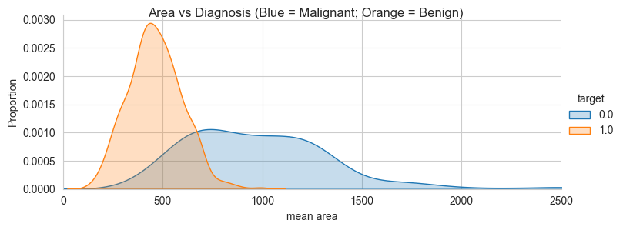
Data analysis and visualization
Figure : Kernel Density Estimate plot of 'mean area' distribution for malignant vs benign tumors

Slide 8
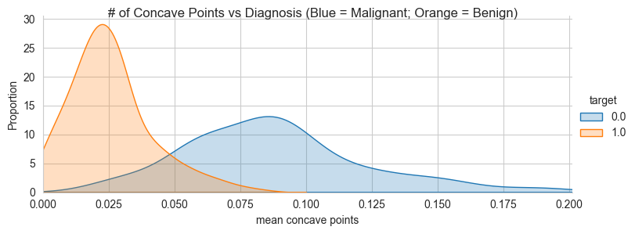
Figure : KDE plot of 'mean concave points' showing class separation

Slide 9
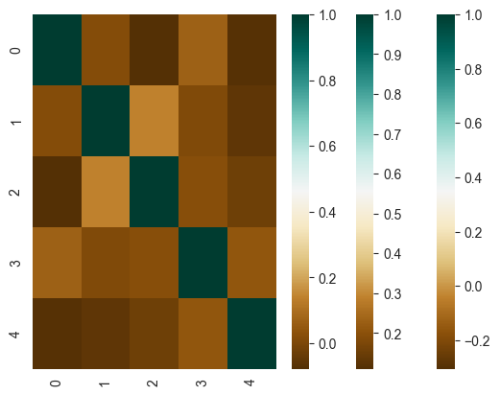
Figure : Correlation heatmap of all 30 original features

Slide 10
Feature Selection Approaches
All 30 features → 94% accuracy
Reduced set (3 features) → 84%
PCA (5 components) → 91%
Tradeoff: Interpretability vs Performance

Slide 11
Decision Tree Models
Tree rules based on:
Worst Perimeter
Worst Concave Points
Mean Area & Mean Texture

Slide 12
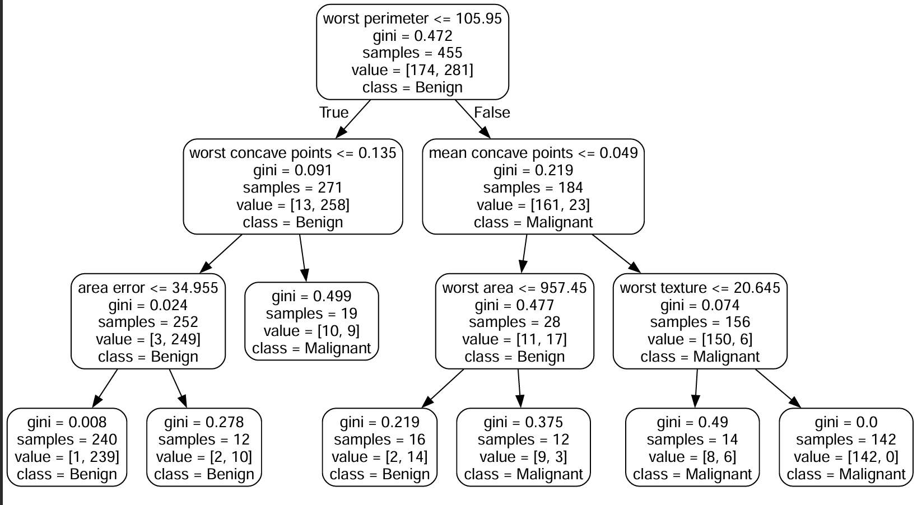
Figure : Decision Tree visualization using all original features

Slide 13
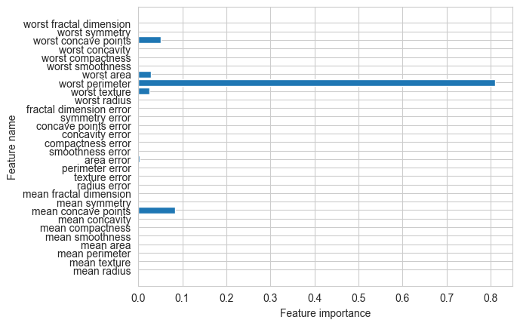
Figure : Feature importance plot for Decision Tree with all features.

Slide 14
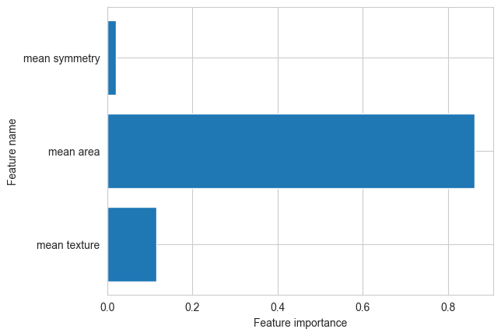
Figure : Retain only features that were produced through PCA transformation.

Slide 15
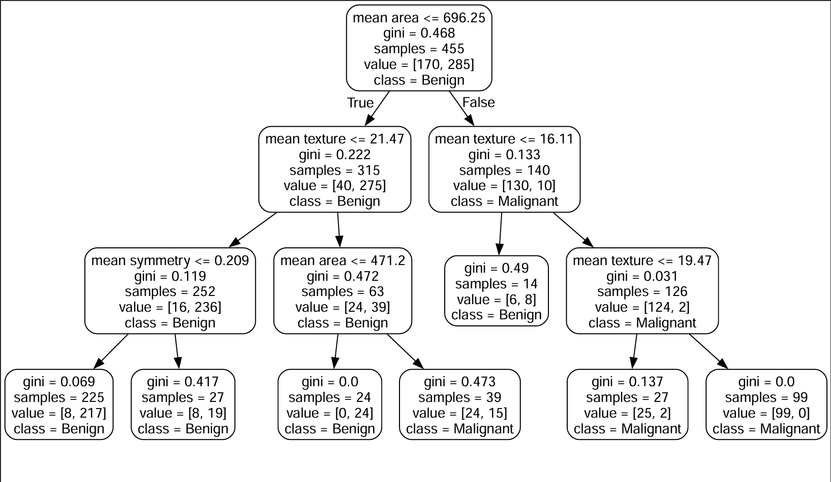
Figure : Decision Tree visualization using reduced feature set (3 features)

Slide 16
Results & Analysis
Performance:
All Features: Train=95%, Test=94%
Reduced Features: Train=91%, Test=84%
PCA: Train=96%, Test=91%
Best single tree: All features (94%).

Slide 17
Random Forest Comparison
Random Forest (30 features):
Training Accuracy: 100%
Test Accuracy: 97%
Advantages:
Higher accuracy
More robust
Reduced overfitting

Slide 18
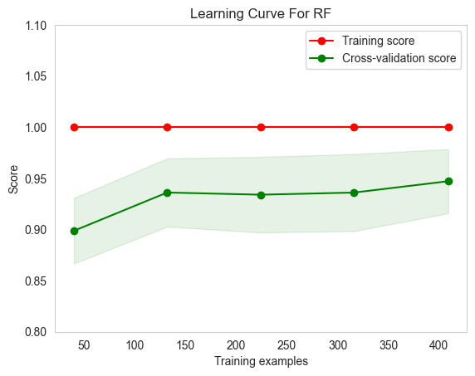
Figure : Learning curve for Random Forest classifier

Slide 19
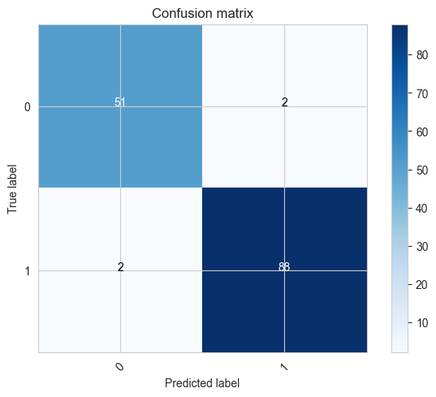
Figure : Confusion matrix for Random Forest test predictions

Slide 20
Conclusion
Best single DT: All features (94%)
Critical features: Worst Perimeter, Worst Concave Points
PCA balanced reduction & performance
Random Forest outperformed (97%).

Slide 21
Applications & Future Work
Applications:
Diagnostic Support
Screening Programs
Research & Education
Future Work:
Cross validation
Feature engineering
Advanced ML models

