Slide 1
Naive Bayes for Breast Cancer Diagnosis
By: Abdul Muizz & Muhammad Abdullah
Course: Machine Learning Fundamentals
Dataset: Wisconsin Breast Cancer

Slide 2
Abstract
Implemented Gaussian Naive Bayes classifier.
Dataset: 569 cases.
Test accuracy: 96.49%.
Strong in distinguishing benign vs malignant.
Probabilistic approach, fast and effective.

Slide 3
Problem Statement
Goal: Classify tumors (Benign vs Malignant).
Apply Naive Bayes.
Analyze feature distributions.
Evaluate accuracy & metrics.
Build reliable diagnostic support.

Slide 4
Dataset Description
Source: breast-cancer.csv
Samples: 569
Benign: 357 (62.7%)
Malignant: 212 (37.3%)
Features: 30 numerical + ID & diagnosis

Slide 5
Feature Categories
Features derived from cell nuclei:
Mean features
Standard Error features
Worst features
No missing values, all numerical.

Slide 6
Methodology
Load dataset & explore
Analyze class distribution
Preprocess: remove ID, encode target
Train test split (80/20)
Standardize features
Train Gaussian Naive Bayes

Slide 7
Data Visualization
Target distribution: Benign majority.
Histograms show malignant tumors have:
Larger nuclei size
Higher texture
Larger area & perimeter.

Slide 8
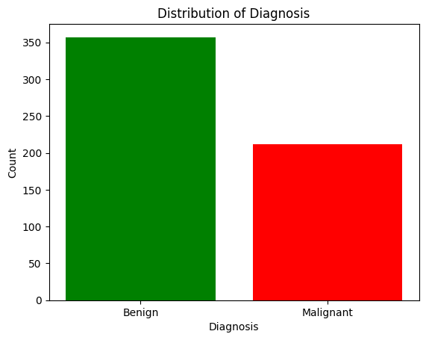
Figure 1
Figure 1: Bar chart showing distribution of diagnosis (Benign vs Malignant).

Slide 9
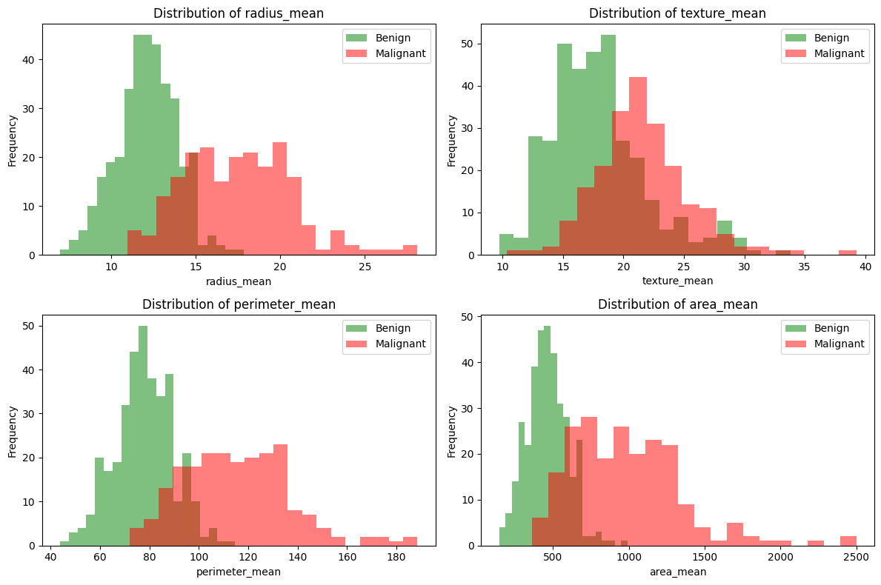
Figure 2
Figure 2: 2x2 grid of histograms comparing feature distributions

Slide 10
Model Implementation
Algorithm: Gaussian Naive Bayes
Assumes Gaussian distribution
Predicts using probabilities
Fast and efficient
Advantages:
Simple
Handles high dimensions
Works with imbalance

Slide 11
Results & Metrics
Training Accuracy: 93.63%
Test Accuracy: 96.49%
Precision (Malignant): 98%
Recall (Malignant): 93%
F1-score: 95%

Slide 12
Confusion Matrix & Analysis
TN=70, FP=1
FN=3, TP=40
Low false positives (1)
Few false negatives (3)
High sensitivity for malignant cases

Slide 13
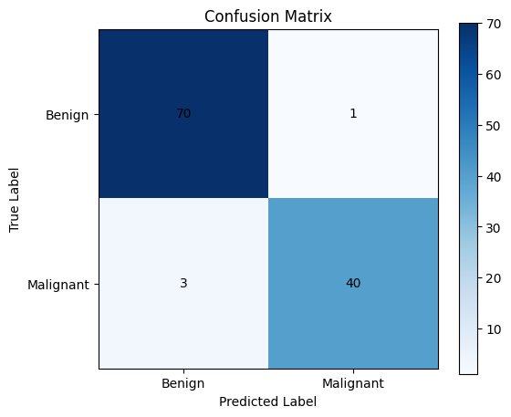
Figure 3
Figure 3: Confusion matrix heatmap showing prediction results

Slide 14
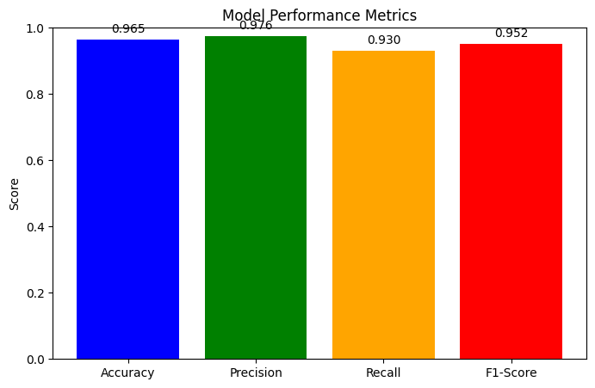
Figure 4
Figure 4: Bar chart comparing performance metrics (Accuracy, Precision, Recall, F1-Score)

Slide 15
Conclusion
High accuracy & generalization
Strong precision & recall
Low false negatives (important in medicine)
Fast & interpretable
Suitable for screening & support

Slide 16
Applications & Future Work
Applications:
Screening tool
Diagnostic support
Research & Education
Future Work:
Cross validation
Handle correlated features
Compare with SVM, RF, NN
Clinical validation

