Slide 1
TEMPLATE FILLING AND SLOT FILLING USING TRANSFORMERS AND DEEP LEARNING
NAME : ANUPAM DWIVEDI
ENROLLMENT NO. : IIT2020198
SEMESTER : 6TH
COURSE NAME: NATURAL LANGUAGE PROCESSING
PROFESSOR’S NAME: DR. MUNEENDRA OJHA

Slide 2
TABLE OF CONTENTS
INTRODUCTION
LITERATURE REVIEW
PROBLEM STATEMENT
DATASET DESCRIPTION
METHODOLOGY
RESULTS
FUTURE SCOPE
CONCLUSION
REFERENCES

Slide 3
INTRODUCTION
Template filling is an efficient approach to extract and structure complex information from text. It plays a major role in information extraction (IE) systems (Information Extraction; Text Mining) to merge information across multiple sentences to identify all role fillers of interest.
The goal of Slot Filling is to identify from a running dialog different slots, which correspond to different parameters of the user’s query.
Github Project Link: https://github.com/a-n-u-p-a-m/NLPCOURSEPROJECT

Slide 4
LITERATURE REVIEW

Slide 5
S.NO | Paper Title | Author Name | Methodology used | Dataset Used | Results
1. | Template Filling with Generative Transformers | Xinya Du, Alexander M. Rush and Claire Cardie | generative model for template filling, a task that involves filling structured templates with information extracted from a given document | MUC-4 Dataset | The results demonstrate that the defined framework more often predicts the correct event type, performs better on PERPIND and PERPORG, and achieves slightly worse performance with GRIT-PIPELINE on roles that appear later in the template (i.e., TARGET and VICTIM).
2. | Document-Level Event Role Filler Extraction using Multi-Granularity Contextualized Encoding | Xinya Du and Claire Cardie | a hierarchical model that combines different levels of representation to generate the final output. The different levels of representation include word-level, sentence-level, and document-level representations | MUC-4 Dataset | When increasing the input context from a single sentence to two sentences, the reader has a better precision and lower recall, resulting in no better F-1; When increase the input context length further to the entire paragraph, the precision increases and recall remains the same level, resulting in higher F-1; When we keep increasing the length of input context, the reader becomes more conservative and F-1 drops significantly

Slide 6
S.NO | Paper Title | Author Name | Methodology used | Dataset Used | Results
3. | Entity, Relation, and Event Extraction with Contextualized Span Representations | : David Wadden, Ulme Wennberg, Yi Luan and Hannaneh Hajishirz | f a unified, multitask framework for three information extraction tasks: named entity recognition, relation extraction, and event extraction | Four datasets: ACE05, SciERC, GENIA and WLPC | Coreference propagation (CorefProp) improves named entity recognition performance across all three domains;Relation propagation (RelProp) improves relation extraction performance over pretrained BERT, but does not improve fine-tuned BERT.
4. | :Joint Extraction of Events and Entities within a Document Context | Bishan Yang and Tom Mitchell | ,a novel approach is proposed that models the dependencies among variables of events, entities, and their relations, and performs joint inference of these variables across a document. The goal is to enable access to document-level contextual information and facilitate contextaware predictions. | ACE Dataset | Comparing to the state-ofthe-art event extractor JOINTBEAM, the improvements introduced by WITHINEVENT are substantial in both event triggers and event arguments; JOINTEVENTENTITY provides the best performance among all the models on all evaluation categories. It boosts both precision and recall compared to WITHINEVENT

Slide 7
PROBLEM STATEMENT
Template filling is generally tackled by a pipeline of two separate supervised systems – one for role-filler extraction and another for template/event recognition. Since pipelines consider events in isolation, they can suffer from error propagation. I try to devise and analyze different approaches to template filling and slot filling.

Slide 8
DATASET DESCRIPTION
MUC-4 DATASET
MUC-4 consists of 1,700 documents with associated templates. We split the dataset as: 1,300 documents for training, 200 documents (TST1+TST2) as the development set and 200 documents (TST3+TST4) as the test set.
There are 6 event types (i.e., kidnapping, attack, bombing, robbery, arson, forced work stoppage) in MUC-4.
ATIS DATASET

Slide 9
METHODOLOGY
Encoder-decoder architecture is heavily used in this project.
For the generative transformers, BERT is used as the encoder and decoder and pointer decoding is used to predict next token.
For the slot filling on the encoder side a Bidirectional RNN is used and on the decoder side a unidirectional RNN is used both with LSTM as a RNN unit.
For the slot filling a RNN network is also defined which uses an additional attention field.
Metrics used for evaluation are- Precision, Recall, F1 Score and Accuracy.

Slide 10
RESULTS
On the ATIS dataset for slot filling, the results are as follows:
Model name | Intent acc(%) | Slot F1(%) | Sentence acc(%)
BERT | 97.87 | 95.59 | 88.24
DistilBERT | 97.76 | 95.50 | 87.68
ALBERT | 97.64 | 95.78 | 88.13

Slide 11
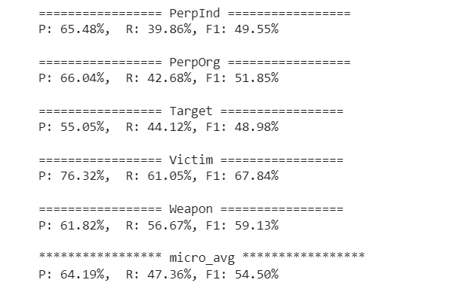
RESULTS
For the MUC-4 dataset results for the generative transformer are:

Slide 12
RESULTS
It is also concluded that generative transformers are better than traditional deep learning models for template filling.
SImilarly on comparing the different models used for slot filling it is conclusive that BERT is the best model for the task followed by DistilBERT, then ALBERT and lastly RNN+attention.

Slide 13
FUTURE SCOPE
In this project I have studied and implemented different techniques for different Information Extraction tasks. For future work there is a possibility of checking the models in some Out-Of-Distribution(OOD) cases. Also an ensemble can be used for the task instead of a single encoder-decoder. There is also the possibility of checking different transformer networks for the tasks and fine-tuning them.

Slide 14
CONCLUSION
In this project I studied, analyzed and designed some techniques and models for different information extraction tasks. These tasks include Named Entity Recognition, Template Filling, Event extraction, etc. I studied different transformers and deep learning models and used them for the mentioned tasks. In the end I concluded that using generative transformers is better for the task of template filling over traditional deep learning models.

Slide 15
REFERENCES
[1] Sowmya Vajjala, Bodhisattwa Majumder, Anuj Gupta, Harshit Surana - Practical Natural Language Processing-A Comprehensive Guide to Building Real-World NLP Systems-O’Reilly Media, Inc. (2020)
[2] Template-Based Information Extraction without the Templates by Nathanael Chambers and Dan Jurafsky
[3] Newton Spolaor, Everton Alvares Cherman, Maria Carolina Monard, and Huei Diana Lee. 2013. A comparison of multi-label feature selection methods using the problem transformation approach. Electronic Notes in Theoretical Computer Science, 292:135– 151.
[4] GRIT: Generative Role-filler Transformers for Document-level Event Entity Extraction by Xinya Du Alexander M. Rush Claire Cardie
[5] Attention-Based Recurrent Neural Network Models for Joint Intent Detection and Slot Filling by Bing Liu , Ian Lane

