Slide 1

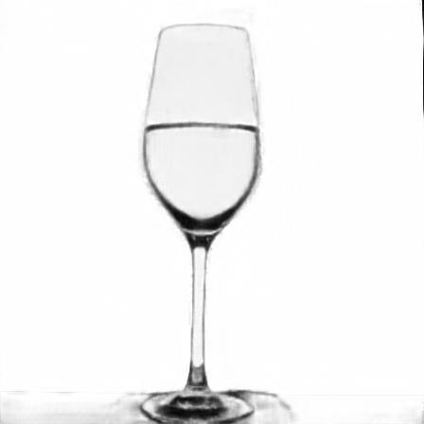




Concat
Input Image
Conv + BN + ReLU
16
1/1
32
1/2
64
1/4
128
1/8
256
1/16
256
1/32
256
1/64
Conv (stride-2) + BN + ReLU
Encoder-Decoder Network
Residual Network
Refined Matte
Conv + BN + ReLU + Upsample
Coarse Stage
Refinement Stage
Residual Block
Coarse Matte
Skip Connection

