Slide 1

A Meta-Reinforcement learning approach to process control
Daniel McClement¹, Nathan Lawrence², Philip Loewen², Michael Forbes³, Johan Backström⁴, Bhushan Gopaluni¹
¹Chemical and Biological Engineering, University of British Columbia
²Mathematics, University of British Columbia
³Honeywell Process Solutions
⁴Backström Systems Engineering Ltd.
Notes:
Hello my name is Daniel and my presentation today is on using meta-reinforcement learning for industrial process control.
This work was done by me, Nathan Lawrence and Philip Loewen from the university of British Columbia math department, Bhushan Gopaluni from the department of chemical engineering, Johan Backstrom form Backstrom systems engineering limited, and Michael Forbes from Honeywell.

Slide 2
Motivation
An audit of 700 control loops¹ across 12 companies revealed:
16% were in manual mode
65% were poorly tuned
16% had severe tuning problems
¹Torres et al., “Performance Assessment of Control Loops- Case Studies”, IFAC, 2006.
Notes:
Despite so much research having gone into designing better process controllers over many decades, the vast majority of control loops in use today still use the basic proportional integral derivative control structure developed over a century ago.
Of these PID controllers, many are poorly tuned. A study done in Brazil across a range of industries from pulp and paper, cement, petrochemicals, and more revealed 16% of control loops were in manual mode, 65% were poorly tuned meaning the actuator was saturated most of the time, there was significant oscillation around the setpoint, sluggish control, or otherwise poor setpoint tracking. 16% of control loops had severe tuning problems. This issue isn’t specific to Brazil either, similar results have been shown in other countries.
These poorly tuned control loops can be costly. Kruger paper, a company in Quebec Canada, found they began to save 1 million dollars annually after retuning all 500 control loops part of their paper machine. Chemical manufacturers in the UK and a refinery in Washington had both reported saving 300,000 dollars annually after fixing issues with their hundreds of control loops.
If good process control can save companies hundreds of thousands of dollars annually, why do so many control loops remain dysfunctional?
Control Engineering | The Link Between Automation and Enterprise KPIs:

Slide 3
Motivation
Poor control is expensive so why isn’t every loop tuned well?
Re-tuning is costly
Control loop performance degrades over time

Slide 4
Motivation
“In 2012, General Electric found that one of its factories was generating over 150,000 data samples every second. Just one product line could produce as much as 4 trillion data points per year.”¹
Can we use data-driven control approaches to maintain performance?
¹Savitz, “5 Ways the Industrial Internet Will Change Manufacturing”, Forbes, 2012.
Notes:
At the same time, plants are producing more and more data each year and there’s buzz around Industry 4.0 which at its core is about the collection and analysis of more process data to improve manufacturing processes.
To bring a sense of scale to the data collected, way back in 2012 General Electric found one of its factories generated over 150,000 data samples every second. And just one product line could produce as much as 4 trillion data points per year. It would take several terabytes to store the data collected by a single product line over the course of year, and I imagine the amount of data GE has access to has only increased since 2012.
So the question is, are we using this data to its fullest? Can any of this data help us achieve maintenance free control? This inspires all the research efforts taking place into data-driven controllers which use machine learning.
And our research uses a type of machine learning called reinforcement learning which I will give a brief overview of in the next few slides.

Slide 5
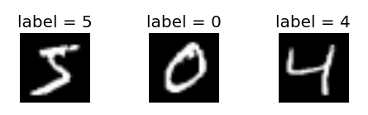
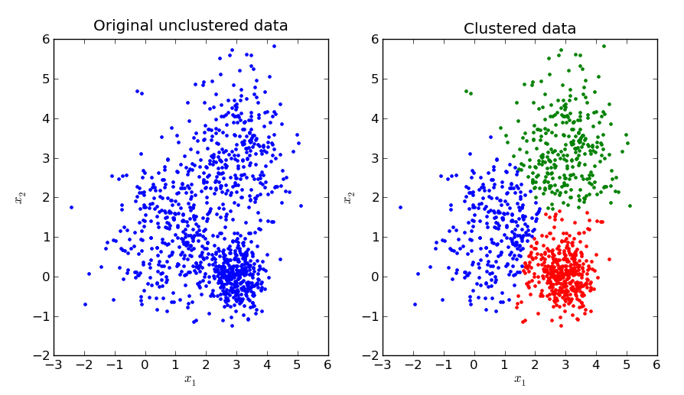
Machine Learning
There are 3 important categories:
1) Supervised learning: labelled data
2) Unsupervised learning: unlabelled data
Notes:
Most types of machine learning can be grouped into 3 categories.
The first and probably most familiar is supervised learning. This type of machine learning uses labelled data where the objective is to find a mapping from the input features to a corresponding output feature (i.e. a label). A classic example is matching handwritten text, specifically digits, with the correct labels.
The problem with using supervised learning to construct process controllers is you need to know ahead of time what the correct output should be. So based on the state of the system, what action should the controller take? However if we were able to compute an optimal control action in advance we could manually program a controller to compute the correct control action and we wouldn’t need to construct a machine learning model in the first place.
The second category of machine learning is unsupervised learning. The data is unlabelled and machine learning models are focussed on determining which data samples are more similar or different to each other than others or to compress the data by finding lower dimensional representations of the features. This type of machine learning might be useful for performance monitoring and fault detection. For example, unsupervised learning might help identify if a process is behaving irregularly sooner than an operator could notice.

Slide 6
Machine Learning
There are 3 types:
3) Reinforcement learning (RL):
“evaluated data”
Integral absolute error, MPC objective function
action
RL Controller
System
reward
state
Notes:
“evaluated data” – it is difficult for a control engineer to determine the optimal control action a priori (i.e. labelled data-> supervised learning), but we have very simple tools to measure the relative quality of different control trajectories (this is the principal behind MPC, rather than programming in the optimal control action, we program a cost function to evaluate the relative quality of control actions and let the computer do the optimization). RL is essentially
The third type is reinforcement learning or RL for short. RL uses “evaluated data”. I’ll turn to process control to explain what I mean by “evaluated data”. While it is hard for us to label control action as correct or incorrect, it is easier for us to evaluate the relative quality of a control action relative to other possibilities. In fact, this is how MPC works. We don’t know what the correct control action is, but we design an objective function and use an optimization algorithm to compute the optimal action for us given our objective function. The objective function allows the controller to “evaluate” the relative quality of the data.
RL works in a similar manner. An RL controller takes the state of a system as input and it uses this to compute an action to take. The RL controller is fed a “reward” signal which is similar to the idea of a stage cost in MPC. The RL controller learns to maximize its future reward which is similar to how MPC tries to minimize its future cost.

Slide 7
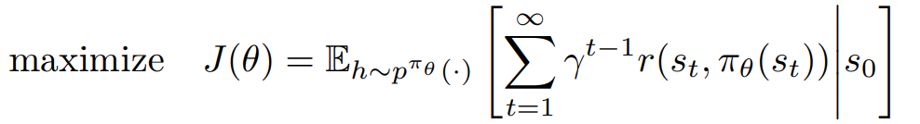

What are RL controllers trying to do?
Many RL algorithms have an “actor-critic” structure
Actor: A nonlinear feedback control law: $π_{θ}(s_{t})$
Notes:
So how does an RL controller learn and how is this different than MPC?
The type of RL I’ll be talking about in this presentation is called actor-critic RL. Actor-critic methods have 2 eponymous parts.
There is the actor which learns a nonlinear feedback control law called pi. The actor has parameters denoted as theta, often this parameterization is a neural network. The actor parameters are trained usually through gradient descent, to try and maximize the future reward the controller receives starting from its current state, s. This is similar to MPC’s objective function. MPC usually optimizes over a finite horizon so make the optimization problem tractable. In RL, the controller optimizes over an infinite horizon (or until the end of an episode for things link batch processes) but to ensure the expected future rewards converge to some finite value, we use a discounting factor called gamma.

Slide 8
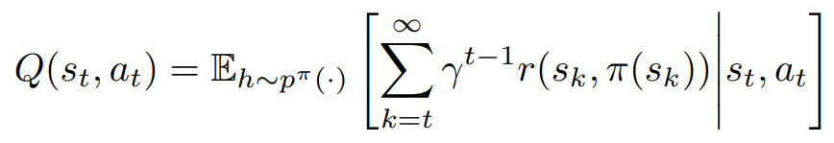

What are RL controllers trying to do?
Many RL algorithms have an “actor-critic” structure
Critic: Learns to approximate the state-action value function $Q(s_{t},a_{t})$
Notes:
Then there is the critic. The critic is one difference between RL and MPC. MPC requires a process model to optimize its future control outputs. RL is able to work in model-free settings using the critic which tries to approximate the state-action value function. The state-action value function is the expected future reward the controller should receive if it starts in state s, takes action a, then follows the actor’s current policy at every future step.
Using the state-action value function allows us to iteratively design better controllers. For instance, if we replace the actor’s current control policy with one which picks the action maximizing the state-action value function at each time step, we expect this to be an improvement over the previous controller.

Slide 9
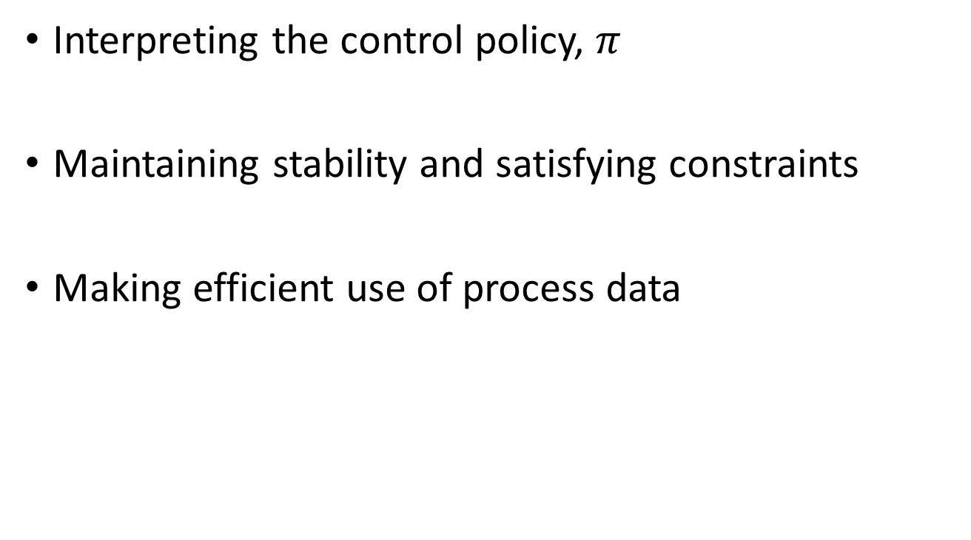
Challenges with Deep-RL
Interpreting the control policy, $π$
Maintaining stability and satisfying constraints
Making efficient use of process data
Notes:
The overview of RL up to this point sounds fairly appealing, so aren’t we using RL controllers already? Aside from implementation issues like the added complexity of adding neural networks all over a plant, there are 3 fundamental challenges with current RL methods.
The first is interpretability. PID controllers are nice as they have a parameterization we as humans can understand. We have some sense of how the proportional gain effects the process. MPC is a bit harder to interpret, but we can at least look at the process model being used for the optimization to get a sense of what is going on inside the controller. Current RL methods which use neural networks are more of a black box.
The second challenge is stability and constraint satisfaction. The majority of RL research is done in simulated environments where failure is an option and oftentimes helps the agent improve its control policy. RL controllers learn by interacting with their environment so there is not an easy way to teach an RL controller to not violate constraints unless it tries the actions itself first. Letting a controller do this type of exploratory actions on a physical plant would not be good and possibly unsafe. Safe RL, which seeks to create RL controllers which remain stable as the control policy is updated and satisfy constraints, is a very active field of research at the moment.
The other challenge with RL is its sample efficiency, meaning the RL controller takes many timesteps to converge to its optimal performance. This is the challenge with RL we were tackling with our research project.

Slide 10
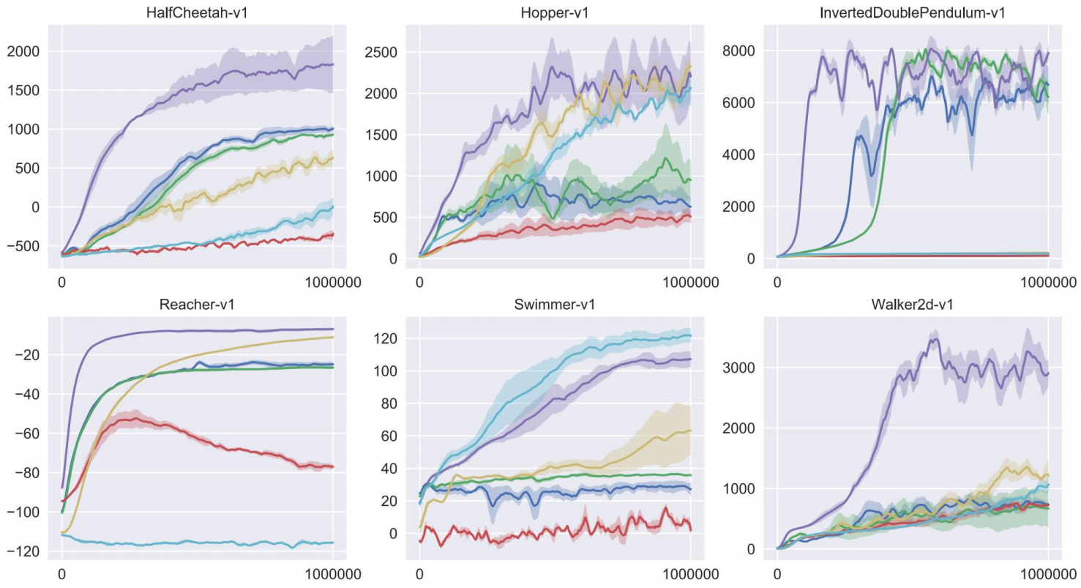
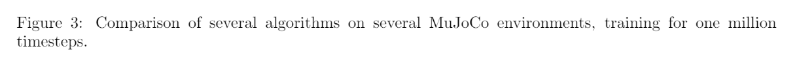
RL Sample Efficiency
J. Schulman et al., “Proximal Policy Optimization Algorithms”. International Conference on Learning Representations, 2017.
Notes:
The plots on this slide are from a very influential paper in the field of RL by Schulman et al published a few years ago. These plots show the performance of some of the most common RL algorithms on a few benchmark problems. The reason I bring this figure up in my presentation is the x axis. The performance is being plotted against the number of timesteps and it’s taking on the order of a million timesteps to achieve good performance in some cases. This level of sample efficiency is not practical for real-time process control.
Let’s say we implement an RL controller on a plant and expect it to take 1 million time steps to reach peak performance. Let’s also assume a sampling rate of 1 second. This means the controller would take 11 and a half days of continuous operation to reach its peak performance. The algorithms in this figure are also generally unsafe and aggressively try out various actions to learn the state-action value function quicker. If we use a safe RL algorithm, the training time would be even slower.

Slide 11
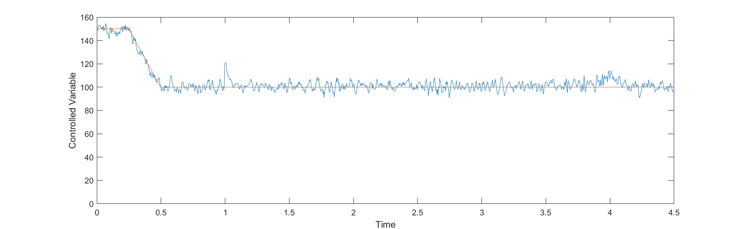
RL Sample Efficiency
Good industrial control tends to create repetitive data
Repetitive data further reduces sample efficiency
Notes:
Unlike the environment on the previous slide, here is what good control tends to look like in industrial process control settings. While we can collect many samples, many of these samples are very similar to each other. Very little additional information can be gleaned from the first million timesteps that isn’t already available in the first thousand time steps. If we only expect the controller to see data within a small range around the operating conditions, there is no problem with this. But if it is exposed to a disturbance or the desired setpoint is changed, the system may be pushed into a part of the state-space it had seen very rarely during training and its performance would suffer.

Slide 12
Addressing Sample Efficiency
Transfer learning: applying a machine learning model trained to solve one problem to a different but related problem
Notes:
The framework we use in our research to address the sample efficiency of RL is transfer learning. The idea is if we are training a machine learning model to solve a problem we’re interested in, the parameters will require less data to train if we initialize the machine learning model with parameters that were previously optimized to solve a similar problem as opposed to randomly initializing the model parameters.
A good example of this is computer vision. Researchers have previously trained neural networks for object recognition on over 14 million annotated images from a database called ImageNet. The models which perform best on this large dataset come packaged with most software libraries you can download for machine learning because if you are designing any sort of computer vision model, it is much more efficient to start from one of these pre-trained computer vision models than from scratch.

Slide 13
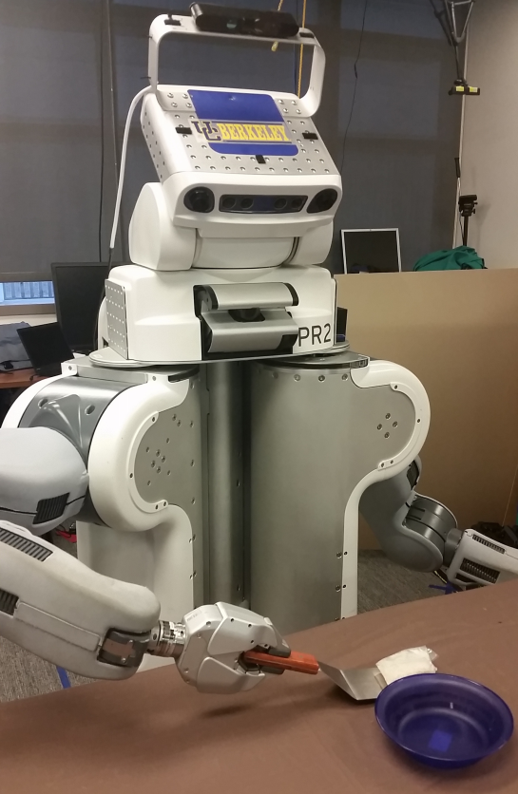
Addressing Sample Efficiency
RL agents can struggle with basic transfer learning
Finn et. al “Deep Spatial Autoencoders for Visuomotor Learning”, IEEE International Conference on Robotics and Automation, 2016.
Notes:
In contrast to people, machines are not always so good at transfer learning.
This picture is a robot Chelsea Finn et al trained using RL to scoop paper into a bowl using a spatula. The problem they found was that the robot did not learn to scoop A paper into A bowl using A spatula, it learned to scoop THAT paper into THAT bowl using THAT spatula. Changing the dimensions of these objects, the weight of the spatula, etc. pushed the robot’s performance almost back to square one. The RL controller learned by the robot generalized very poorly.

Slide 14
Addressing Sample Efficiency
The internal structure of the machine learning model matters for transfer learning
Example: transfer learning for machine translation
“The quick brown fox”
“The quick brown fox”
“Der schnelle braune fuchs”
“La volpe marrone veloce”
(German)
(Italian)
Notes:
This leads to an interesting point. For a machine learning model to effectively pick up new skills, its internal structure matters.
As an analogy, imagine training a machine learning model to translate sentences from English to German. This problem shares similarities to translating from English to Italian, but in all likelihood, the parameters learned for English to German probably wouldn’t be very useful for translating to Italian where the syntax is different.

Slide 15
The internal structure matters for transfer learning
“The quick brown fox”
“The quick brown fox”
“Der schnelle braune fuchs”
“La volpe marrone veloce”
“The quick brown fox”
“The quick brown fox”
article
adjectives
noun
article
adjectives
noun
“Der schnelle braune fuchs”
“La volpe marrone veloce”
(German)
(Italian)
Notes:
HOWEVER, imagine if we modified the internal structure of the machine learning model. Rather than being trained to directly translate from English to German, what if it were trained to extract meaning from the English phrase and identify the parts of speech and then it used this information to construct a German sentence? This model would probably transfer much better to Italian translation since we’d expect roughly half the parameters for these two tasks to be the same. It would be extracting meaning from the English sentence just as before, but how it converted this meaning to a sentence in the target language would be different.
The first part of the machine learning model is creating an embedding to encode information about the meaning of a sentence. An embedding in machine learning is a low-dimensional representation of a higher dimensional input.

Slide 16
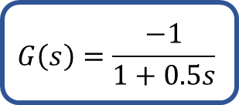

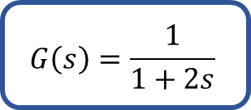
Meta-learning:
Learning an underlying structure across related tasks
Makes adaptation to new tasks more sample efficient
Different process dynamics can be seen as different “tasks”
$$G\left(s\right)=\frac{−1}{1+0.5s}$$
$$G\left(s\right)=\frac{1}{1+2s}$$
$$G\left(s\right)=\frac{2}{1+1.5s}$$
Notes:
This brings us to the current research project focus: meta-learning. The idea is to learn an underlying structure across related tasks to make controller adaptation to a new task more sample efficient. For example, a task could be a unique combination of an objective function and process dynamics. The meta-controller would be pre-trained across many different tasks so it would be able to adapt faster online to any given task.
In our research so far, we primarily focussed on different first order systems but in the future the work can be extended to training across higher order systems as well.

Slide 17
Latent-Variable Meta-RL¹
Control policy is conditioned on the latent variable z
z encodes task-specific information
action
System
RL Controller
System
System
System
reward
z
Encoding Network
state
¹Rakelly et al., “PEARL: Efficiency Off-policy Meta-learning via Probabilistic Context Variables”, ICML, 2019.
Notes:
Our work follows research done by Rakelly et al at UC Berkeley. The idea is to train an RL controller across many different tasks. The actions taken by the RL controller are conditioned on a latent variable z.
This latent variable encodes information about the control objective and the dynamics of the system being controlled. Z is calculated using an encoding neural network.
A controller like this which is meta-trained effectively would require very little task-specific learning. Once it accumulates enough data to estimate the latent variable z, the RL controller would be able to control a process effectively.

Slide 18
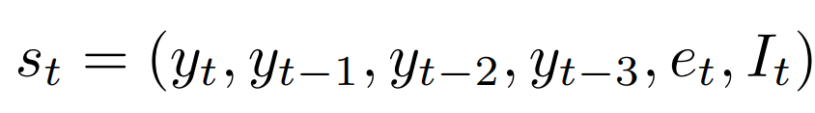
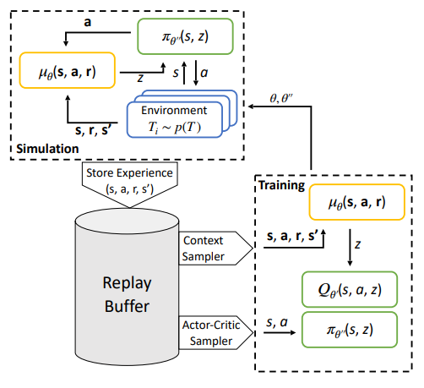

Latent-Variable Meta-RL
Notes:
This figure introduces our methodology.
To train the controller, we must collect data across many different processes. We simulate the current iteration of the RL controller interacting with a control environment. The observed state transitions are used to construct the latent variable z which is input to the controller. The experience generated is stored in a replay buffer so the data can be used to train the controller.
Once a sufficient amount of experience has been generated, the controller is trained using gradient descent. Experience is sampled to compute the latent variable z for different tasks. Experience is then sampled for the actor-critic networks and the latent variable is used as an augmented component of the state vector. Gradient descent is then used to update the actor, critic, and encoder parameters. More experience is collected by simulating the updated controller across different environments.
The state of the system is initially defined as the controlled variable’s value at the current timestep as well as 3 previous timesteps. The state also includes the setpoint error and the integral of the set point error. While most of our simulations only involved a first order system and in theory only the current value of the controlled variable and the set point error would be needed to determine an optimal control action, we found adding redundancies to the state definition made the controller more robust to white noise added during simulations.
The reward function we initially used was the negative absolute set point error. The idea is to maximize future reward, the set point error should be zero. While in many contexts a quadratic regulator is used, we found using an absolute value improved the controller’s performance by placing more emphasis on attenuating small steady-state set point tracking errors.

Slide 19
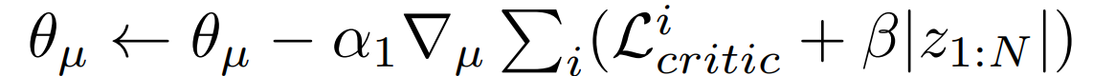
Latent-Variable Meta-RL
Notes:
The actor and critic are constructed and trained using the deep deterministic policy gradient algorithm: a simple model-free deep RL algorithm. The encoder is trained using critic network’s gradient. A regularization penalty, beta, is also applied to the encoding network to encourage latent variables close to zero.
You might ask, if the encoding network is trained using the critic’s gradient, why is not considered as just another part of the critic?
First, The encoding network’s objective is to create a low-dimensional representation of the process dynamics. To enable it to fulfill this purpose, the encoding network is shown state transitions, which include the state of the system at a given time step, the control action taken, the reward received, and the resulting state of the system at the following time step. The encoding network calculates a latent variable for many of these transitions which are then averaged to compute a final estimate of z.
In contrast, the critic takes states, not state transitions, as inputs. It computes a unique output for each input rather than averaging across many different inputs.
Secondly, the encoding network’s latent variable is also used as an input to the actor network unlike any part of the critic network.
The encoding network produces a low-dimensional representation of the system’s dynamics and control objective. The critic conditions its estimate of the state-action function on this latent variable.

Slide 20
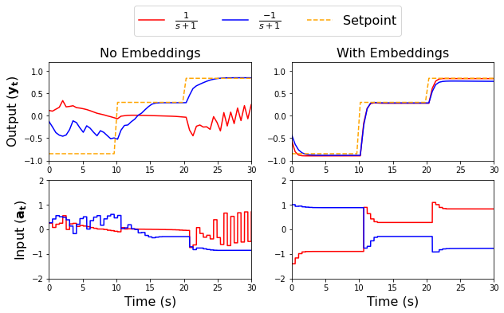
Results
Experiment with training RL controllers to control two processes with opposite gains
Notes:
The first experiment we run is to compare the performance of the meta-controller which uses a latent variable (i.e. embedding) vs a regular RL controller when both are trained the same way across two different processes with the same dynamics but their gains have opposite signs.
The meta-controller can easily master this toy problem while the regular RL controller fails. When considering the composition of the RL state, this makes sense. The state-action value function will be very different for these two processes because the same action taken in each environment will produce a very different response. This is where the latent variable comes in. By conditioning the state-action function on the latent variable z, a meta-state-action value function can be constructed which incorporates both environments.

Slide 21
Results
For future experiments, the state is modified:
This allows the non-meta critic to understand the process dynamics
This adds more complexity to the non-meta critic
Notes:
That experiment isn’t very fair because the regular RL controller has no way to construct a state-action value function which works in both environments without being given enough information to understand which of the two environments it is controlling.
This problem is easily solved by adding past control actions to the state, allowing the controller to understand the process dynamics being controlled from the state information.
However, we suspect this is still not as desirable as the meta-RL formulation. This formulation makes the critic network’s optimization problem more difficult since it must simultaneously solve for the process dynamics as well as the expected cumulative future rewards. The meta-RL algorithm separates the task of understanding the system dynamics and estimating the state-action value into two different problems. When the controller is being trained to adapt to a new system online, the encoding network does not need any further training. Only the actor and critic are trained. We suspect this will improve the sample efficiency when training the controller on a physical system as a much simpler critic network is being trained. One which only computes state-action values rather than one which must also understand the system dynamics. Just like the machine translation example, two machine learning models with the same performance on one task may have quite different abilities to adapt to a new task.

Slide 22
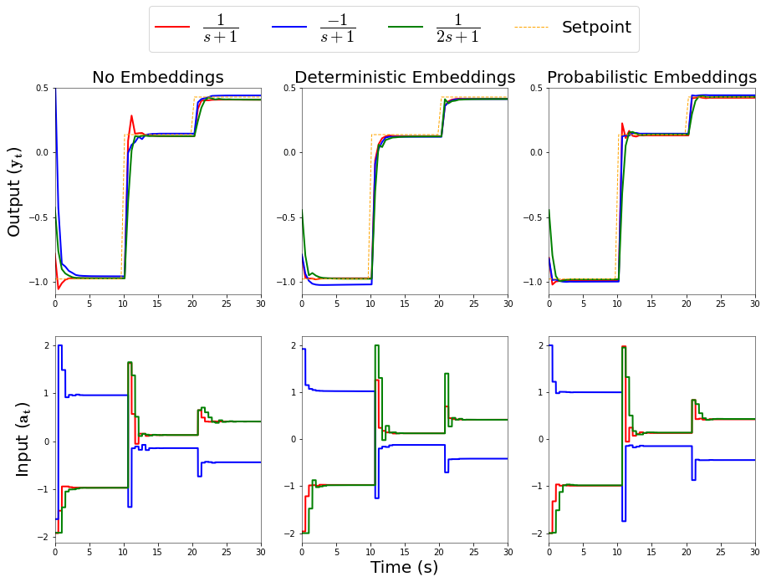
Results
We experiment across a larger distribution of first order systems
Notes:
We then trained the meta-RL and regular RL controller across a larger distribution of first order systems (only a few are plotted to make the figure easier to read)
Even when the non meta-RL controller is given enough information in the state vector to understand the dynamics of the system being controlled, it struggles to condition its control action on these process dynamics.
We can see the regular RL controller takes a very similar control actions for both systems with a positive gain but different time constants. In contrast, the meta-RL controller is better at recognizing the red system has faster dynamics than the green system and is able to avoid the overshoot which occurs with the regular RL controller’s action.

Slide 23
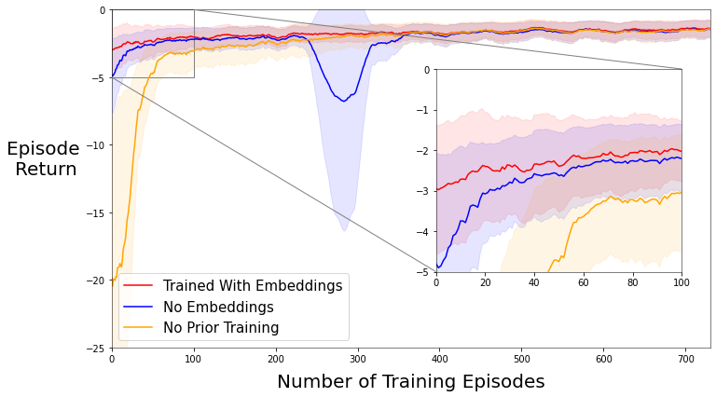
Results
We test how fast regular and meta-RL networks adapt to a new first-order system
Notes:
Most importantly, we test the performance of the meta-RL controller to adapt to a new first order system’s dynamics. We compare its performance to a non-metaRL controller trained using the same first order systems, and a separate RL controller trained from a random parameter initialization on the new system.
While all 3 attain the same asymptotic performance, the meta-RL controller starts very close to it’s asymptotic performance with no task-specific training i.e. it appears to be more sample efficient at adapting to new problems.
The dip in performance for the regular RL controller around the 300th episode is a phenomenon called catastrophic forgetting. I don’t have time to cover this problem in this presentation but I will say that this issue can be mitigated with more sophisticated RL algorithms besides the deep deterministic policy gradient algorithm used in this research project.

Slide 24
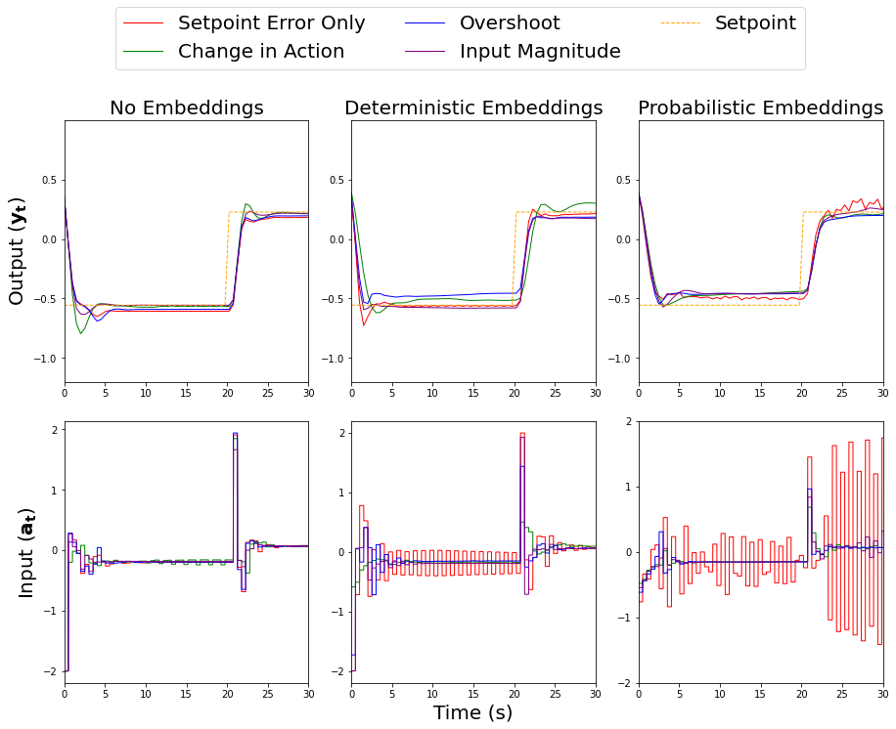
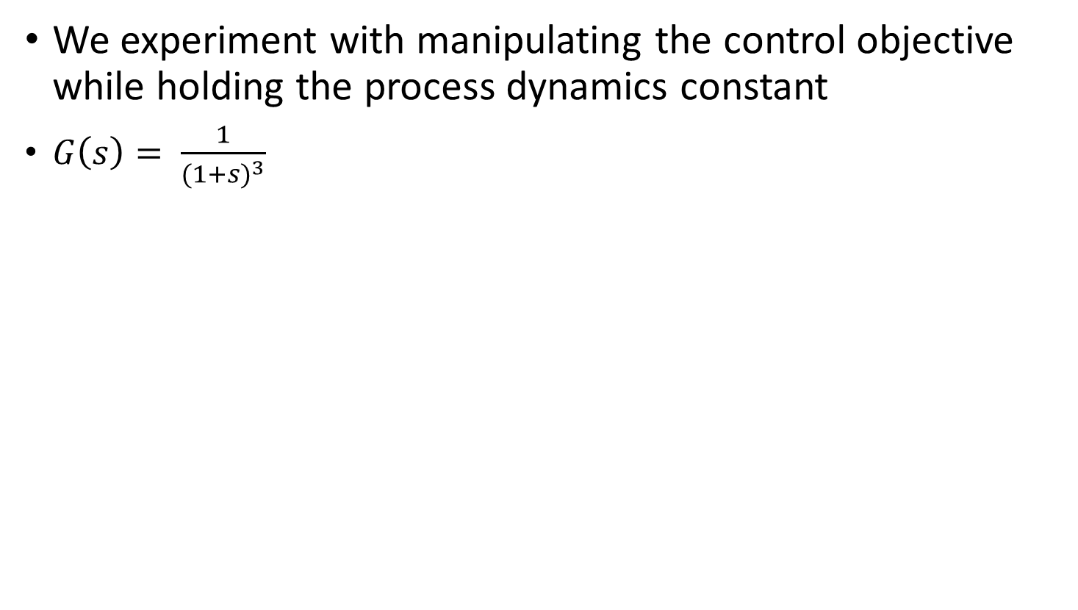
Results
We experiment with manipulating the control objective while holding the process dynamics constant
$G\left(s\right)= \frac{1}{{(1+s)}^{3}}$
Penalties within the Reward Function:
+
+
+
Notes:
Next, we experiment with training our meta-controller across different control objectives while keeping the process dynamics constant. Both a meta-RL controller and regular RL controller are trained on a third order system where different environments penalize different types of control.
For this experiment, past rewards are incorporated into the state vector for the regular RL controller to ensure it has the information necessary to differentiate the control tasks.
The controllers are trained across 4 tasks. One where reward function only penalizes the absolute setpoint tracking error, one where there is an additional penalty for the change in control action between timesteps, one where overshoot and setpoint tracking are penalized, and one where the magnitude of the input is penalized as well as setpoint tracking error.
Once again, we see the regular RL controller seems to learn one general control law whereas the meta-RL controller tailors itself to the particular objective function. When not penalized for changes to control action, it tends to take oscillating control actions for example. This behaviour may not be desirable and demonstrates the importance of picking a suitable reward function, but it illustrates how the meta-RL controller is more responsive to the specific control objective the control engineer asks it to optimize.

Slide 25
Summary
Training meta-RL controllers across a distribution of processes is a promising approach to improve sample efficiency.
Notes:
In conclusion, learning across a distribution of tasks in a manner which enables good transfer learning could be a promising approach to increasing the sample efficiency of reinforcement learning so it can be used for industrial process control. We are continuing to explore different ways meta-RL can be used in process control.
Thank you very much for listening to my presentation.
And thank you to Honeywell and the Natural Sciences and Engineering Research Council of Canada for funding this research.

