Slide 1
Prot2Chat
Protein LLM with Early Fusion of Text, Sequence & Structure
Study & Implementation Review
B.Tech Major Project | CST Department | IIEST Shibpur
Submitted by: Anurag Chaurasia | Guide: Dr. Apurba Sarkar | 2025–2026
Original paper: Wang et al., Bioinformatics 2025, 41(8):btaf396

Slide 2
About the Paper
Prot2Chat
Our Implementation Work
Wang et al. | Bioinformatics 2025 | 41(8):btaf396
Task | Status
Download & setup base model | ✅ Done
Load LoRA weights (PEFT) | ✅ Done
Load adapter checkpoint | ✅ Done
Run Flask web application | ✅ Done
Debug 4-bit quantization issues | ✅ Done
Identify gibberish output root cause | ✅ Done
Apply inference fixes (sampling, bfloat16) | ✅ Done
Full diagnostic logging added | ✅ Done
• Novel protein Question & Answering (Q&A) framework
• Fuses three modalities: amino acid sequence + 3D structure + question text
• Architecture: Modified ProteinMPNN → Text-Aware Adapter → LLaMA3
• 109M trainable parameters — 10–30× fewer than competing models
• Achieves BLEU-2 of 35.85, ROUGE-L of 50.51 on Mol-Instructions
This project involved studying, implementing, and deploying the Prot2Chat system locally. The original research and model training were conducted by Wang et al.

Slide 3
Problem Statement & Motivation
Sequence Only
Models like BioMedGPT miss critical 3D structural context
Separate Encoders
ProtChatGPT, Evola use independent modules — poor cross-modal interaction
Classification Output
FAPM, InstructProtein produce limited structured text, not free answers
No Eval Standard
No multi-metric framework to fairly compare protein Q&A systems
Protein Q&A Model Comparison
Model | Input | Output Type | Trainable Params
Prot2Text | Sequence | Structured text | 256M–898M
BioMedGPT-10B | Sequence + Question | Free text | ~3B
Evola-10B | Structure + Seq + Q | Free text | ~1.7B
ProtChatGPT | Structure + Seq + Q | Free text | Large
Prot2Chat (Wang et al.) | [Struct+Seq+Q] Early Fusion | Free text | 109M ✓

Slide 4
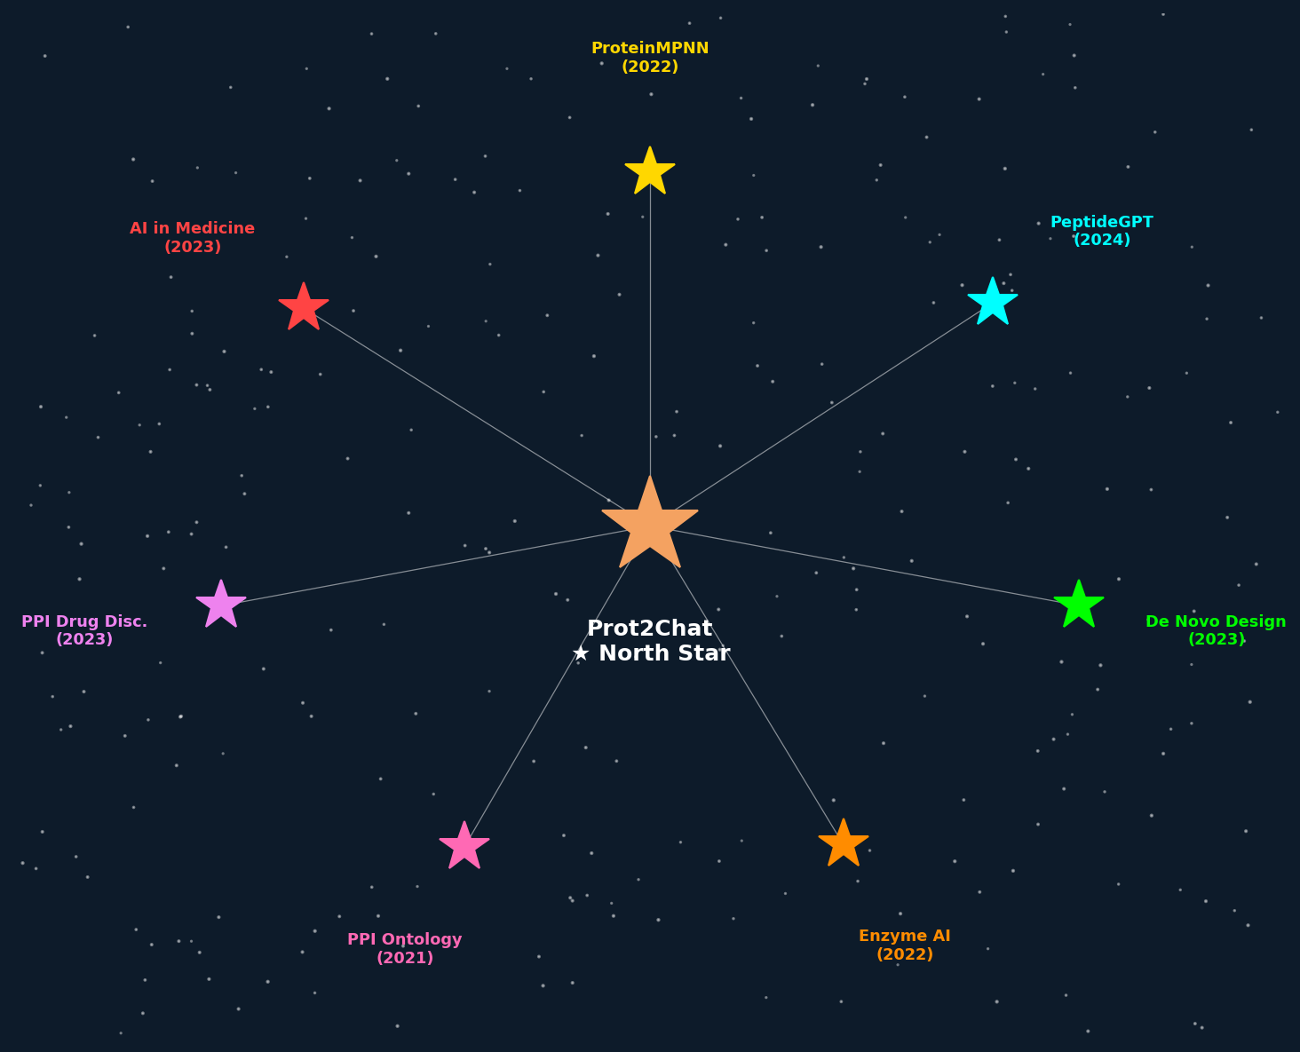
Literature Review – Research Constellation
Each star = a key reference paper studied. Prot2Chat (North Star) synthesises insights from all surrounding research themes.

Slide 5
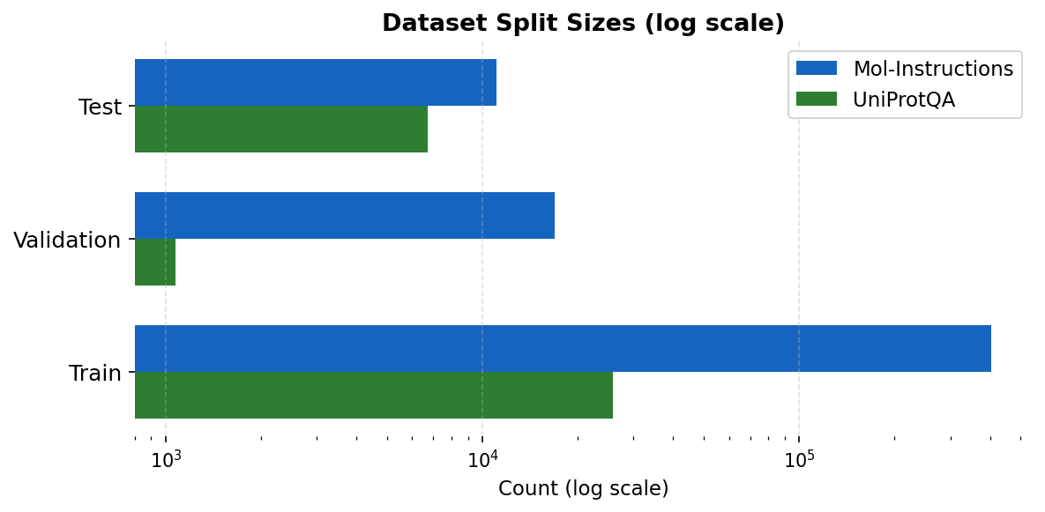
Datasets Used in Training & Evaluation
Mol-Instructions
UniProtQA
Source: UniProtKB / SwissProt
Source: UniProt Knowledge Base
Protein domains, functions & biological activity Q&A pairs
Protein function & property textual descriptions
Split | Count
Train | 404,640
Validation | 16,859
Test | 11,072
Total | 432,571
Split | Count
Train | 25,820
Validation | 1,075
Test | 6,734
Total | 33,629
Used for: Primary training
Used for: Zero-shot & fine-tuned generalisation

Slide 6
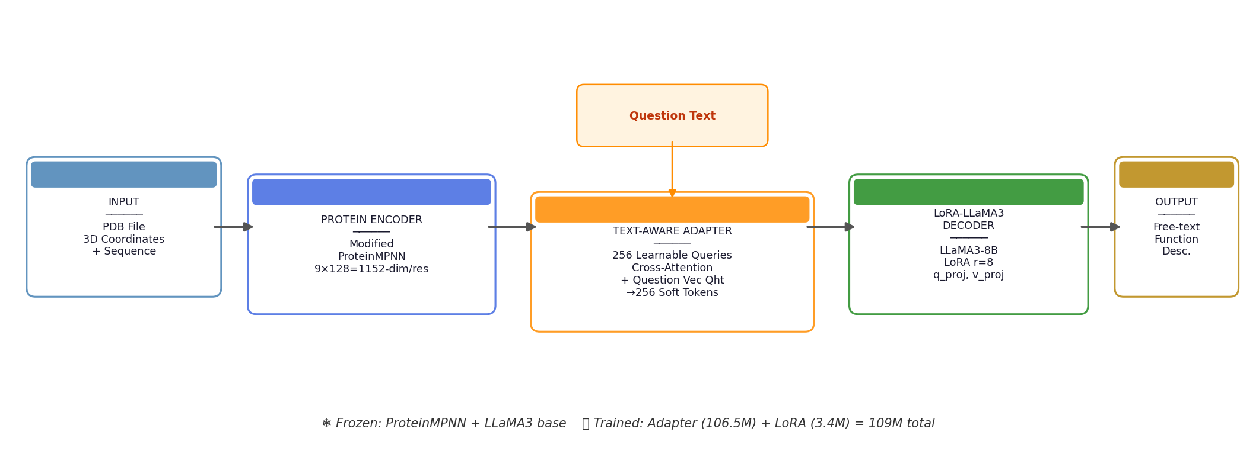
Prot2Chat – System Architecture Overview
Input: PDB + Question
Encoder Output: 1152-dim
Adapter Output: 256 × 4096
Total Params: 109M

Slide 7
Protein Encoder – Modified ProteinMPNN
How ProteinMPNN Was Modified
9-Model Ensemble → 1152-dim
• ProteinMPNN (Dauparas et al., 2022): originally designed for sequence design from backbone 3D coords
• Processes atoms: N, Cα, C, O per residue
• Standard init: hV = Zeros(n, Dc) ← node features start as zero
• Prot2Chat change: hV = Embedding(S) ← initialise with sequence embeddings
• Result: structural processing is guided by sequence identity from the very first layer — true early fusion with no extra training
# | Model Type | Noise σ | Output Dim
1 | Full-atom | 0.02 | 128
2 | Full-atom | 0.10 | 128
3 | Full-atom | 0.20 | 128
4 | Full-atom | 0.30 | 128
5 | Soluble | 0.02 | 128
6 | Soluble | 0.10 | 128
7 | CA-only | 0.02 | 128
8 | CA-only | 0.10 | 128
9 | CA-only | 0.20 | 128
Concatenated | — | — | 1152-dim ✓
 | Standard ProteinMPNN | Prot2Chat Version
Node Init | hV = Zeros(n, Dc) | hV = Embedding(S)
Extra Params | — | None (frozen)

Slide 8
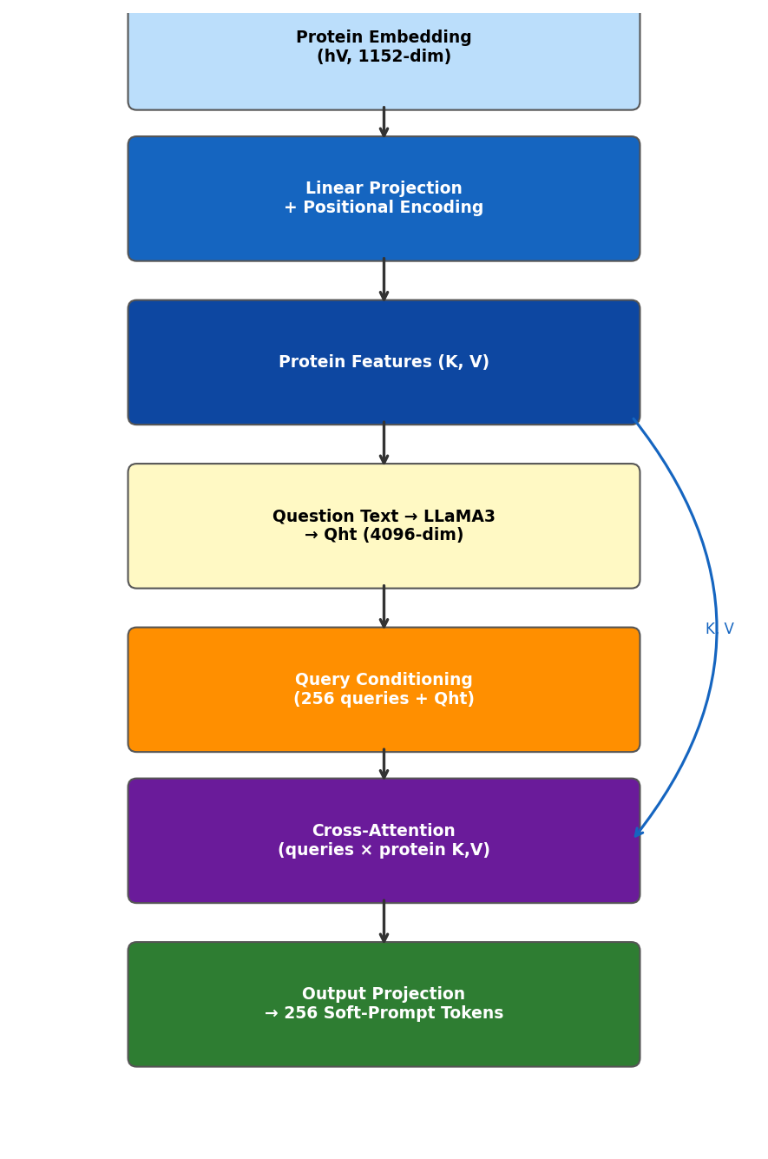
Text-Aware Protein-Text Adapter
Adapter Processing Steps
1. Linear Projection + Positional Encoding: Xproj = Wproj · hV + PE
2. Question Vector from frozen LLM: Qht = LLM(question).hidden_state[last_token]
3. 256 learnable queries conditioned on Qht: Q' = Q_learned + question_proj(Qht)
4. Multi-head Cross-Attention (16 heads): Ak = softmax(Qk Kk^T / √Dk) · Vk
5. Output Projection → 256 soft-prompt tokens Xprotein ∈ ℝ^(256 × 4096)
Why Early Fusion Matters:
Approach | BLEU-2 | ROUGE-L
Late Fusion (no Qht in adapter) | 33.25 | 47.90
Early Fusion (Qht in adapter) ✓ | 35.85 | 50.51

Slide 9
LLM Decoder – LoRA Fine-Tuned LLaMA3
LoRA Configuration
Training Setup
Parameter | Value
Base Model | LLaMA3-8B-Instruct
LoRA Rank (r) | 8
LoRA Alpha | 16
Dropout | 0.1
Target Modules | q_proj, v_proj
LoRA Params | 3,407,872
• Dataset: Mol-Instructions (404,640 samples)
• Optimizer: Adam, LR = 1×10⁻⁴
• Batch size: 2 + gradient accumulation (×16)
• Max context: 1,024 tokens (question + answer)
• Epochs: 2
• Loss: CrossEntropyLoss (masked to answer tokens)
• Hardware: NVIDIA RTX 3090 (24GB VRAM)
• Duration: ~1,600 GPU-hours
• Precision: PyTorch AMP (float16)
Parameter Budget
Key Design Principle:
Component | Params | State
ProteinMPNN | 0 | Frozen ❄
Adapter | 106,483,712 | Trained 🔥
LLaMA3 LoRA | 3,407,872 | Trained 🔥
LLaMA3 Base | ~8 Billion | Frozen ❄
TOTAL TRAINED | ~109 Million | —
Freeze the encoder & LLM base. Train only the adapter + LoRA. This keeps parameter count at 109M while achieving state-of-the-art performance.

Slide 10
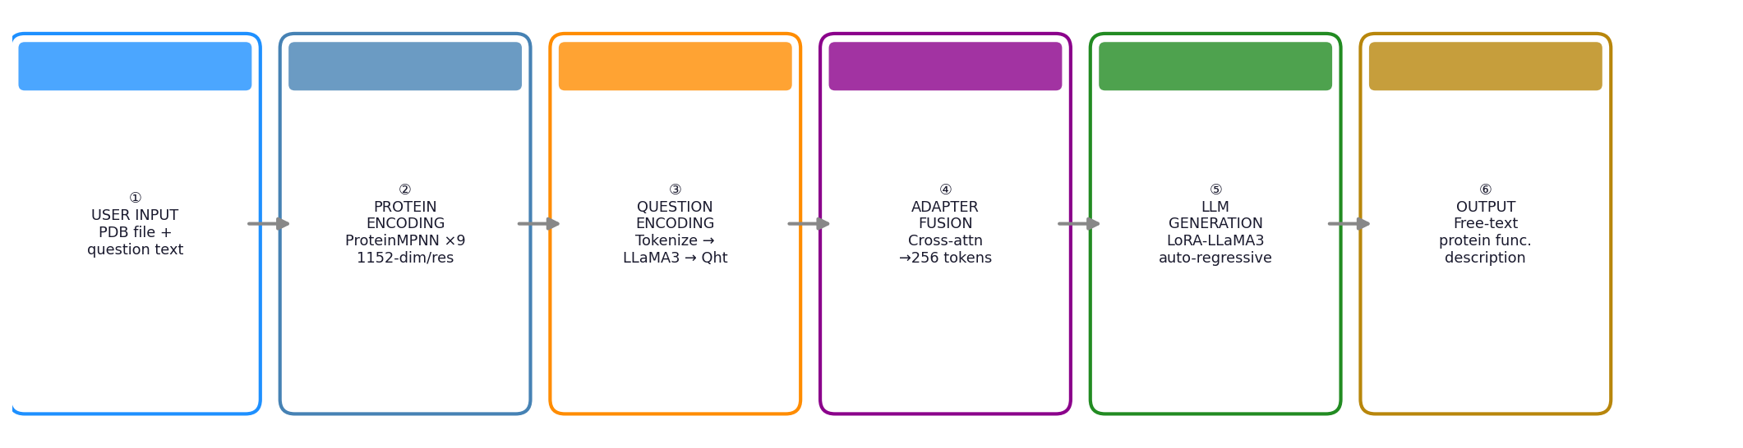
How the System Generates an Answer
Technical Details
• Input: 256 protein tokens + ~15 question tokens
• Protein embed norm: ~408 vs text norm: ~0.4
• Sampling: temperature=0.3, top_p=0.9
• repetition_penalty=1.3, no_repeat_ngram=4
Deployment (Our Implementation)
• Flask REST API: POST /api/query
• Input: multipart/form-data (PDB + question)
• Output: JSON {"answer": "..."}
• 4-bit NF4 quantization (bfloat16 compute)
• Flags: --zero_question, --no_quant, --no_lora

Slide 11
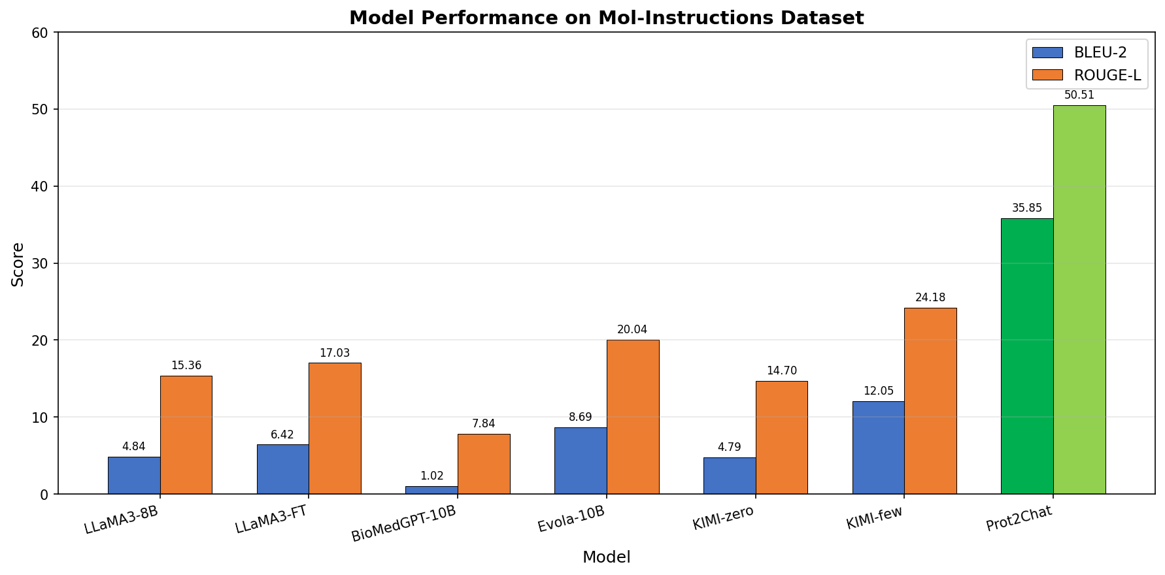
Experimental Results – Mol-Instructions Dataset
Performance Scores
Model | BLEU-2 | ROUGE-L
LLaMA3-8B | 4.84 | 15.36
LLaMA3-FT | 6.42 | 17.03
BioMedGPT | 1.02 | 7.84
Evola-10B | 8.69 | 20.04
KIMI zero-shot | 4.79 | 14.70
KIMI few-shot | 12.05 | 24.18
Prot2Chat | 35.85 | 50.51
Prot2Chat achieves 35.85 BLEU-2 — over 4× Evola-10B (8.69) and 2.9× KIMI few-shot (12.05) — with only 109M parameters

Slide 12
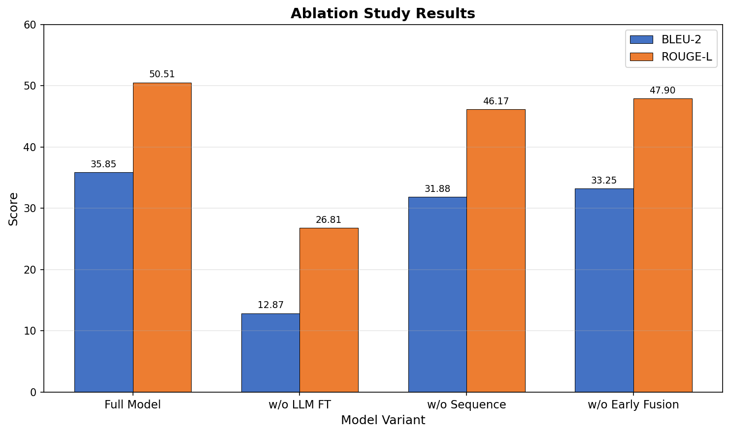
Ablation Study – Impact of Each Component
What Each Component Contributes
Removed | BLEU-2 | Drop
None (Full model) | 35.85 | —
w/o LLM fine-tuning | 12.87 | ▼64%
w/o Protein sequence | 31.88 | ▼11%
w/o Early text fusion | 33.25 | ▼7.3%
🔥 LLM fine-tuning is the most critical component — removing it causes 64% drop
🧬 Sequence adds identity info that structure alone cannot provide
💬 Early fusion of question text improves relevance by 7.3%

Slide 13
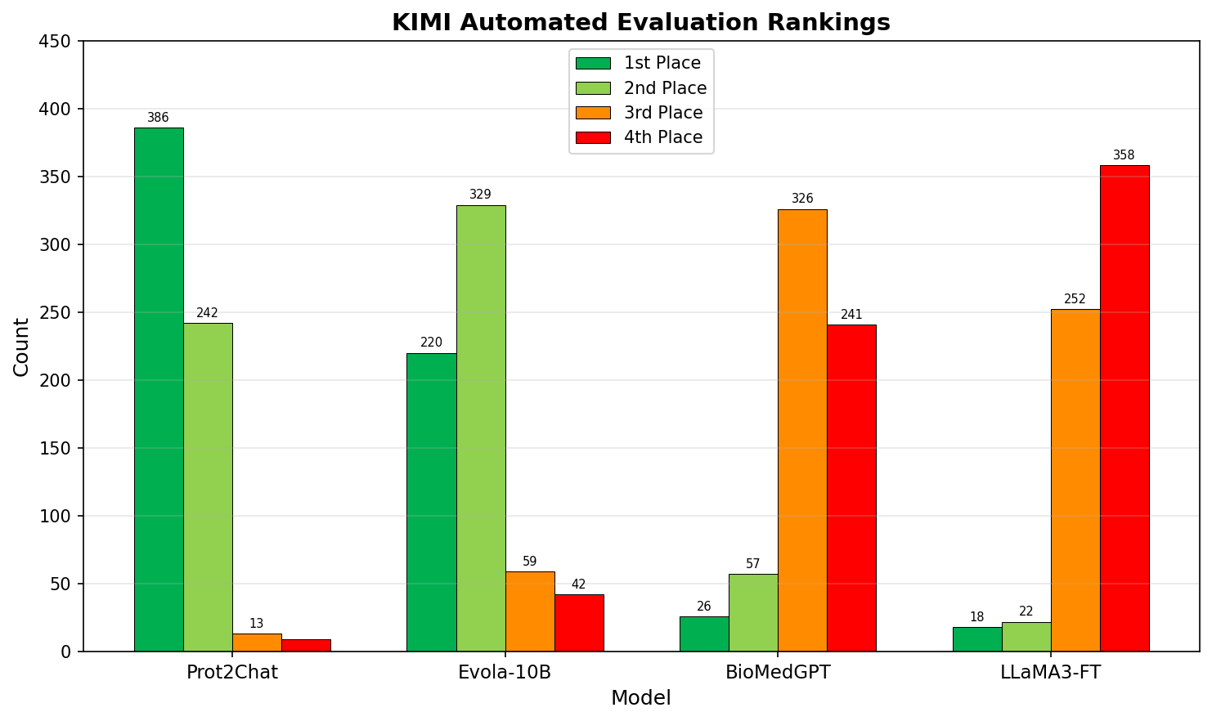
Expert Evaluation & Case Study
KIMI Automated Ranking (650 samples)
Case Study – Protein O58736
Q: Assess potential function from structure + sequence
LLaMA3-FT
Lists transmembrane regions. No functional prediction. Generic sequence analysis.
Prot2Chat ✓
Identifies adenylate kinase activity, ATP biosynthetic process, and phosphorylation.
Model | Avg. Rank | 1st Place
Prot2Chat | 1.45 | 386/650
Evola-10B | 1.88 | 220/650
BioMedGPT | 3.20 | 26/650
LLaMA3-FT | 3.46 | 18/650
Ground Truth
ATP binding and phosphorylation involvement confirmed.
Expert ranking mirrors KIMI (1.49 vs 1.45 avg rank) — validates automated evaluation reliability

Slide 14
Conclusion & Future Scope
Key Findings from the Study
Future Scope
✅ Early fusion outperforms late fusion (BLEU-2 +7.8%)
✅ Structure + Sequence beats Sequence alone (+12.6%)
✅ LLM fine-tuning gives the biggest boost (+170%)
✅ 109M params outperforms models 10–30× larger
✅ Expert & KIMI evaluations are highly consistent
🔭 Integrate AlphaFold3 predictions — remove PDB requirement
🔭 Extend to protein complexes & protein-ligand interactions
🔭 Apply framework to multi-omics (genomics, metabolomics)
🔭 Larger, higher-quality protein Q&A training datasets
🔭 Real-time drug discovery pipeline integration
Limitations
Our Implementation Contribution
⚠ Requires PDB file — limits proteins without known structure
⚠ ~1,600 GPU-hours for training on RTX 3090
⚠ Zero-shot performance modest (BLEU-2: 2.23 on UniProtQA)
⚠ 4-bit quantization causes output degradation on low-VRAM GPUs
Implemented the complete Prot2Chat inference pipeline locally. Diagnosed and documented the 4-bit quantization issue causing gibberish output. Applied fixes: bfloat16 compute dtype, --zero_question flag, temperature sampling, and detailed diagnostic logging. Contributed to GitHub: github.com/a-nnurag/Prot2Chat

Slide 15
Thank You
Questions & Discussion
Paper: Wang et al. | Bioinformatics 2025 | DOI: 10.1093/bioinformatics/btaf396
Implementation by: Anurag Chaurasia | IIEST Shibpur | 2025–2026
GitHub: github.com/a-nnurag/Prot2Chat

