Slide 1
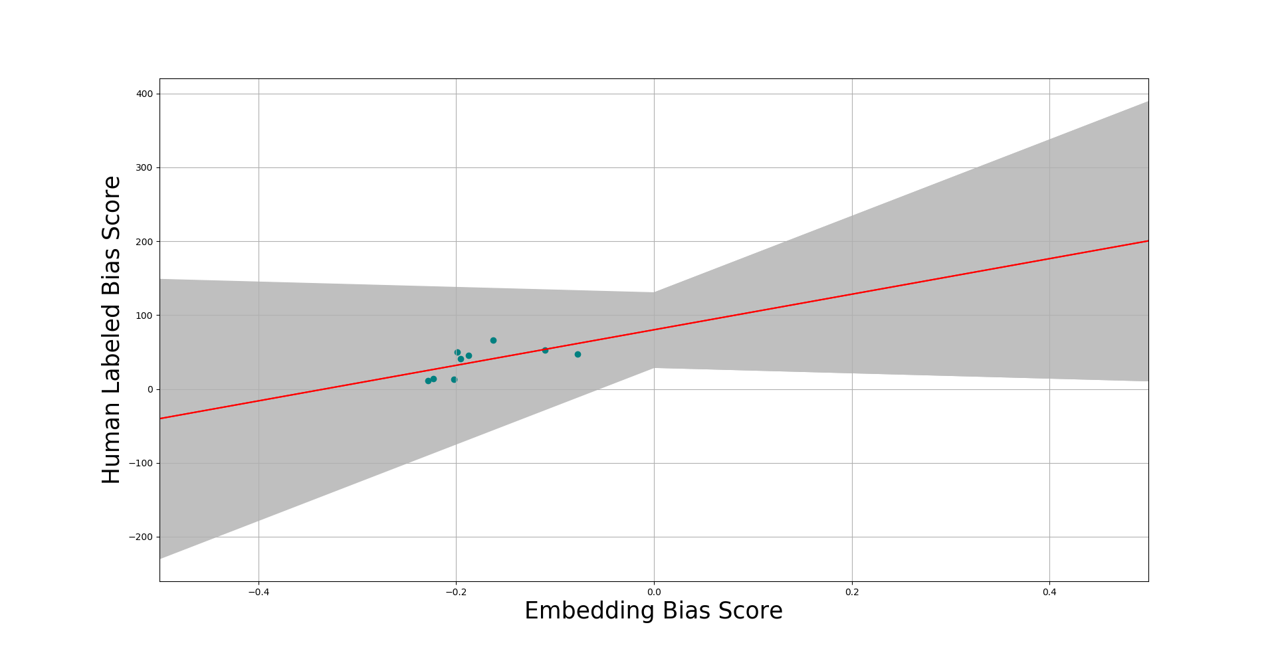
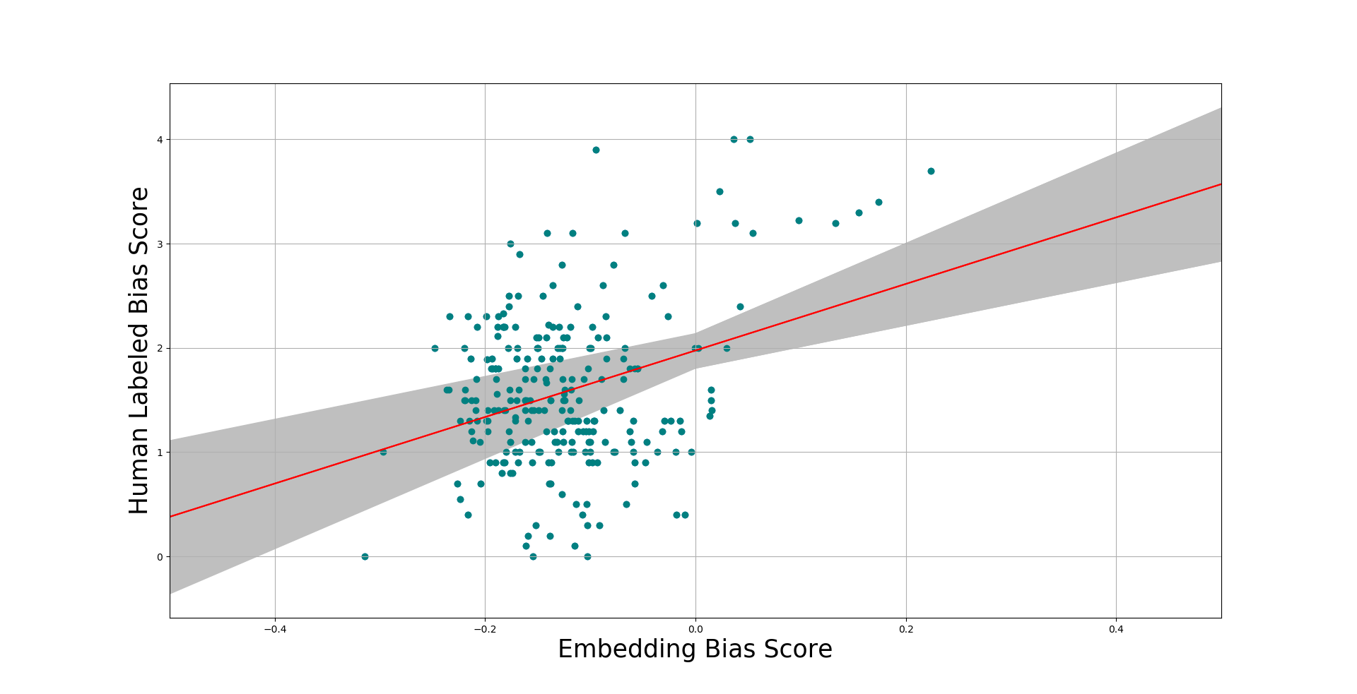
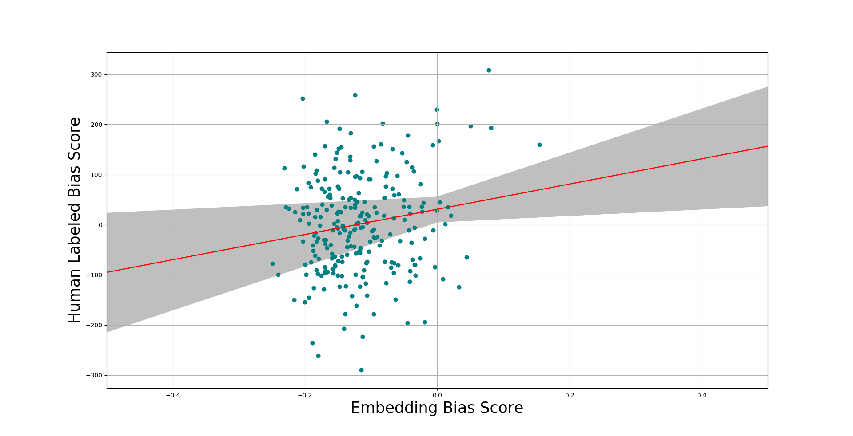
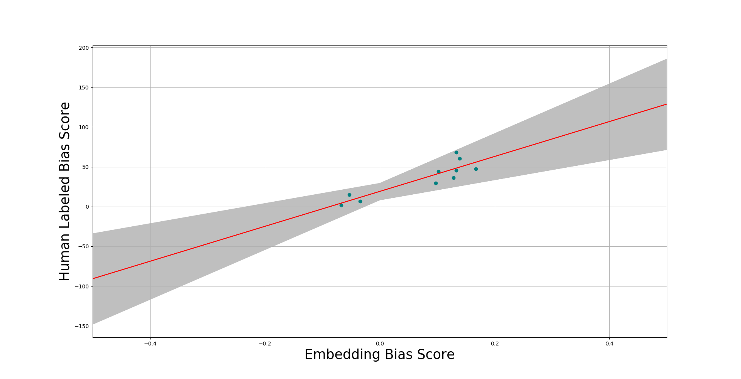
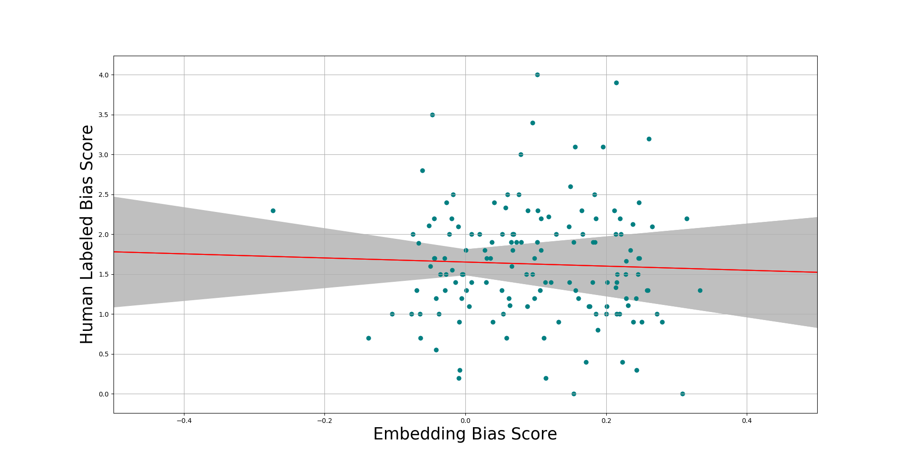
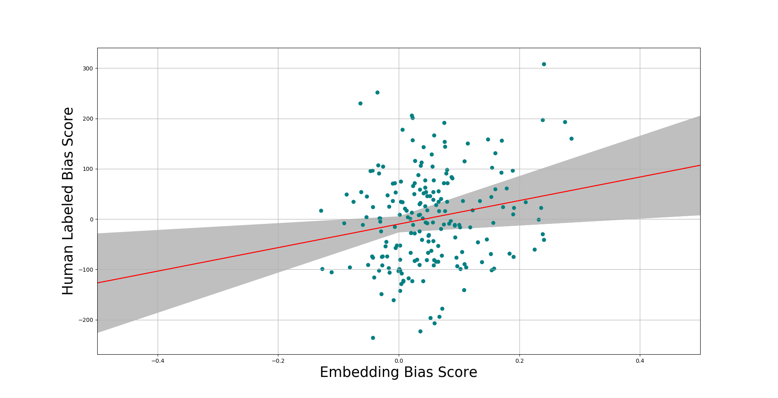
Word Embeddings Quantify 100 Years of Gender and Ethnic Stereotypes:
Looking into Bias in Korean and Japanese Word Embeddings
Team 3
Youngin Lee, Minseon Hwang, Jaewoo Ji
Introduction
Methodology
Dataset
Natural language and word embeddings trained on natural language can reflect gender and ethnic stereotypes
Original paper constructs a framework to quantify such bias
Applying framework to Korean and Japanese can confirm that gender bias is strongly reflected in Korean and Japanese word vectors
We performed ordinary least square regression with embedding bias scores and three metrics: participation rate and human labeled scores for occupation and adjectives
Embedding Bias Score: difference in distance from neutral word vectors to group vectors
Bias Score for Women = (distance to male) – (distance to female)
Higher bias score is favorable to women
Compare bias score with real life metrics using ordinary least-square regression
Word Vectors
Fasttext word vectors obtained from Korean and Japanese Wikipedia dump
Fasstext shows better performance for morphological languages (KR, JP)
Metrics
Female participation rate for occupations in Korea and Japan
Human labeled gender bias scores on occupations translated to Korean and Japanese
Human labeled gender bias scores on adjectives translated to Korean and Japanese
Neutral Words
Averaged Vector for Group A
Occupations
Averaged Vector for Group B
Words related
to Female
Her
She
Mother
…
Adjectives
Words related
to Male
He
Him
Father
...
Results
Female Participation Rate by Industry
Human Labeled Gender Bias on Occupation
Human Labeled Gender Bias on Adjectives
Korean
Participation rate(%)
Japanese
P-value: 7.896e-02, r squared: 0.3762
P-value: 4.051e-08, r squared: 0.1186
P-value: 8.559e-03, r squared: 0.0273
Participation rate(%)
P-value: 6.098e-04, r squared: 0.7877
P-value: 0.6330, r squared: 0.0016
P-value: 5.958e-03, r squared: 0.0371
The grey area indicates the 95% confidence interval of the regression.
Discussion
Conclusion
Most trials show a significant positive correlation between embedding bias and real life metrics
For occupation participation rates, only a small number of sample points were available
Statistics are for industries (9 for Korean, 11 for Japanese) instead of individual occupations
For gender stereotypes on occupation in Japanese, the data does not show a clear correlation
This might be due to a high percentage (48.9%) of OOV words in the translated list in Japanese
Translation posed a moderate problem, as some words in English did not translate into a single word in Korean or Japanese (ex. Businesswoman => 여성 사업자)
The original list had multiple words with the same meaning (ex. Taxi driver and cab driver) and different scores
For these words we took the most general meaning (the first word in NAVER’s dictionary) and an average of the scores
The human labeled scores were taken from studies conducted in the U.S., and might not correctly reflect the social stereotypes of Korea and Japan
Our study still produced meaningful results; however, human labeled scores obtained in Korean and Japanese might increase the accuracy of the analysis
Confirmed gender bias in Korean and Japanese word vectors
Discovered significant positive correlation between embedding bias and participation rate, human labeled bias scores for occupations and adjectives
Lack of fine-grained statistics for participation rate and translation issues might affect robustness of result
In further research, obtaining human labeled bias scores in Korean and Japanese might add to robustness of the results

