Slide 1

Improving User Journey in Purchase Funnel for Meesho
By Sarthak Gadge and Anushka Negi

Slide 2



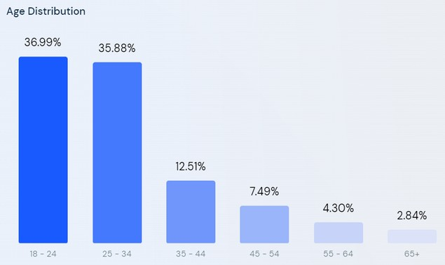



Overview
About Meesho:
Meesho is a social commerce platform that undertakes retail distribution, enabling small retail merchants to connect and sell their products effectively via social media channels. The startup aims to create about 20 million micro-entrepreneurs. There are over 2.6million resellers on the Meesho platform and more than 20,000 manufacturers from more than 500 towns who get distribution through Meesho.
Audience Demographics
4.4
4.5

Slide 3
User Research and Insights
Key Questions Asked:
Conducted an online user survey to understand the user motivations and painpoints and explore the possibility to introduce new features to enhance the user experience.
How long have you been using Meesho?
How Frequently do you shop from Meesho?
What difficulties did you face while shopping from other categories than clothing?
Do you feel it confusing while choosing from large number of options?
Do you feel the product image/descriptions on Meesho were accurate when you received the actual product?
How much did you trust the product reviews?
Are you interested in getting featured on product page as a model?
40.5%
64.3%
52.4%
71.4%
40.6%
feel it is hard to shop from any other category other than clothing because of lack of quality, price, lack of good product reviews and ratings
64.28% people feels it confusing while choosing from large number of options
52.38% people feel the product image/descriptions on Meesho were not accurate to what they received as actual product
40.57% people are interested in getting featured on the product page as model
71.42% people do not trust the product reviews

Slide 4


User personas
Shubham is pursuing his bachelors degree. Along with it he is also doing an internship. He is a regular Meesho customer and spent about 3-4k per month on shopping mainly from clothing and personal care category products from meesho.
Pain Points:
Unable to find genuine product reviews and images for a lot of products. Searching for a specific product on the app is time consuming.
Product categories are quite confusing and time consuming to browse.
Not getting any rewards out of Meesho coins earned from shopping regularly.
Shubham Goyal
22, Delhi, Student
Sharda is a housewife and lives with her husband and daughter. She is relatively new to Meesho, started shopping online during COVID to avoid the hassle of offline stores. She shops mostly budget products from household, cloths, and beauty categories.
Pain Points:
Product discovery is poor as compared to other ecommerce platform.
Most of the product image and reviews are not genuine and the genuine ones are hard to find due to spammed ratings and reviews section.
Unable to find the right size fit for her kid.
.
Sharda Sharma
32, Indore, Housewife

Slide 5

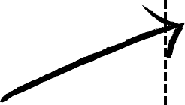

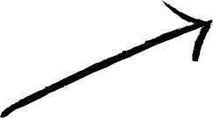

User Journey
Pre Purchase
During Purchase
Post Purchase
😄
Opens Meesho APP
😕
😩
😑
Browses the offers and category pages, all categories looks similar, not sure what to buy
Meesho Coins received, but not sure what to do next after this tiresome purchase
Chooses product from a huge catalogue, a very tiresome job
Proceeds for payment and order placed, still not satisfied with the purchase due to lack of information available for product
Checks ratings and reviews of product to better understand, but the reviews section is spammed with Product image screenshots

Slide 6
Problem Identification and Goals
Problems Identified:
Meesho, which originally offered only clothing, now serves wide categories of products like home and kitchen appliances, electronics, beauty and health products, etc. However, the users face difficulties in navigating through the categories section in the app.
Many users face difficulty in making a final decision of purchase, primarily because they don't trust the "Ratings and Reviews" section of a product due to fake reviews. The reviews section helps users determine important details like discrepancies between featured photos and shipped products.
The Meesho coins earned by the users after shopping cannot be used for getting any real reward/discount coupons which reduces the user's motivation to shop regularly from Meesho and also reduces the user's engagement with the app after the purchase.
Goals:
To improve the UI of the Categories section to differentiate better between different categories in order to save user's time, reduce confusion and enhance the user experience.
To restructure the UI of ratings and reviews section to show the genuine reviews and photos to the user first in order to help user get genuine information about the product.
To make the platform more engaging for post purchase by introducing a feature to play games and use the meesho coins to realize real rewards.

Slide 7
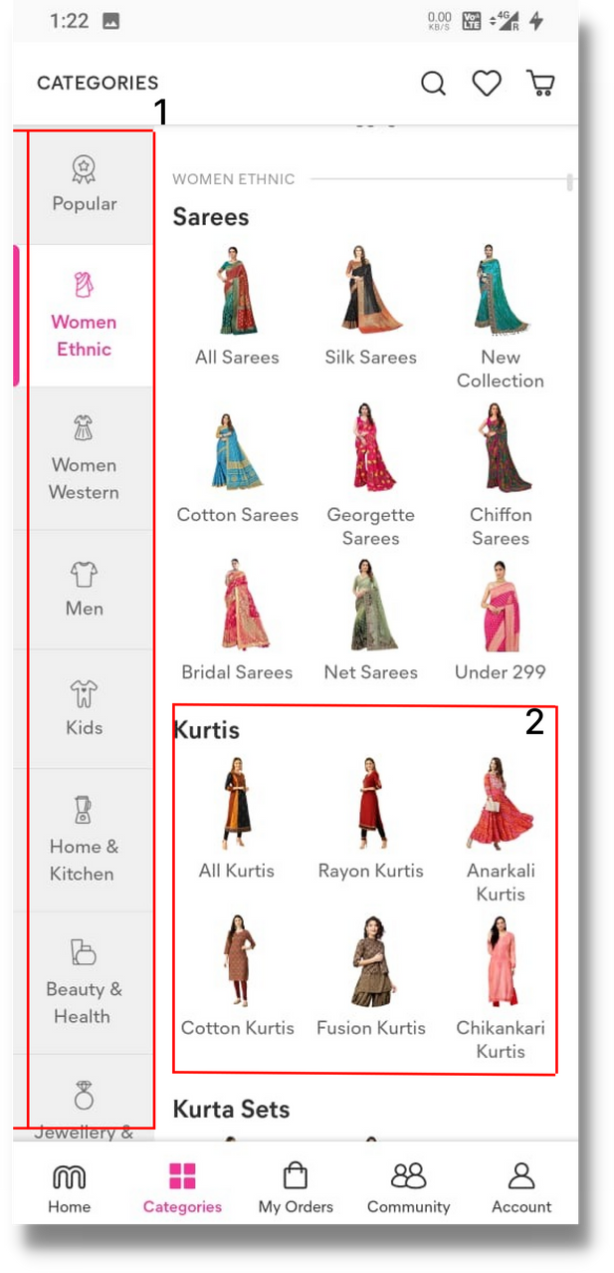
Feature #1: UI Improvement for Categories section
Problem with existing UI: The current implementation of the categories section has a choice overload bias where people have a difficult time making a decision when faced with too many options.
All the categories are in a scrollable list that spans over 2 mobile screens. Searching for the relevant product category in this UI frustrates users.
Categories, sub-categories, and different types of products are all displayed at a single time which further increases the cognitive overload of the user.
Hypothesis:
The current product category and subcategory distribution reduces the category differentiation and reduces
the product discovery
ultimately decreasing the customer satisfaction.
Dividing current product categories in various bucket such as trending, most popular, etc. will help user browse them easily and conveniently.

Slide 8
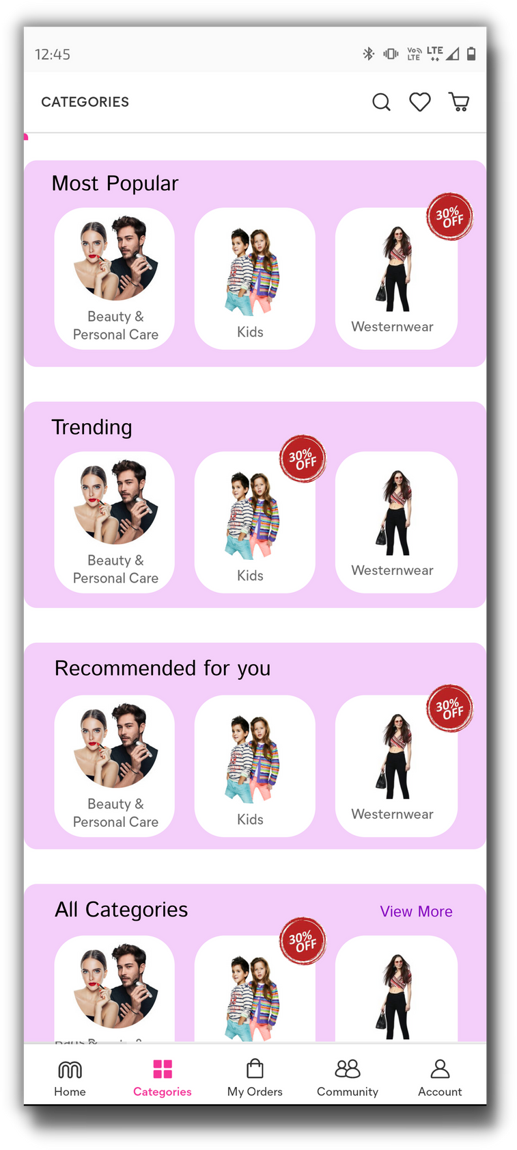
Feature #1: UI Improvement for Categories section
Feature Overview:
Bucketing the categories in "Trending", "Most popular", and "Recommended for you" categories to nudge the users to explore popular categories and categories they might like
Highlighting the discounts, if any for each category for user consideration
Displaying all the categories on a single screen which aims to reduce the friction of choice for users.
Metrics to be Tracked:
Bounce rate (success: decreases by 25%)
av. ratio of no. of clicks on trending categories to all categories section per user* > 0.5
* similar for most popular and recommended for you section

Slide 9
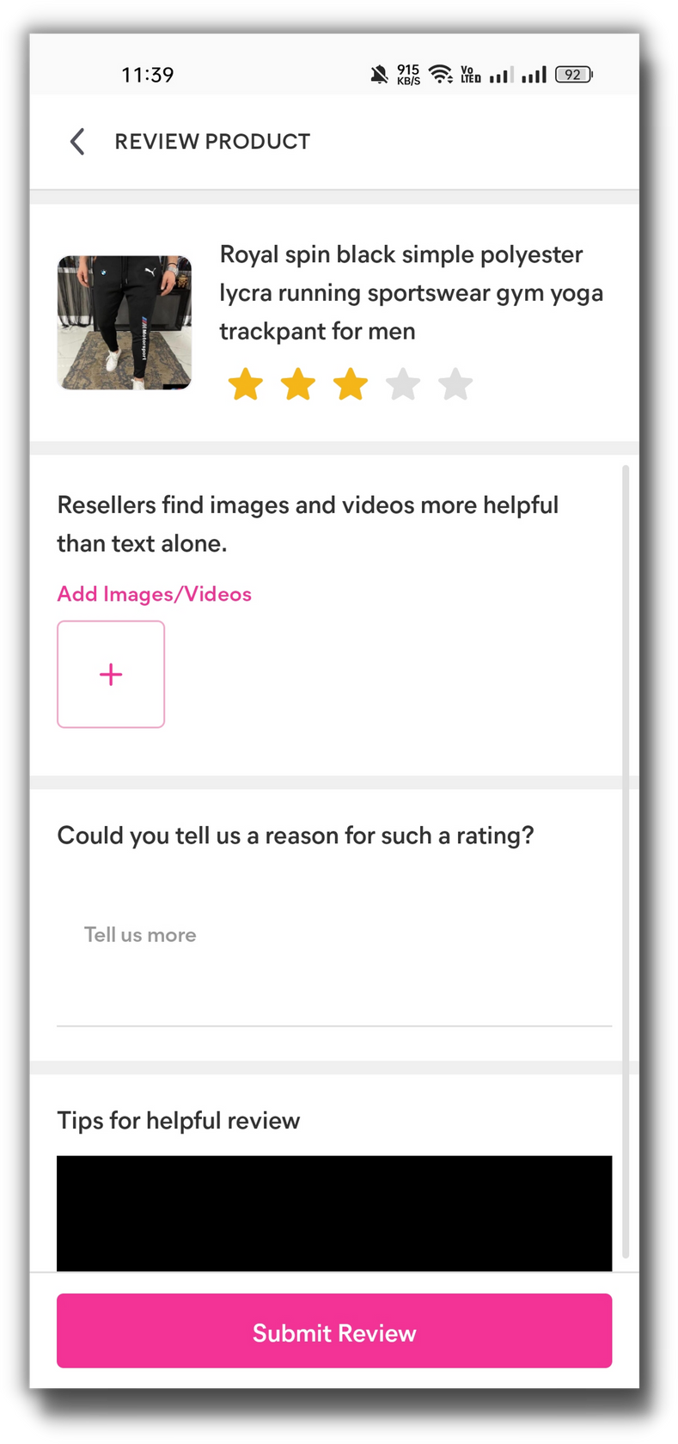
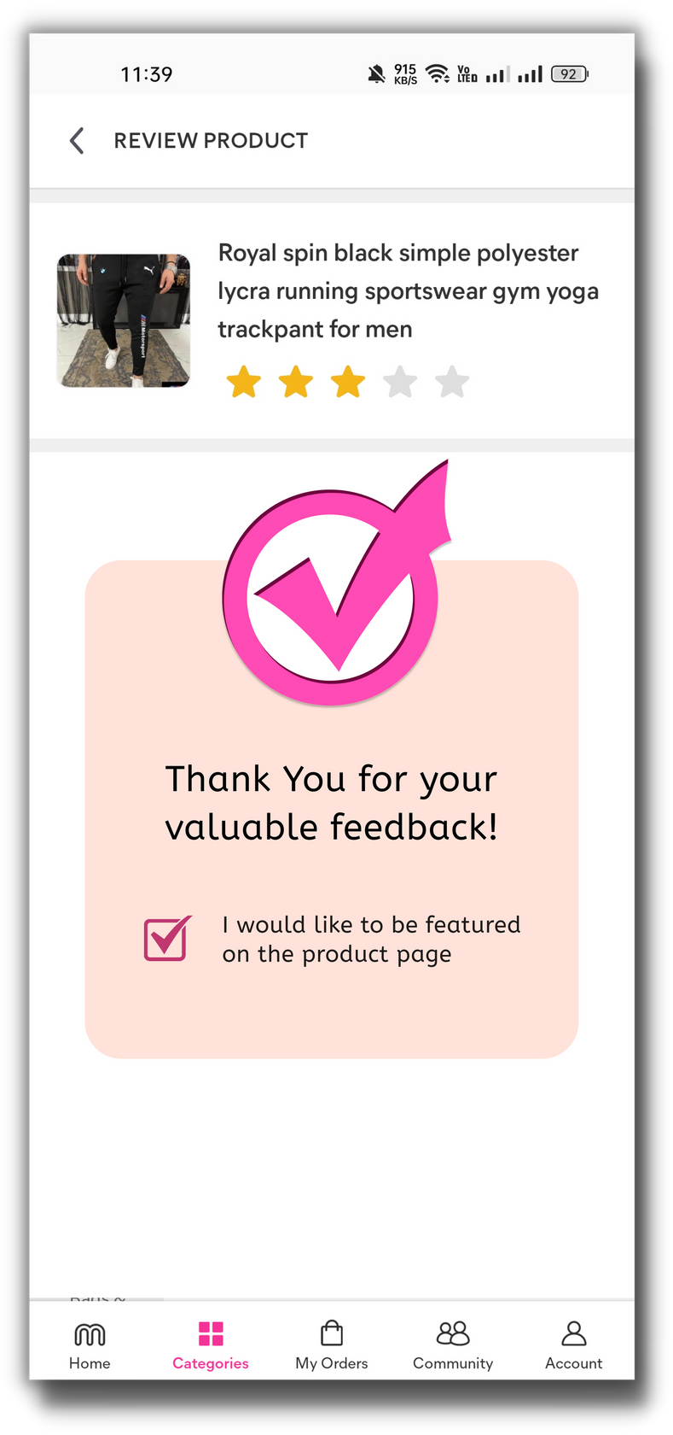
Feature #2: Improved Reviews Section
Hypothesis:
Genuine photos and videos in reviews will help users make better-informed decisions about purchasing an item.
The majority complaints of Meesho are regarding the return policy. The root cause of these complaints is a discrepancy in chosen and shipped. These malpractice sellers will be filtered out in a better way with genuine reviews.
Features overview:
Users can be nudged to upload genuine media on the "Add a review" page using Meesho coins as an incentive (10 coins for genuine images and 50 coins for genuine video (min. 5 secs) can be awarded).
User will also be given a chance to be featured on product page as an incentive.

Slide 10
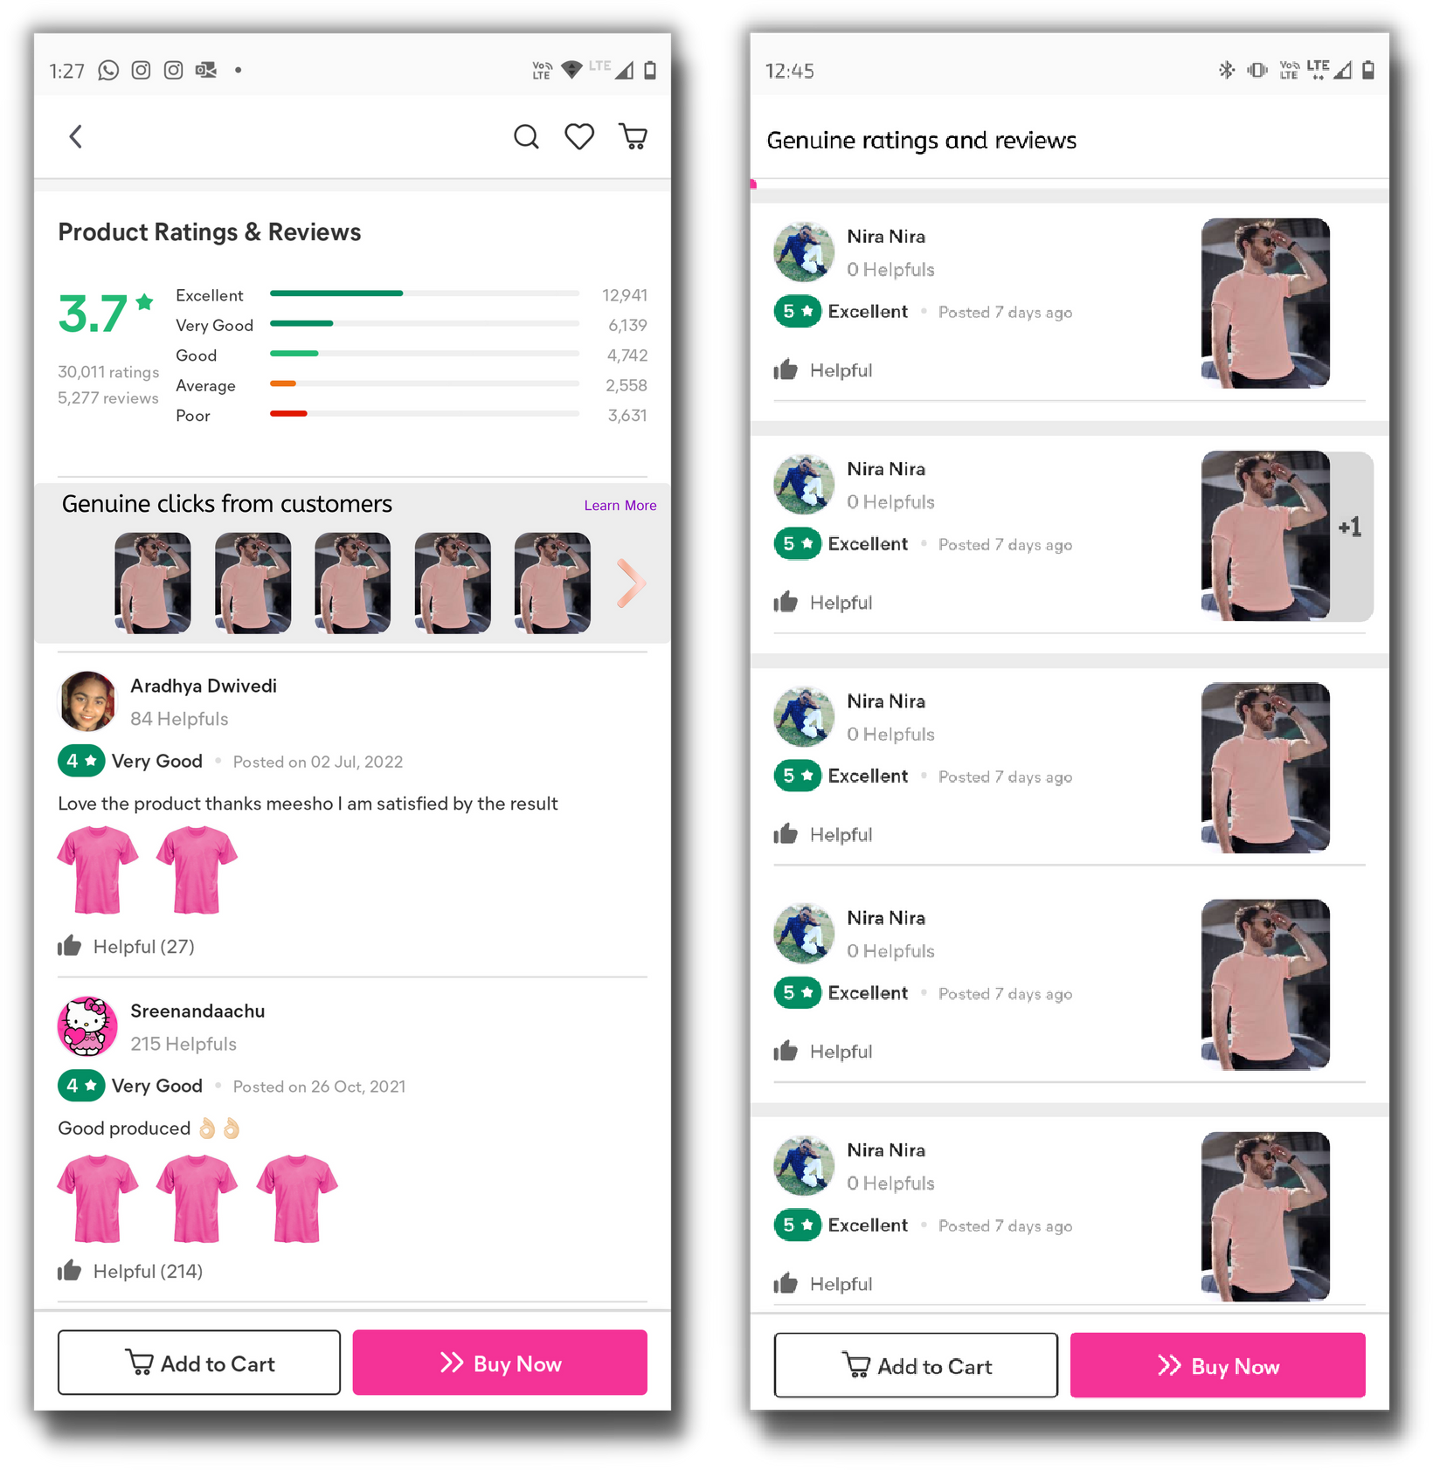
Feature #2: Improved Reviews Section
Detailed reviews and ratings with genuine product images and videos.
Metrics to be tracked and OKRs:
Decrease in the
#ViewAllReviews button clicks by 50%
Increase in %users who place order after clicking on image in Genuine clicks section should increase by 50%
The genuine images and videos of product will be displayed before the rest of reviews in the ratings and review section

Slide 11
Feature #3: Gamification
Feature overview:
Customer retention is one of Meesho's major challenges, so we've developed a number of well-connected Games, Quizes and some entertaining activities.
Rewarding points on winnings then which can be redeemed in future and rewards in return for future purchases.
Metrics to be tracked:
Average session time
Load time and game crashes CTRs of Gamification feature Avg. sessions per user per day Time spent per user per day Daily/weekly repeat users
no. of Active Gaming users/ no. of Active Non Gaming Users.
Hypothesis:
This feature can enhance how customers engagement with Meesho esp. post purchase, resulting in more brand awareness and effective marketing engagement,
Gamification in Meesho can help to increase consumer engagement and constitutes a conscious reposition of the shopping experience as a form of entertainment. If this features designed and implemented in the right manner, can help to retain brand engagement and purchase intention.

Slide 12
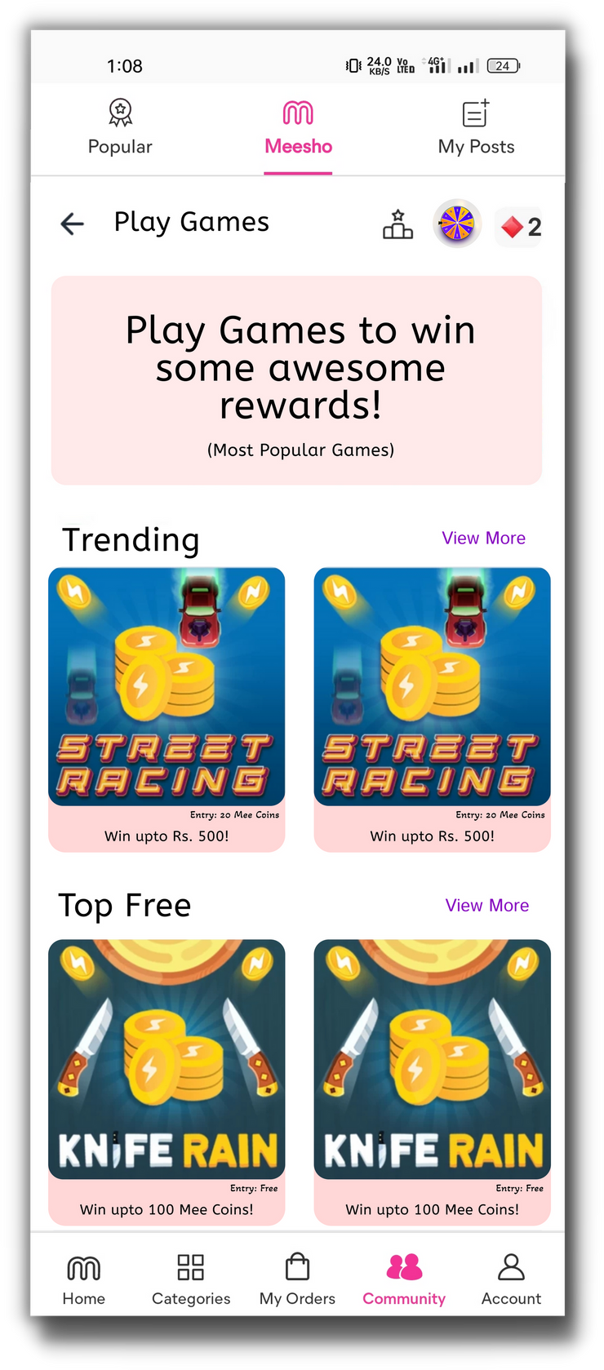
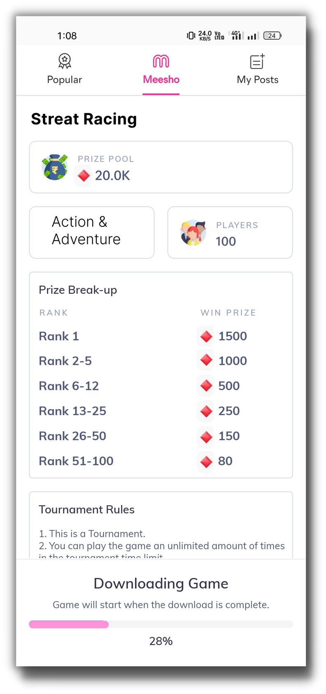
Feature #3: Gamification
The Play Games section
Spin wheel
Meesho Coins
Game page
Prize distribution and rules
Various games with free entry and paid entry(with meesho coins)

Slide 13




Feature Prioritization
Sr.
No.
Feature
Effort to implement the feature
Impact of the feature
(increase in user engagement and time spent on the app(3), increased usability & value perception of coins (2))
****
(reducing buyer's remorse effect, indirectly decreasing no. of returns)
***
(reducing friction of choice, reducing user frustration)
1 Gaming (full-fledged game dev(3), integration with Meesho Coin
Economy(1), marketing campaigns(2))
****
(AI implementation to differentiate genuine photos(3), slight UI change(1))
***
(UI change, recommendation engine)
2
3
Genuine reviews
Category section revamp
Feature 2: Genuine reviews is the most prioritized feature, we'll be executing it first.

Slide 14
Go To Market Strategy
Feature Development and Testing
Feedback Analysis and Improvement
Promotion and Final Launch
Metric Tracking and Impovements
Beta launch
Some campaigns such as "Become a model: Get a chance to be featured on the product page" will be launched before final launch to incentivize the uses to upload genuine and high quality photos and videos on reviews section which can be featured on the product page.
The bugs found in the beta testing will be resolved and the feature will be improved based on feedback obtained from users
Post the launch various KPIs will be tracked and compared with the OKRs predicted. The feature and strategy will be improved upon based on data obtained.
The Prioritized feature: Genuine Ratings and Review will be developed and tested for various case scenarios
The developed feature will be launched first for a small section of users to check for bugs and collect feedback from users

Slide 15


