Slide 1
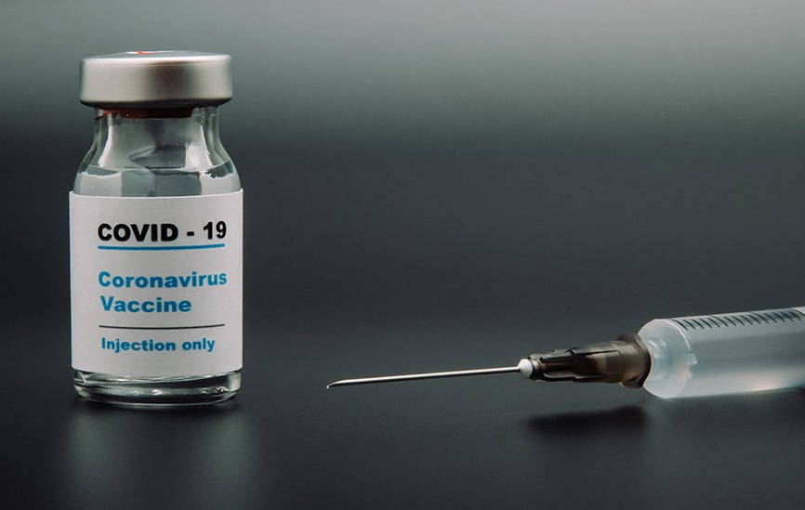
Project 5: COVID19 Vaccination a race of injection vs. infection
Rahul Parab, Jesse Tao, Letty Wu, Alyssia Oh

Slide 2
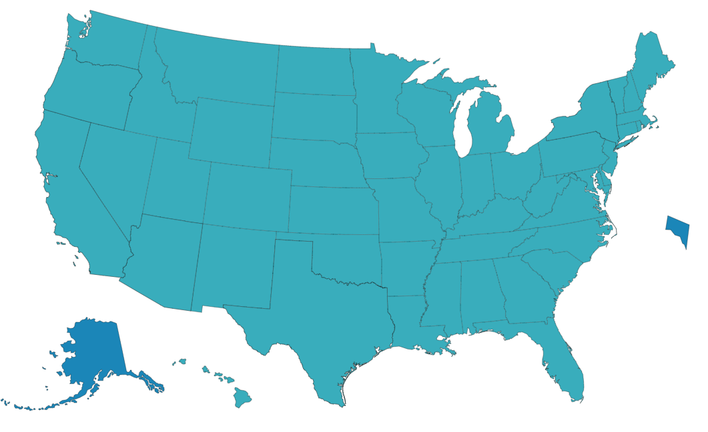
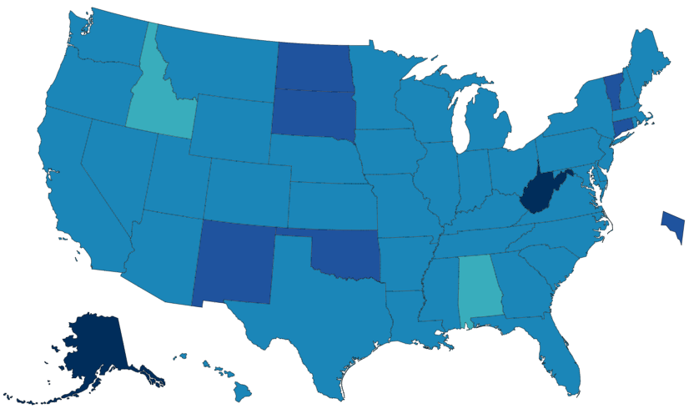
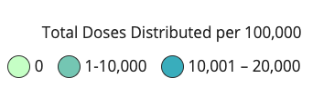
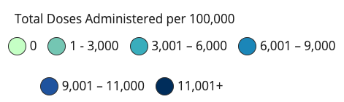
How are we doing on vaccine distribution?
Federal Distribution
14,000-16,000 / 100K
State Administration
3,000-11,000+ / 100K
Notes:
At the federal level, more or less uniform
Higher discrepancy at the state level

Slide 3
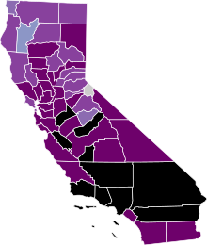
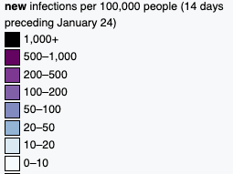
Total vaccines administered = 5200 per 100k
New cases = 1142.3 per 100k in the last 14 days
Speed matters
Highly Impacted States like CA - Slow in Vaccine Distribution
Costs lives
Costs money
Virus mutates
- new variants may spread faster
- escape current vaccines
Notes:
unfortunately, highly impacted states like CA is slow in vaccine distribution
So far total vaccine administered is at round 5000 per 100K
Whereas just within the last 2 weeks, more than 1000 people per 100k have been newly confirmed.

Slide 4
Problem Statement
Can we optimize vaccine distribution by forecasting the next hot spots? 1. what is the current distribution protocol? 2. can we develop a model to forecast hot spots? 3. does this work? ( If so, should we change the protocol? )
Notes:
- Subject to change as the model develops…

Slide 5
Current Vaccine Distribution Plan
Phase 1A (in progress)
Phase 1B
Phase 1C
Age 50-64 yrs old
~ 3 million
healthcare workers
long-term care residents
Tier 1 (we are here)
Age 65+ yrs old
Essential workers
Tier 2
Essential workers
Age 16-49 yrs old with underlying health conditions
(education, childcare, emergency services, food, agriculture)
(transportation, residential, and sheltering facilities, services, critical manufacturing)
Notes:
What is the current distribution plan?
Prioritize on healthcare workers and elderly
Makes sense to protect the elderly and most exposed workers, but also heavily influenced by “ethics”

Slide 7
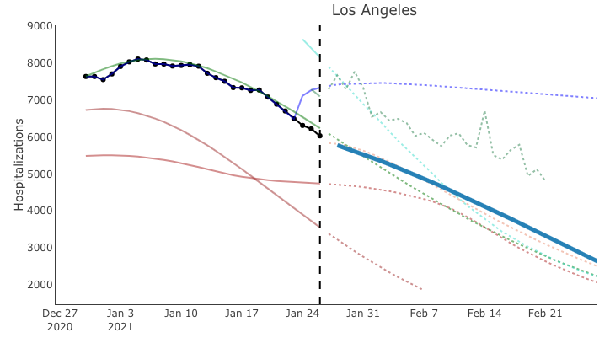
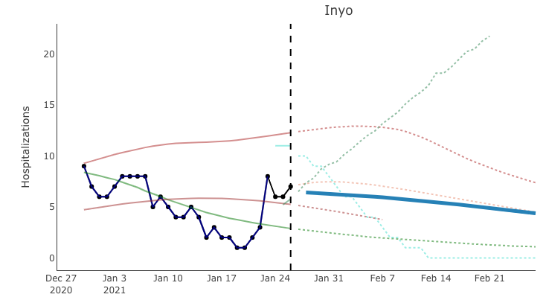
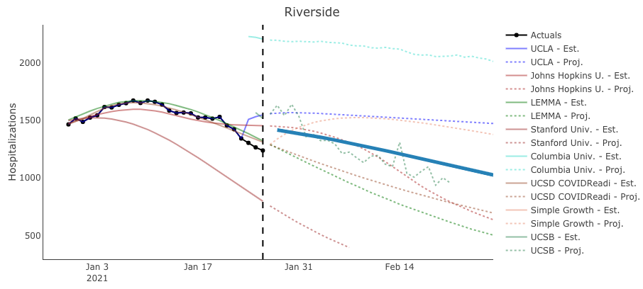
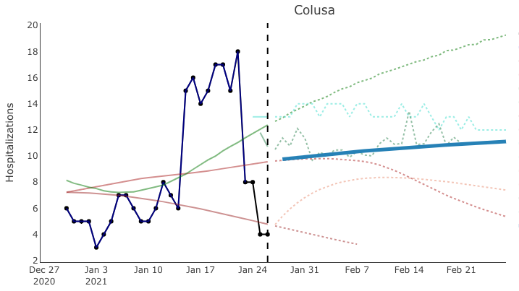
How does our model compare to existing models?
Notes:
None of the models predict the actual change very well
May need to consider numerous other factors to consider

Slide 8
Conclusion
forecasting is extremely difficult
currently, none of the existing models perform well
many unexpected factors can change the trends
(govt policies, supply issues, distribution within the county, etc)
mathematical models over ethics?
can we justify “optimizing” for the state?
should race/gender/age/wealth be used to decide who gets the vaccine first?
Notes:
None of the models predict the actual change very well
May need to consider numerous other factors to consider

