Slide 1
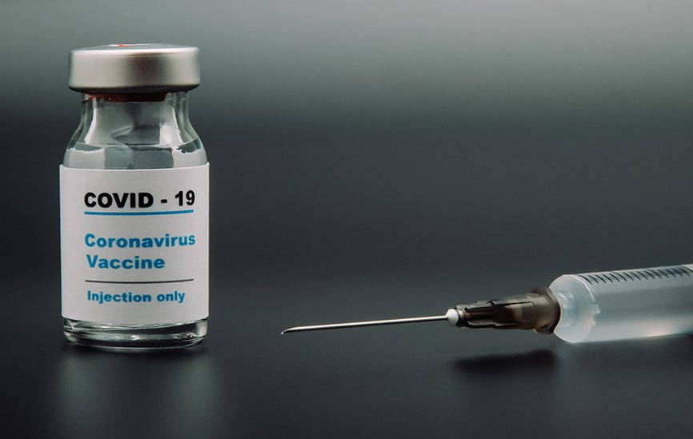
Project 5: COVID19 Vaccination
Rahul Parab, Jesse Tao, Letty Wu, Alyssia Oh

Slide 2
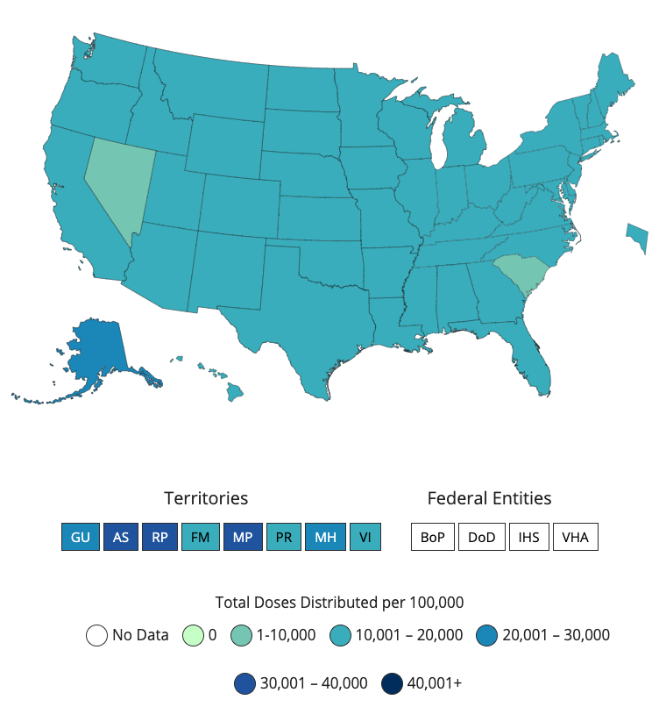
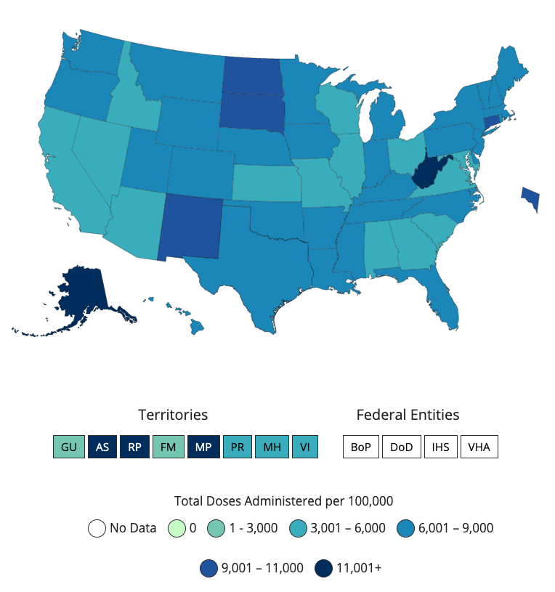
How are we doing on vaccine distribution?
Federal Distribution
10,000-12,000 / 100K
State Administration
3,000-11,000+ / 100K
Notes:
At the federal level, more or less uniform
Higher discrepancy at the state level

Slide 3
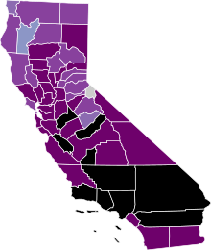
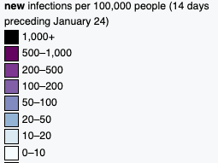
Total vaccines administered = 5200 per 100k
New cases = 1142.3 per 100k in the last 14 days
Speed matters
Highly Impacted States like CA - Slow in Vaccine Distribution
Notes:
unfortunately, highly impacted states like CA is slow in vaccine distribution
So far total vaccine administered is at round 5000 per 100K
Whereas just within the last 2 weeks, more than 1000 people per 100k have been newly confirmed.

Slide 4
Problem Statement
Can we optimize vaccine distribution by forecasting the next hot spots? 1. what is the current distribution protocol? 2. can we develop a model to forecast hot spots? 3. does this work? ( If so, should we change the protocol? )
Notes:
Which brings me to my main question – is there any distinctive characteristics of high clickthrough rate news articles, without using the buzzfeed-like clickbait equations?
Such as how long should it be, what topics draw more clicks, and what is the sentiment?

Slide 5
Speed matters
Total vaccines administered = 5200 per 100k
New cases = 1142.3 per 100k in the last 14 days
Speed matters

Slide 6
Is there an ideal length for title?
Based on 10,000 posts with comments & upvotes >= 10
Notes:
So is there an ideal length for a title?
I looked at 10,000 posts with comments and upvotes higher than 10 as a quality control, to make sure that not only the articles here are being posted by someone, but actually gain a decent amount of attention from users.
Uplifting news, was more tolerant with longer titles with the average being around 16 words with a long skew to the right. The standard deviation is quite wide as well compared to NottheOnion,
Which tends to be more restrictive with the length, with very few titles with higher than 20 words.
Considering that a longer title reveal a lot more information, thus contain less of surprise,
It makes sense that NottheOnion titles resemble the traditional sensationalist headlines. Interestingly, that means that if the news is ‘uplifting’ and positive enough, readers would still consume the content without the typical clickbaity titles.

Slide 7
What are the most frequently appearing words?
Notes:
Then, in this limited space of 10-15 words, what words appear most frequently?
Here, I filtered out the top 100 words from each subreddit, then excluded commonly popular words, and looked at unique words that are not in the top 100 of the other subreddit.
When you look at the top 20 unique words from each subreddit, some are very much expected such as rescue, save, donate, cat….?? While others are slightly more unexpected, such as cancer, lost, plastic, or victim, which probably pair with another word to represent a positive content, like cure cancer, save victim, lost cat found, ban plastic, etc.
Most top words from nottheonion on the other hand, were negative, except the four highlighted here, which seem to reveal the racial and geographical tension in America.

Slide 8
Highest scoring posts
r/Uplifting News
title
Over a Million People Sign Petition Calling For KKK to Be Declared a Terrorist Group
when China demands names of airline's employees who protested, CEO lists only himself
Chattanooga's Police Chief has updated his department's Code of Conduct, saying they have a duty to stop others in the department from committing illegal activities including acts of brutality and abuse of authority.
Saudi Arabian heir to the crown has declared war on radical clerics, he also said "We are returning to what we were before, a country of moderate Islam that is open to all religions and to the world."
r/Not the Onion
 | title
 | Nat Geo hires Jeff Goldblum to walk around, being professionally fascinated by things
 | Man rescued from Taliban didn't believe Donald Trump was President
 | Trump dedicates golf trophy to hurricane victims
 | 'They’re going to get over it': Missouri Gov. insists kids must go back to school even though 'they will' get COVID-19
Notes:
However, when I look at the highest scoring posts from both subreddits, it becomes apparent that just looking at the positivity or negativity of words has serious limitation,
Especially when you consider how difficult it is to identify sarcasm in titles such as ‘trump dedicates golf trophy to hurricane victims.’
Which made me question,
Can sentiment analysis be used to reveal anything useful for subreddits like nottheonion where the negative emotional impact is hidden behind absurdity and sarcasm.

Slide 9
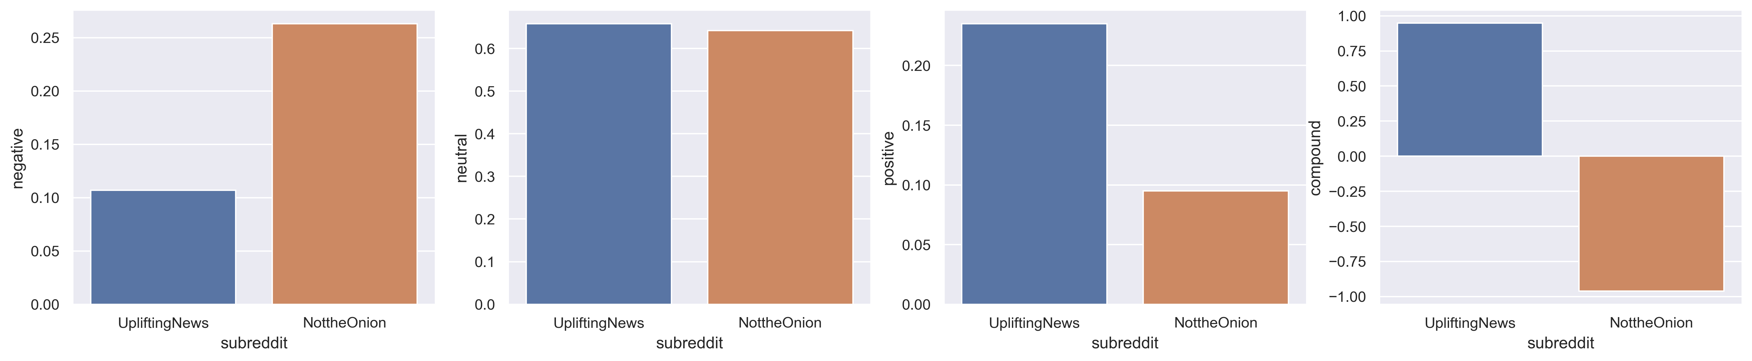
How are the sentiments of the titles?
Negative
Neutral
Positive
Compound
Notes:
To my surprise, the sentiment analysis reveal the true negativity in nottheonion titles, that results in almost polar opposites when you look at the compound score.
So this convinced me that

Slide 10
Preprocessing tokenizer = RegexpTokenizer lemmatizer = WordNetLemmatizer
Model testing
Transformers
CountVectorizer
TfidfVectorizer
Tested models
Multinomial Naïve Bayes
Logistic regression
Random forest

Slide 11
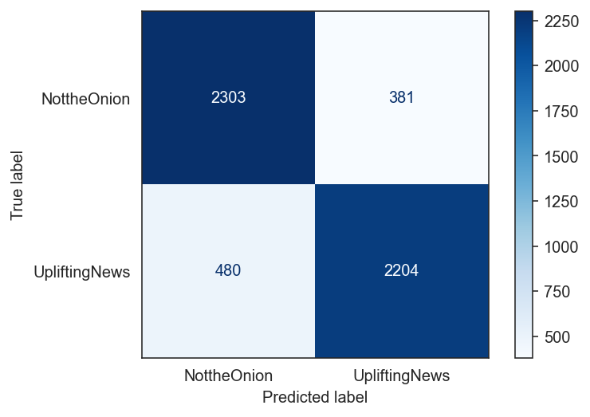
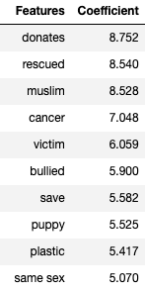
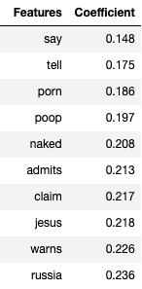
Best prediction – Logistic Regression (overfit)
Highest Coefficient Lowest Coefficient
Baseline: 50%
CountVectorizer/LogReg
Accuracy : 84.0%
Precision : 85.4%

Slide 12
Conclusion
What are some characteristics of high CTR news articles? 1. length – between 10-20 words
2. words
- help, rescue, donate, animals
- sex, crime, racial tension, police violence 3. sentiment
- Either extreme positivity or extreme negativity (including sarcasm/absurdity) to evoke strong emotional response
However, due to the complex nature of language, no single superior model to generate the high CTR

