Slide 1
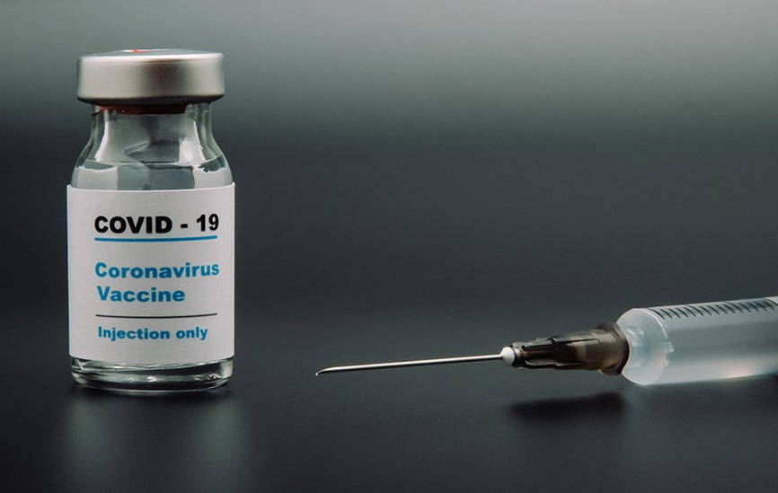
Project 5: COVID19 Vaccination a race of injection vs. infection
Rahul Parab, Jesse Tao, Letty Wu, Alyssia Oh

Slide 2
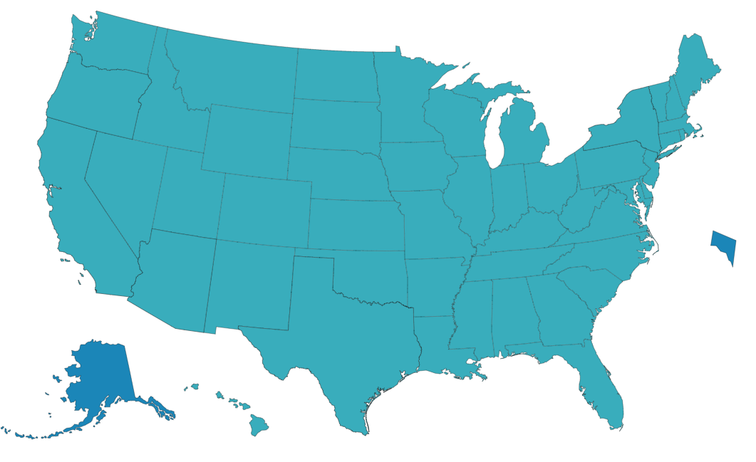
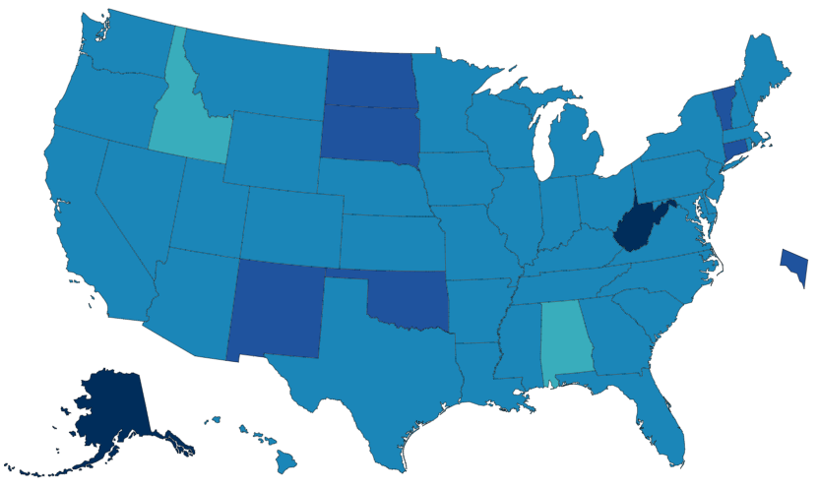
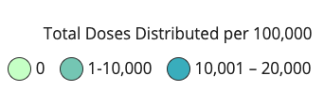
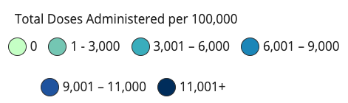
How are we doing on vaccine distribution?
Federal Allocation
14,000-16,000 / 100K
State Distribution
3,000-11,000+ / 100K
Notes:
At the federal level, more or less uniform
Higher discrepancy at the state level

Slide 3
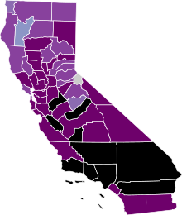
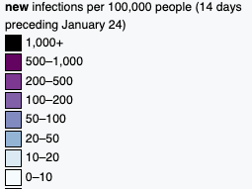
Total vaccines administered = 5200 per 100k
New cases = 1142.3 per 100k in the last 14 days
Speed matters
Highly Impacted States like CA - Slow in Vaccine Distribution
Costs lives
Costs money
Virus mutates
- new variants may spread faster
- escape current vaccines
Notes:
unfortunately, highly impacted states like CA is slow in vaccine distribution
So far total vaccine administered is at round 5000 per 100K
Whereas just within the last 2 weeks, more than 1000 people per 100k have been newly confirmed.

Slide 4
Problem Statement
Can we optimize vaccine distribution by forecasting the next hot spots? 1. can we develop a model to forecast hot spots? 2. what is the current distribution protocol and how to modify it? 3. should we make the change?
Notes:
- Subject to change as the model develops…

Slide 5
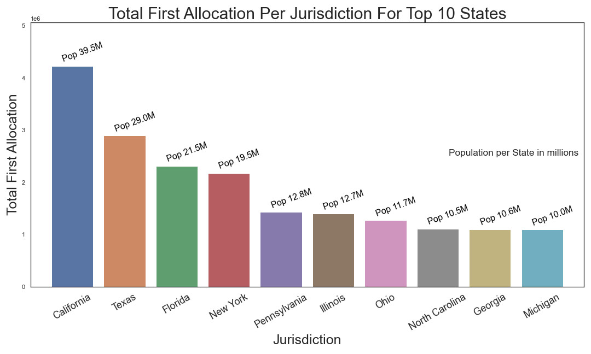
- Pfizer and Moderna are vaccine suppliers
- From 12/14/2020 to 02/01/2021
- Vaccine Allocation: California: 4,226,100; Texas: 2,894,925; Florida: 2,313,050

Slide 6
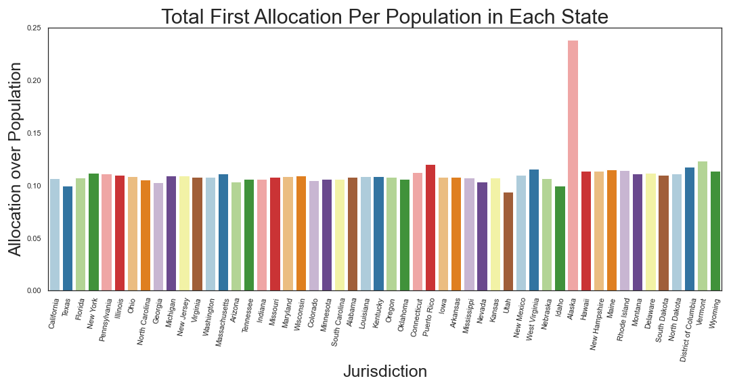

Slide 7
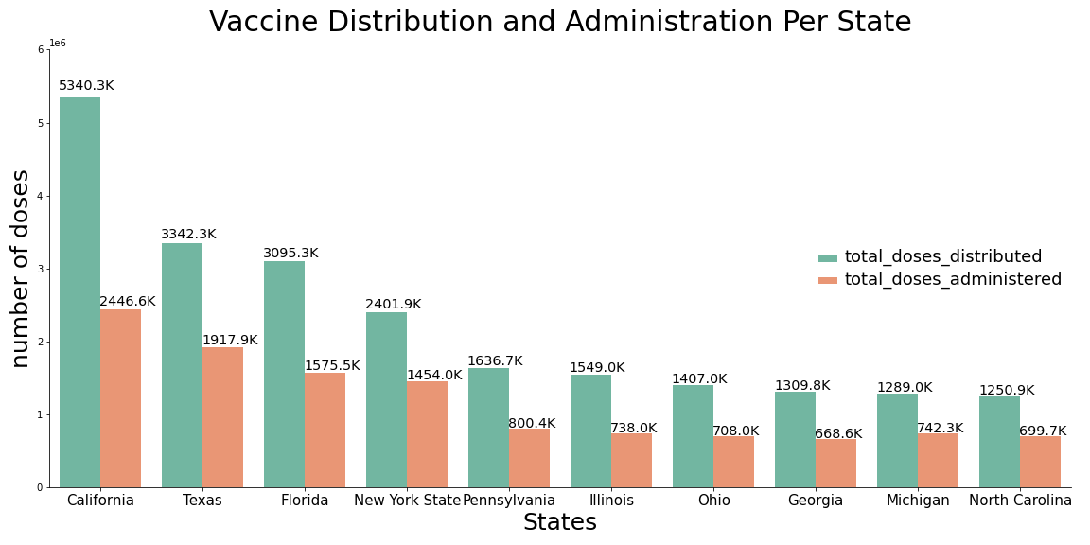
- From 1/16 to 1/27
- California got 5,340,275 distribution, but only 2,446,577 got administered

Slide 8
Modeling - RNN
As time series and geospatial data is hard to visualize in slides, we will be using an interactive web app to go through our modeling process
- Visit this link to follow along: https://covid.jesseptao.com

Slide 9
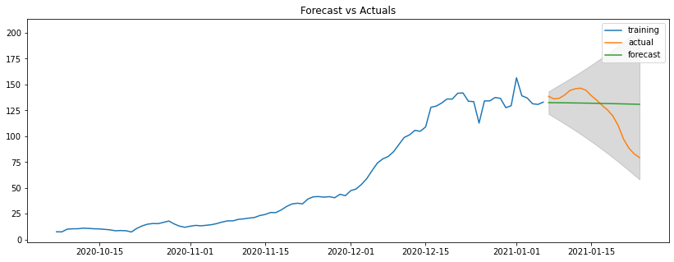
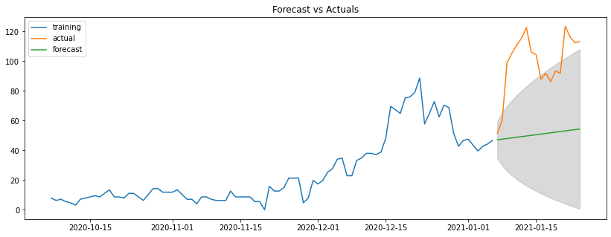
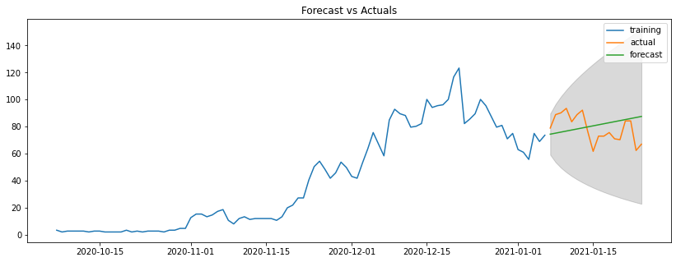
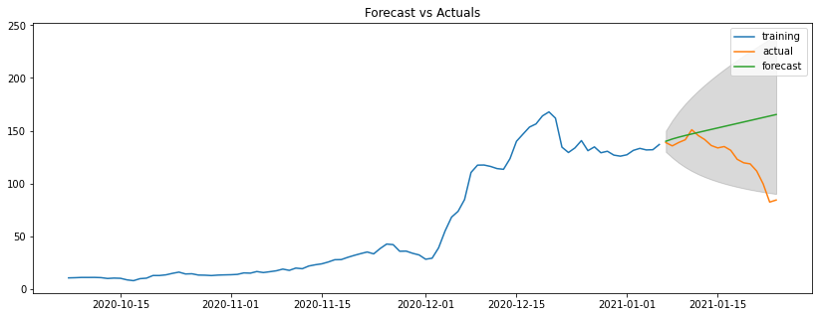
Modeling –ARIMA
Los Angeles Inyo
Colusa Riverside

Slide 10
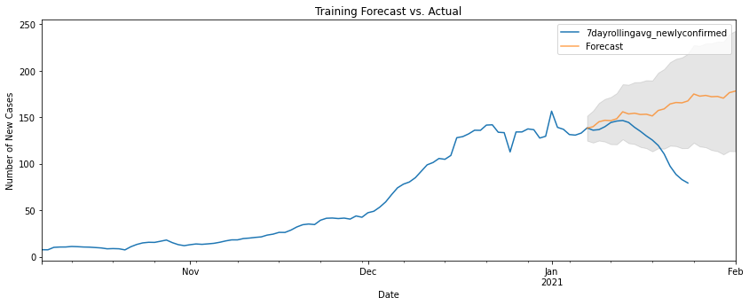
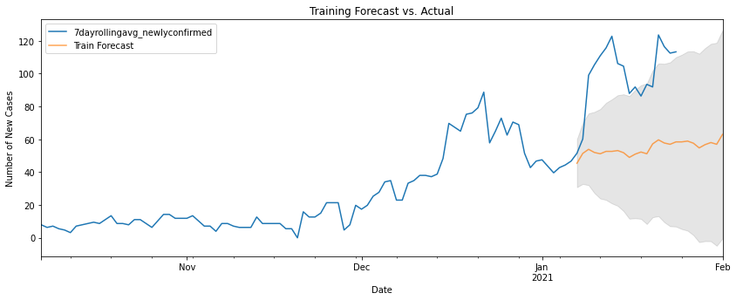
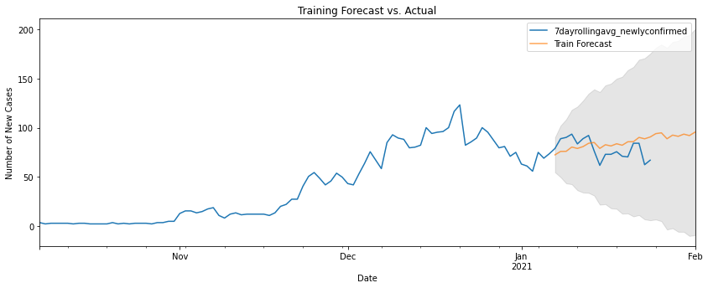
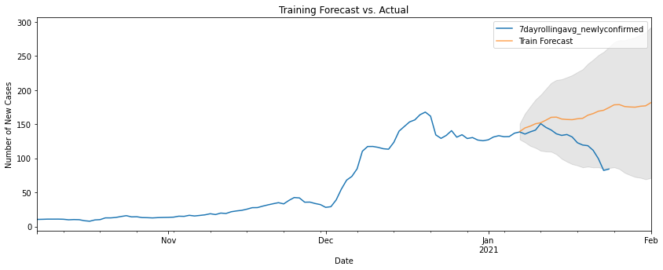
Modeling –SARIMAX
Los Angeles Inyo
Colusa Riverside

Slide 11
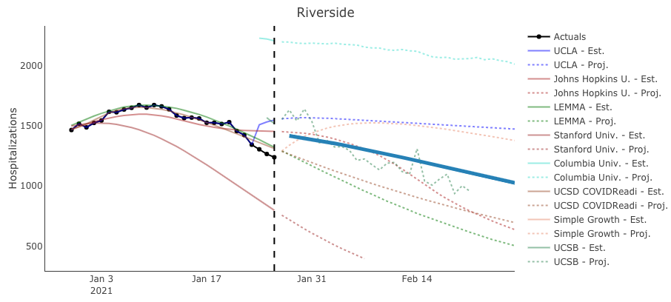
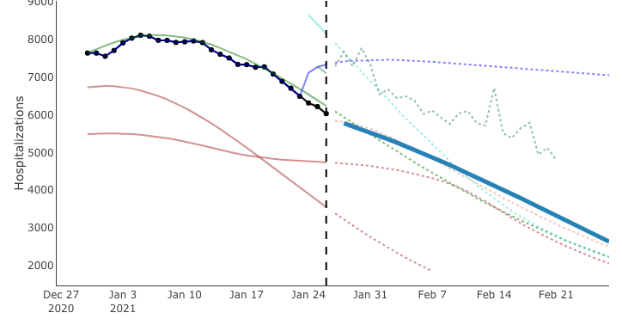
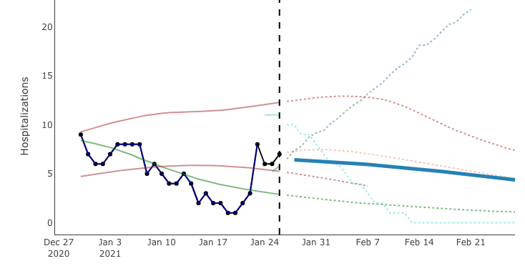
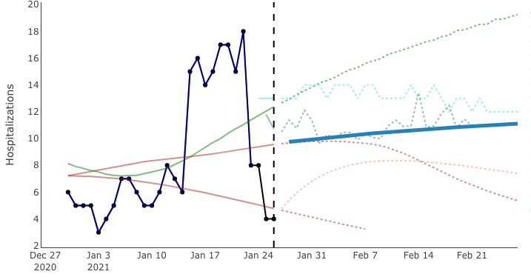
How does our model compare to existing models?
Los Angeles Inyo
Colusa Riverside
Notes:
None of the models predict the actual change very well
May need to consider numerous other factors to consider

Slide 12
CA’s Vaccine Distribution Plan
Phase 1A (in progress)
Phase 1B
Phase 1C
Age 50-64 yrs old
~ 3 million
healthcare workers
long-term care residents
Tier 1 (we are here)
Age 65+ yrs old
Essential workers
Tier 2
Essential workers
Age 16-49 yrs old with underlying health conditions
(education, childcare, emergency services, food, agriculture)
(transportation, residential, and sheltering facilities, services, critical manufacturing)
Notes:
What is the current distribution plan?
Prioritize on healthcare workers and elderly
Makes sense to protect the elderly and most exposed workers, but also heavily influenced by “ethics”

Slide 13
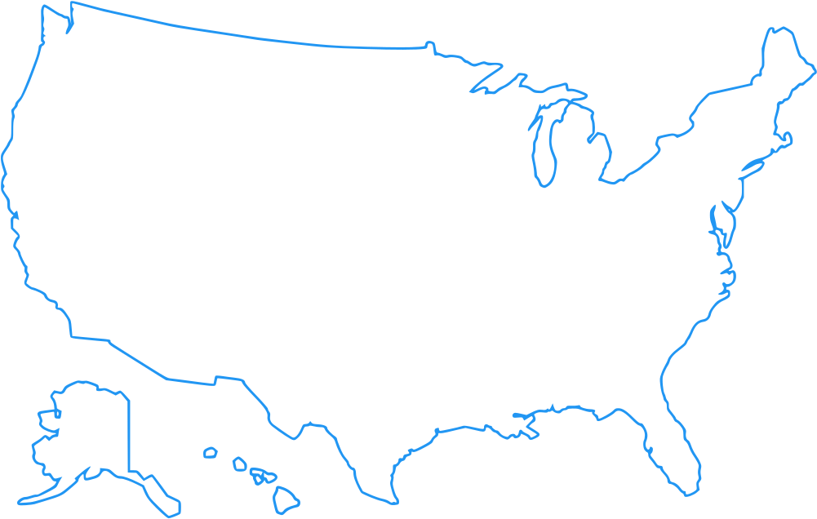


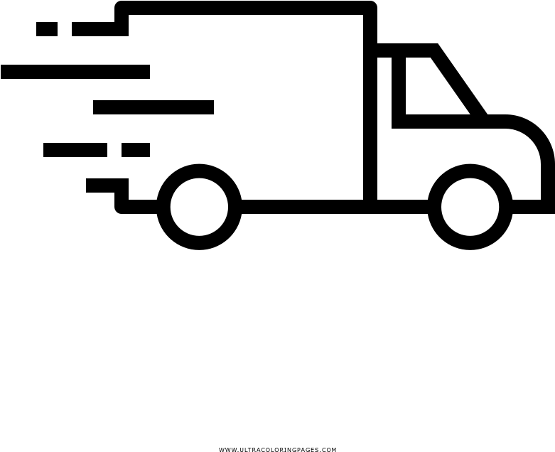
Federal Vaccine Allocation Plan
2.8 million/week
(1.4 million people)
Total doses allocated (Jan 28th 2021) = 48 million
Total doses ordered (July 31st 2021) = 600 million
Total doses received (Jan 28th 2021) = 5.5 million
Total doses expected (July 31st 2021) = 69 million

Slide 14
Conclusion
forecasting is extremely difficult
currently, none of the existing models perform well
many unexpected factors can change the trends
(govt policies, supply issues, distribution within the county, etc)
mathematical models over ethics?
can we justify “optimizing” for the state?
should race/gender/age/wealth be used to decide who gets the vaccine first?
Notes:
None of the models predict the actual change very well
May need to consider numerous other factors to consider

