Slide 1
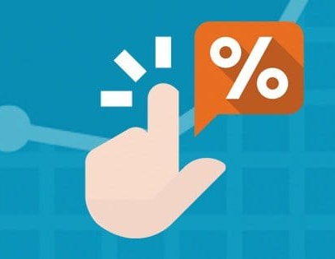
Project 3: Subreddit NLP Uplifting or Absurd: The Art of High Click-Through Rate Titles
Alyssia Oh
Notes:
Hello my name is Alyssia Oh,
and today I will be talking about the art of high click-through rate titles by analyzing two subreddits as case studies using NLP modeling.

Slide 2
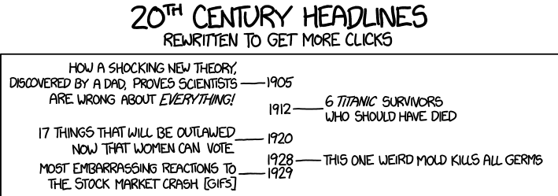
Notes:
Here is a cartoon that demonstrates how news articles are titled today to be used as so-called clickbait.
6 titanic survivors who should have died, or most embarrassing reactions to the stock market crash…
Although these have been written as a joke, it demonstrates the type of sensationalist titles with a shock value
that provoke the readers to click the headline to find out further.

Slide 3
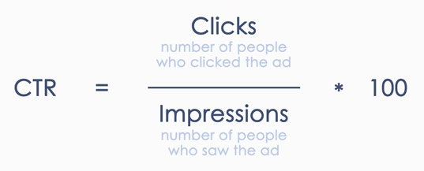
Background
Clickthrough rate (CTR):
A ratio showing how often people who see your ad or product listing end up clicking it.
Clickthrough rate (CTR) can be used to gauge how well your keywords and ads are performing.
Notes:
Although the term clickbait has some negative connotation,
‘clickthrough rate’ is actually an important metric that is widely used for internet marketing and user research
to measure how often people who see your ad or listing end up clicking it,
Therefore one can gauge how well your keywords and ads perform

Slide 4
Problem Statement
What are some characteristics of high CTR news titles? 1. how long should it be 2. what words to include 3. what is the sentiment
Notes:
Which brings me to my main question – is there any distinctive characteristics of high clickthrough rate news articles, without using the buzzfeed-like clickbait equations?
Such as how long should it be, what topics draw more clicks, and what is the sentiment?

Slide 5
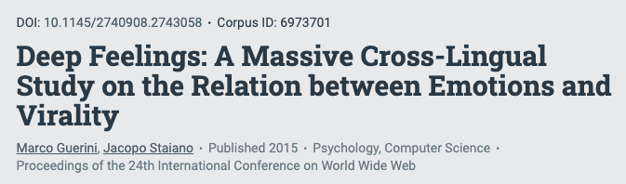
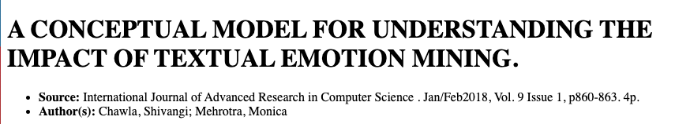
r/Uplifting News vs r/Not the Onion
r/UpliftingNews
- 16.6m subscribers
- trust, joy, anticipation
r/NottheOnion
- 18.5m subscribers
- surprise, anger, disgust
Notes:
I chose two subreddits as uplifting news and not the onion,which are both very popular with comparable number of subscribers, as case-study
To look at two very different types of news articles that gain popularity among readers.
From a quick research, I was able to find a number of studies done on what makes something go viral,
And one very interesting feature that kept coming up was how emotion plays a big role in gaining attention from readers.
It might be counter-intuitive for some people, but most highly circulated videos, stories, and pictures tend to be very positive topics
Although if negative content has an element of surprise or strong negative emotional aspect, that is an exception to this rule.
Uplifting news, as the name implies has articles that evoke positive emotions such as trust, joy, and anticipation.
NottheOnion, on the other hand, is a subreddit where you can find rather absurd articles you can’t believe aren’t made up as a joke.
While these are often disguised as humor, underneath, they provoke a negative emotion in the readers’ mind, such has anger, disgust, or unpleasant surprise.

Slide 6
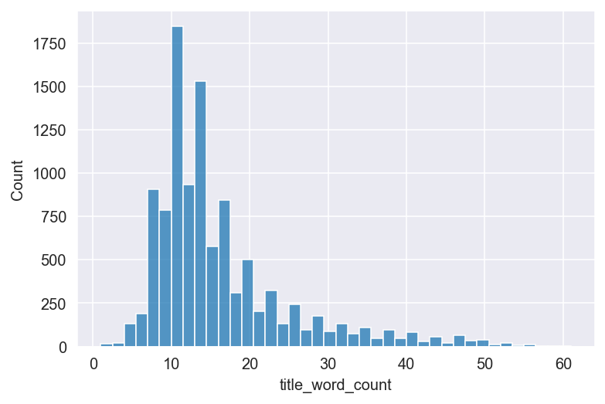
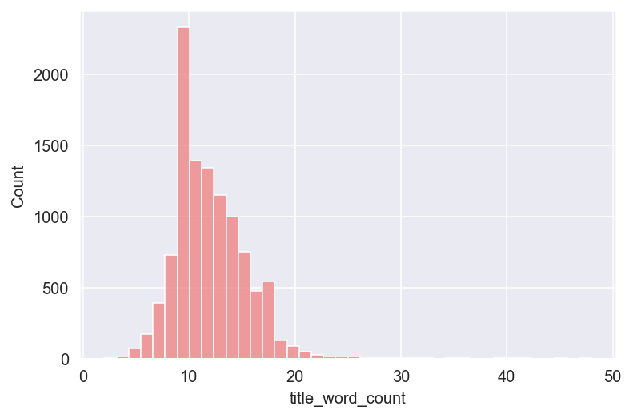
Is there an ideal length for title?
Based on 10,000 posts with comments & upvotes >= 10
r/Uplifting News r/Not the Onion
15.9 words +/- 9 words
12 words +/- 3.4 words
Notes:
So is there an ideal length for a title?
I looked at 10,000 posts with comments and upvotes higher than 10 as a quality control, to make sure that not only the articles here are being posted by someone, but actually gain a decent amount of attention from users.
Uplifting news, was more tolerant with longer titles with the average being around 16 words with a long skew to the right. The standard deviation is quite wide as well compared to NottheOnion,
Which tends to be more restrictive with the length, with very few titles with higher than 20 words.
Considering that a longer title reveal a lot more information, thus contain less of surprise,
It makes sense that NottheOnion titles resemble the traditional sensationalist headlines. Interestingly, that means that if the news is ‘uplifting’ and positive enough, readers would still consume the content without the typical clickbaity titles.

Slide 7
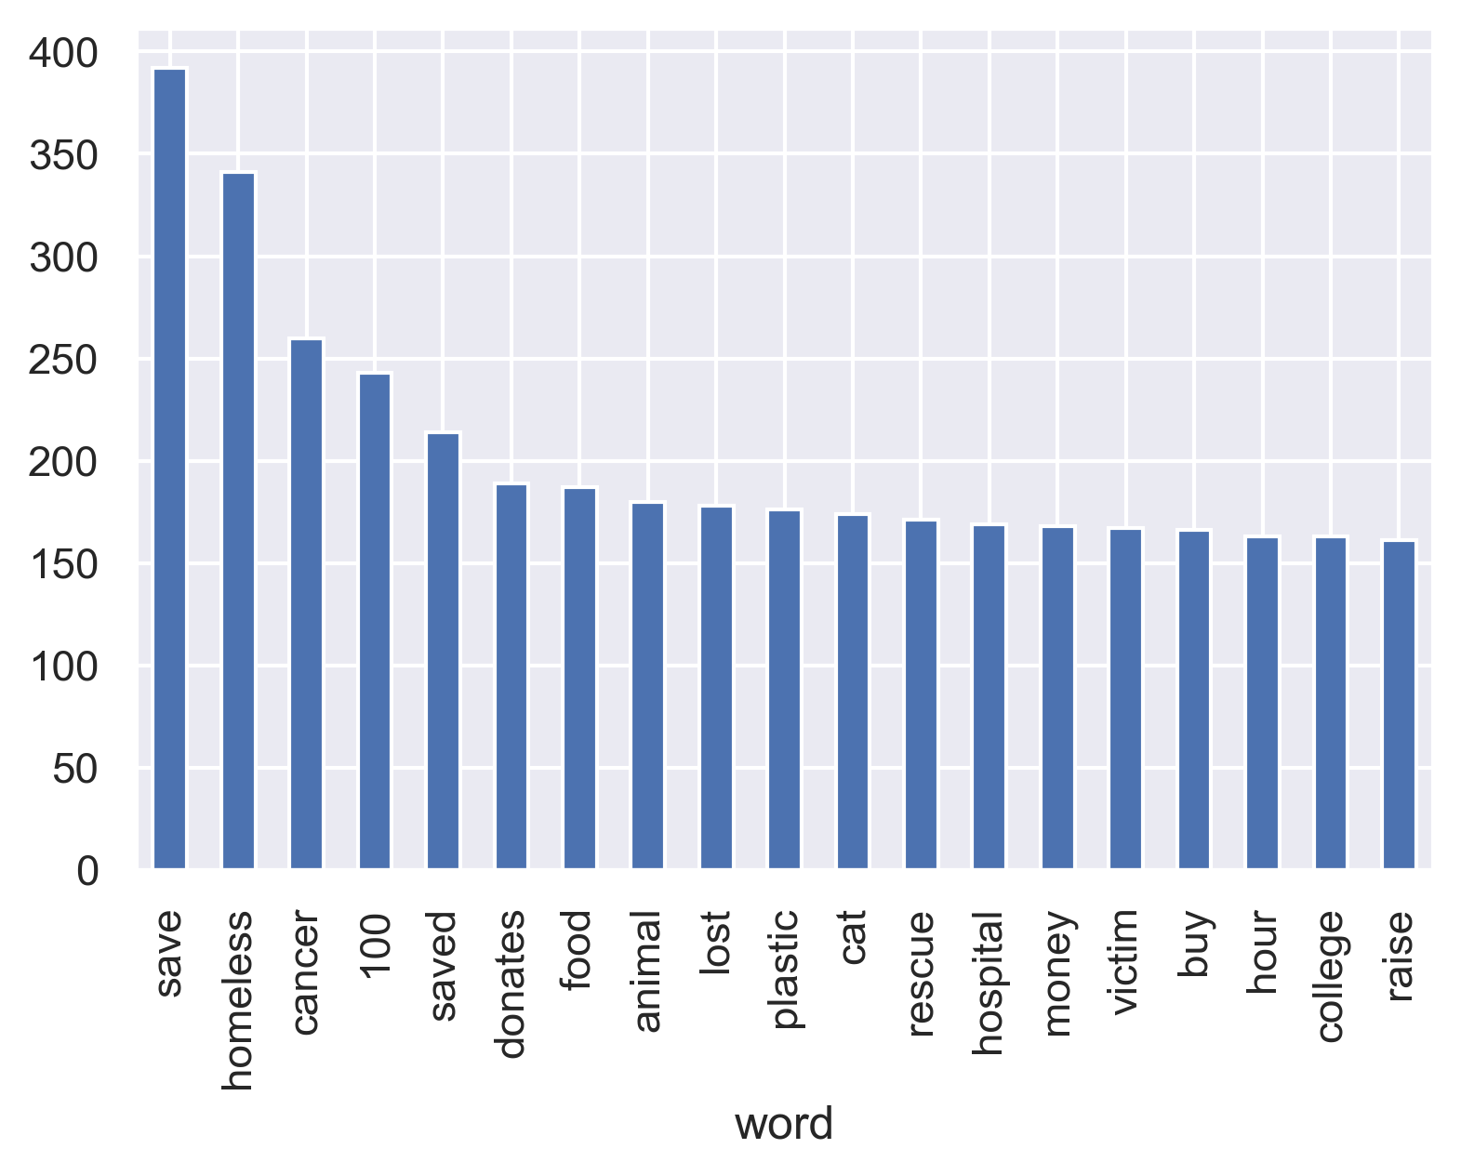
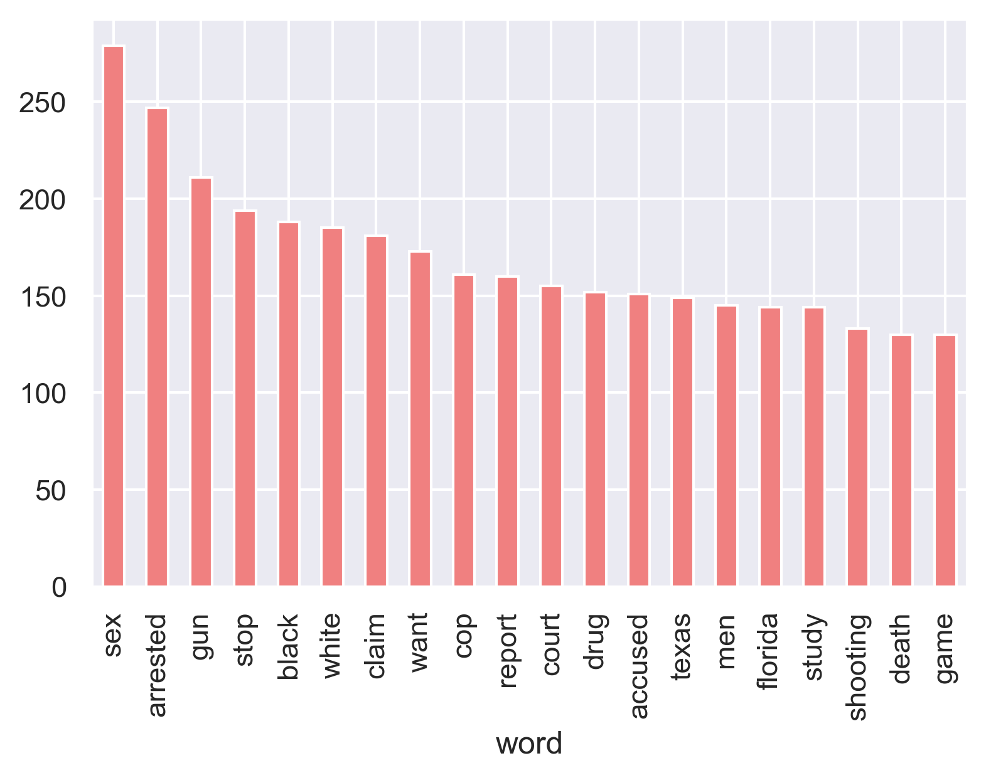
What are the most frequently appearing words?
r/Uplifting News r/Not the Onion
Save
Homeless
Cancer
Donate
Food
Animal
Lost
Plastic
Cat
Rescue
Hospital
College
Money
Victim
Raise
Buy
Sex
Arrested
Gun
Stop
Black
White
Claim
Want
Cop
Court
Drug
Accused
Texas
Florida
Study
Shooting
Death
Game
Notes:
Then, in this limited space of 10-15 words, what words appear most frequently?
Here, I filtered out the top 100 words from each subreddit, then excluded commonly popular words, and looked at unique words that are not in the top 100 of the other subreddit.
When you look at the top 20 unique words from each subreddit, some are very much expected such as rescue, save, donate, cat….?? While others are slightly more unexpected, such as cancer, lost, plastic, or victim, which probably pair with another word to represent a positive content, like cure cancer, save victim, lost cat found, ban plastic, etc.
Most top words from nottheonion on the other hand, were negative, except the four highlighted here, which seem to reveal the racial and geographical tension in America.

Slide 8
Highest scoring posts
r/Uplifting News
title
Over a Million People Sign Petition Calling For KKK to Be Declared a Terrorist Group
when China demands names of airline's employees who protested, CEO lists only himself
Chattanooga's Police Chief has updated his department's Code of Conduct, saying they have a duty to stop others in the department from committing illegal activities including acts of brutality and abuse of authority.
Saudi Arabian heir to the crown has declared war on radical clerics, he also said "We are returning to what we were before, a country of moderate Islam that is open to all religions and to the world."
r/Not the Onion
 | title
 | Nat Geo hires Jeff Goldblum to walk around, being professionally fascinated by things
 | Man rescued from Taliban didn't believe Donald Trump was President
 | Trump dedicates golf trophy to hurricane victims
 | 'They’re going to get over it': Missouri Gov. insists kids must go back to school even though 'they will' get COVID-19
Notes:
However, when I look at the highest scoring posts from both subreddits, it becomes apparent that just looking at the positivity or negativity of words has serious limitation,
Especially when you consider how difficult it is to identify sarcasm in titles such as ‘trump dedicates golf trophy to hurricane victims.’
Which made me question,
Can sentiment analysis be used to reveal anything useful for subreddits like nottheonion where the negative emotional impact is hidden behind absurdity and sarcasm.

Slide 9
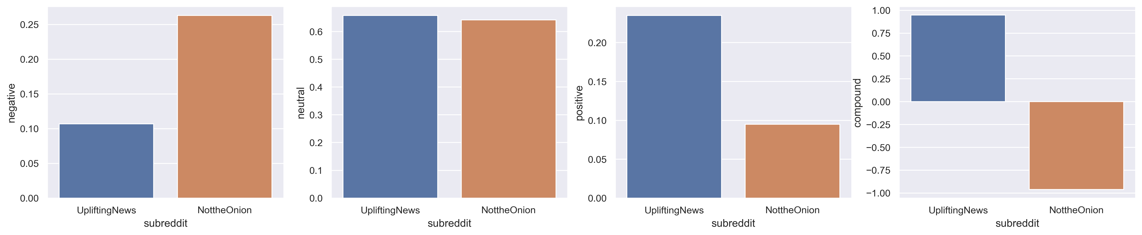
How are the sentiments of the titles?
Negative
Neutral
Positive
Compound
Notes:
To my surprise, the sentiment analysis reveal the true negativity in nottheonion titles, that results in almost polar opposites when you look at the compound score.
So this convinced me that

Slide 10
Preprocessing tokenizer = RegexpTokenizer lemmatizer = WordNetLemmatizer
Model testing
Transformers
CountVectorizer
TfidfVectorizer
Tested models
Multinomial Naïve Bayes
Logistic regression
Random forest

Slide 11
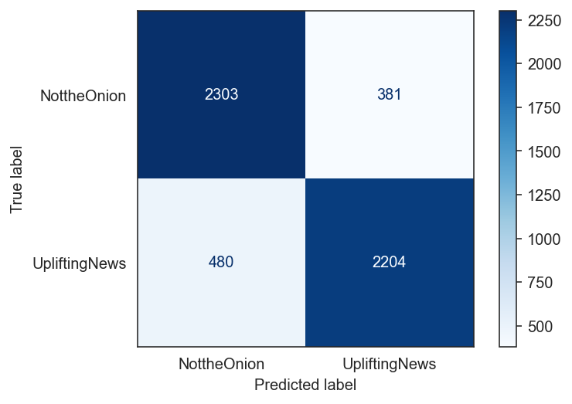
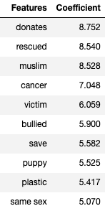
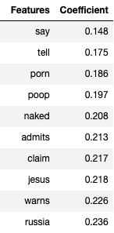
Best prediction – Logistic Regression (overfit)
Highest Coefficient Lowest Coefficient
Baseline: 50%
CountVectorizer/LogReg
Accuracy : 84.0%
Precision : 85.4%

Slide 12
Conclusion
What are some characteristics of high CTR news articles? 1. length – between 10-20 words
2. words
- help, rescue, donate, animals
- sex, crime, racial tension, police violence 3. sentiment
- Either extreme positivity or extreme negativity (including sarcasm/absurdity) to evoke strong emotional response
However, due to the complex nature of language, no single superior model to generate the high CTR

