Slide 1
Road Safety and Accident Severity in the United States: A Case Study of Texas
ECON 5140: Applied Econometrics
Artykzhan Ospan

Slide 2
Motivation and Research Question
Which weather and roadway factors are associated with higher crash severity in Texas?
Traffic accidents create major medical, economic, and productivity costs.
Reducing severity is as important as reducing crash frequency.
Weather and road design may significantly affect outcomes.
These findings can inform policy, infrastructure, and emergency response.

Slide 3
Identification
Is This Causal?
No direct causal claim is made.
Weather and nighttime conditions are not randomly assigned.
Results are interpreted as conditional associations after controlling for observed factors.
Several models are used to evaluate severity outcomes in different ways. Comparing results across models helps assess reliability.

Slide 4
Overview
Data
U.S. Accidents Dataset (2016–2023)
Texas case study
Original sample: 572,795 observations
Working sample: 20,000 observations
Plan:
OLS regression benchmark
Ordered Logit main model
Binary Logit for severe crash probability
Marginal effects
Robustness checks
Clustered standard errors
Model evaluation
Outcomes
Severity (1–4)
HighSeverity = 1 if Severity ≥ 3
Severe4 = 1 if Severity = 4
Explanatory Variables
Rain, Visibility, Temperature, Wind Speed, Night, Weekend, Rush Hour, Junction, Traffic Signal, Crossing

Slide 5
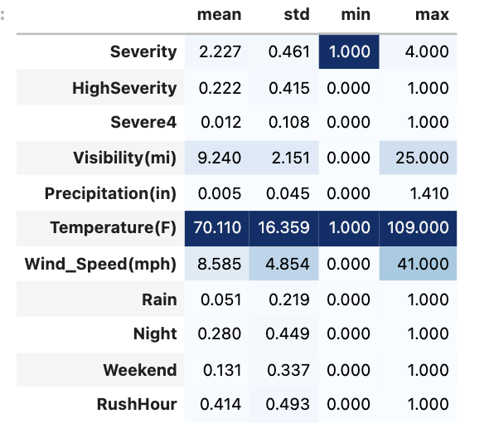
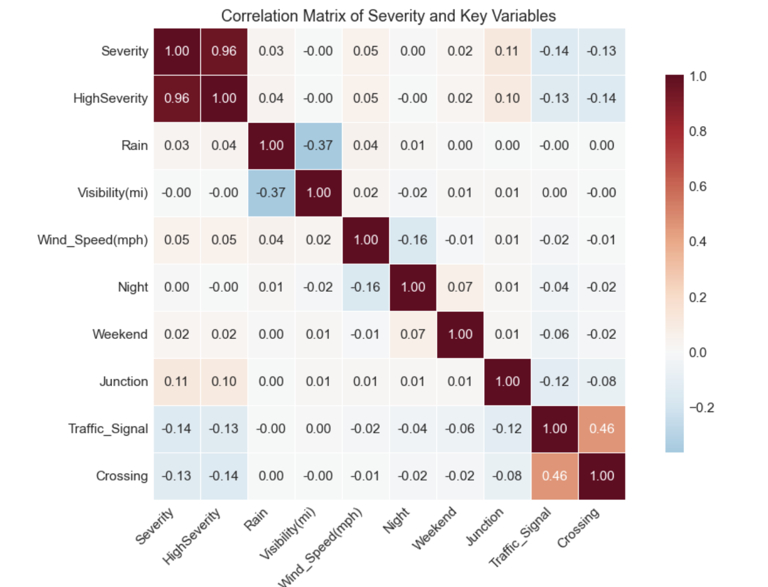
Sample Statistics and Correlation

Slide 6
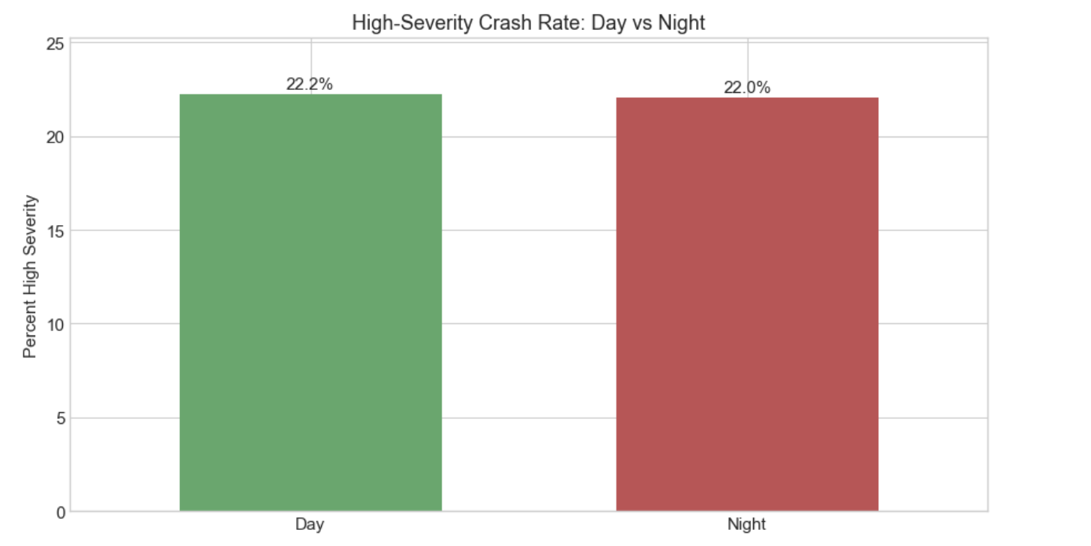
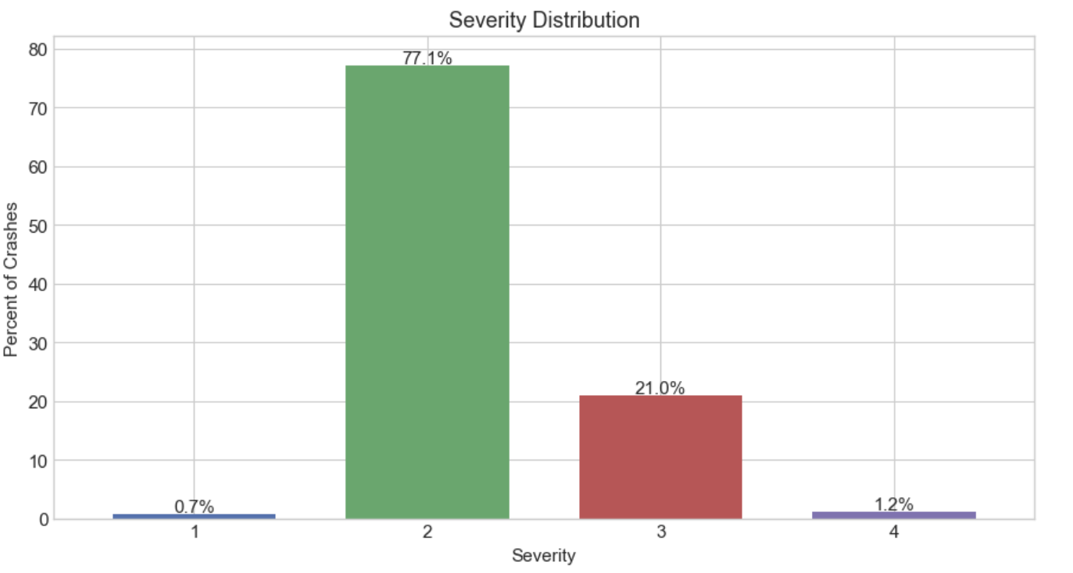
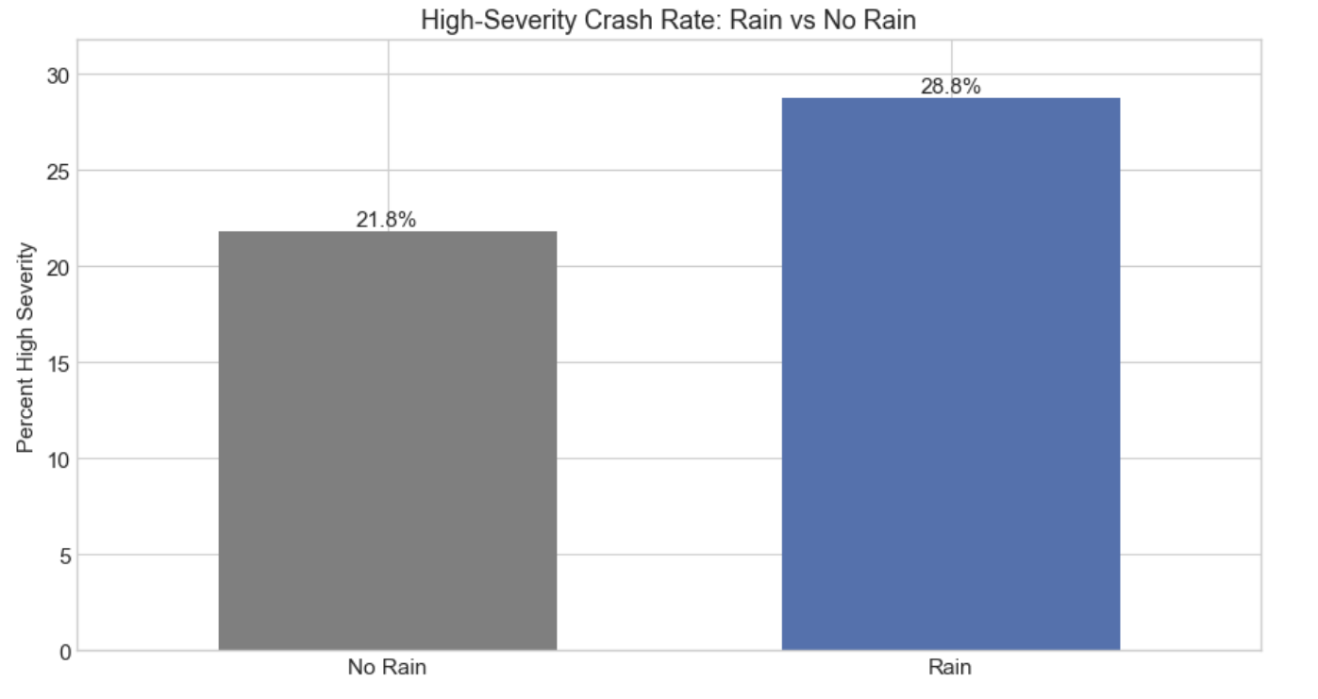
Key Patterns

Slide 7
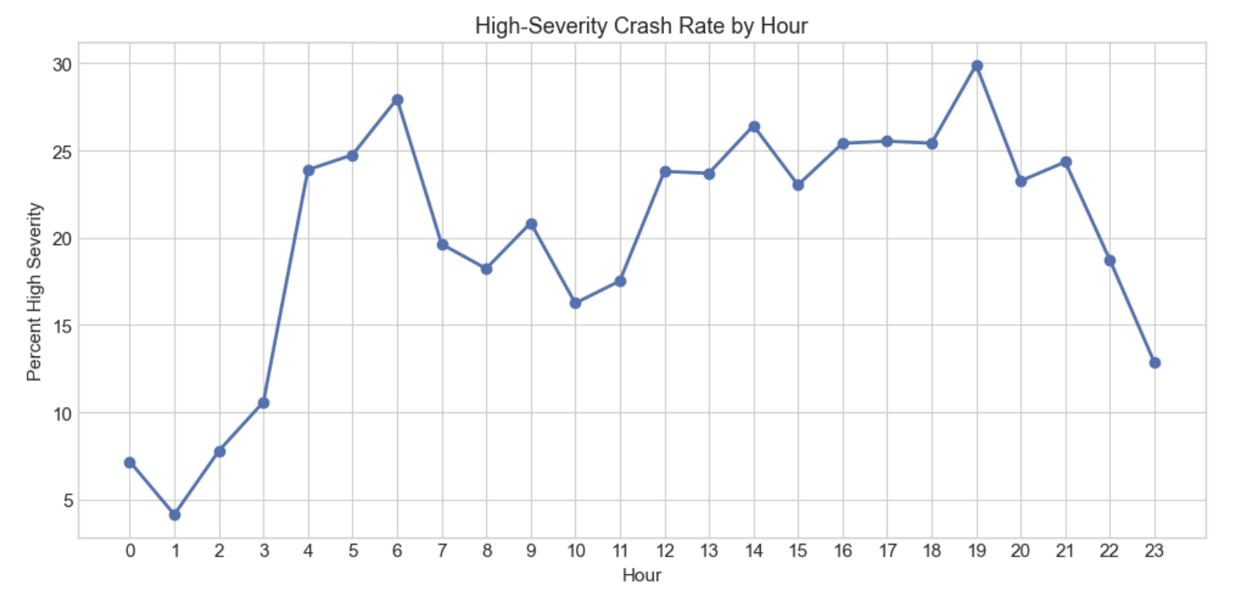
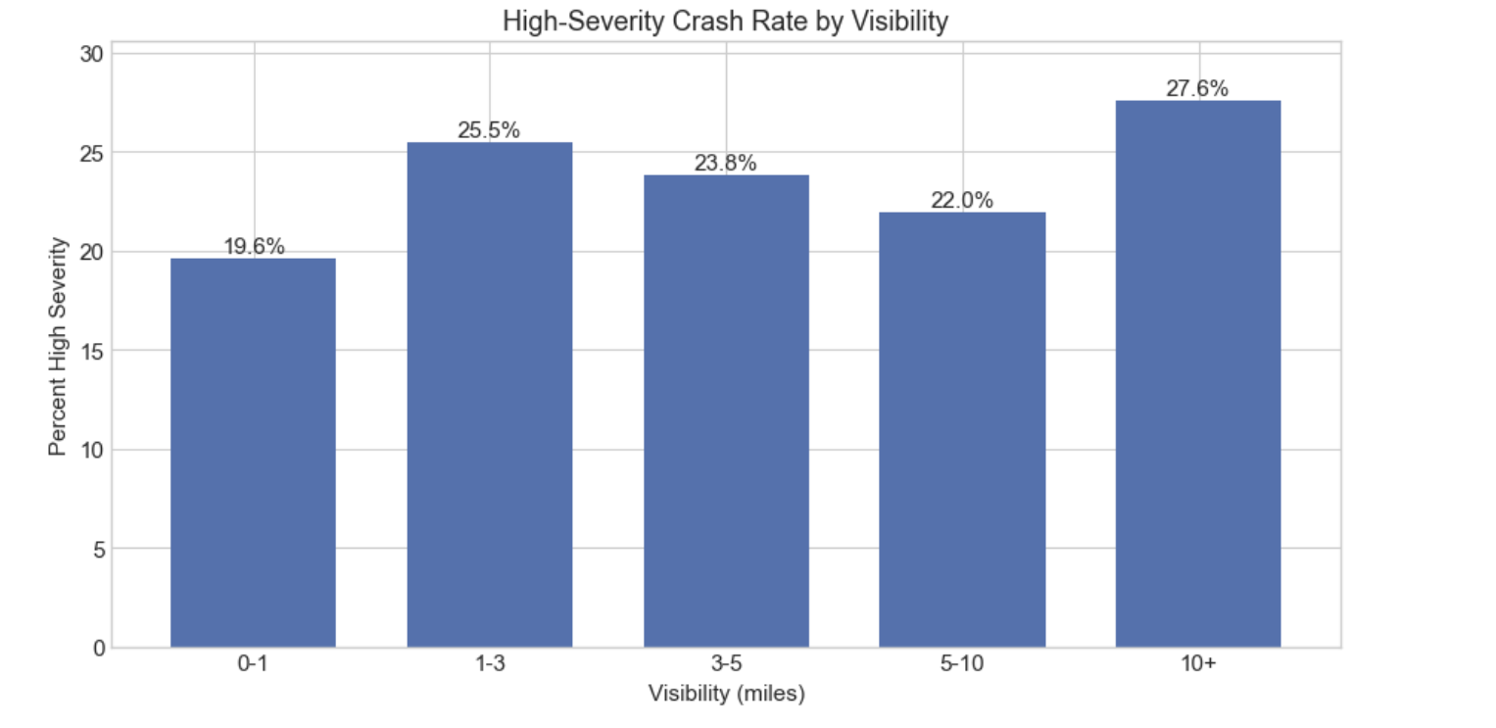
Key Patterns

Slide 8
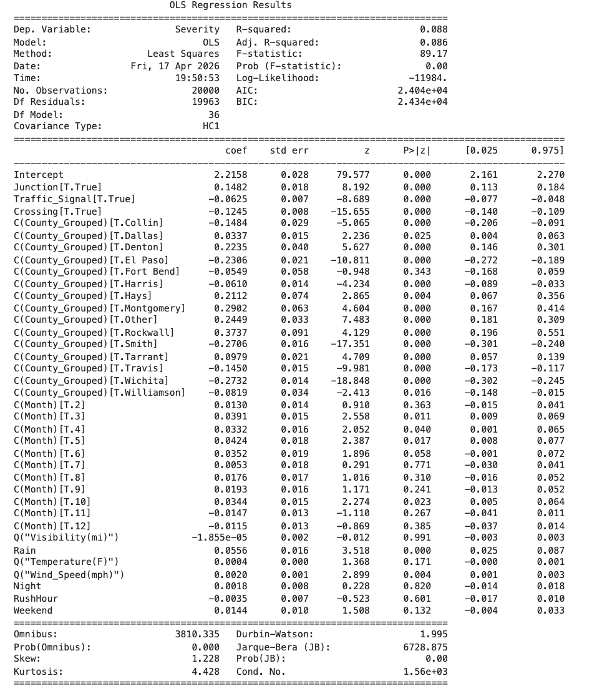
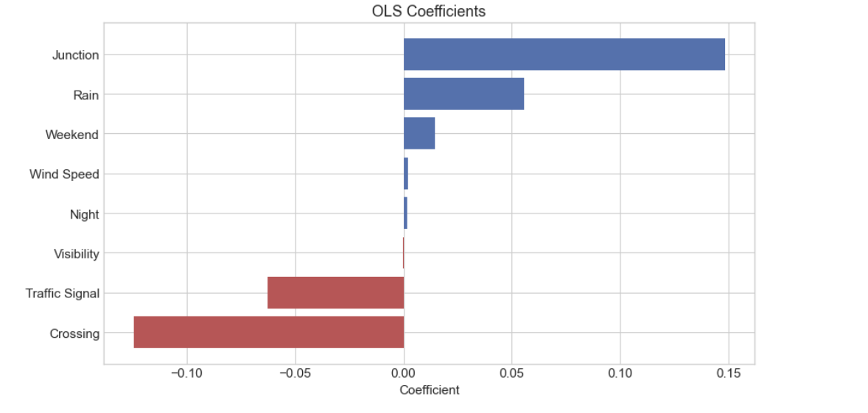
OLS Benchmark Model

Slide 9
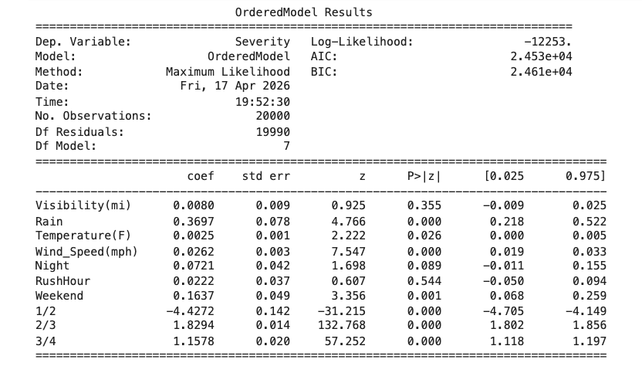
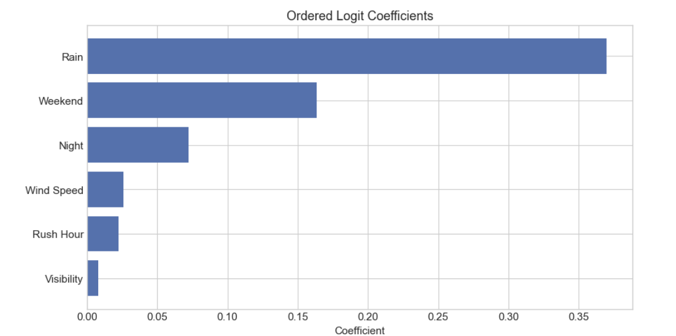
Ordered Logit Model

Slide 10
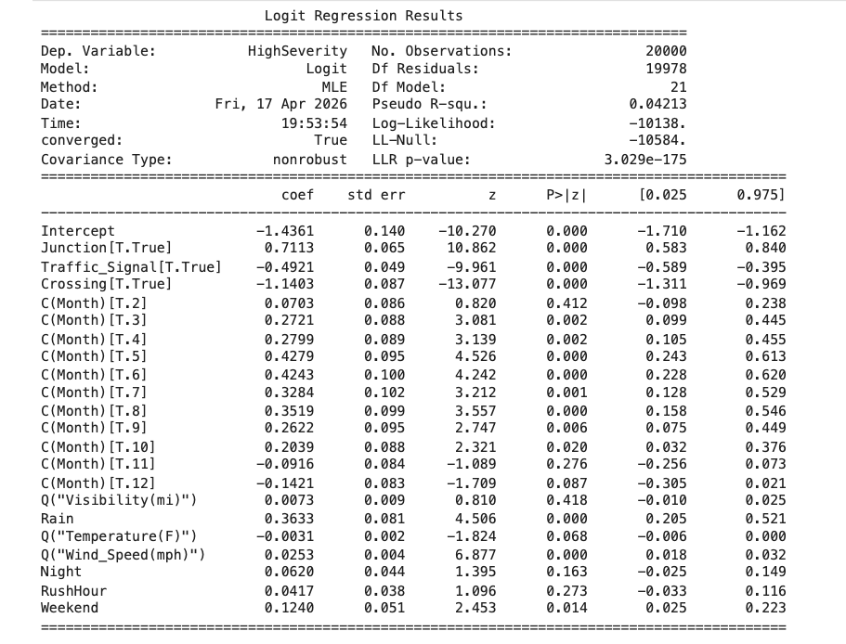
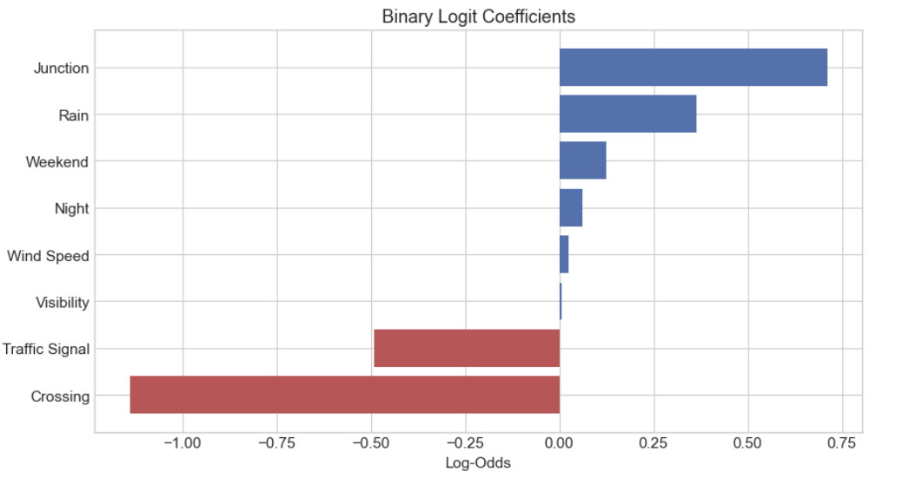
Binary Logit Model

Slide 11
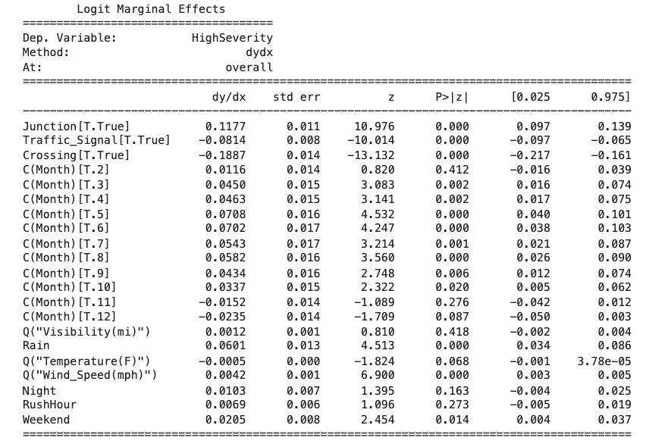
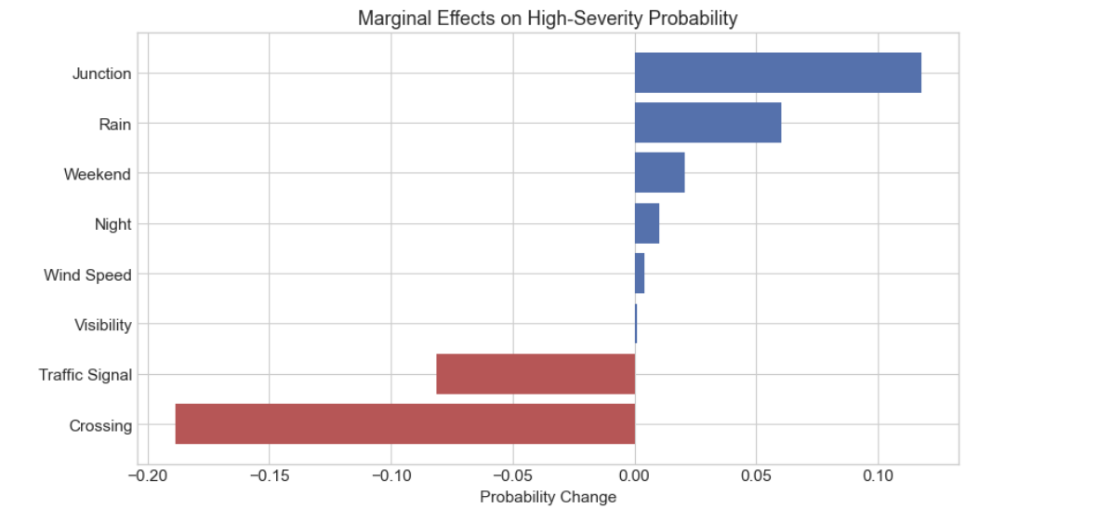
Marginal Effects

Slide 12
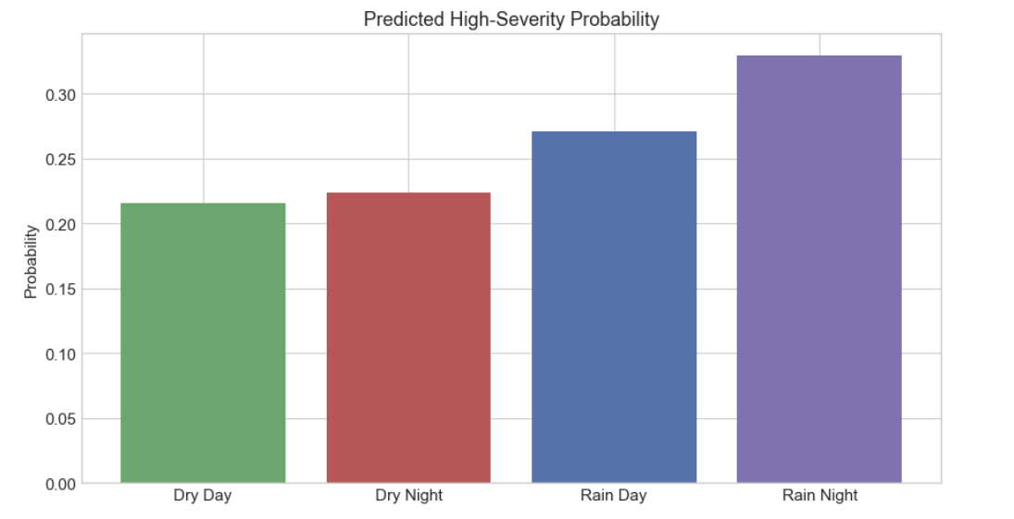
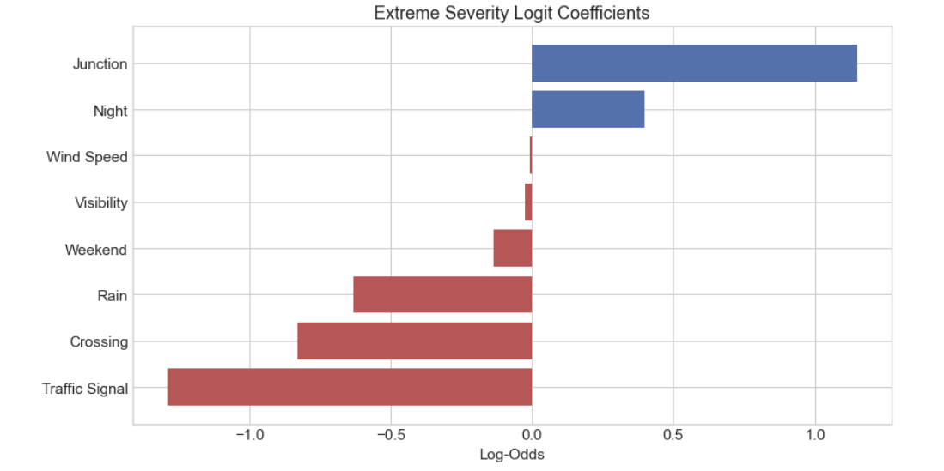
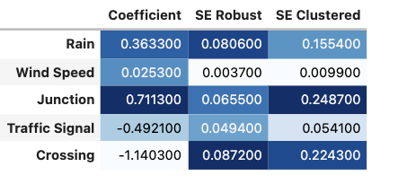
Robustness Checks
Rain and Night Interaction
Extreme Severity Outcome
County-Clustered Standard Errors

Slide 13
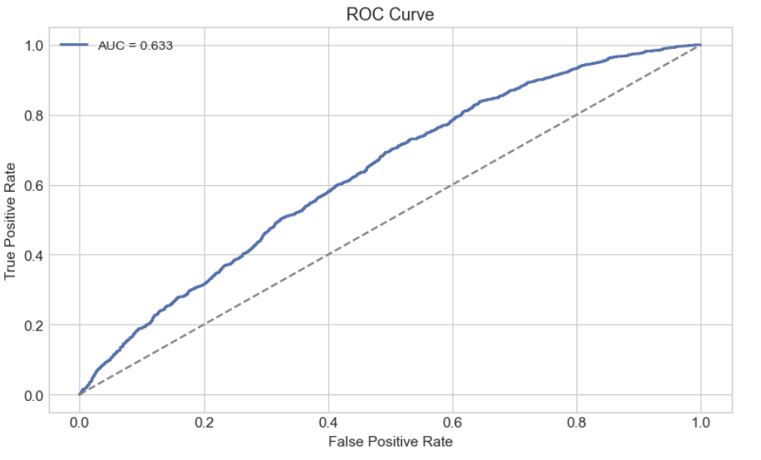
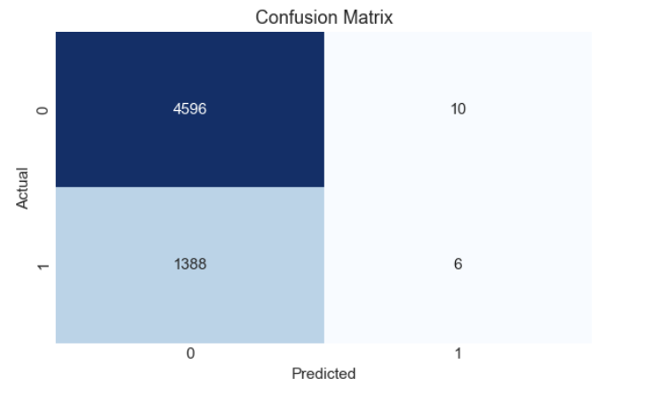
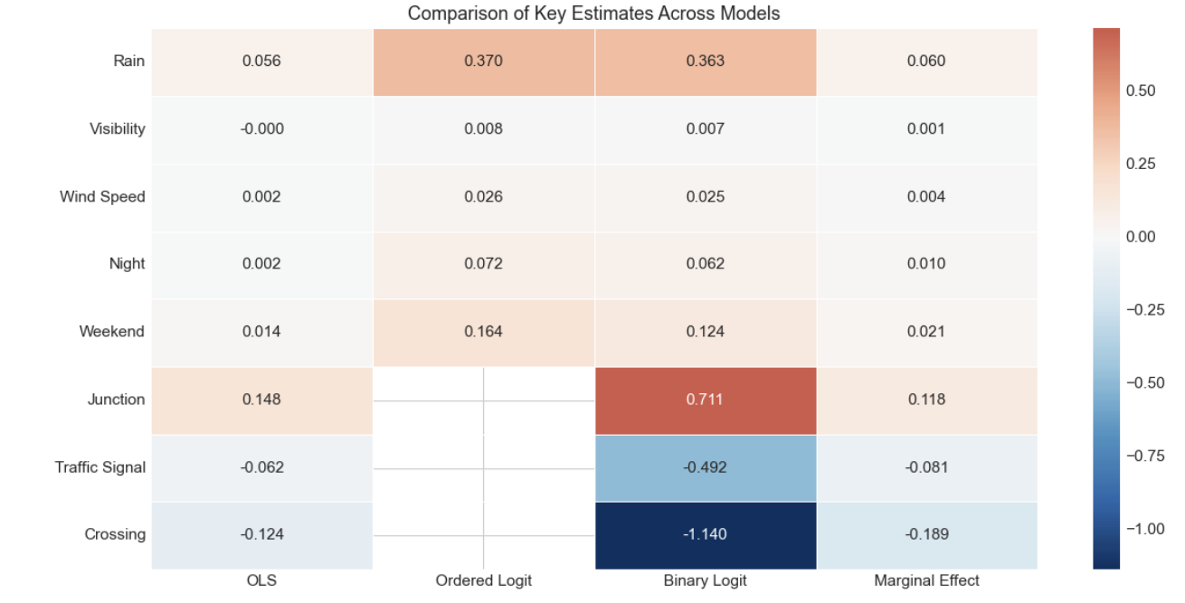
Model Evaluation

Slide 14
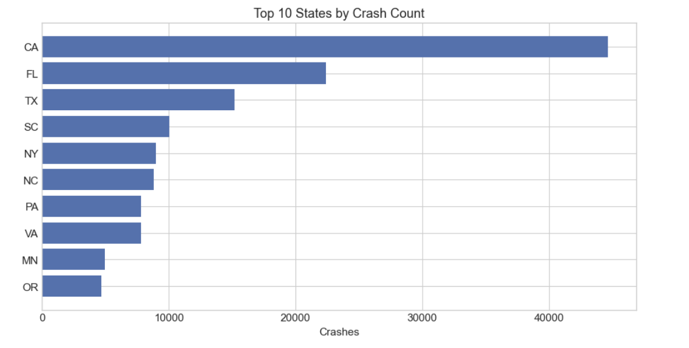
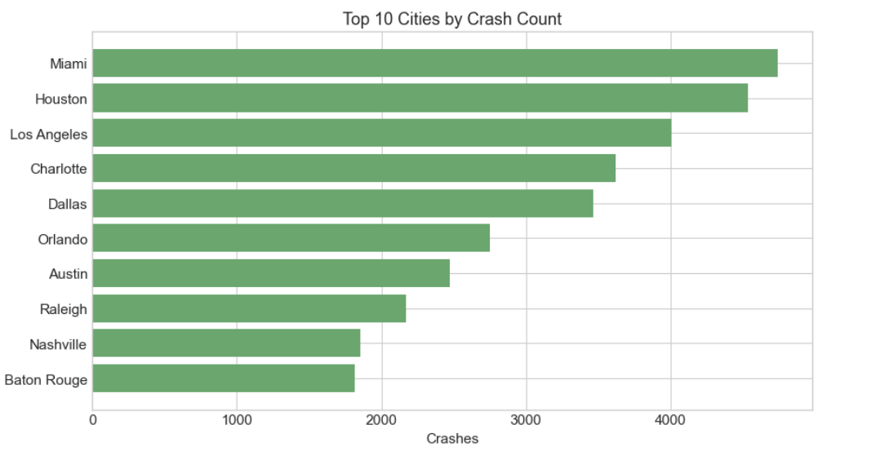
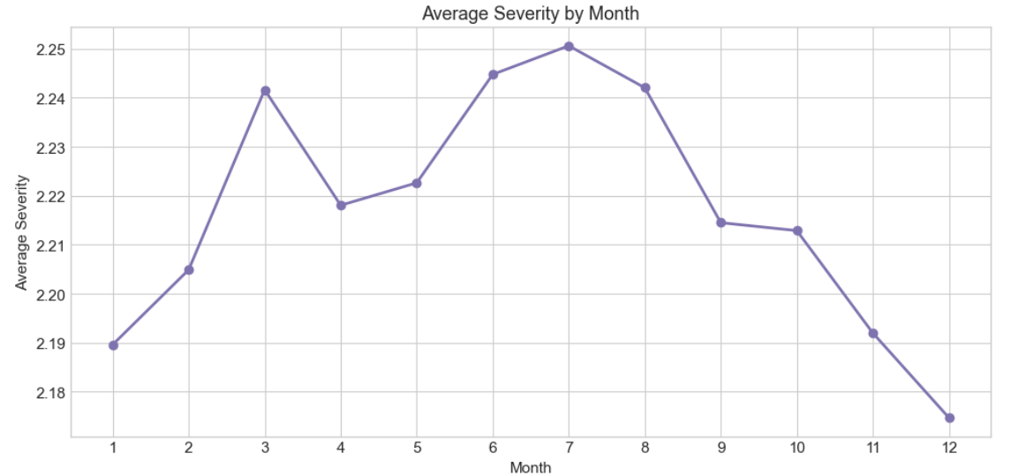
National Comparison (from 200,000 samples)

Slide 15
Limits and Conclusion
Results reflect conditional associations, not causal effects.
Some factors such as driver behavior and speed are not observed.
Only reported crashes are included.
Texas results may differ from other states.
Rain, wind speed, and junctions are linked to higher crash severity.
Traffic signals and crossings are linked to lower severity.
Results are consistent across models.
Weather and road design matter for traffic safety.

Slide 16
THANK YOU!

