Slide 1
PERSONAL VOCABULARY APPLICATION

Slide 2
TABLE OF CONTENTS
Why Personal Vocabulary?
Application requirements
Technologies
Project plan
Application overview
Show case

Slide 3
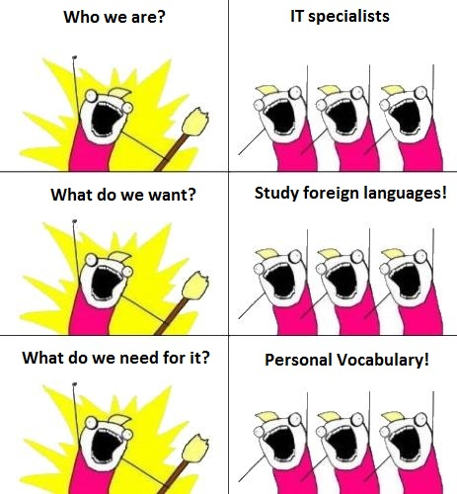
WHY PERSONAL VOCABULARY?
Because:
It’s useful
It’s interesting
We can

Slide 4
MAIN REQUIREMENTS
A multi-user web app
One account – many vocabularies
Two types of vocabulary: linguistic or explanatory
Synonyms
User options:
Add a new word
Update an existing word
View all words
View details for a specific word

Slide 5
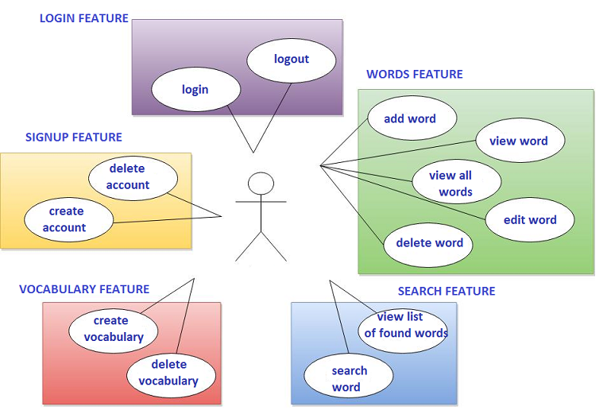
FEATURES

Slide 6
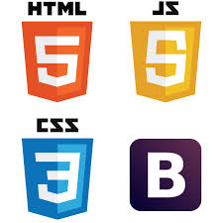







CHOSEN TECHNOLOGIES
FRONT-END
HTML
CSS
JavaScript
jQuery
BACK-END
Java 7
JSP
Framework: Spring Framework
Database: MySQL
Web container: Apache Tomcat
Tools: Eclipse, Maven, GIT

Slide 7
PROJECT PLAN
Time-frames: April 21 – June 17 2015
Involved in the project:
Alexandr Panchenko, Julia Denysova
Oleksii Odnoiko

Slide 8
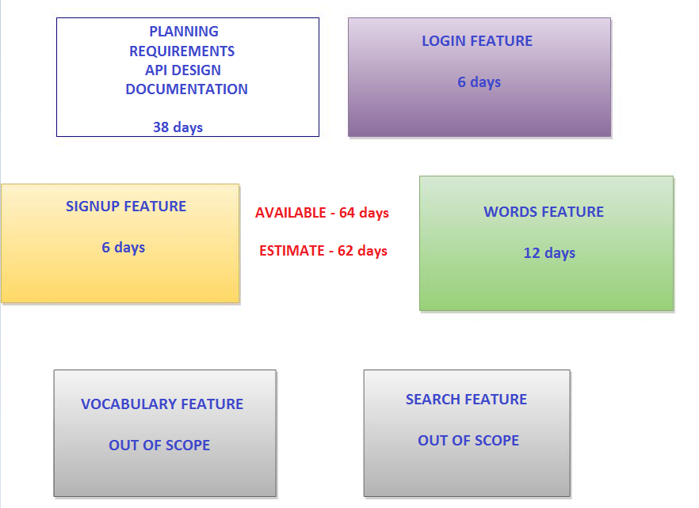
ESTIMATE

Slide 9
Back-end development plan
Dates | Sprint | Sprint tasks | TL
April 21-30 | Sprint 0 | Work setup | Julia Denysova
May 5-15 | Sprint 1 | Design Create/delete user feature | Alexander Panchenko
May 18-29 | Sprint 2 | Create/delete user feature update Log In/Out, Update/Delete/View word feature, External controllers | Alexander Panchenko
June 2-12 | Sprint 3 | Update/Delete/View word feature | Julia Denysova

Slide 10
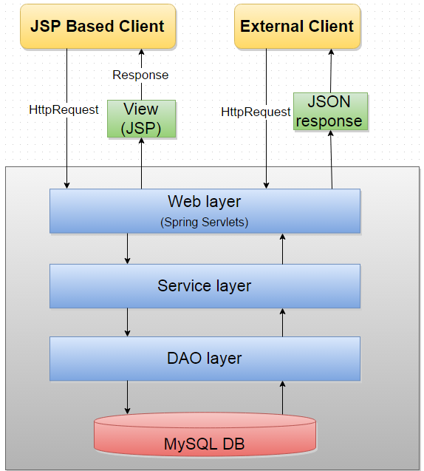
APPLICATION OVERVIEW

Slide 11
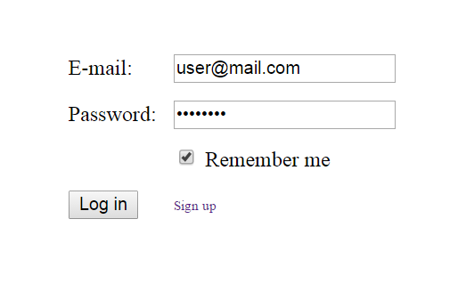
Home page

Slide 12
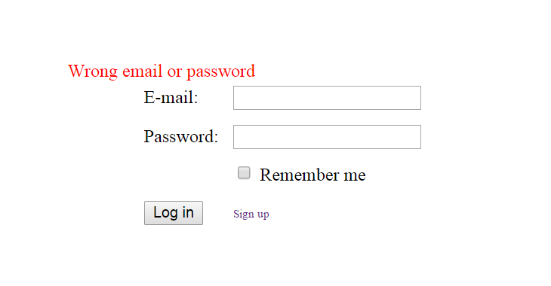

Slide 13
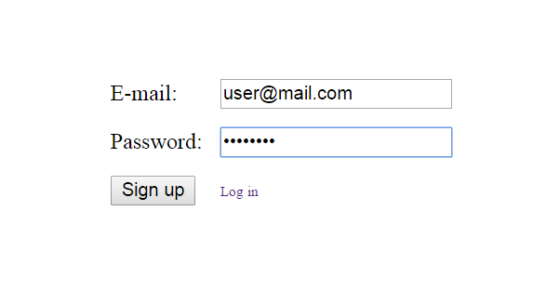
Sign up page

Slide 14
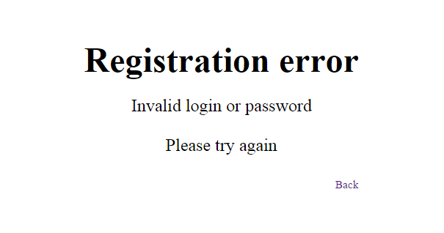

Slide 15
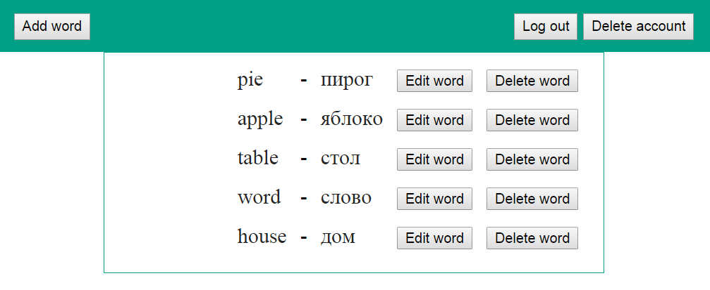
Words page

Slide 16
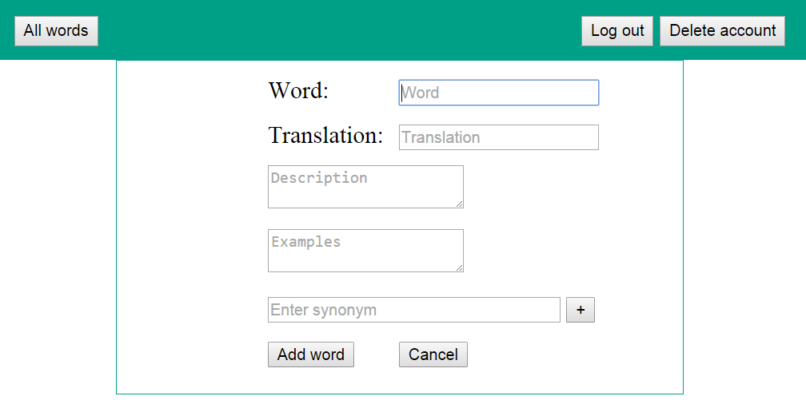
Add word page

Slide 17
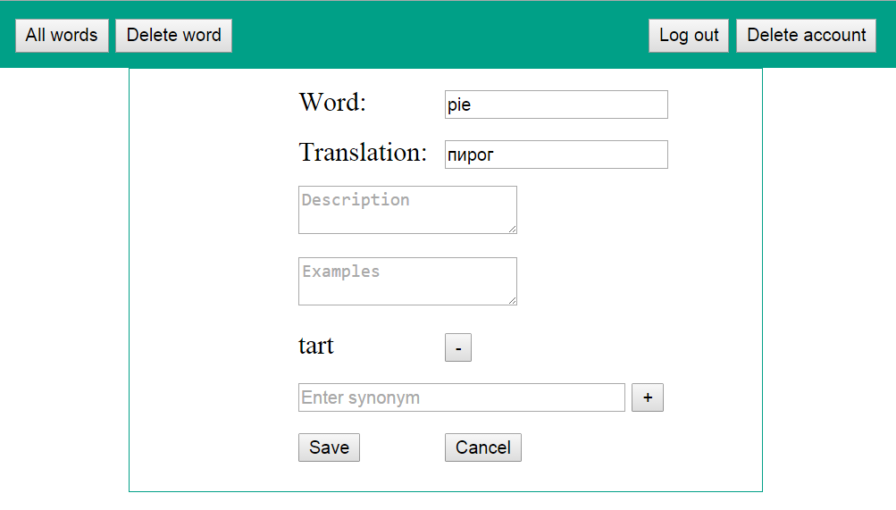
Edit word page

Slide 18
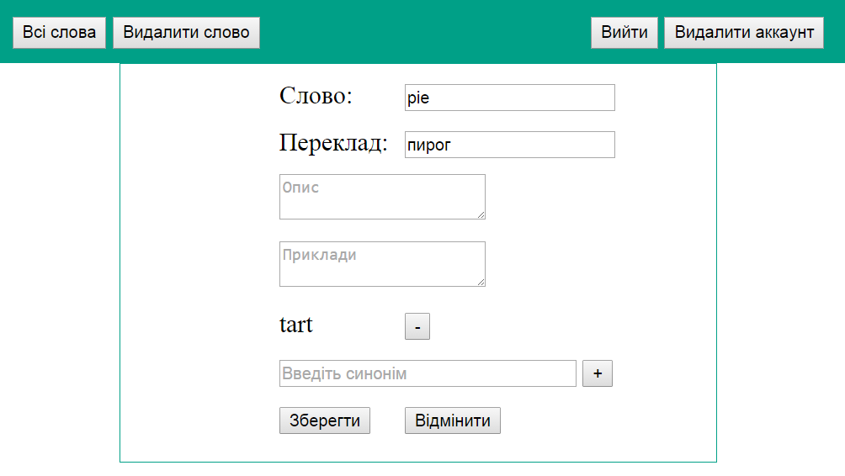
Localization

Slide 19
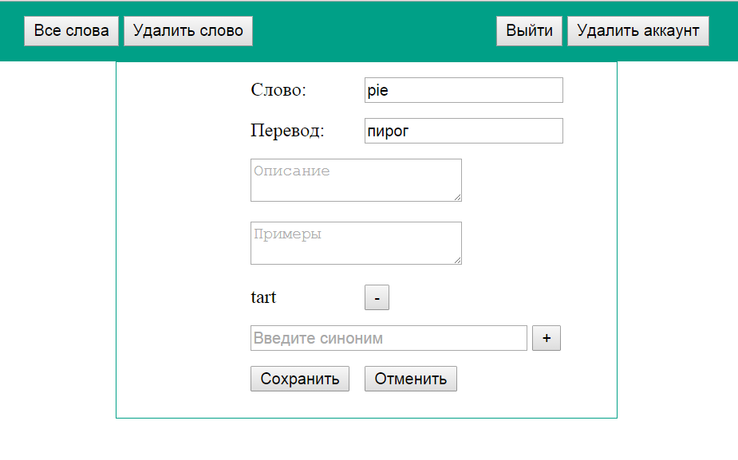

Slide 20
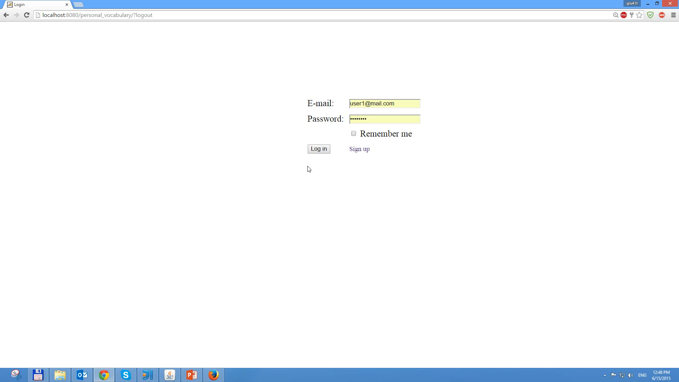
DEMO

Slide 21
CLIENT FOR PERSONAL VOCABULARY
Project start: May 26
Release: June 18

Slide 22
REQUIREMENTS
Adaptive Web Design
Data validation before sending to the server
Resources loader
Pagination with transition effect
Drop-down menu for phone
Data sort in main table
Search word

Slide 23
SUPPORTED BROWSERS
Desktop
Tablet
OS/browsers | Mozilla Firefox | Google Chrome | IE | Safari
Windows 7 | latest version | latest version | 11+(non metro) | -
Windows 8.1 | latest version | latest version | 11+(non metro) | -
MacOS10.9 | - | - | - | latest version
Device | OS | Safari (Mobile)
Apple iPad 3 | iOS 8 | Yes

Slide 24


TECHNICAL UTILITIES
HTML 5
CSS 3
Bootstrap 3
jQuery
Grunt
JSHint

Slide 25
DEMO

Slide 26

more information about Personal Vocabulary with JSP client
more information about HTML client

