Slide 1
Statistical Modelling and Machine Learning
Bundesliga Ranking Prediction for Season 2016
Abhijeet Parida, Mu Yujiao, Falko Spaeh, Nikhil Agarwal

Slide 2
Aim
To predict the team ranking of Bundesliga 2016 based on data collected over past 4 years

Slide 3
Idea
Each team has its own strength and weakness
A team is strong if it scores more or concedes less
A team is weak if it scores less and concedes more
When strong team plays a weak team probability of it scoring more goals is high

Slide 4
Model
The goal scoring of is considered as a Poisson distribution
Most Likelihood Estimation(MLE) for each team goal in a match
Game outcomes with confidence evaluated for ranking

Slide 5
Why Poisson?
based on following assumptions:
Scoring of goals is discrete
the goal scoring are independent and occur in fixed interval of time (i.e. one match)
the event occurs with the modelled average rate

Slide 6

How Poisson?
Consider Team A is home
Team A home attack= $\frac{Average Goals scored by team A at home}{Average goals scored by all teams at home}$
Team A home defence= $\frac{Average Goals scored against team A at home}{Average goals scored against all teams at home}$

Slide 7

How Poisson?
Consider Team B is away
Team B away attack= $\frac{Average Goals scored by team B at away}{Average goals scored by all teams at away}$
Team B away defence= $\frac{Average Goals scored against team A at away}{Average goals scored against all teams at away}$

Slide 8

How Poisson?
Poisson mean scoring rate(λ)
Team mean scoring rate= Team attack * opponent defence
Team goal distribution (PMF)= $\frac{\text{λ} k exp⁡(−\text{λ}\text{)}}{\text{k} !}$

Slide 9
Most Likelihood Estimation
The PMF of both teams give the most likely score of the match
The confidence of win, loss or draw evaluated on all possible scenario

Slide 10
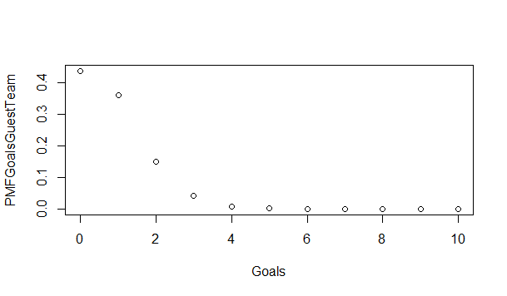
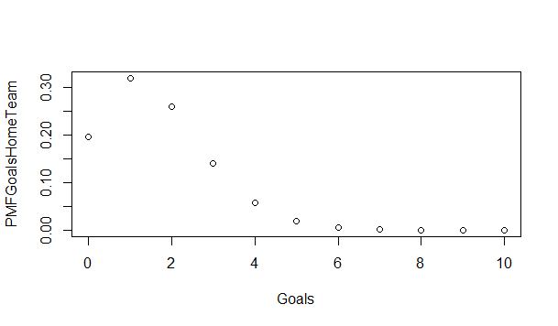
Most Likelihood Estimation

Slide 11
Game Outcomes
Points scored by A = 3*ConfidenceWin +1*ConfidenceDraw+ 0*ConfidenceLoss
Points scored by B = 3*ConfidenceWin +1*ConfidenceDraw+ 0*ConfidenceLoss

Slide 12
Problems
Missing Data of Leipzig
Cannot handle penalty or game time extension or red cards….
Highly marginalised chances of draw

Slide 13
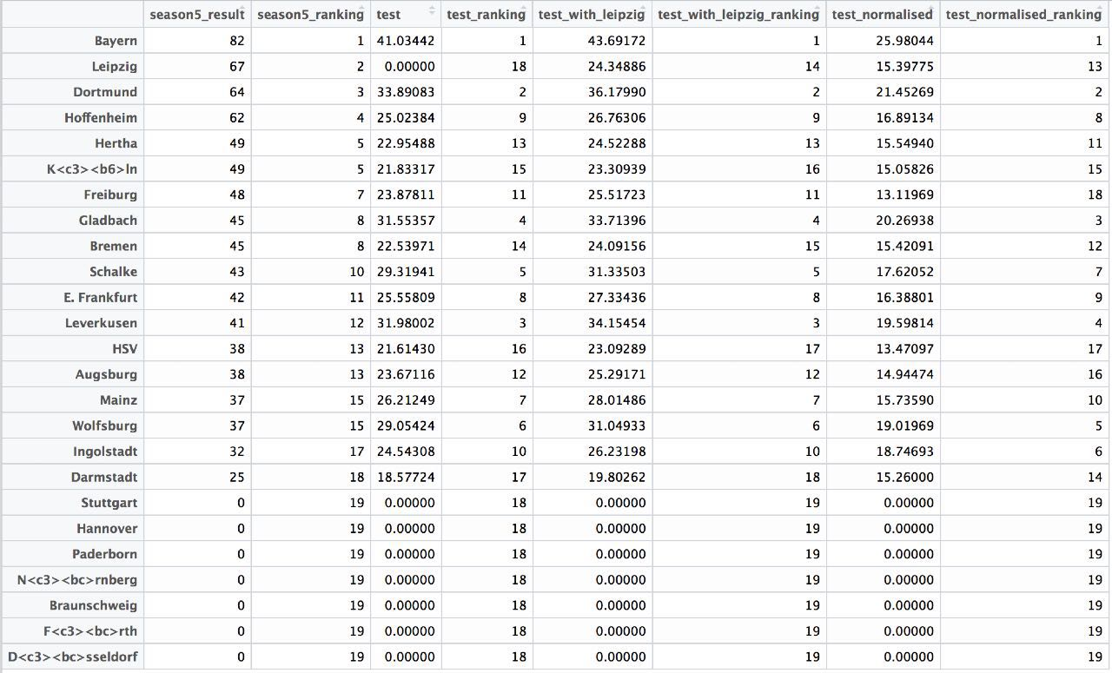

Predicted Ranking 1 – (Leipzig not considered)
Model: Leipzig assumed to be weakest
$Test Parameter =\sum_{n teams}{{\left(Absolute deviation between predicted and actuals rank\right)}^{2}}$
$=$ 833

Slide 14
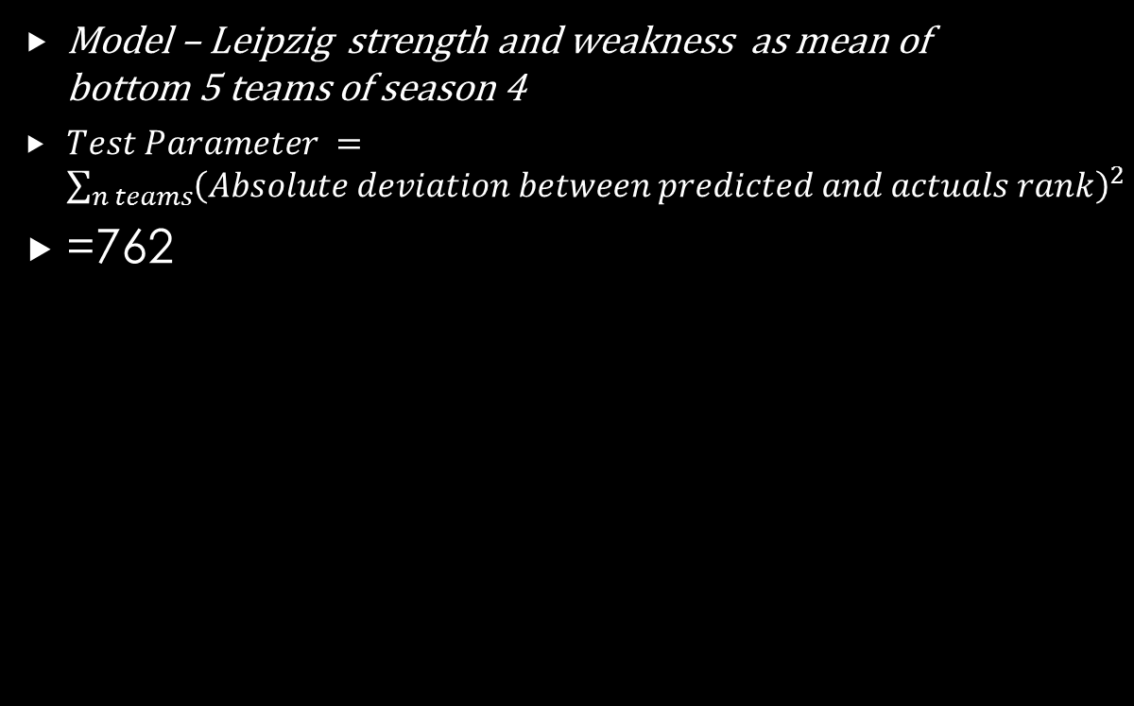
Predicted Ranking 2 – (Leipzig considered)
Model – Leipzig strength and weakness as mean of bottom 5 teams of season 4
$Test Parameter =\sum_{n teams}{{\left(Absolute deviation between predicted and actuals rank\right)}^{2}}$
=762

Slide 15
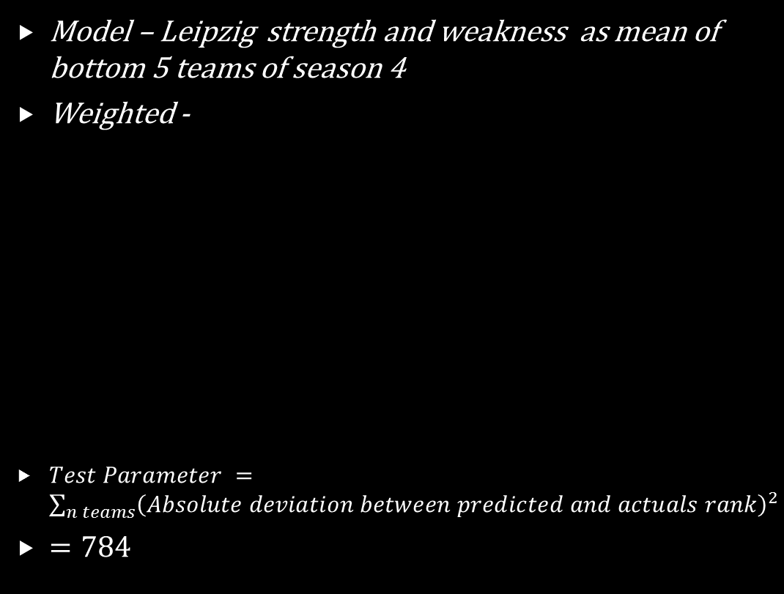
Predicted Ranking 3 – With Leipzig, Weighted Seasons
Model – Leipzig strength and weakness as mean of bottom 5 teams of season 4
Weighted -
$Test Parameter =\sum_{n teams}{{\left(Absolute deviation between predicted and actuals rank\right)}^{2}}$
$=784$
Season | Weight
1 | 0.1
2 | 0.2
3 | 0.3
4 | 0.4

Slide 16
Conclusion
The first model is the worst → Leipzig is actually 2nd best and the model assumes it to be the last
The second and third model → On an average the teams have performed consistently over the seasons
The prediction for strong teams (top 4) and weak teams(bottom 4) are very good
Overall accuracy of 40.3% on each game results

Slide 17
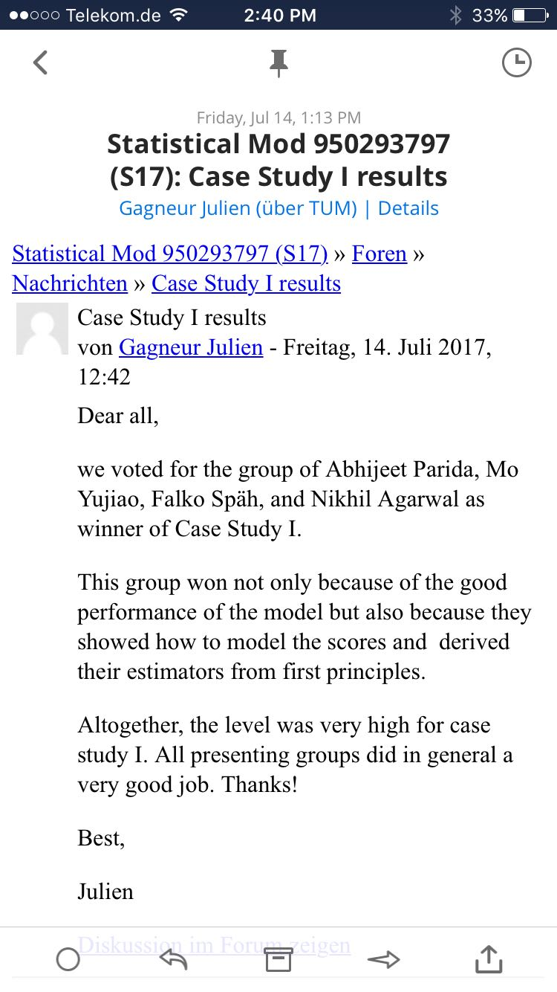
Professor's Words

Slide 18
Thank You

