Slide 1
Introduction To Scientific Computing
By
Abinav.R
Praveen. R

Slide 2
Ordinary Differential Equations
•
Equation with a function y(t) and derivatives of y(t)
y
(
)+
(
)=
t
y
t
0
˙
n
∑
(
)
a
i
(
)=
y
t
0
=
i
i
0
•
typical: development of a variable over time
y
(
)=
(
(
))
˙
t
f
t , y
t

Slide 3
Ordinary Differential Equations
•
Example: radioactive decay
–
Half-life: Period of time in which half of the
atoms decay
–
Decay constant k: Describes rate of decay
and thus half-life
dr
(
t
)
=
−
k
⋅
r
(
t
)
dt

Slide 4
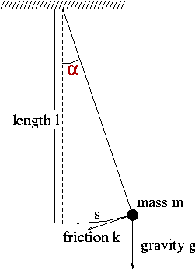
Ordinary Differential Equations
•
Example: pendulum
2
α
α
d
k
d
g
+
⋅
+
⋅
α
=
sin(
)
0
dt
2
m
dt
l

Slide 5
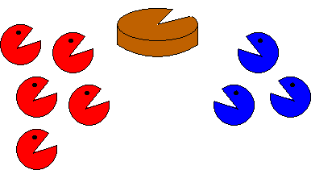
Ordinary Differential Equations
•
Example: population growth
•
populations P and Q
competition
dp


t
=
2
−
p
−
q
⋅
p
dt
dq


t
=
2
−
p
−
q
⋅
q
dt

Slide 6
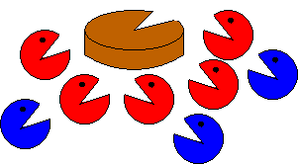
Ordinary Differential Equations
Example: population growth
populations P and Q – predator-prey
dp


t
=
2
−
p

q
⋅
p
dt
dq


t
=
2
−
10p
−
q
⋅
q
dt

Slide 7
Explicit Discretization
•
explicit Euler
•
method of Heun
•
Runge-Kutta
y
=
F
(
y
, t
Δ
)
➢
,
t
n
+
1
n
n

Slide 8
Explicit Discretization
•
explicit Euler
y
(
)
t
y
˙
n
y
=
y
+Δ
⋅
t
y
˙
n
+
1
n
n
=
y
+Δ
⋅
(
)
t
f
t
, y
n
n
n
t
Δ
t

Slide 9
Explicit Discretization
•
method of Heun
1
y
=
y
+Δ
⋅
(
+
)
t
y
y
˙
˙
n
+
1
n
2
n
n
+
1
with
y
=
f
(
+Δ
⋅
(
))
˙
t
, y
t
f
t
, y
n
+
1
n
+
1
n
n
n

Slide 10
Explicit Discretization
•
Runge-Kutta
1
y
=
y
+Δ
⋅
(
+
+
+
)
t
Y
'
2Y
'
2Y
'
Y
'
n
+
1
n
6
1
2
3
4
with
Y
=
(
)
'
f
t
, y
1
n
n
Δ
t
Y
=
(
+
⋅
)
'
f
t
, y
Y
'
2
n
+
1
n
2
1
2
Δ
t
Y
=
(
+
⋅
)
'
f
t
, y
Y
'
3
n
+
1
n
2
2
2
Y
=
(
+Δ
⋅
)
'
f
t
, y
t
Y
'
4
n
+
1
n
3

Slide 11
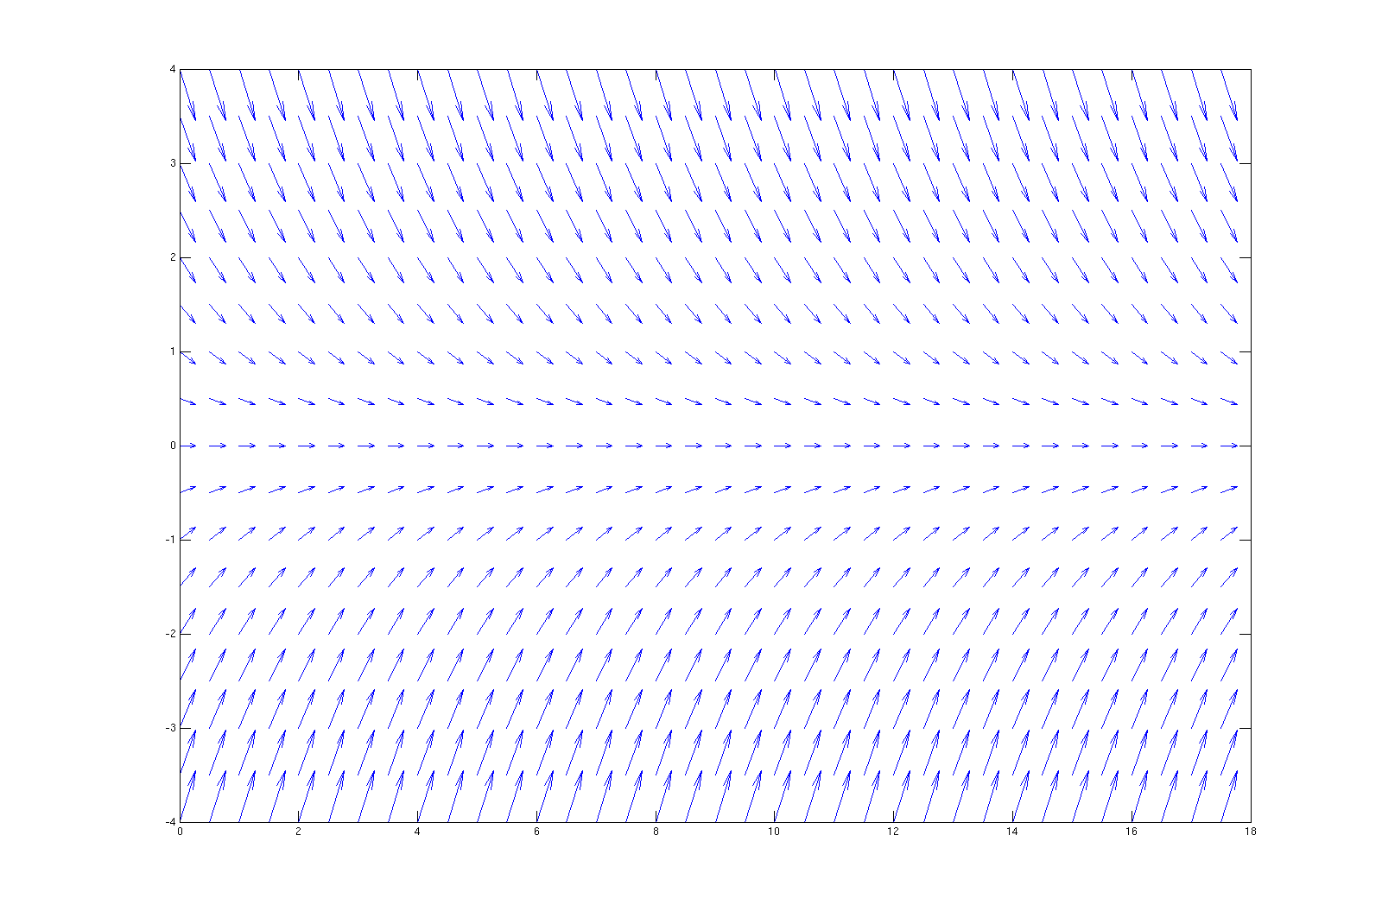
Instability
y
(
)=−
⋅
(
)
•
Vector field of ODE
˙
t
k
y
t

Slide 12
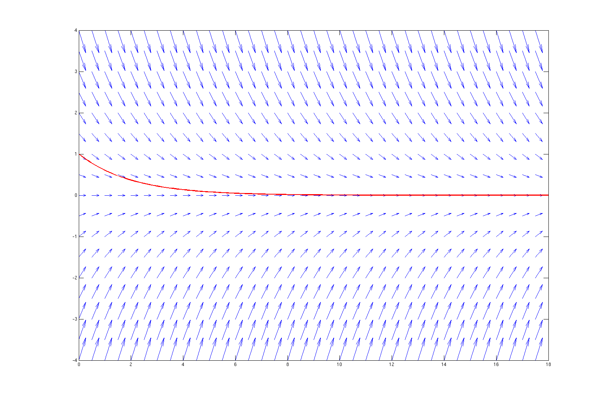
Instability
y
(
)=−
⋅
(
)
•
Vector field of ODE
˙
t
k
y
t

Slide 13
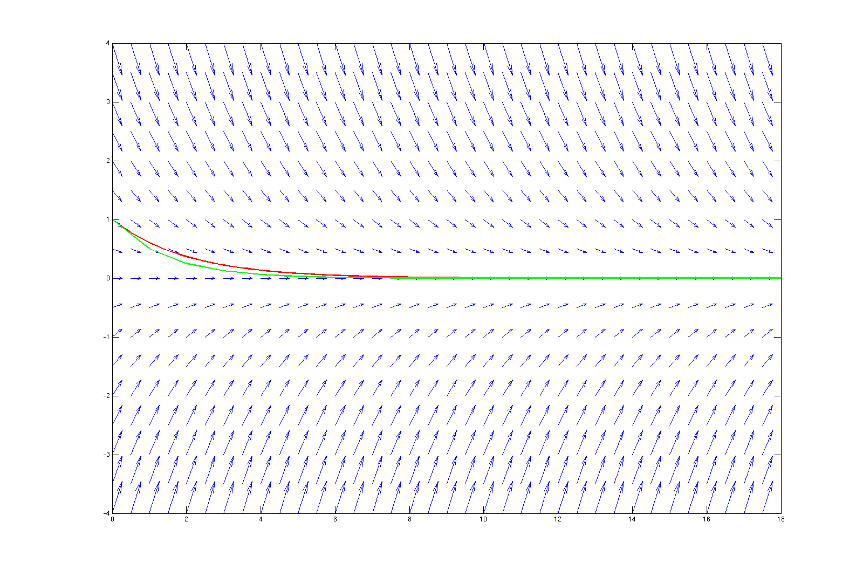
Instability
•
Exlicit Euler, time step size: 1

Slide 14
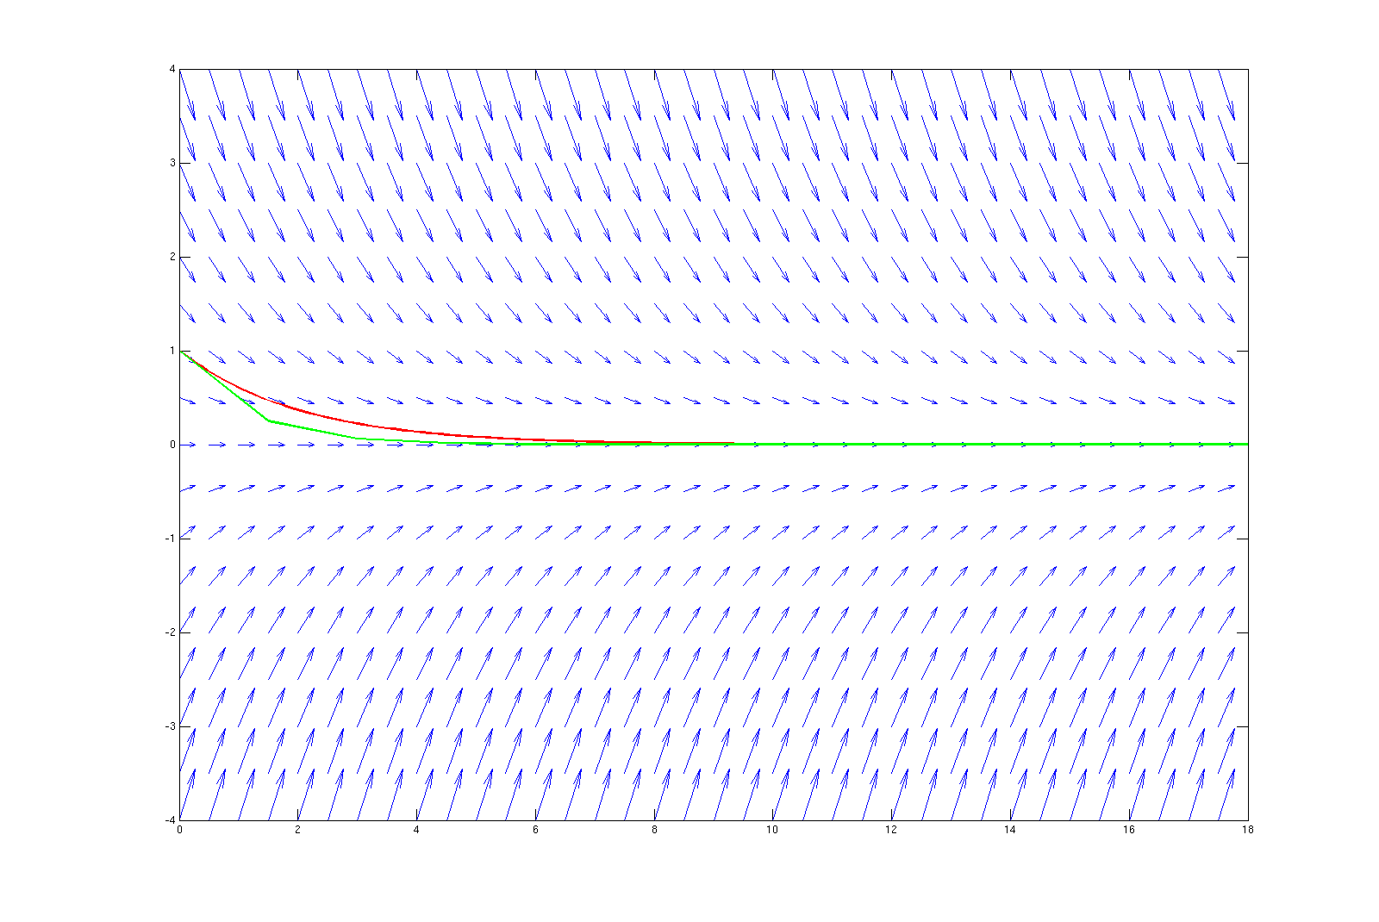
Instability
•
Exlicit Euler, time step size: 1.5

Slide 15
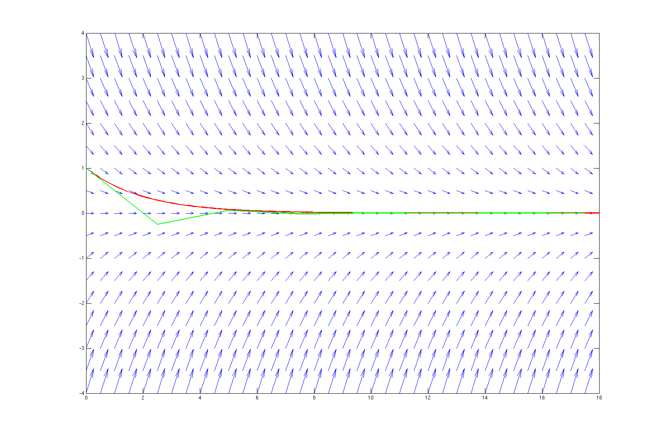
Instability
•
Exlicit Euler, time step size: 2.5

Slide 16
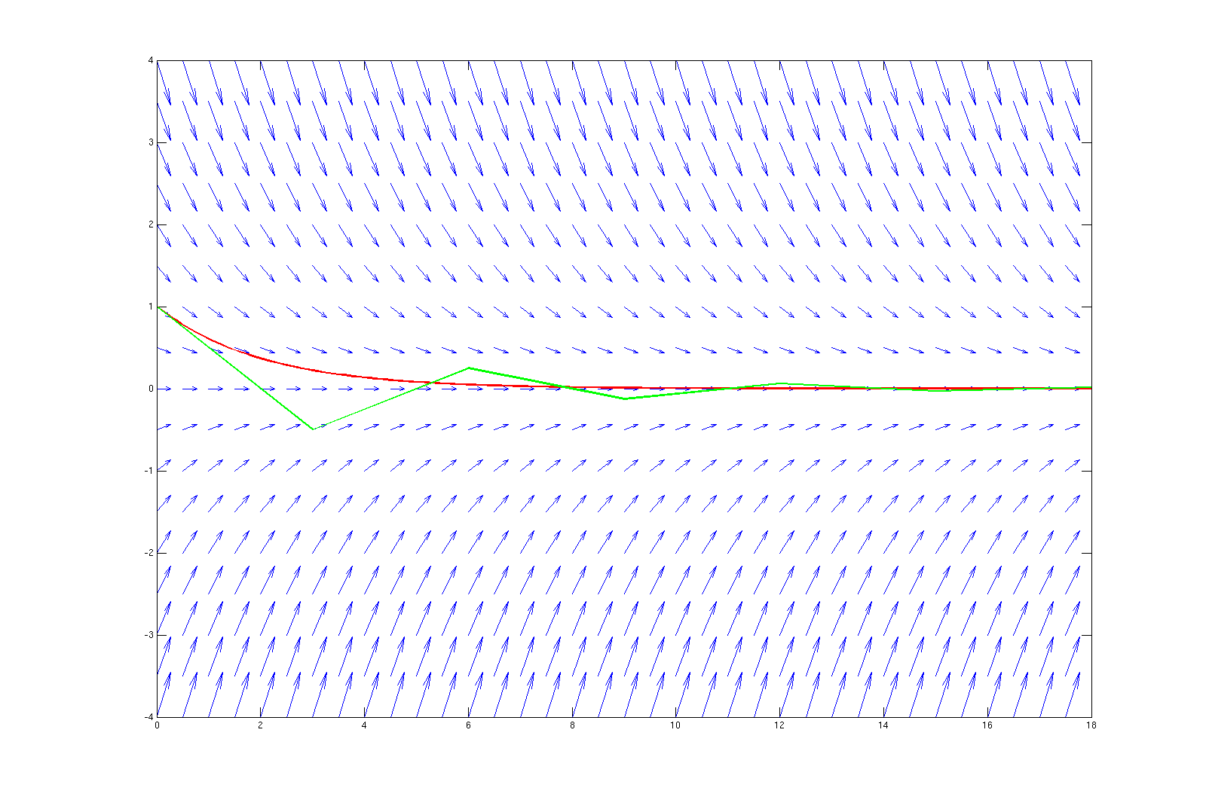
Instability
•
Exlicit Euler, timestep-size: 3.0

Slide 17
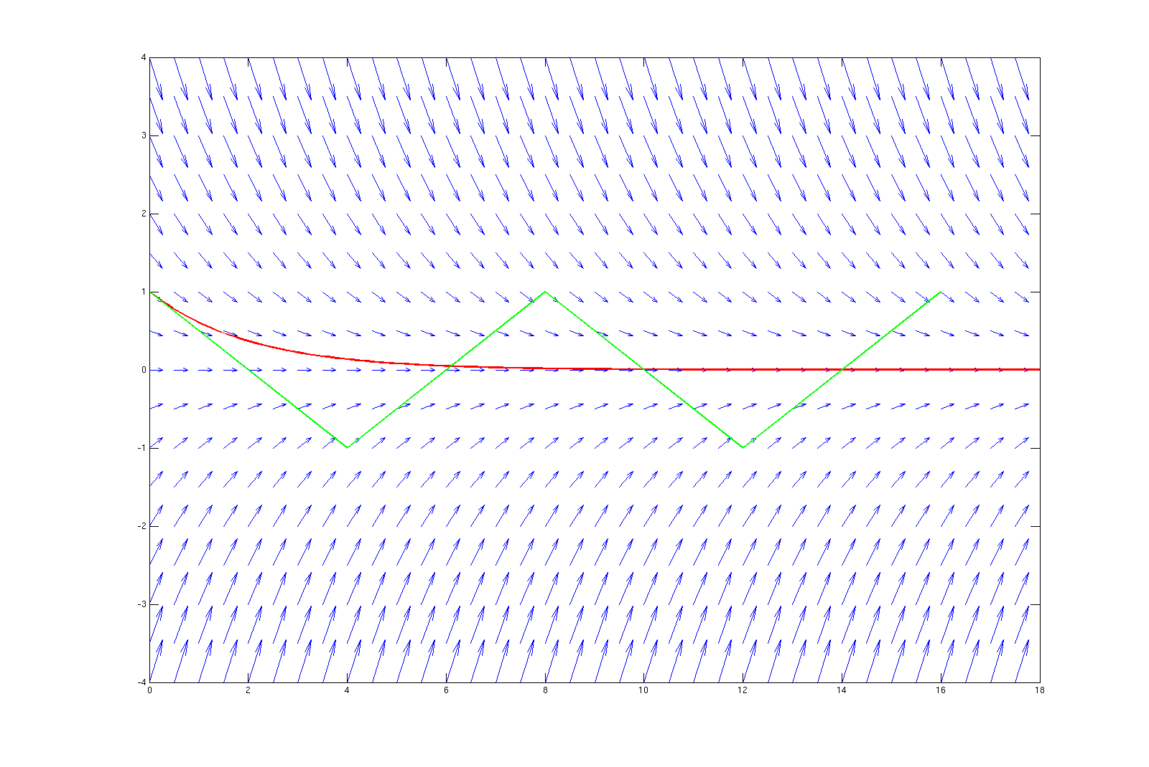
Instability
•
Exlicit Euler, time step size: 4.0

Slide 18
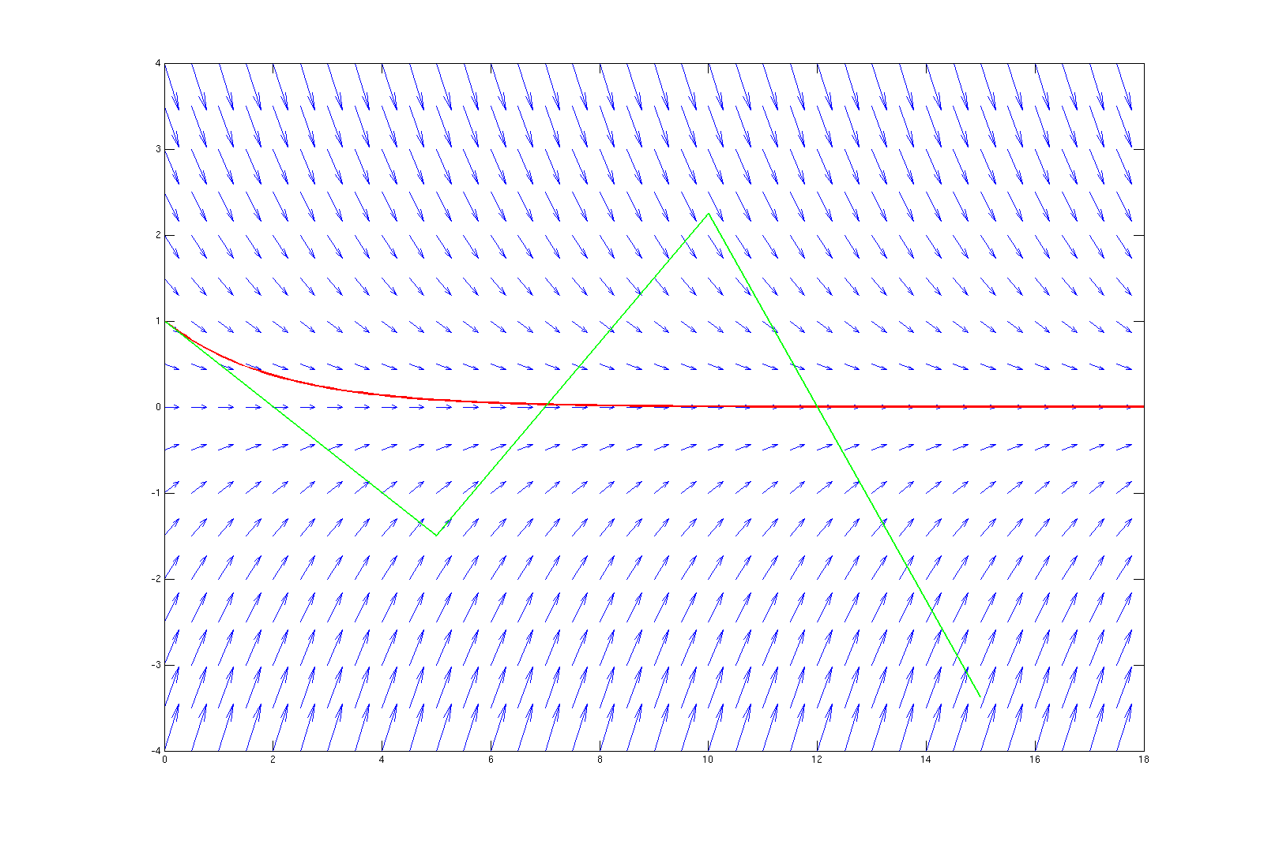
Instability
•
Exlicit Euler, time step size: 5.0

Slide 19
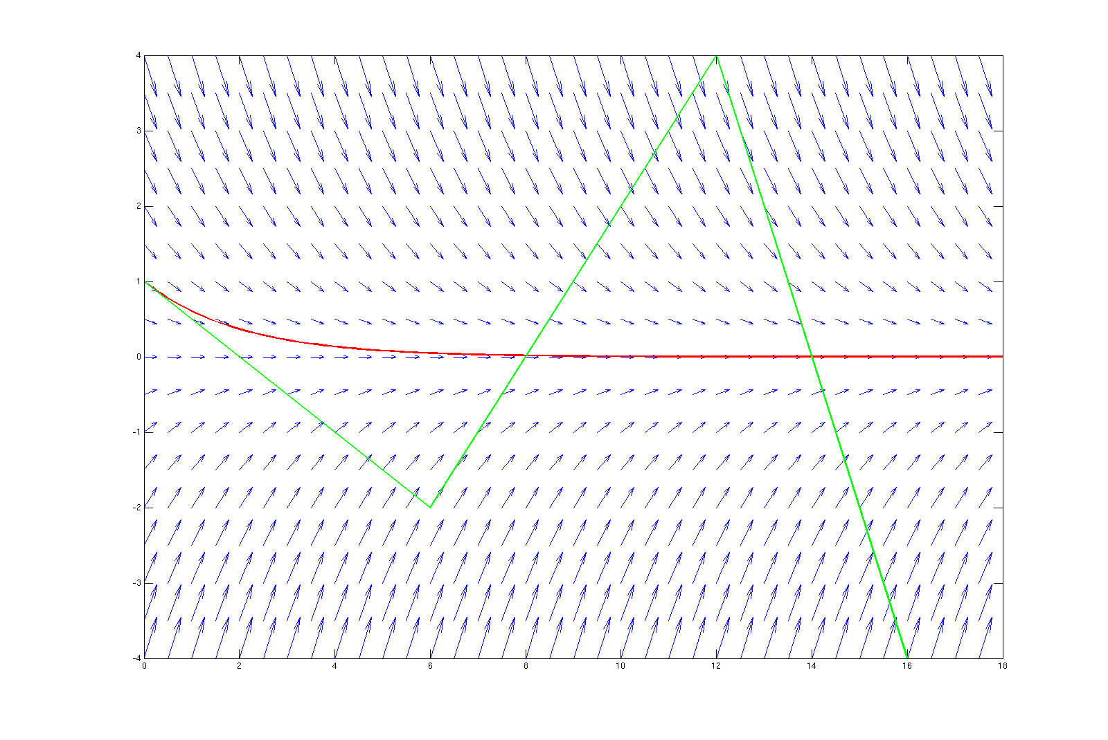
Instability
•
Exlicit Euler, time step size: 6.0

Slide 20
Instability
•
stiff equations
–
instabilities if dt does not obey restrictions
–
„all explicit SSM with stable dt provide very small local errors”
–
examples: damped mech. systems, parabolic PDE, chem.
reaction kinetics
•
remedy: (special) implicit methods

Slide 21
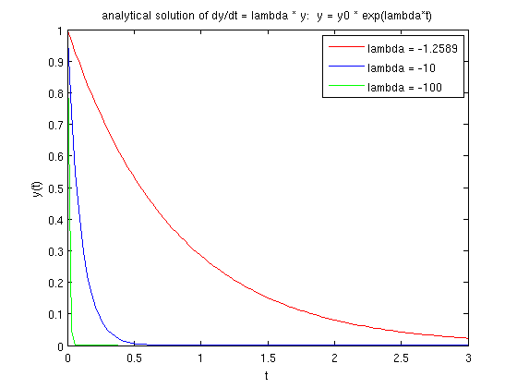
Stiff Equations
y
(
)=λ⋅
(
)
•
Example: Dahlquist's test equation:
˙
t
y
t
–
stable analyt. solution
–
explicit methods:
Δ
≤∣
/ λ∣
t
c
also in
steady phase
(c depending on the method)
transient phase
steady phase
Δ
t
Δ
t
limited by stability & accuracy
limited by stability only!

Slide 22
Implicit Methods
•
implicit Euler
•
2
-order Adams Moulton
nd
y
=
F
(
y
, t
Δ
)
➢
,
t
n
+
1
n
+
1
n

Slide 23
Implicit Methods
•
implicit Euler (1
st
-order method)
y
˙
+
t
n
1
y
=
y
+Δ
⋅
t
y
˙
n
+
1
n
n
+
1
y
+
n
1
=
y
+Δ
⋅
(
)
t
f
t
, y
n
n
+
1
n
+
1
t
Δ
t

Slide 24
Implicit Methods
•
2
-order Adams Moulton (Trapezoidal Rule)
nd
y
y
˙
˙
+
t
n
n
1
Δ
t
y
=
y
+
⋅(
y
+
y
)
˙
˙
y
n
+
1
n
2
n
n
+
1
n
+
1
Δ
t
=
y
+
⋅(
f
(
)+
(
))
t
, y
f
t
, y
n
2
n
n
n
+
1
n
+
1
t
Δ
t

Slide 25
Newton's Method
•
Implicit method may result in complex expressions:
ODE
f
(
(
))=−
(
(
))
t , y
t
log
y
t
implicit Euler:
y
=
y
+Δ
⋅
t
y
˙
n
+
1
n
n
+
1
=
y
+Δ
⋅
(
)
t
f
t
, y
n
n
+
1
n
+
1
=
y
−Δ
⋅
(
)
t
log
y
n
n
+
1

Slide 26
Newton's Method
•
Implicit method may result in complex expressions:
implicit Euler:
y
=
y
−Δ
⋅
(
)
t
log
y
n
+
1
n
n
+
1
needs to be solved:
y
+Δ
⋅
(
)−
=
t
log
y
y
0
n
+
1
n
+
1
n
Can (only) be solved numerically!

Slide 27
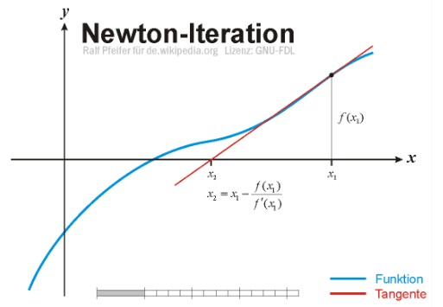
Newton's Method
•
Numerical approach to find roots of functions
G
(
)=
x
0
Ralf Pfeifer – http://upload.wikimedia.org/wikipedia/commons/e/e0/NewtonIteration_Ani.gif

Slide 28
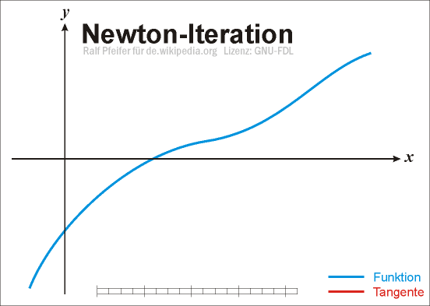
Newton's Method
•
Numerical approach to find roots of functions
G
(
)=
x
0
Ralf Pfeifer – http://upload.wikimedia.org/wikipedia/commons/e/e0/NewtonIteration_Ani.gif

Slide 29
Newton's Method
•
Numerical approach to find roots of functions
G
(
)=
x
0
G
(
)
x
x
=
x
−
i
+
i
1
i
G '
(
)
x
i
Ralf Pfeifer – http://upload.wikimedia.org/wikipedia/commons/e/e0/NewtonIteration_Ani.gif

Slide 30
Newton's Method
•
Numerical approach to find roots of functions
•
In our case we get
G
(
y
)=
0
n
+
1
•
Thus, we need
G '
(
y
)
n
+
1

Slide 31
Newton's Method
y
=
y
−Δ
⋅
(
)
•
Initial example:
t
log
y
n
+
1
n
n
+
1
G
(
y
)=
y
+Δ
⋅
(
)−
t
log
y
y
n
+
1
n
+
1
n
+
1
n
Δ
t
G '
(
y
)=
1
+
n
+
1
y
n
+
1

Slide 32
Newton's Method
•
Convergence examples of the Newton iteration
(cf. separate file)

Slide 33
Explicit versus Implicit
•
explicit:
–
cheap time steps
–
many time steps
•
implicit:
–
expensive/impossible time steps
–
less time steps

Slide 34
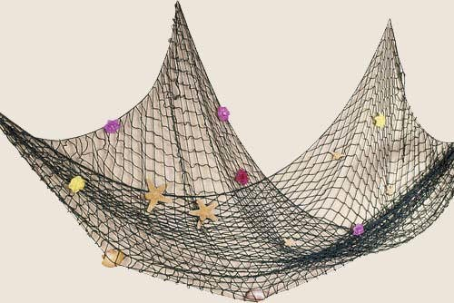
Stationary Partial Differential Equations
How to compute this?
http://orionwell.files.wordpress.com/2007/05/fish_net.jpg

Slide 35
Stationary Partial Differential Equations
What do we want to have?
http://orionwell.files.wordpress.com/2007/05/fish_net.jpg
Function f(x,y) that describes the
displacement for each joint (x,y).

Slide 36
Stationary Partial Differential Equations
F
g
Forces in initial state

Slide 37
Stationary Partial Differential Equations
F
g
Forces in equilibrium state

Slide 38
Stationary Partial Differential Equations
F
g
Forces in equilibrium state

Slide 39
Stationary Partial Differential Equations
f
−
f
−
x
1
x
f
−
f
x

1
x
F
g
F
=−
F

f
−
f

f
−
f
x
g
−

x
1
x
x
1
x
F
=−
F

f
−
⋅

2
f
f
x
g
−

x
1
x
x
1

Slide 40
Stationary Partial Differential Equations
1D:
F
=−
F

f
−
⋅

2
f
f
x
g
−

x
1
x
x
1
2D:
F
g
What is ? What is ?
F
f
x , y
x , y

Slide 41
Stationary Partial Differential Equations
2D:
F
g
What is ? What is ?
F
f
x , y
x , y

Slide 42
Stationary Partial Differential Equations
2D:
f
x , y

1
f
x
−
1, y
f
f
x

1, y
x , y
f
x , y
−
1
F
g
F
=−
F

f

f
−
⋅


4
f
f
f
x , y
g
x
−
1, y
x , y
−
1
x , y
x

1, y
x , y

1

Slide 43
Stationary Partial Differential Equations
What are Partial Differential Equations (PDEs)?
•
Dependent on several variables
•
Containing partial derivatives
•
boundary value problems
➢
no start and end (for stationary problems)

Slide 44
Discretization
What is discretization?
→
Solving the function just on some points
Why do we discretize?

Slide 45
Discretization
What is discretization?
→
Solving the function just on some points
Why do we discretize?
→
Continous form hard to store in the computer
→
Analytical solving often not possible

Slide 46
Discretization
•
space
grid
•
functions
finite difference/volume/element
•
operators

Slide 47
Discretization
•
space
grid
•
functions
finite difference/volume/element
•
operators
➢
How to solve this?
F
=−
F

f

f
−
⋅


➢
4
f
f
f
x , y
g
x
−
1, y
x , y
−
1
x , y
x

1, y
x , y

1
➢
In the equilibrium:
f

f
−
⋅


=
4
f
f
f
F
x
−
1, y
x , y
−
1
x , y
x

1, y
x , y

1
g
−
F

f

f
−
⋅


=
4
f
f
f
0
g
x
−
1, y
x , y
−
1
x , y
x

1, y
x , y

1

Slide 48
Discretization
f

f
−
⋅


=
4
f
f
f
F
x
−
1, y
x , y
−
1
x , y


x
1, y
x , y
1
g
How to transform this to the following form?






f
0,0
f
⋅
1,0
=
⋮
f
N , N

Slide 49
Discretization
f

f
−
⋅


=
4
f
f
f
F
x
−
1, y
x , y
−
1
x , y


x
1, y
x , y
1
g
Applied on each point (x,y) this gives






⋯
f
F
0,0
g
1
⋯
1
−
4
1
⋯
1
⋯
f
F
⋅
1,0
=
g
⋮
⋮
⋮
⋮
⋮
⋮
⋮
⋮
⋮
⋮
⋯
f
F
N , N
g
→
Linear System of Equations

Slide 50
Solvers for Systems of Linear Equations
What solving strategies do you know?

Slide 51
Solvers for Systems of Linear Equations
What solving strategies do you know?
•
Direct solvers
–
Full matrix
–
Sparse matrix
•
Iterative solvers
–
Jacobi
–
Gauß-Seidel
–
...

Slide 52
Gauß-Seidel Solver
•
point-by-point processing
•
eliminate local residual
f

f
−
⋅


=
4
f
f
f
F
x
−
1, y
x , y
−
1
x , y


x
1, y
x , y
1
g

Slide 53
Gauß-Seidel Solver
•
point-by-point processing
•
eliminate local residual
f

f
−
⋅


=
4
f
f
f
F
x
−
1, y
x , y
−
1
x , y


x
1, y
x , y
1
g

Slide 54
Gauß-Seidel Solver
•
point-by-point processing
•
eliminate local residual
f

f
−
⋅


=
4
f
f
f
F
x
−
1, y
x , y
−
1
x , y


x
1, y
x , y
1
g

Slide 55
Gauß-Seidel Solver
•
point-by-point processing
•
eliminate local residual
f

f
−
⋅


=
4
f
f
f
F
x
−
1, y
x , y
−
1
x , y


x
1, y
x , y
1
g

Slide 56
Gauß-Seidel Solver
•
point-by-point processing
•
eliminate local residual
f

f
−
⋅


=
4
f
f
f
F
x
−
1, y
x , y
−
1
x , y


x
1, y
x , y
1
g

Slide 57
Gauß-Seidel Solver
•
point-by-point processing
•
eliminate local residual
f

f
−
⋅


=
4
f
f
f
F
x
−
1, y
x , y
−
1
x , y


x
1, y
x , y
1
g

Slide 58
Gauß-Seidel Solver
•
point-by-point processing
•
eliminate local residual
f

f
−
⋅


=
4
f
f
f
F
x
−
1, y
x , y
−
1
x , y


x
1, y
x , y
1
g

Slide 59
Gauß-Seidel Solver
•
point-by-point processing
•
eliminate local residual
f

f
−
⋅


=
4
f
f
f
F
x
−
1, y
x , y
−
1
x , y


x
1, y
x , y
1
g

Slide 60
Gauß-Seidel Solver
•
point-by-point processing
•
eliminate local residual
•
elimination for one point increases residual of
neighbouring points
→ Overall residual is smaller than before
→ Iterate until desired accuracy

Slide 61
Instationary PDEs
●
Stationary PDEs (time-independent):
●
Only spatial derivatives
2
2
∂
T
∂
T

=
rhs


x , y
∂
2
∂
2
x
y

Slide 62
Instationary PDEs
●
Stationary PDEs (time-independent):
●
Only spatial derivatives
2
2
∂
T
∂
T

=
rhs


x , y
∂
2
∂
2
x
y
●
Instationary PDEs (time-dependent):
●
Derivatives in space and time
∂
2
2
T
∂
T
∂
T
=

∂
t
∂
2
∂
2
x
y

Slide 63
Discretization
•
Spatial discretization
•
Time discretization

Slide 64
Explicit/Implicit
•
explicit time steps
➢
restricted time step sizes
➢
dependent on spatial step
➢
no equations to solve
•
implicit time step
➢
unrestricted time step sizes
➢
large systems of equations

Slide 65
Accuracy Issues
➢
Discretization error in time and space
=

e
e
e
space
time
➢
e
High-order space disc. → dominates
time
➢
e
High-order time disc. → dominates
space

Slide 66
Accuracy Issues
➢
Take into account:
–
Order of discretization
–
Region of stability
–
Maximum allowed timestep size

Slide 67
Accuracy Issues
➢
Take into account:
–
Order of discretization
–
Region of stability
–
Maximum allowed timestep size
➢
Higher-order methods do not harm (in terms of
accuracy; but be aware of comput. costs!)

Slide 68
Explicit/Implicit
•
Separation in space/time-discretization
–
Compute spatial derivatives
–
Consider function value on each grid-point as
an ODE
•
Sketch: 2.5 ways to a full discretization

Slide 69
Example

Slide 70
Example - Continuous
Hook's Law:
du
σ=
E
ε
dx
Normal tension:
F
du
du
σ=
u
with
ε=
→
F
=
E A
A
dx
u
dx
Newton's Law:
2
dF
2
d
u
d
u
dF
=
dm
dm
=ρ
A dx
→
u
=ρ
A
u
dt
2
with
dx
2
dt

Slide 71
Example - Continuous
dF
2
du
d
u
u
=ρ
A
F
=
E A
du
and
u
dx
dx
dt
2
Differentiate with regard to x:
dx
2
2
∂
u
∂
u
E A
=ρ
A
dx
2
∂
2
t
2
2
∂
u
∂
u
→
E
=ρ
dx
2
∂
2
t
In the following, we set
E
=
1,
ρ=
1

Slide 72
Example - Discretization
x
Continuous
Discretized
Equation:
Equation:
2
2
u
(
+
)−
(
)+
(
−
)
∂
u
(
)
∂
(
)
i
1, t
2 u
i , t
u
i
1, t
x , t
u
x , t
=
⋅
2
2
h
h
∂
x
∂
t
0
1
u
(
+
)−
(
)+
(
−
)
i , t
1
2u
i , t
u
i , t
1
=
δ
2
t

Slide 73
Example - Discretization
Discretized
Equation:
u
(
+
)−
(
)+
(
−
)
(
+
)−
(
)+
(
−
)
i
1, t
2 u
i , t
u
i
1, t
u
i , t
1
2u
i , t
u
i , t
1
=
h
⋅
h
δ
2
t
0
1
δ
2
t
u
(
+
)=
⋅(
(
+
)−
(
)+
(
−
))+
(
)−
(
−
)
i , t
1
u
i
1, t
2 u
i , t
u
i
1, t
2u
i , t
u
i , t
1
h
⋅
h
0
1

Slide 74
Example – Initial/Boundary
Conditions
x
Initial Conditions:
Boundary Conditions:

Slide 75
Example – Initial/Boundary
Conditions
x
Initial Conditions:
Boundary Conditions:
(
)
u
(
)
1
⋮
u
(
)
N




v


1
0
⋮
=
⋮
v


0
N

Slide 76
Example – Initial/Boundary
Conditions
x
Initial Conditions:
Boundary Conditions:
(
)
u
(
)=
u
(
)
0
0
1
⋮
∂
u
(
)
u
(
)
N
N
=
0
∂
x




v


1
0
⋮
=
⋮
v


0
N

