Slide 1
DATS 6202
Identifying Lung Cancer with Convolutional Neural Networks
Will Arliss
Alice Pascalev

Slide 2
About the Dataset
25,000 images
5 classes (5,000/class)
Lung benign tissue
Lung adenocarcinoma
Lung squamous cell carcinoma
Colon benign tissue
Colon adenocarcinoma
All images are 768x768 pixels
.jpeg format
Lung and Colon Cancer Histopathological Images
HIPAA-compliant
De-identified
750 lung & 500 colon images, augmented to 25,000
Compiled by Borkowski AA, Bui MM, Thomas LB, Wilson CP, DeLand LA, Mastorides SM. Lung and Colon Cancer Histopathological Image Dataset (LC25000). arXiv:1912.12142v1 [eess.IV], 2019
Accessed on Kaggle

Slide 3
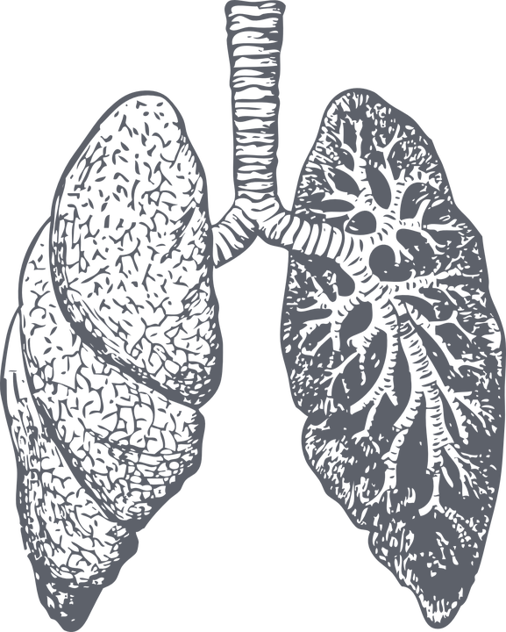
About the Dataset
For the purpose of this project, we are focusing on the three lung classes:
benign lung tissue (lung_n) - 5,000 images
lung adenocarcinoma (lung_ac) - 5,000 images
lung squamous cell carcinoma (lung_scc) - 5,000 images

Slide 4
Motivation
Lung Cancer - Leading cause of cancer-related deaths, Low survival rate (as low as 3% depending on stage and type)
Adenocarcinoma & Squamous cell carcinoma - most common
Using CNN models to analyze tissue → harnessing the power of machine learning & advancements in medical imaging → early detection (key to saving lives, especially in aggressive and/or treatment-resistant cancers)

Slide 5
EDA

Slide 6
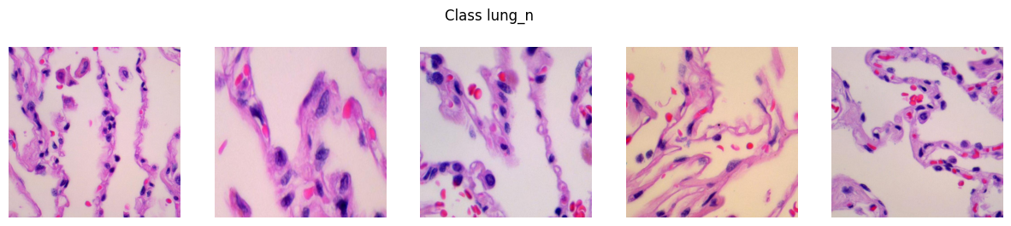
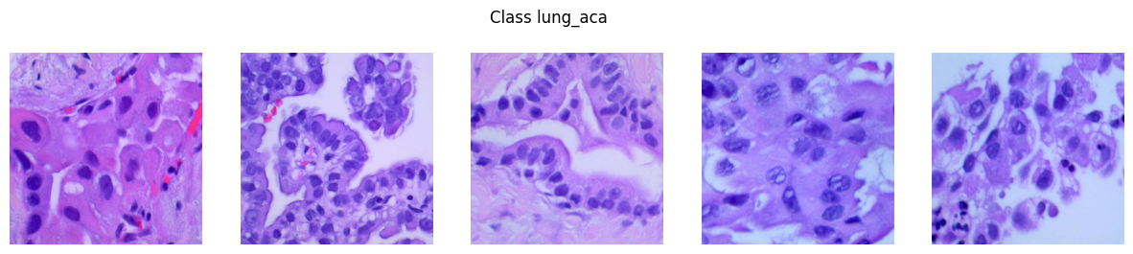
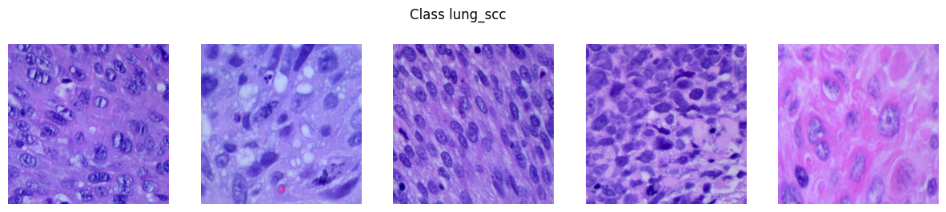
Lung Image Set

Slide 7
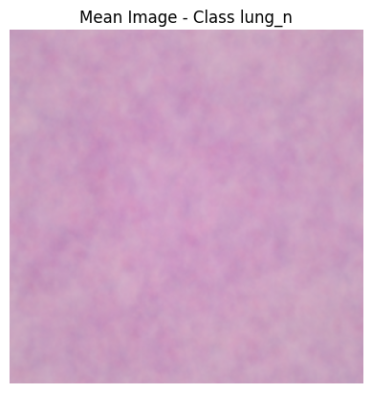
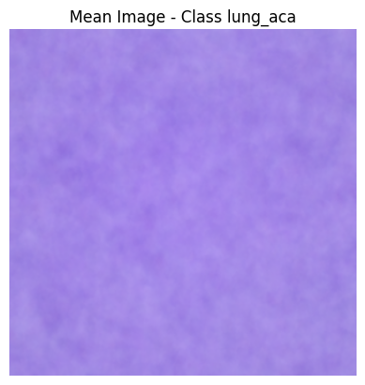
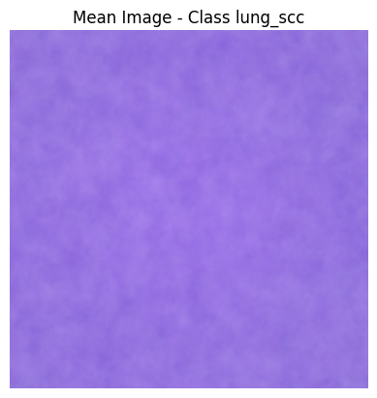
Mean Image

Slide 8
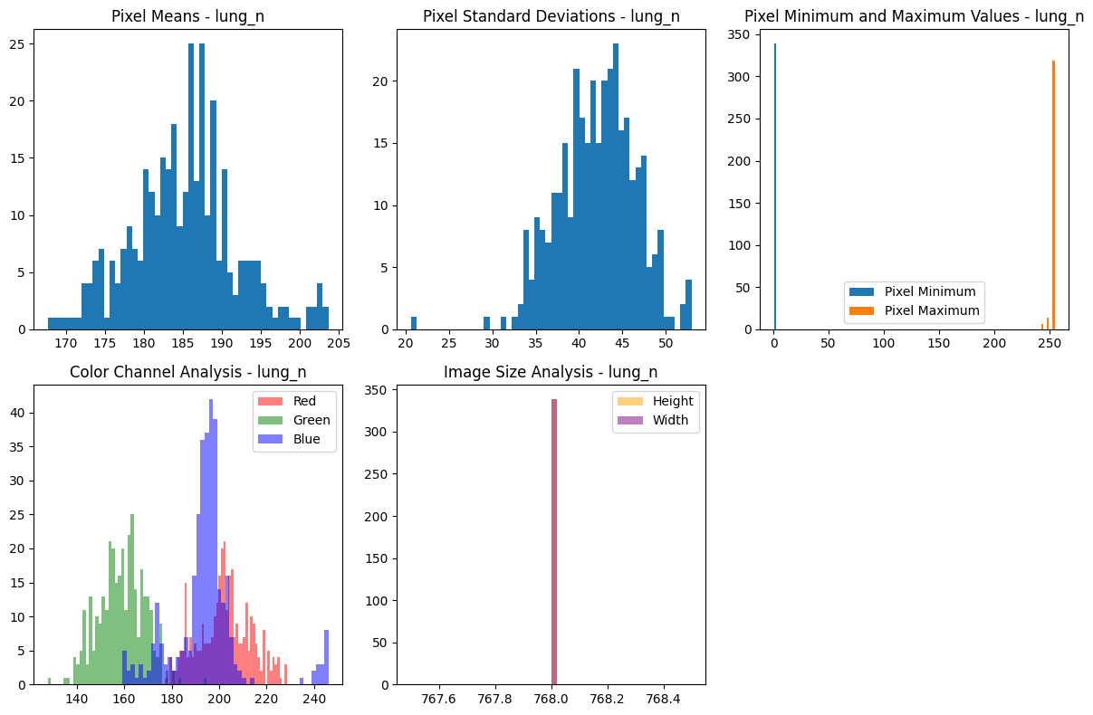
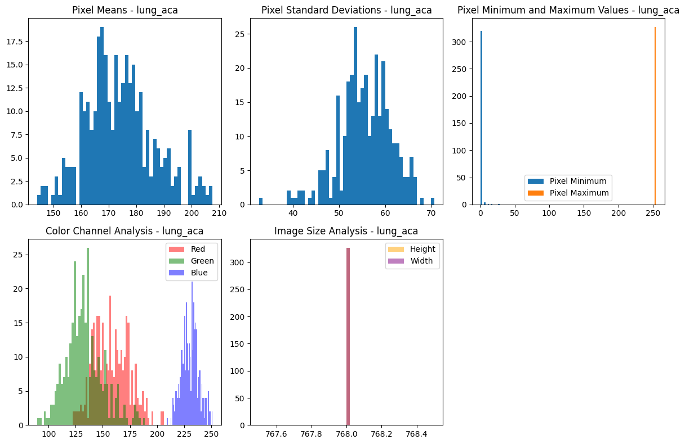
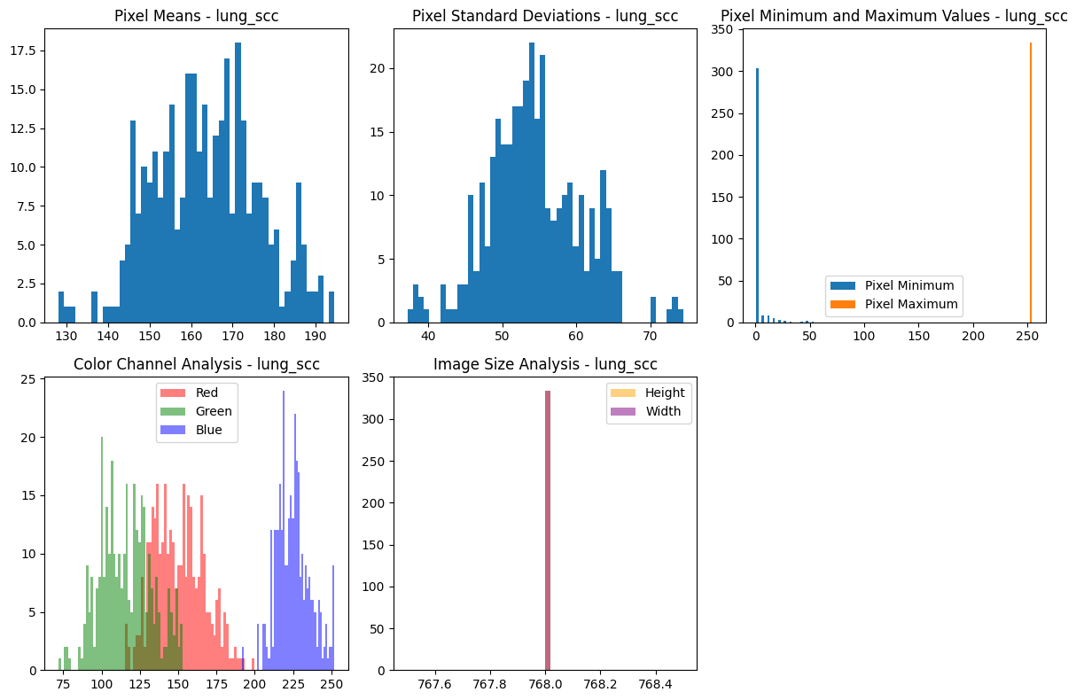
Color Channel Analysis

Slide 9
Pixel Statistics

Slide 10
Image Size Analysis

Slide 11
Pixel Statistics - Benign (lung_n)

Slide 12
Pixel Statistics - Adenocarcinoma (lung_aca)

Slide 13
Pixel Statistics - Squamous Cell Carcinoma (lung_scc)

Slide 14
Pre-Processing

Slide 15
Adjusting the Data
Working with a large image data set is computationally expensive, so we took two steps to make our code work in Colab (and run much faster, locally)
Undersampling
Reduced data to 1,200 images
Train - 1000
Validation - 100
Test - 100
Reducing Image Size
768x768 pixels → 256x256 pixels
(224x224 pixels for pre-trained model)
Note: The original lung image dataset was based on 750 images, augmented to 15,000 for public use & research. The reduced dataset is still larger than the original dataset, but is easier for our computers (and Colab) to handle
Notes:
The lung tissue dataset consists of 15,000 768 x 768 pixel images distributed equally across three classes. This posed a challenge in Colab, where we were working with limited memory, which resulted in extremely long runtime (and often also causing Colab to crash). To mitigate this, we made the decision to both resize the images to 256 x 256, and undersample the dataset to 1,200 to train the model. Because the dataset was previously augmented from 250 images from each class to 5,000 of each class, there are still more images in our dataset than there were originally.

Slide 16
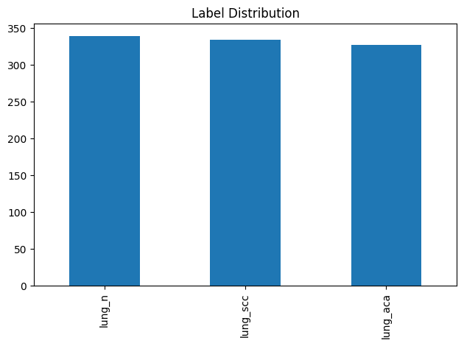
Notes:
Here we see that the class distribution remains nearly even after undersampling the data. With an even class distribution, we do not need to worry about over or underfitting as a result of an imbalanced dataset.

Slide 17
Baseline Model
MobileNetV2
MobileNetV3Small
NASNetMobile
Notes:
Now, lets get to modeling. We will begin with the baseline model, followed by three pre-trained models.
We have selected three lighteright pre-trained models designed for mobile compute, as they are able to run in Colab in a timely manner

Slide 18
A note on model choice…
"Mobile" models motivated by previously mentioned memory/space problems
Initially had trouble training larger models like ResNet
Resorted to these smaller models designed to operate on limited compute

Slide 19
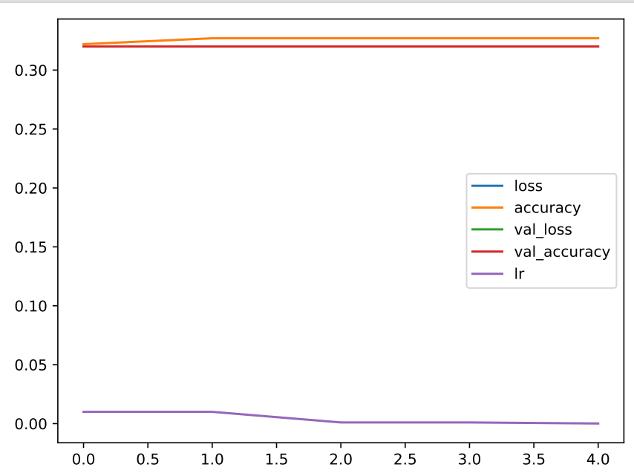
Baseline Model
Accuracy: 70% on Validation Set

Slide 20
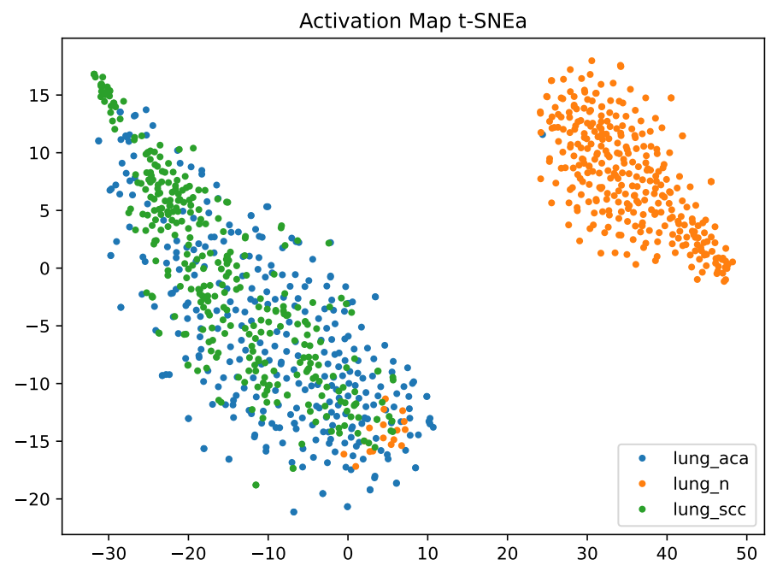
Baseline Model

Slide 21
Experimentation
MobileNetV2 - MobileNetV3Small - NASNetMobile

Slide 22
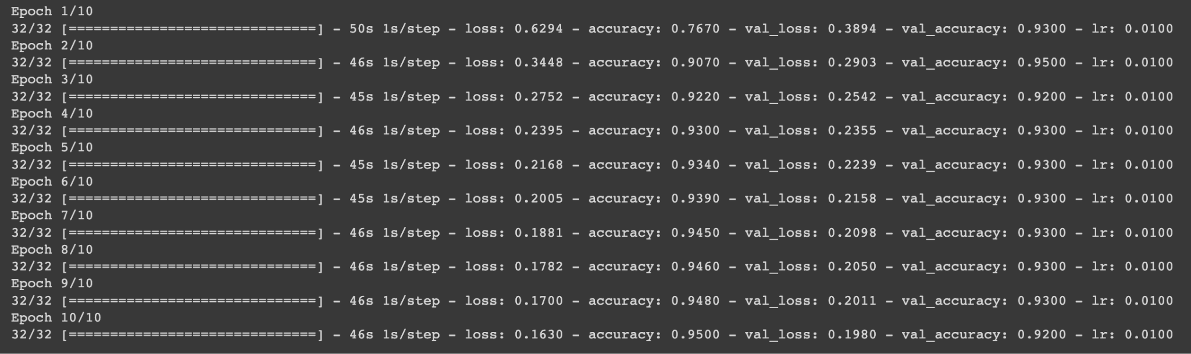
MobileNetV2
Accuracy: 95% on the Validation Set

Slide 23
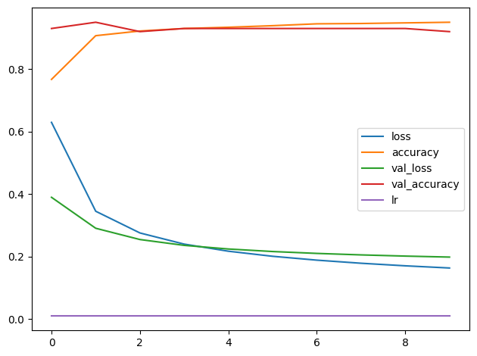
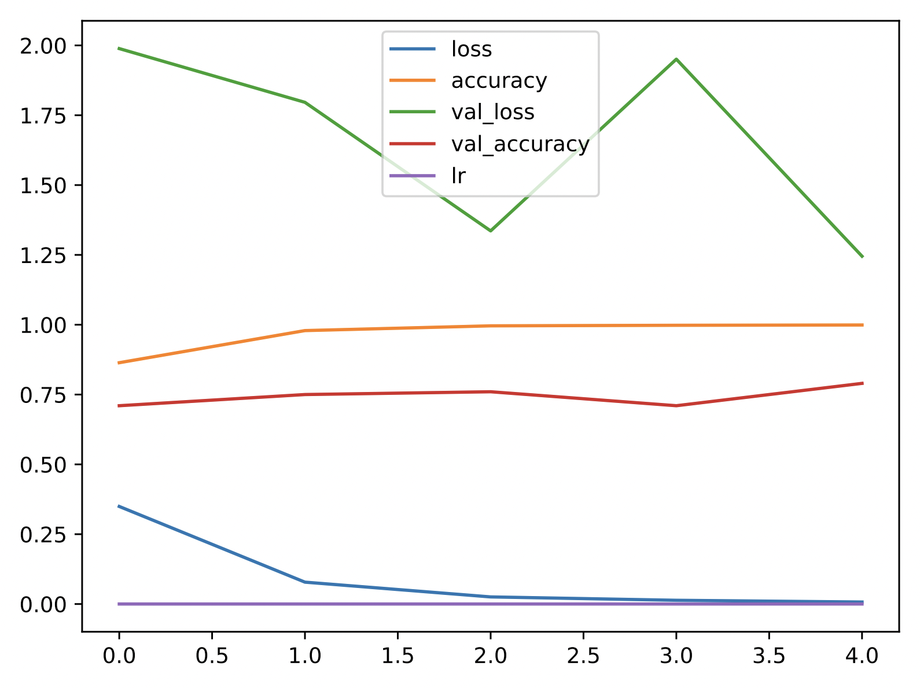
MobileNetV2
Before unfreezing
After unfreezing

Slide 24
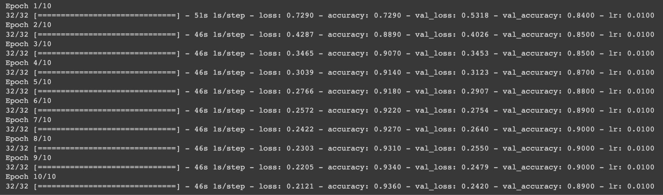
MobileNetV3 Small
Accuracy: 90% on the Validation Set

Slide 25
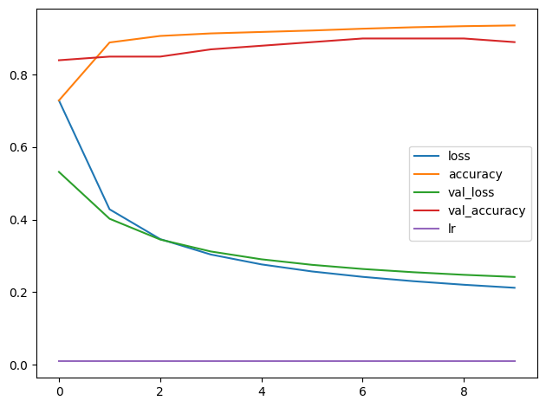
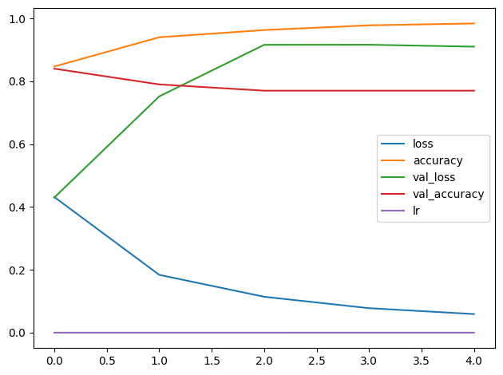
MobileNetV3 Small
Before unfreezing
After unfreezing

Slide 26
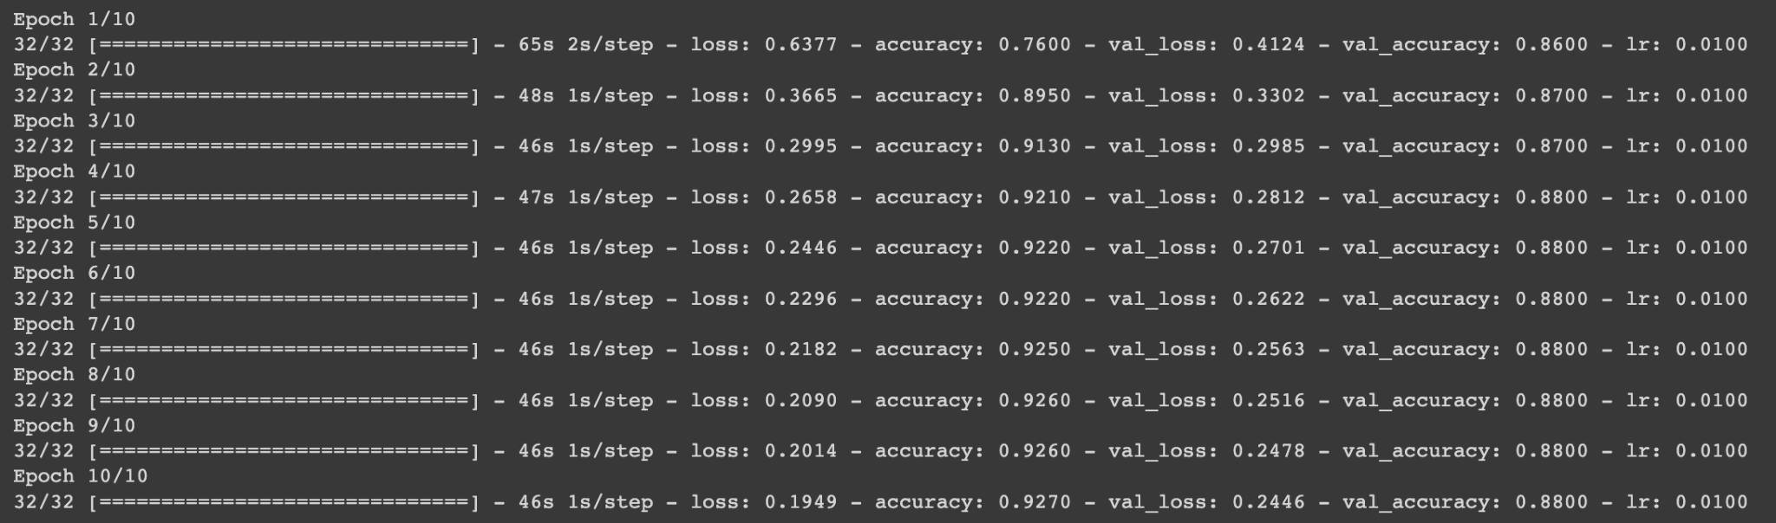
NASNetMobile
Accuracy: 92% on the Validation Set

Slide 27
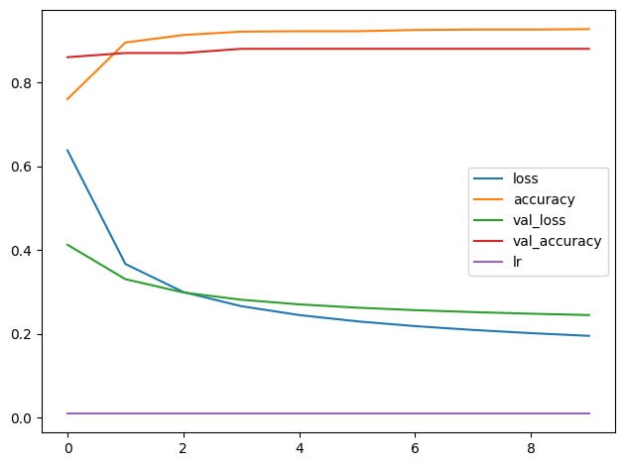
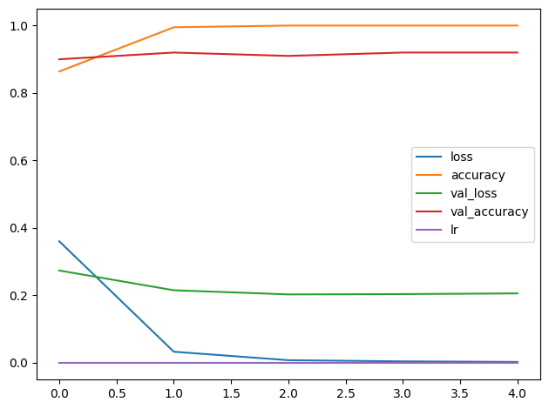
NASNetMobile
Before unfreezing
After unfreezing

Slide 28
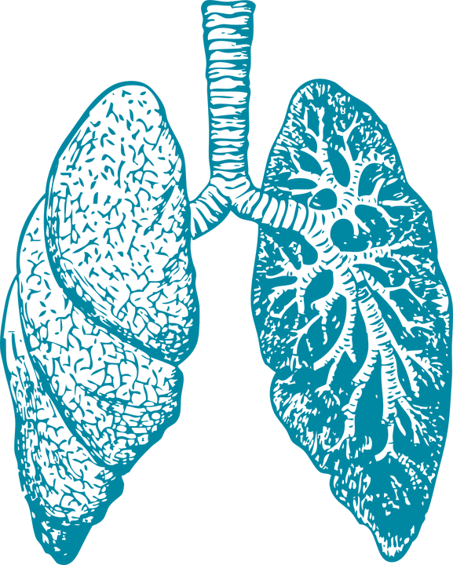
Selecting the Best Model
Most accurate model (validation set):
MobileNetV2 - 95%
MobileNetV2 Test Accuracy: 84%

Slide 29
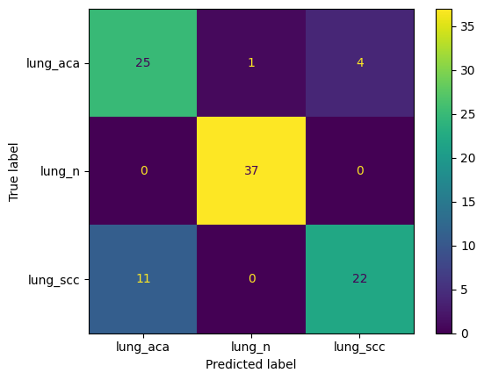
Testing Performance

Slide 30
Citations
Borkowski, A. A. (2019, December 16). Lung and Colon Cancer Histopathological Image Dataset (LC25000). arXiv.org. https://arxiv.org/abs/1912.12142v1
Wali, A., & LoCicero, R. (2022). Lung Cancer Grading: How Cancer Cells Look and Behave Compared With Normal Cells. MyLungCancerTeam. https://www.mylungcancerteam.com/resources/lung-cancer-grading-how-cancer-cells-look-and-behave-compared-with-normal-cells
Lung Cancer Survival Rates | 5-Year Survival Rates for Lung Cancer. (n.d.). https://www.cancer.org/cancer/types/lung-cancer/detection-diagnosis-staging/survival-rates.html
Sandler, Mark, et al. "Mobilenetv2: Inverted residuals and linear bottlenecks." Proceedings of the IEEE conference on computer vision and pattern recognition. 2018. https://arxiv.org/abs/1801.04381
Zoph, Barret, et al. "Learning transferable architectures for scalable image recognition." Proceedings of the IEEE conference on computer vision and pattern recognition. 2018. https://arxiv.org/abs/1707.07012
Howard, Andrew, et al. "Searching for mobilenetv3." Proceedings of the IEEE/CVF international conference on computer vision. 2019. https://arxiv.org/abs/1905.02244

