Slide 1

ANALYZING THE SAN RAMON AREA HOUSING MARKET
DATA EXPLORATION, ANALYSIS AND HOUSING PRICE PREDICTION
SUBMITTED BY
ALARMELU PICHUMANI
TJ6723

Slide 2
Steps involved:
Data preprocessing
Exploratory analysis and visualizations
Research questions

Slide 3
Data Preprocessing

Slide 4
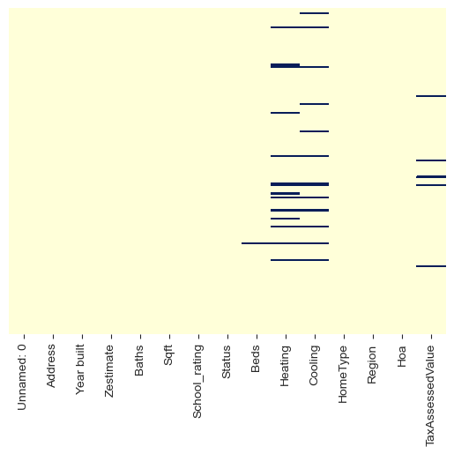
Data preprocessing
Importing data from the csv file
Import the data scraped from Zillow.com and stored in ‘SanRamon_housing.csv’ file into a dataframe.
Check the dataset for missing values using a heatmap.
Some values in the Beds, Heating, Cooling and TaxAssessedValue columns are missing.

Slide 5
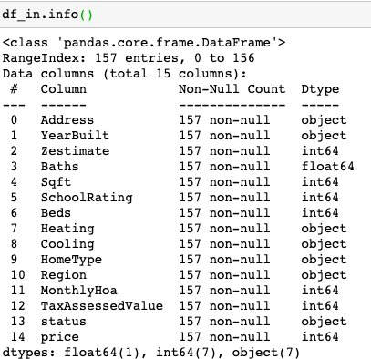
Data preprocessing cleaning and imputations
Each feature(column) is checked for unwanted strings, special characters, extra spaces, repetitions and missing data.
The data is cleaned, and missing values are imputed accordingly.
The column values were extracted in the string format while scraping. The features are converted to appropriate datatypes for further analysis.
E.g., Price, Sqft, Beds and baths are converted to integers/floats.

Slide 6
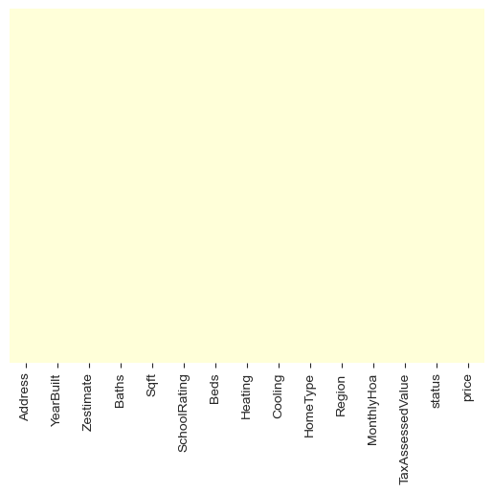
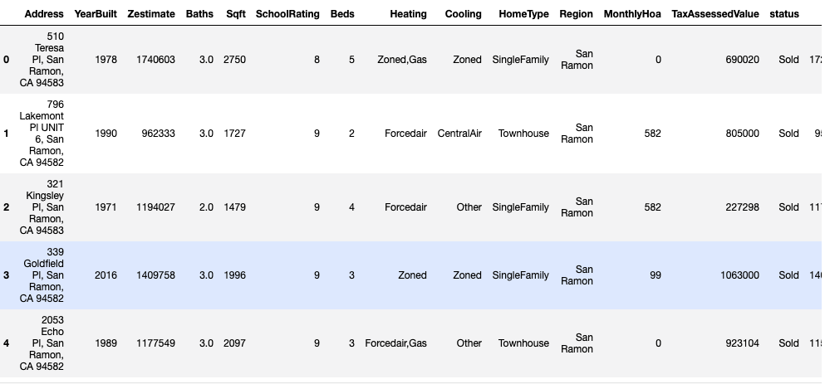
Data preprocessing
After cleaning and imputations
Heatmap after imputations
5 rows from the dataset

Slide 7
Exploratory Analysis and Visualizations

Slide 8
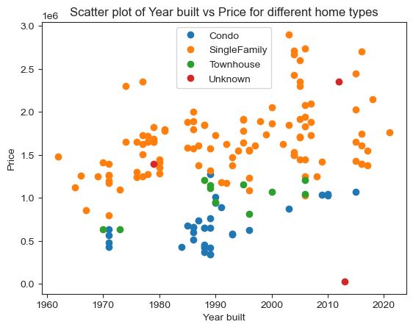
Features impacting the price of the house:
Relationship between Year built, House type and the price of the house
More houses constructed in the recent years show a higher selling price(above 2M).
This can be attributed to several factors such as building cost, inflation and buyer’s preferences about the age of the building.
The behavior is common for all types of house in the San Ramon area.

Slide 9
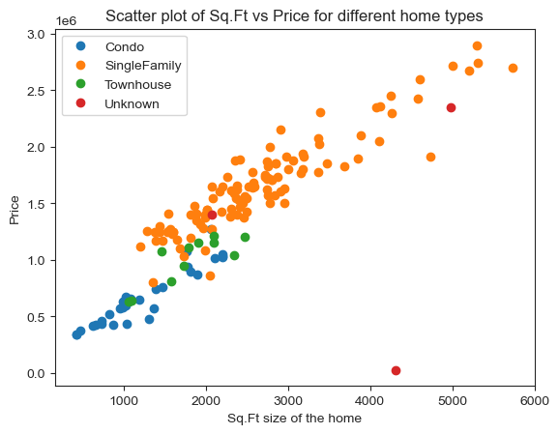
Features impacting the price of the house:
Relationship between Square footage, House type and the price of the house
Square footage and the price has a colinear relationship and the trend can be seen in the plot.
Single family homes have higher square footage (>1000 Sqft up to 6000 Sqft).
Almost all the sub 1000 Sqft homes are condos.

Slide 10
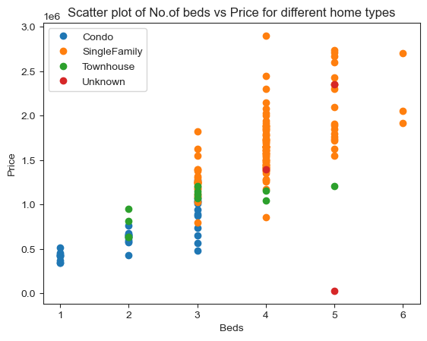
Features impacting the price of the house:
Relationship between number of Bedrooms and the price of the house
Number of bedrooms and the price has a colinear relationship and the trend can be seen in the plot.
Single family homes predominantly have at least 3 bedrooms and up to 6 bedrooms in our dataset.
Condos cover the 1-3-bedroom range.
Townhomes has bedroom options anywhere between 2 to 5.

Slide 11
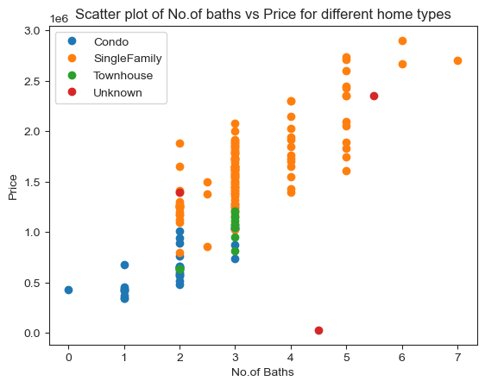
Features impacting the price of the house:
Relationship between number of baths and the price of the house
Number of baths and the price has a colinear relationship and the trend can be seen in the plot.
Single family homes predominantly have at least a baths and up to 7 baths in our dataset. 3 baths have a higher presence.
Condos have anywhere between 1 to 3 baths. 2 baths have a high presence.

Slide 12
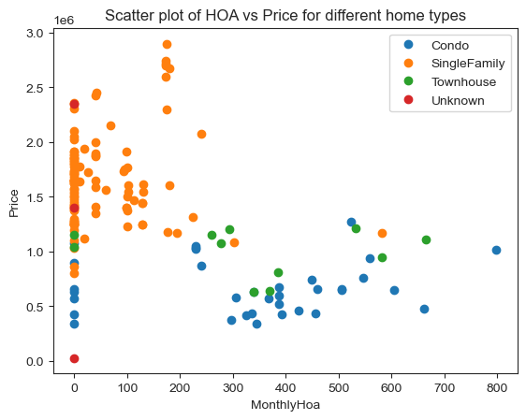
Features impacting the price of the house:
Relationship between monthly hoa fee and the price of the house
Single family homes predominantly have a monthly hoa fee under $200 and are priced anywhere between $1-3 MM.
However , condos and townhomes have higher hoa fees.
This can be attributed to the shared building maintenance and common amenities.
The hoa fees does not show a major impact on the pricing of the house.

Slide 13
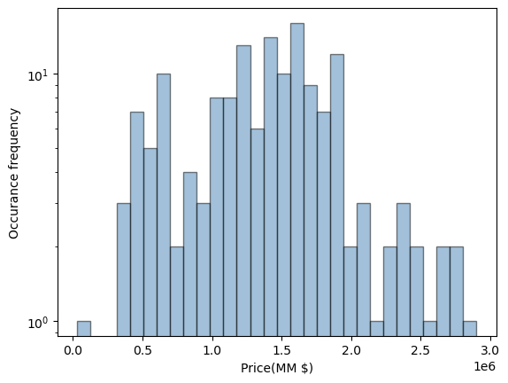
Price distribution
Understand the pricing in San Ramon area
The housing prices fall anywhere between $400,000 to $3MM.
The major concentration is between $1 MM to $2 MM price range.
Median price for a single-family home comes to $1.625 MM.
Median price for a condo comes to $642,500.
Median price for a Townhouse comes to $1.07 MM.
Housing Price distribution in San Ramon area

Slide 14
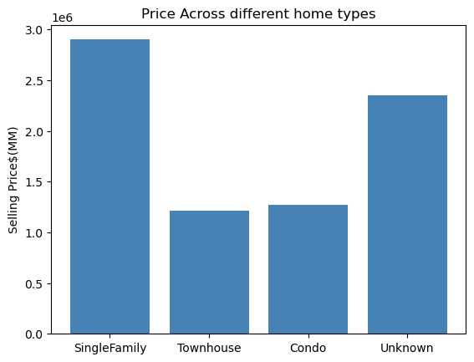
Price distribution
Pricing comparison for different types of homes
Single-family homes have the highest pricing.
Followed by condos and townhomes.
Single family homes are more prevalent than any other home types.
Customer preference can be the reason for this higher concentration of single-family homes.

Slide 15
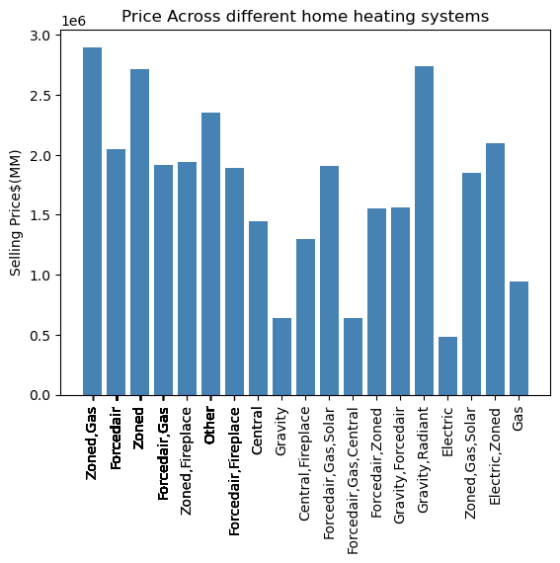
Price distribution
Pricing comparison for different heating systems
Higher priced homes come with Zoned, Gas and Forced air, Gas heating systems.
Gravity, radiant heating systems and fireplaces come with homes that are priced higher.
Electric heating, only gas heating and gravity are seen in the sub $1 MM homes.

Slide 16
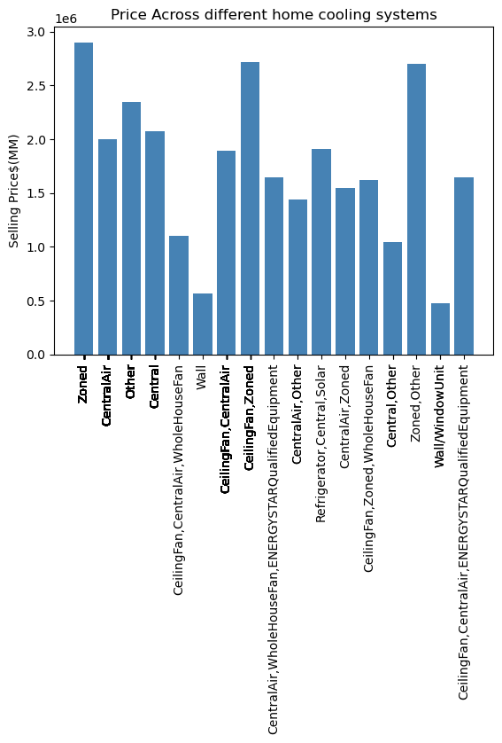
Price distribution
Pricing comparison for different heating systems
Zoned cooling with ceiling fans come with higher priced homes.
Wall and window units dominate the sub $1 MM homes.
Central cooling also seems to be a popular choice for homes priced between $1 - $2 MM.

Slide 17
Research questions

Slide 18
Research questions:
The motivation behind the analysis of the dataset
To statistically understand the features of a home that drives the pricing.
To see if we can accurately predict the selling price of a house in San Ramon given certain features.
How the developed model fares in contrast with Zillow’s Zestimates?

Slide 19
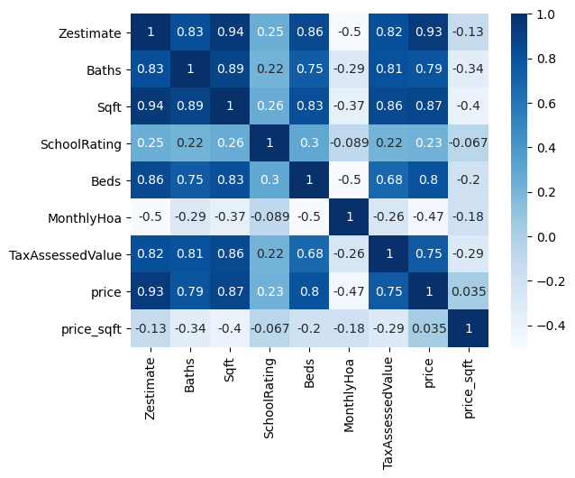
Analyzing the correlation:
Correlation analysis using a heatmap
The price is our feature of interest.
Price shows a high correlation with Bath, Square footage and Beds.
Zestimate and Tax assessed value also show a high correlation but will not be considered as part of our analysis as they are derived from the price feature.
Heatmap of correlation between dataset features

Slide 20
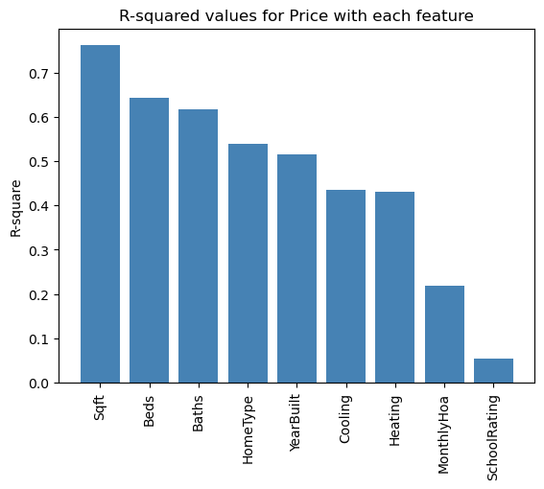
Analyzing the correlation:
Correlation analysis using simple linear regression and R-squared values
To simplify the analysis further, simple linear regression is used to understand specific correlations based on our exploratory analysis.
Square footage, number of beds and baths , home type and year-built show more than 50% correlation.

Slide 21
Analyzing the correlation:
Correlation analysis using multiple linear regression and adjusted R-squared values
Features selected | Adjusted R-squared values
Sqft , Beds , Baths , HomeType | 0.872
Sqft , Beds , Baths , HomeType, YearBuilt, Cooling | 0.948
Sqft , Beds , Baths , HomeType, YearBuilt, Cooling, Heating | 0.941
Based on the exhaustive analysis, we can see that the Sqft , Beds , Baths , HomeType, YearBuilt, Cooling yield the best adjusted R-squared values.
The features can be considered for housing price prediction.

Slide 22
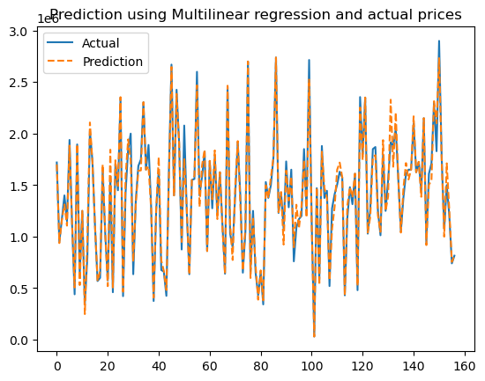
Housing price prediction:
Prediction using multivariate analysis and predictors - Sqft , Beds , Baths , HomeType, YearBuilt, Cooling , Heating
The predicted prices and the real prices coincide predominantly.
The MAPE for the model comes to 5.415.
The R-squared value is 0.973 and the adjusted R-squared value comes to 0.941.
We can say that the model is able to predict the selling price accurately using the selected features.

Slide 23
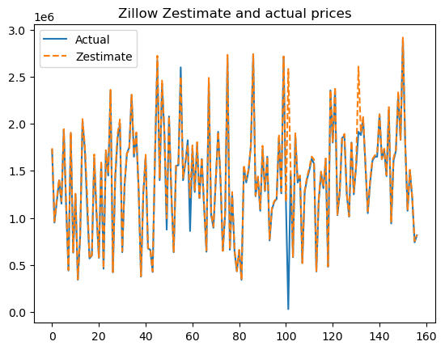
Housing price prediction:
Comparison with Zillow’s Zestimate
Zillow’s Zestimate is close to the real selling price in most cases.
We can see some considerable errors at points 60 and 100.
The MAPE for the model comes to 56.004 which is considerably higher than the developer multivariate model.

Slide 24
Answers to the research questions:
Findings and observations
What drives the housing prices?
  Square footage , Number of beds and baths , type of the home, age of the home, cooling and
  heating systems have a major role in the pricing of the house.
Prediction of housing prices:
  The developed multivariate model using the above features was able to predict the housing price with good accuracy.
How the model fares in comparison to Zillow Zestimates?
  The developed model showed more accuracy than Zillow’s Zestimates with a lower MAPE.

Slide 25
Thank you!

