Slide 1

ANALYZING THE SAN RAMON AREA HOUSING MARKET
DATA SCRAPING AND EXTRACTION
FROM ZILLOW.COM
SUBMITTED BY
ALARMELU PICHUMANI
TJ6723

Slide 2
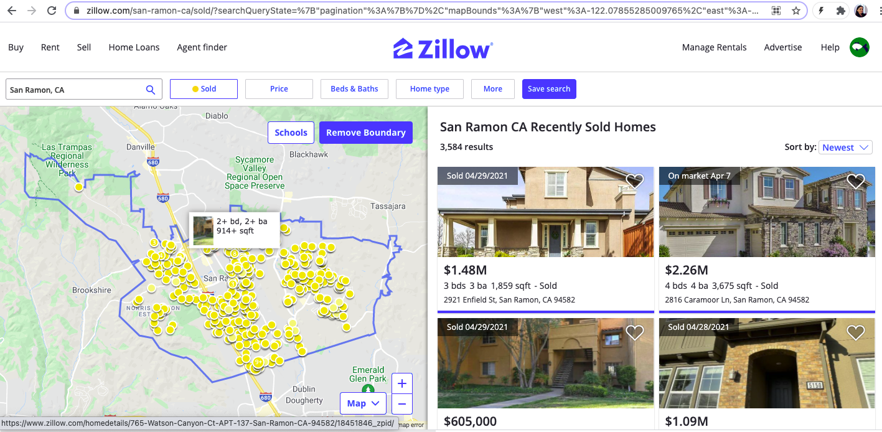
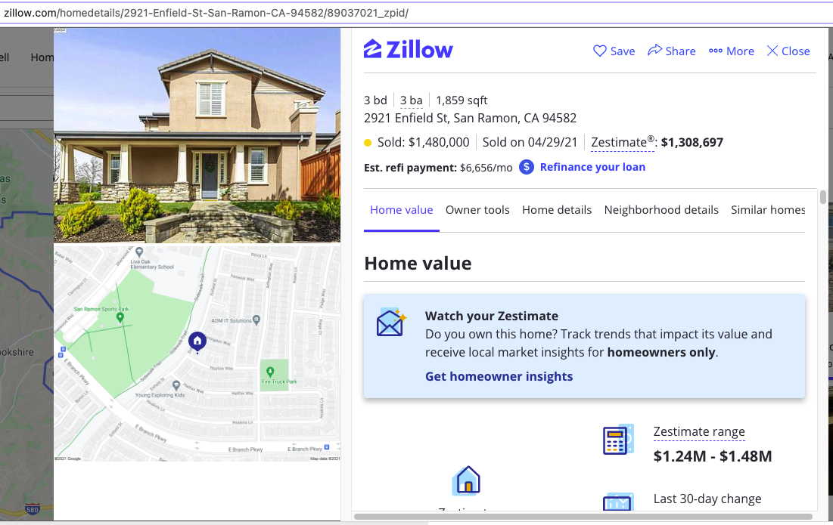
How to get the data from Zillow.com?
Enter our search criteria in the main search page to scrape data about individual houses in San Ramon (image on top)
Results of individual homes listed are to the right .
Scrape house details from the pages of the respective homes (image at the bottom)

Slide 3
What are the features of interest?
Home address
Year the home was built
Zestimate – Zillow’s estimate of the home’s selling price
Home type and square foot area of the home
Number of bedrooms and bathrooms
HOA fees, if any
Tax assessed value – the property’s determined valuation to calculate taxes
School rating, heating and cooling features

Slide 4
How were the data obtained?
A Selenium webdriver to get the main search page and to collect the hyperlinks of the homes listed as part of the search results.
Web driver mimics the human behavior of opening URLs and closing them afterwards.
Beautiful Soup – a python library parses the HTML documents of the website and creates a parse tree, from which features of interest for the homes are extracted.

Slide 5
How was the data extracted and stored?
A list of individual homes’ hyperlinks is captured from the main search page and is compiled into a 'set’ of unique hyperlinks to avoid scraping duplicate data.
The set is iterated through, and the web pages’ HTML document is parsed using Beautiful Soup library.
The features of interest listed earlier are captured by leveraging python’s several text processing techniques.
A python dictionary is used to capture all the data with the labels in place for each home
for example: details_dict={‘Address’:address,’Year built’:year_built ..},{
The data is collected and compiled into a panda data frame and converted into a ‘.csv’ file for further analysis.

Slide 6
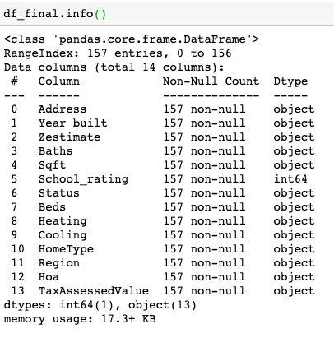
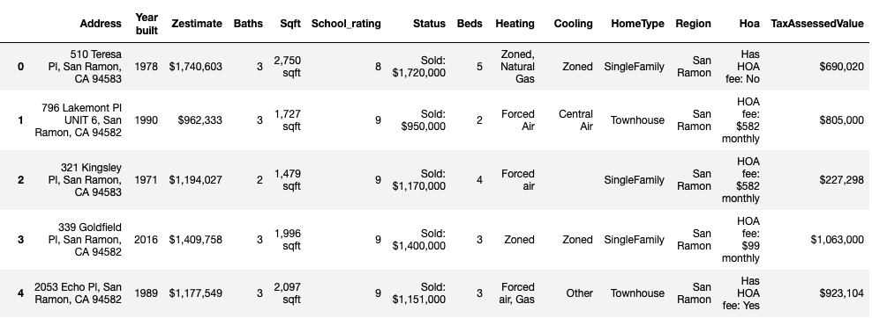
Details of the final data frame after extraction and cleaning:
Screenshot of the first 5 rows from the total of 157 rows of housing data
Data frame information

Slide 7
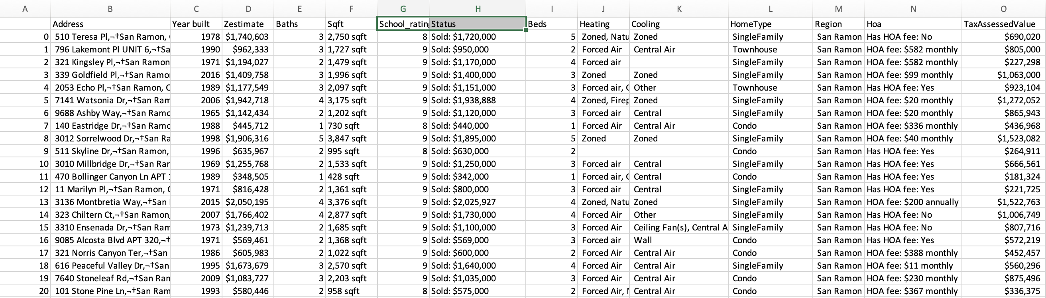
Details of the final .csv file:
(*showing first 20 records)
Name of the file: SanRamon_housing.csv

