Slide 1
An Exploration into the Data of the Craft Beer Industry
Team Strange Brew:
Pauly Richmeier
April Prospero Garcia
Charles Stephens

Slide 2
Research Questions
What are the most popular beer styles nationwide and state?
What is the number of breweries in each state?
What are the top cities for breweries?
What are the cities with the most breweries per person?
What style of beer has the most alcohol content by style?

Slide 3
Datasets Used
Data.World - https://data.world/datafiniti/breweries-brew-pubs-in-the-usa
Kaggle - https://www.kaggle.com/nickhould/craft-cans
OpenDataSoft - https://data.opendatasoft.com/explore/dataset/open-beer-database%40public-us/table/
U.S. Census - https://www.census.gov/en.html

Slide 4
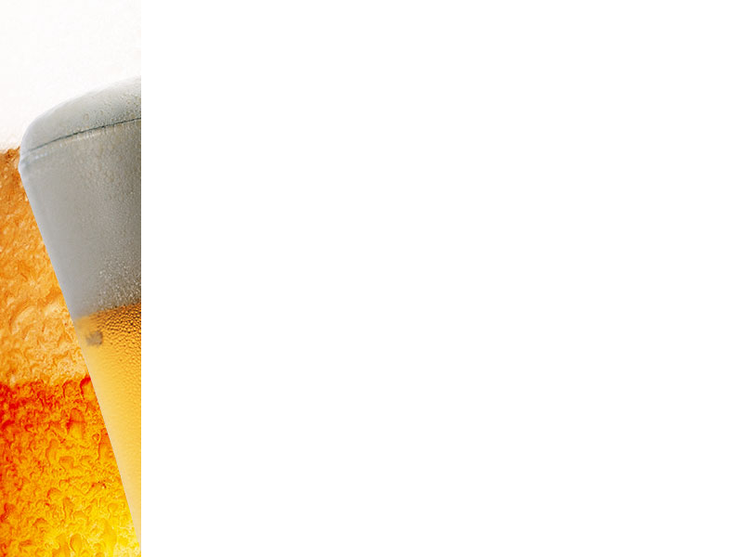
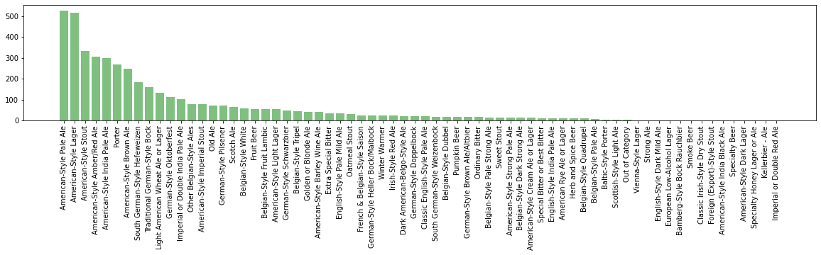
What are the most popular beer styles nationwide and by state?

Slide 5
What are the number top cities and states for breweries?

Slide 6
What are the number top cities and states for breweries?
Our PowerPoint templates and backgrounds are «pre-made» presentation shells («pre-made» slides). All design backgrounds, graphics, typefaces, and colors have been created and are pre-set by an expert graphic designers which are working with some of the most prominent businesses in the world.
You simply insert your text. That's it! You just can't go wrong with these templates and backgrounds!
Download this template as well as our others at http://poweredtemplate.com/food-beverage-ppt-powerpoint-templates.html

Slide 7
Print Slide Master
Our PowerPoint templates and backgrounds are «pre-made» presentation shells («pre-made» slides). All design backgrounds, graphics, typefaces, and colors have been created and are pre-set by an expert graphic designers which are working with some of the most prominent businesses in the world.
You simply insert your text. That's it! You just can't go wrong with these templates and backgrounds!
Download this template as well as our others at http://poweredtemplate.com/food-beverage-ppt-powerpoint-templates.html

