Slide 1
An Exploration into the Data of the Craft Beer Industry
Team Strange Brew:
Pauly Richmeier
April Prospero Garcia
Charles Stephens

Slide 2
Research Questions
What are the most popular beer styles nationwide and state?
What is the number of breweries in each state?
What are the top cities for breweries?
What are the cities with the most breweries per person?
What style of beer has the most alcohol content by style?

Slide 3
Datasets Used
Data.World - https://data.world/datafiniti/breweries-brew-pubs-in-the-usa
Kaggle - https://www.kaggle.com/nickhould/craft-cans
OpenDataSoft - https://data.opendatasoft.com/explore/dataset/open-beer-database%40public-us/table/
U.S. Census - https://www.census.gov/en.html

Slide 4
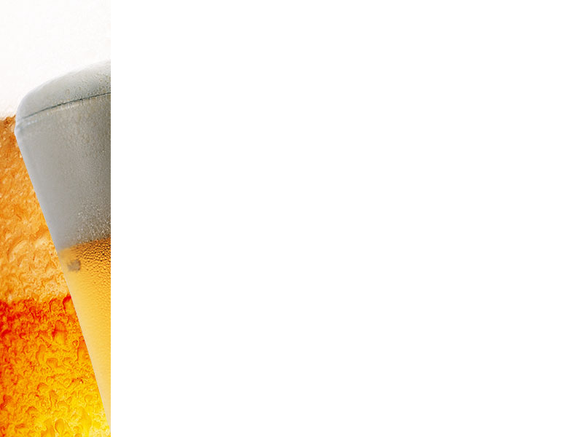
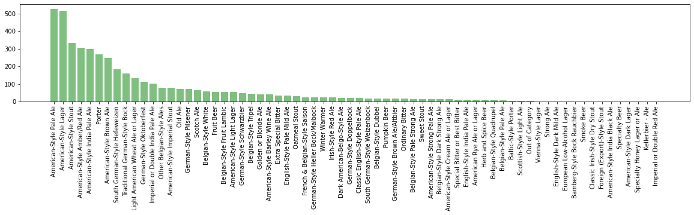
What are the most popular beer styles nationwide and by state?
American-Style Pale Ale
American-Style Lager
American-Style Stout
https://github.com/a-prospero/strange_brew/tree/cs/coding

Slide 5
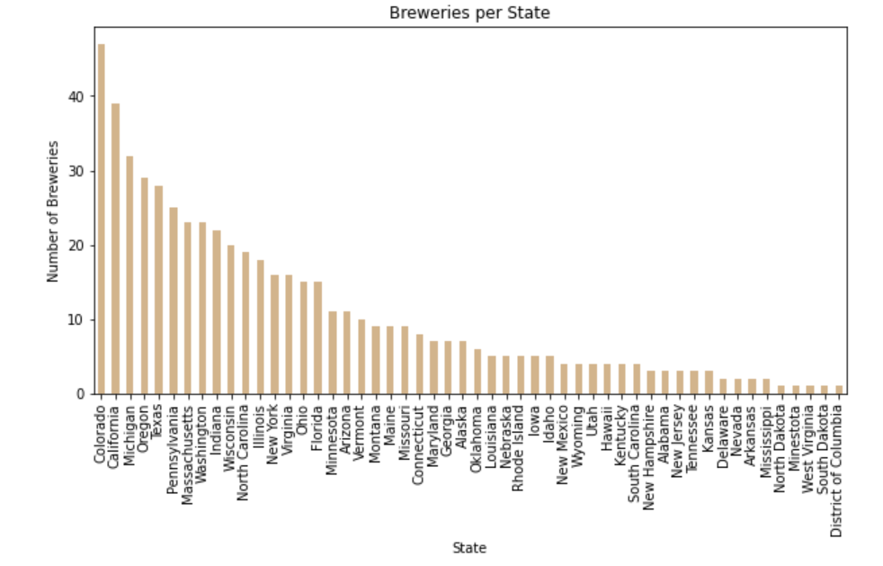
What are the number top cities and states for breweries?
Colorado
California
Michigan
https://github.com/a-prospero/strange_brew/tree/ap/coding

Slide 6
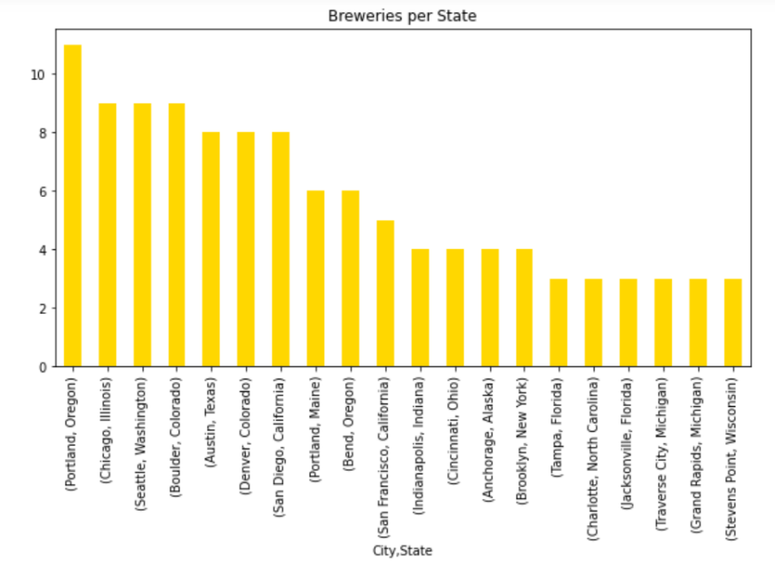
What are the number top cities and states for breweries?
Portland, OR
Chicago, IL
Seattle, WA
https://github.com/a-prospero/strange_brew/tree/ap/coding

Slide 7
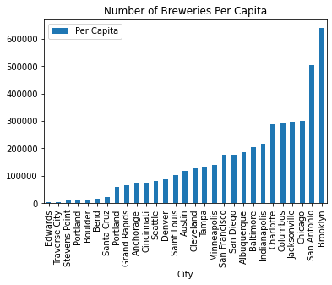
What are the cities with the most breweries per person?
Edwards, CO
Traverse City, MI
Stevens Point, WI
https://github.com/a-prospero/strange_brew/tree/pr/coding

