Slide 1
NEXTHIKES
Project – 1
Bike Sharing Demand Analysis
- RAJWIN GEORGE A R

Slide 2
Project Description
Analysing bike-sharing data helps understand how weather, time, and holidays affect bike rentals.
This project uses Excel skills to clean, combine, and study datasets to find useful patterns that improve business planning.
Organized data leads to better decisions faster.
Create charts, graphs and descriptive statistics for better and easier understanding of the data.

Slide 3
Dataset
Total of 3 datasets are given for this project.
First dataset contains first half of the columns of the first half of the complete dataset.
Second dataset contains second half of the columns of the first half of the complete dataset.
Third dataset contains second half of the complete dataset.
There are total of 13 columns and 1001 rows(1 row for header and 1000 row for data) in the over all combined dataset.

Slide 4
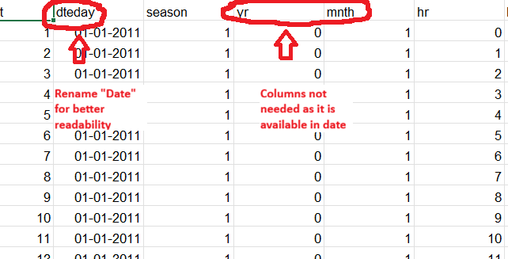
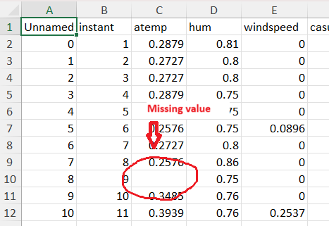
Objectives - 1
Find and Fill the missing Values.
Look for duplicates and delete it.
Delete the unwanted columns.
Rename the columns for better readability.
Change the datatypes of the values.

Slide 5
Objectives - 2
Create the complete dataset of first half of the complete dataset by merging first and second dataset using merge option in data.
In process of merging remove the duplicate columns.
Create the complete dataset by using the dataset that is merged(first dataset + second dataset) and third dataset using append option in data.

Slide 6
Objective - 3
We create new columns by categorizing the data to create a ready and easily readable charts and graphs.
Eg : For temperature column we can group it by very cold, cold, mild, warm and hot.
Create pivot charts using the improved dataset.
Then we create various charts and graphs using pivot table, so that we can connect all the graphs and charts to the slicer using pivot table.

Slide 7
Objective - 4
We can create correlation table and many other things using data analysis option in excel.
Then we create a forecast to see the customer demands in the future which also shows the lowest possibility and the highest possibility.(if needed)
After everything is done we can design the charts, graphs and tables for better look and professional look.

Slide 8
Customer distribution by wind
Moderate wind (0.00 to 0.15) recorded the highest customer count with 24,285 customers.
Calm and moderate wind together has more than 75% of customers.
This suggests that stronger winds may reduce the number of customer visits.

Slide 9
Customer distribution by Temperature
Cold Temperature has the highest percentage of customers with 55% customers.
Hot temperature has the lowest percentage of customers with 0% customers.(i.e. no customer)
As the temperature increases the number of customers decreases.

Slide 10
Customer distribution by humidity
Medium humidity (0.40 to 0.69) recorded the highest percentage with 57% customers.
High humidity (0.70 to 1.00) recorded the lowest percentage with 20% customers.
Customers prefer moderate humidity level for bike riding.

Slide 11
Overall interpretation
Clear and favourable weather conditions generally attract more customers, whereas rainy or snowy conditions are associated with lower usage.
Customer activity is highest during Cold and Mild temperatures, while Warm and Hot conditions contribute comparatively fewer rentals.
Moderate wind conditions account for the largest share of customers.
Most rental records show a significantly higher proportion of registered users, suggesting strong customer loyalty and frequent usage.
Rental activity tends to increase during morning and evening hours, reflecting commuting patterns of regular users.

Slide 12
Thank You

