Slide 1
DynamoDB
Akshay, Girish and Rishideep Reddy

Slide 2
Architecture

Slide 3
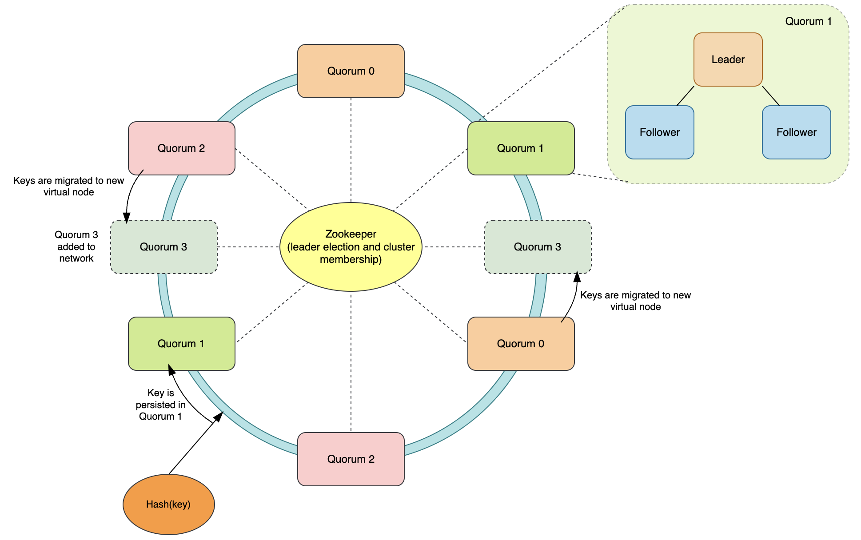
Reads goto leader,
strong consistency

Slide 4
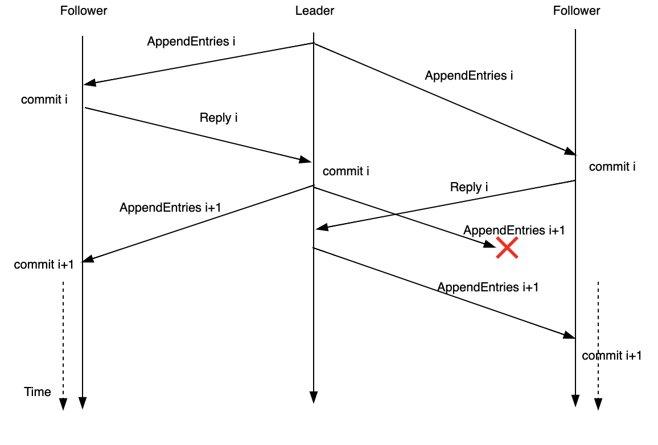
Replication
No concurrent requests even if keys are different

Slide 5
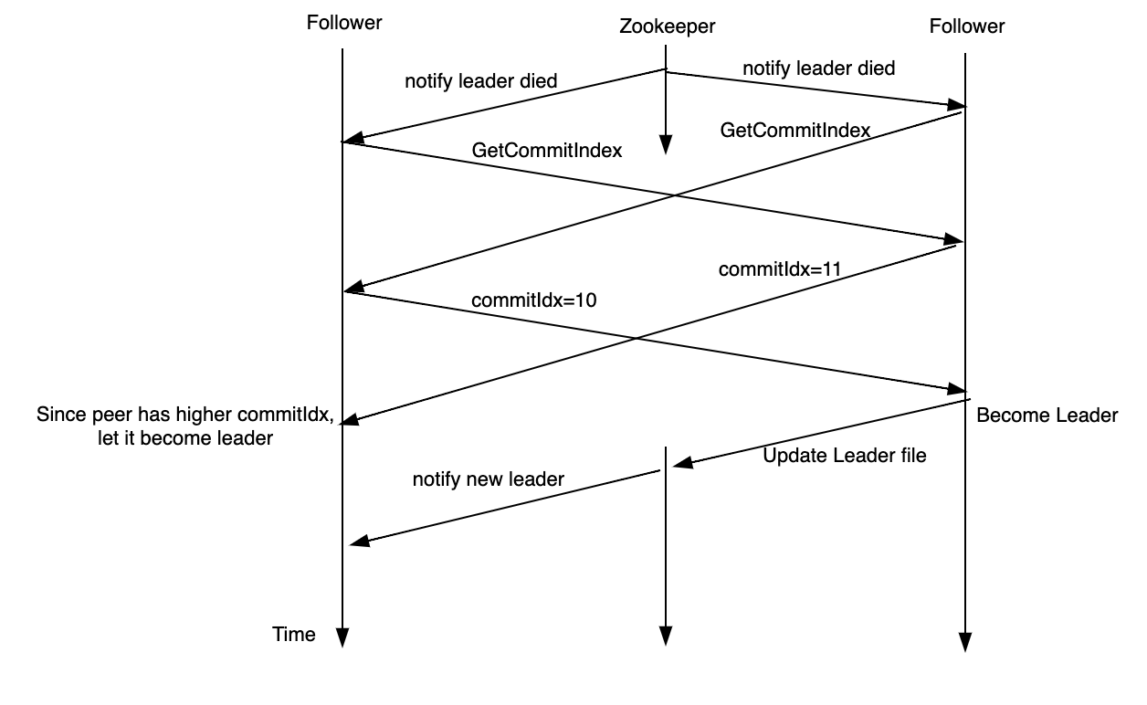
Leader election

Slide 6
Optimizations
Commutative operations need not be ordered using replicated log.
Synchronize nodes on start-up and leader election using anti-entropy sessions.
Use Merkle trees to send only the necessary keys.
Use Merkle Patricia trees instead, as Merkle trees have huge memory overhead.

Slide 7
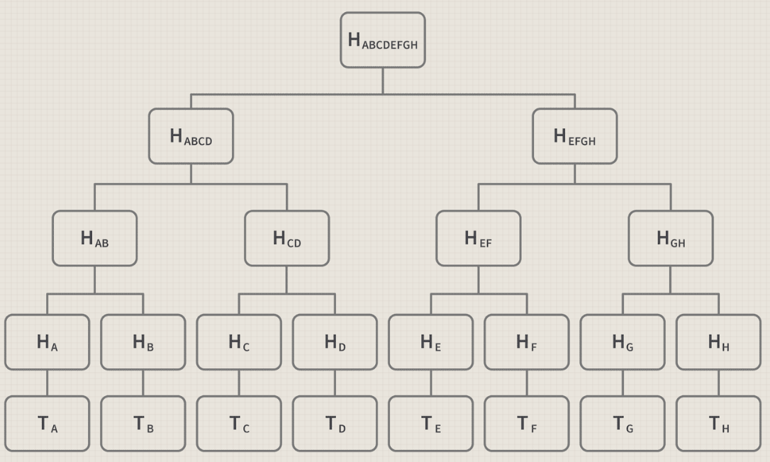
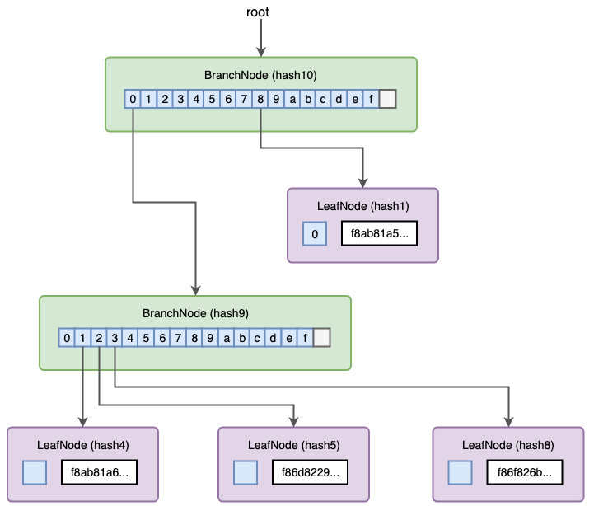
Many leaves may be empty.
Memory efficient (no empty nodes) and can also find conflicting keys efficiently.
© Merkle Tree in Blockchain: What it is and How it Works © Ethereum Merkle Patricia Trie Explained | by Leo Zhang | Medium

Slide 8
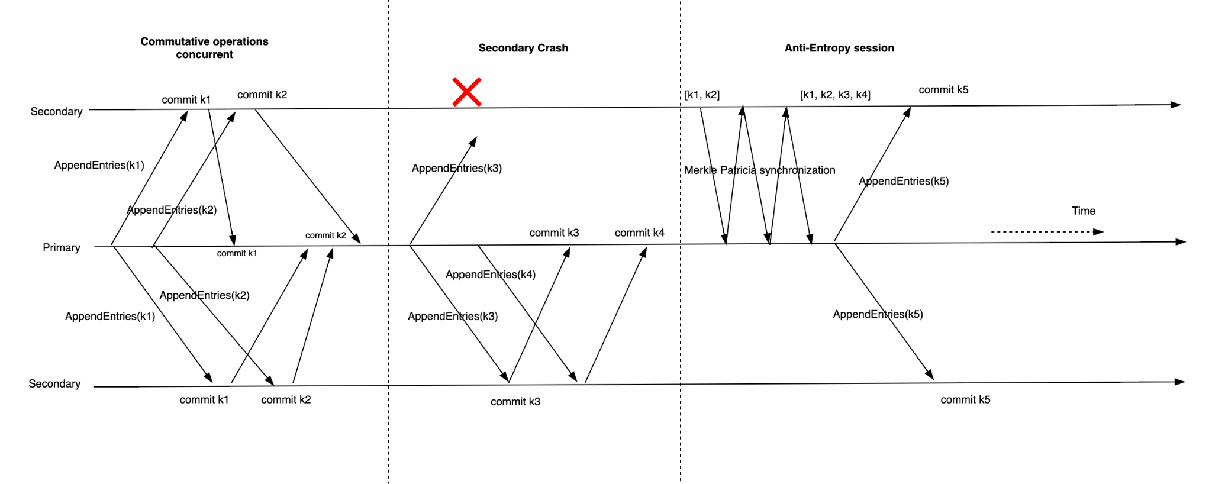
Any replica can become the primary, reads go to primary

Slide 9
Results

Slide 10
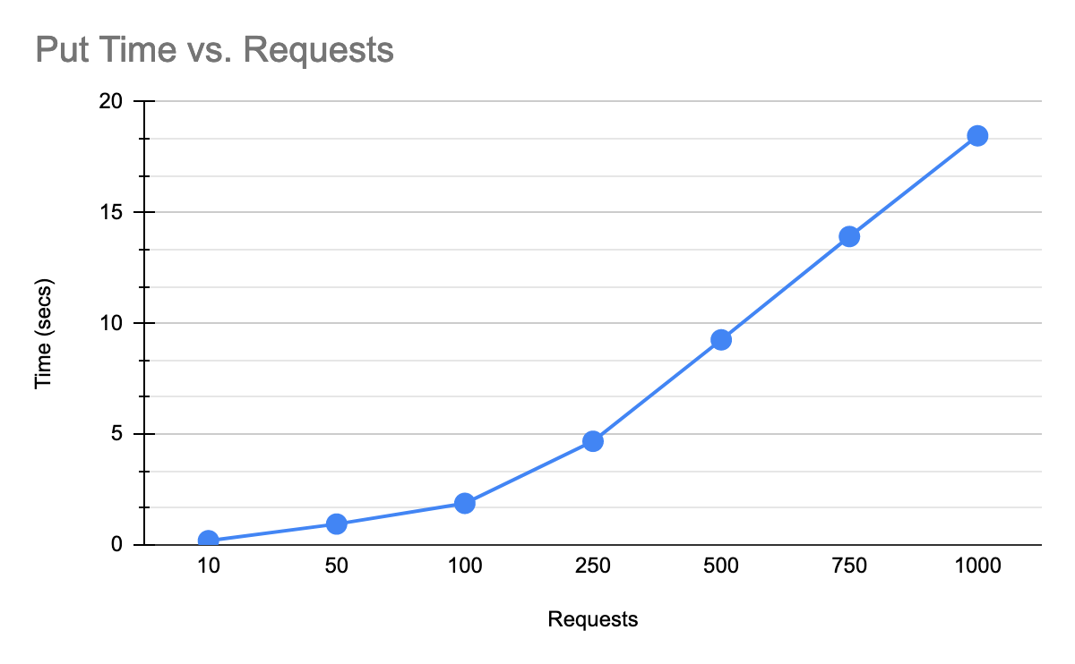

Slide 11
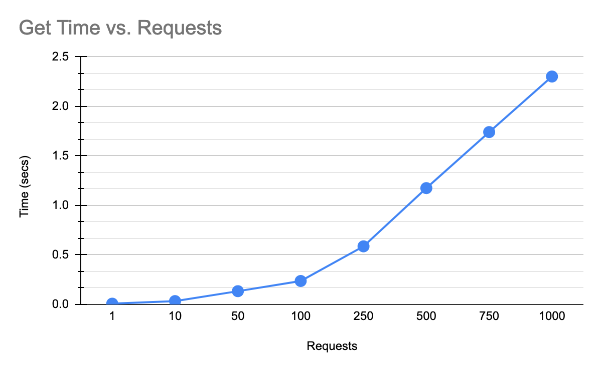

Slide 12
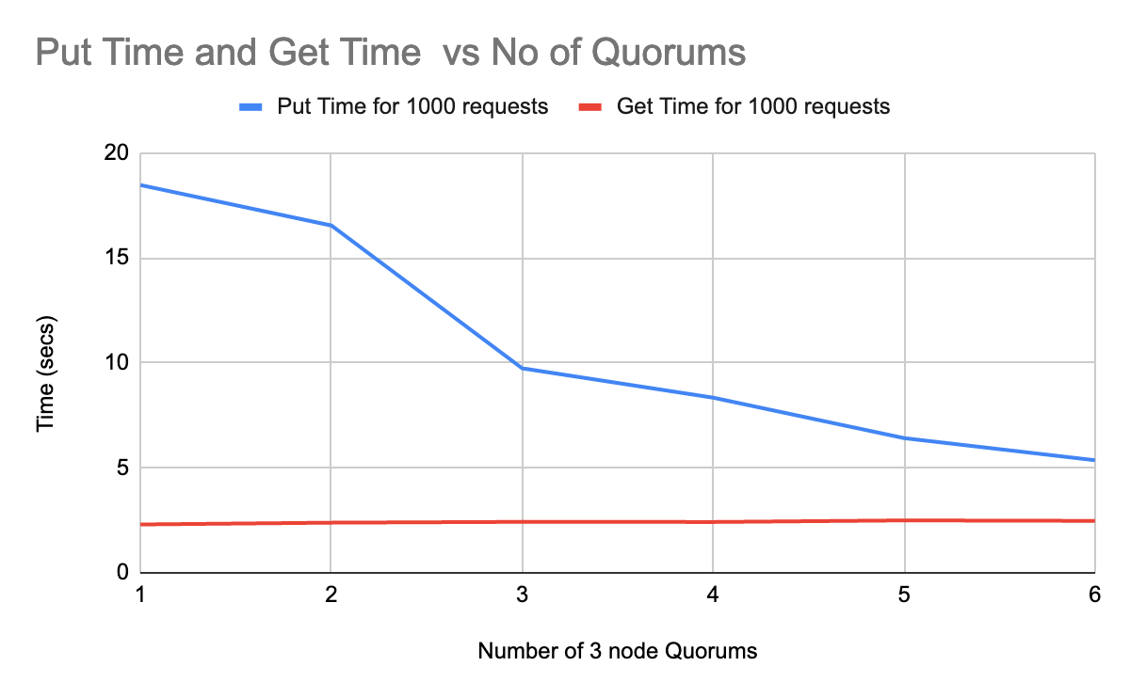

Slide 13
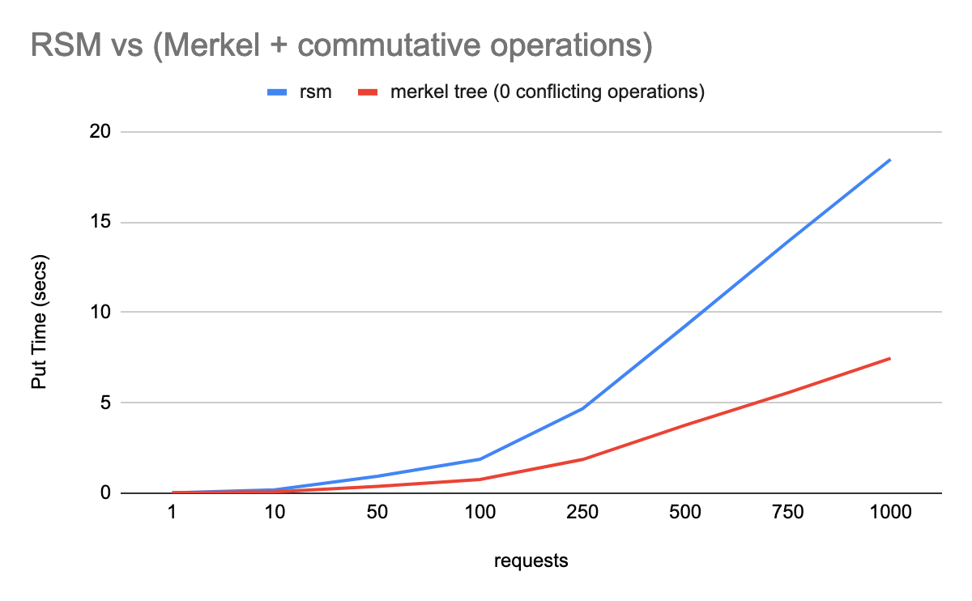

Slide 14
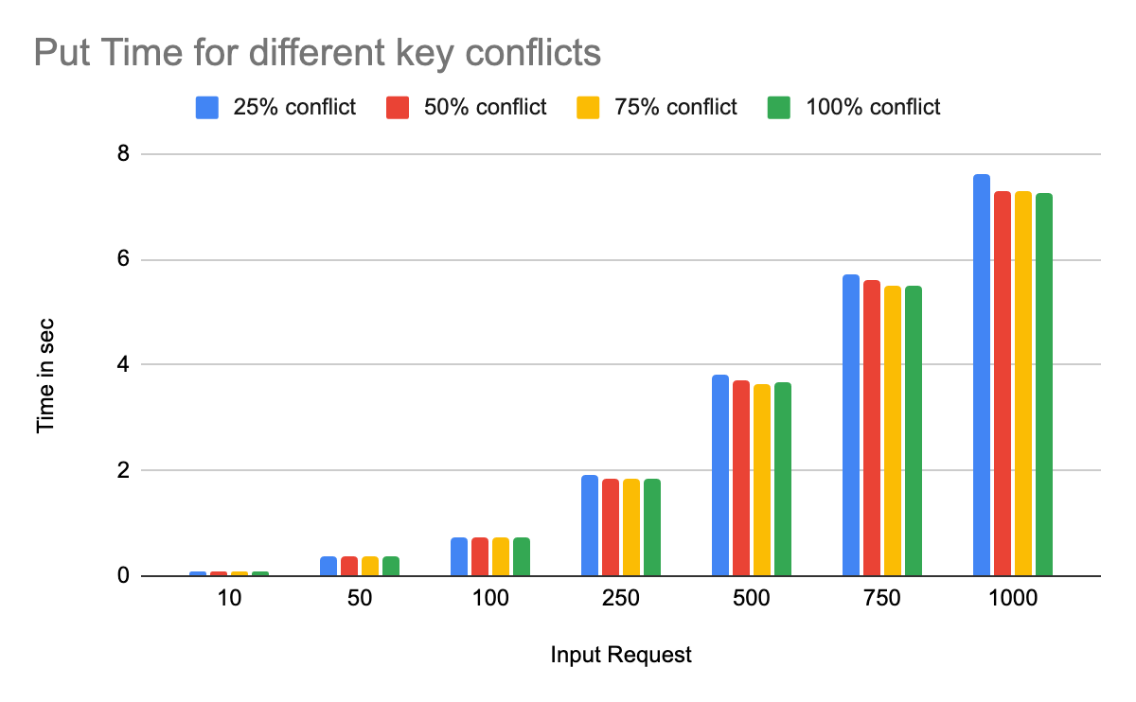

Slide 15
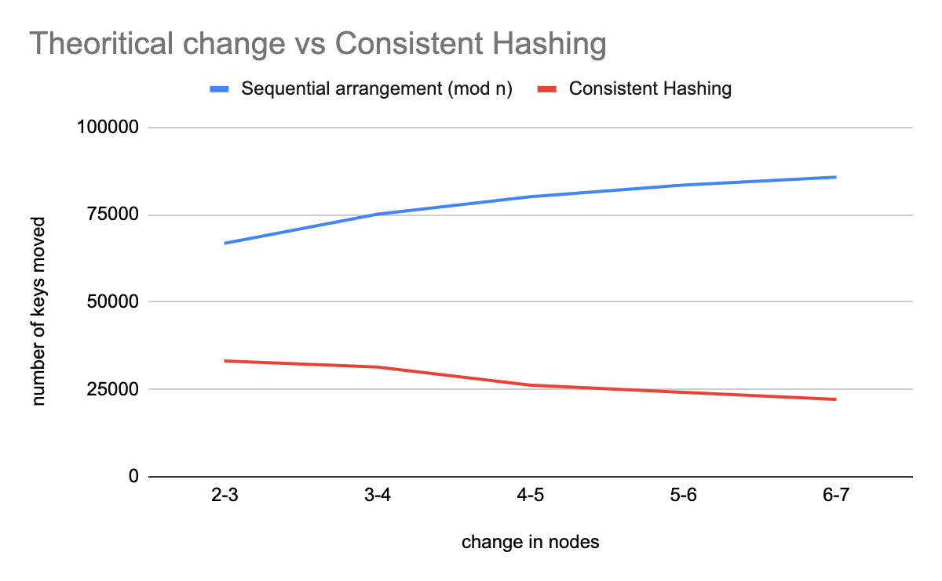

Slide 16
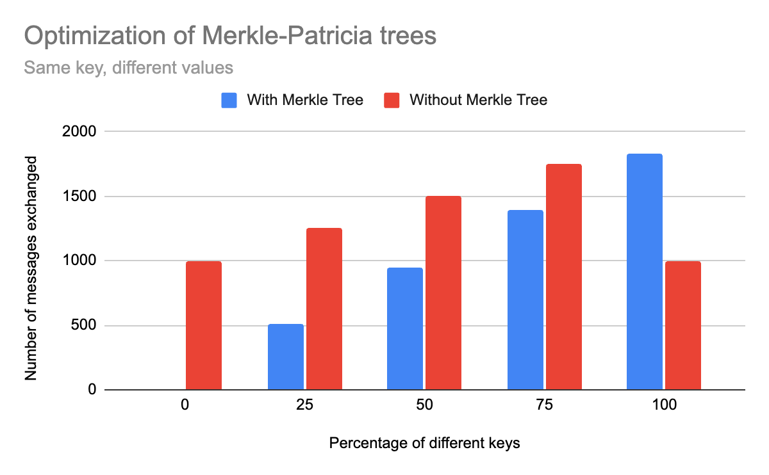
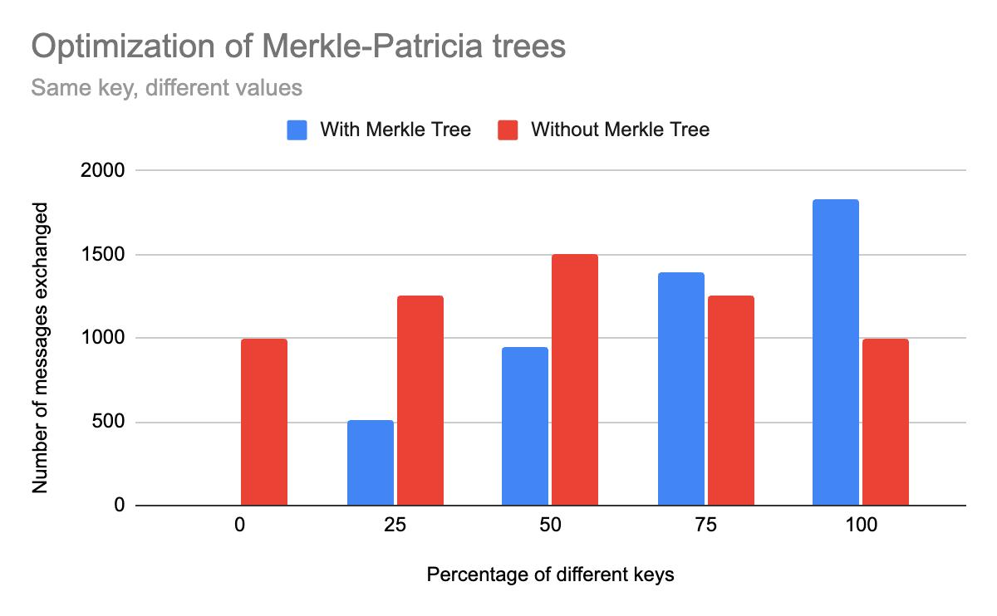
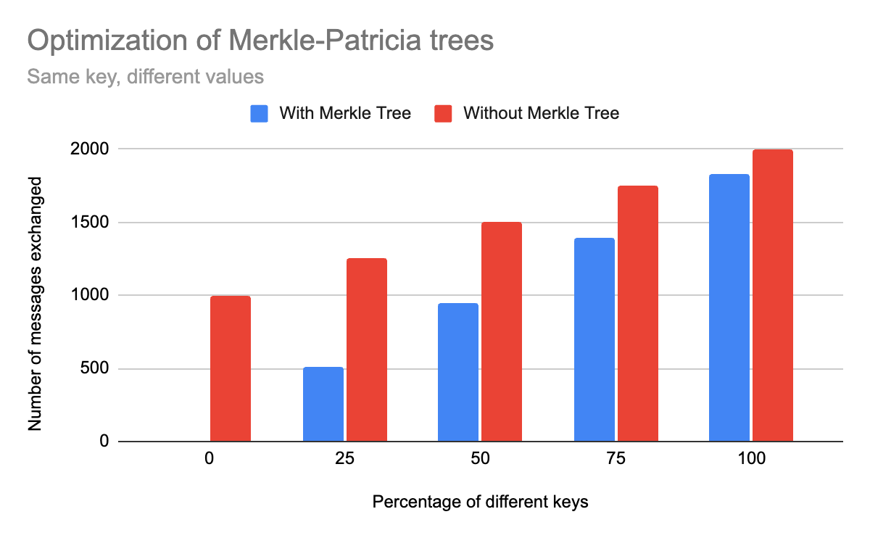
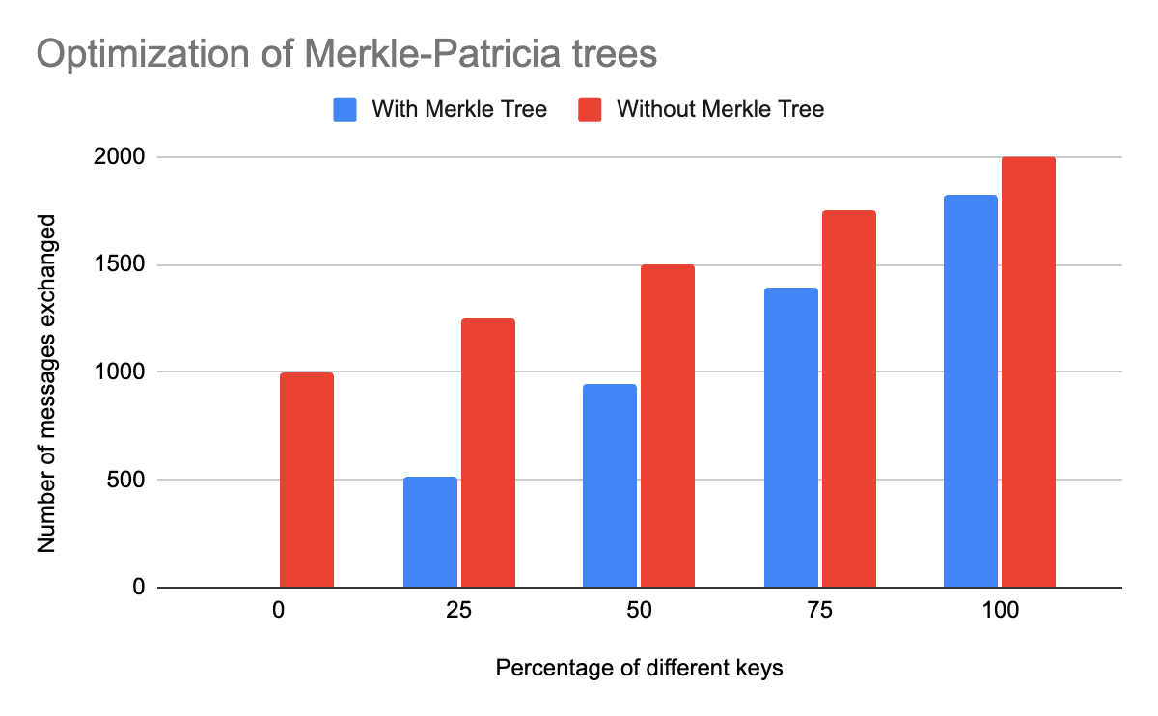

Slide 17
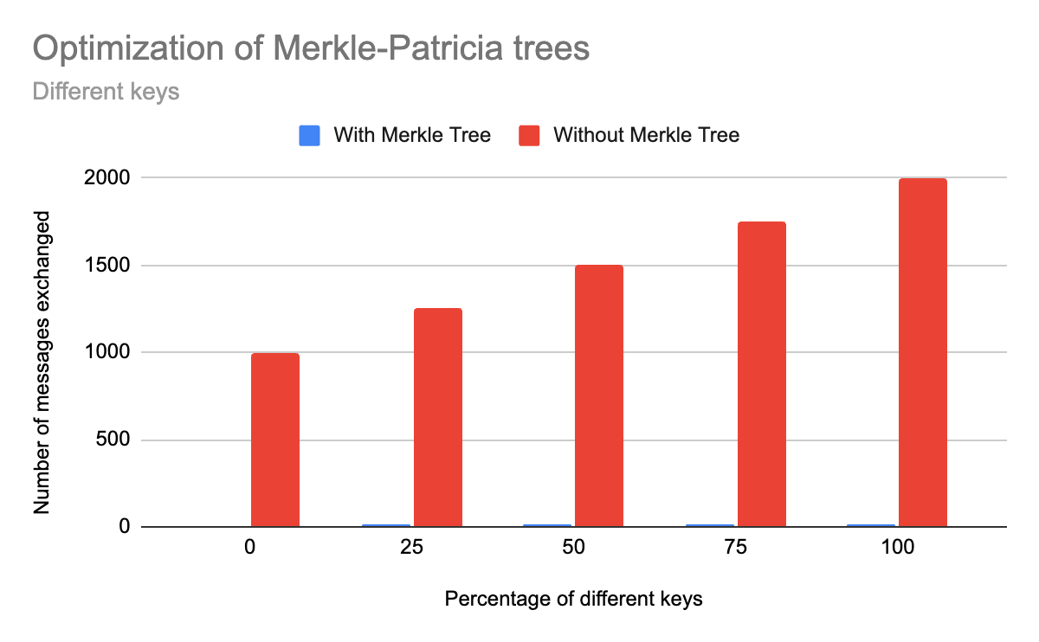

Slide 18
Thank you!

